Slide 1
Don’t Fall For Me !
by
Doc Marco Artiano PT DPT MA
714-553-2727 www.docmarco.org

Slide 2
Brought to you by….

Slide 3
Who is Doc Marco?
A man with a last name few people can pronounce:
ARTIANO…….
_RT_
O
Doc Marco is easier!!

Slide 4
Education
Education:
Chapman University, Orange, CA
Doctor of Physical Therapy - DPT
Bachelor of Arts in Biomolecular Sciences-Biochemistry
Bachelor of Arts in Social Science of Health and Medicine
Bachelor of Arts in Bio-Medical Ethics
Loma Linda University
Master of Arts in Clinical Ministry (IP)
Master of Arts in Biomedical and Clinical Ethics
Associate in Arts in Biology
Medicolegal Death Investigation Certification Training
Certified Phlebotomist
MsT – Certified Massage Therapist
Notes:
Did the BA simultaneously…they didn’t tell me Id be paying off the student loans simultaneously too!
I have to live a long time to pay off the loans.

Slide 5
FALLS: An Epidemic
One in three people > 65 yrs old fall each year
2.4 MILLION falls treated in Emergency Dept
30% hospitalized
$30 BILLION dollars in 2013
By 2020, annual cost of fall injuries is expected to be $67.7 BILLION

Slide 6
Who Falls ?
Demographic factors
Older age (especially > =75 years)
White
Housebound status
No practice getting outside
Living alone
No one to get outside with

Slide 7
Why Do We Fall ?
Historical factors
Use of cane or walker
Previous falls
Acute illness- hospital
Chronic conditions, especially neuromuscular disorders
Medications, especially the use of four or more prescription drugs = polypharmacy**
Shuffling Feet
Vertigo
Notes:
** Lady at SBPT with dizziness. Asked her to bring meds in a big bag. Return home from hospital with meds in blister packs and resume taking old meds plus new ones!! Sent her to primary doc…..one week later no dizziness, walks fine!
See your PCP ASAP after hospital

Slide 8
Why Do We Fall ?
Medications
Polypharmacy – 15 to 20 drugs
Alcohol
Interactions with meds
HYPO tension – low blood pressure
Stand up and fall down, no LOC
CNS – syncope
Walking and suddenly I’m on the floor
Notes:
Orthostatic hypotension

Slide 9
Drugs That May Increase the Risk of Falling
Sedative-hypnotic and anxiolytic drugs
benzodiazepines
Tricyclic antidepressants - imipramine
Major tranquilizers
Antihypertensive drugs
Cardiac medications – beta blockers
Corticosteroids - prednisone
Anticholinergic drugs
Hypoglycemic agents
Pain medications - fentanyl

Slide 10
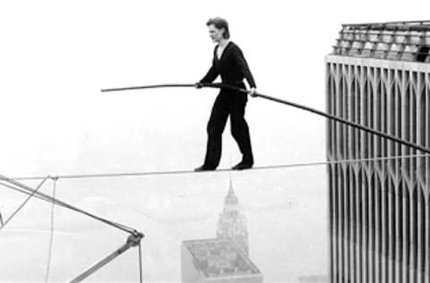
Why Do We Fall ?
Physical deficits
Gait disturbance, balance disorders or weakness,
pain related to arthritis
Cognitive impairment
Risky behaviors
Reduced vision- age-related changes
decline in accommodation
glare intolerance, altered depth perception, presbyopia [near vision], decreased night vision, decline in peripheral vision
Notes:
Gait balance pain are the 3 things PTs treat the most

Slide 11
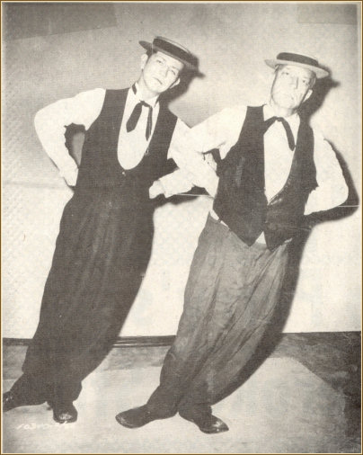
Why Do We Fall ?
Foot problems
Neurologic changes
postural instability
slowed reaction time
diminished sensory awareness for light touch, etc.
decline of central integration of:
visual
vestibular (BPPV)
proprioceptive
Notes:
Eyes, middle ear, proprioception – all diminish as we age.

Slide 12
Where do We Fall ?
Environmental hazards
Accident, environmental hazard, fall from bed
Extension cords
Throw carpets/rugs
Thresholds
Steps/stairs
Absent railing
Bath tub without hand rails

Slide 13
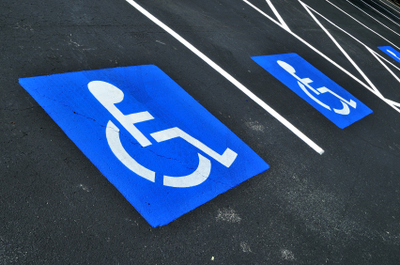
Where do We Fall ?
Outdoors
Curbs
Driveways
Ramps
Handicap parking!! slippery

Slide 14
Did You Know That We ALL Trip ?
But not everyone falls.
Why?
Not fast enough to recover
Not strong enough to recover
Not balanced enough to Recover
Demonstration of tripping

Slide 15
Warning Signs
Difficulty rising from a chair Lets try it!!
Sit–to-Stand: Need to use hands to push up?
Stand-To-Sit - Collapse into chair when sitting
Standing - Lean or wobble during static stand.
Reaching - Loss of balance while reaching for objects on floor or directly in front of them.
Shuffling gait- Indicates inability to maintain single leg stance necessary for normal ambulation
Foot clearance - low of no foot clearance during swing phase of gait
Stepping ability – cant lift legs enough to clear curbs, steps, carpets.

Slide 16
I HATE FALLING

Slide 17
The Bad News !
THE COST – 2.5 million falls in 2013.
30% hospitalized (CDC) = $30 BILLION dollars
Hospital cost for fall injury: $35,000/ fall
300-500K for a broken hip
Be patriotic don’t fall ! Saves money
Put your grand kids through college….
Or go on a nice vacation…and don’t fall.

Slide 18
More Bad News !
Survival Rates
Hip Fracture – rule of 25’s
25% return to previous or better levels
25% recover to less than previous levels
25% in and out of hospital and PT
25% don’t return home
Moral of the story: DONT FALL!!

Slide 19
The Good News !
We Don’t Have To Fall!
Although age is correlated with falls, any age group can train themselves out of the fall group.
Studies of age groups 60, 70, 80, 90. 5-8 weeks of exercise
Physical Therapy cited as # 1 treatment to prevent falls.
Takes some time and effort
How long does it take to get out of the hospital after a fall, hip replacement, rehab, endless physician visits….
Notes:
Studies of age groups 60, 70,80,90 with 5-8 weeks of exercise. Result: ALL of the participants had vastly decreased fall rates. The greatest change….90 year olds!

Slide 20
PREVENTION
Physical Therapy is faster
Much less time than doctors visit
Ave MD visit time? Wait time?
You see your provider for 7 minutes
Physical Therapy is easier
2-3 sessions a week for 30- 45 minutes
In-home or a clinic

Slide 21
The Solution

Slide 22
Doc Marco PT & Wellness
Physical Therapy and Happiness
PT in your own home !
I come to you
30 - 45 minute sessions
Covered by:
Medicare
Insurance
Fee for Service

Slide 23
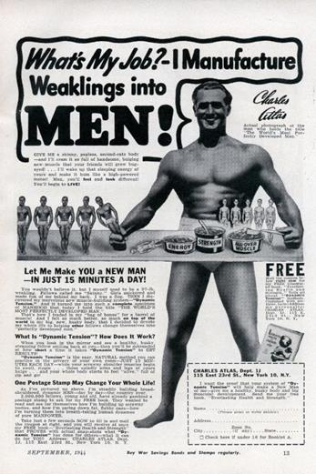
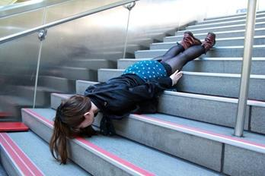
The Solution
Doc Marco takes you from:
Weakness to strength
LE exercise
Poor balance to good balance
Balance training
Gait training

Slide 24
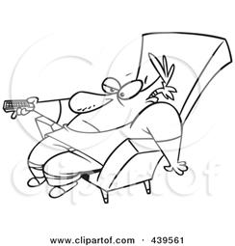
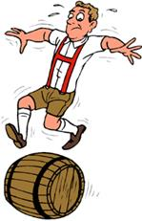
The Solution
Low activity to increased activity level
Sedentary life is out ----get up and get out
Walk, swim, dance, see people

Slide 25
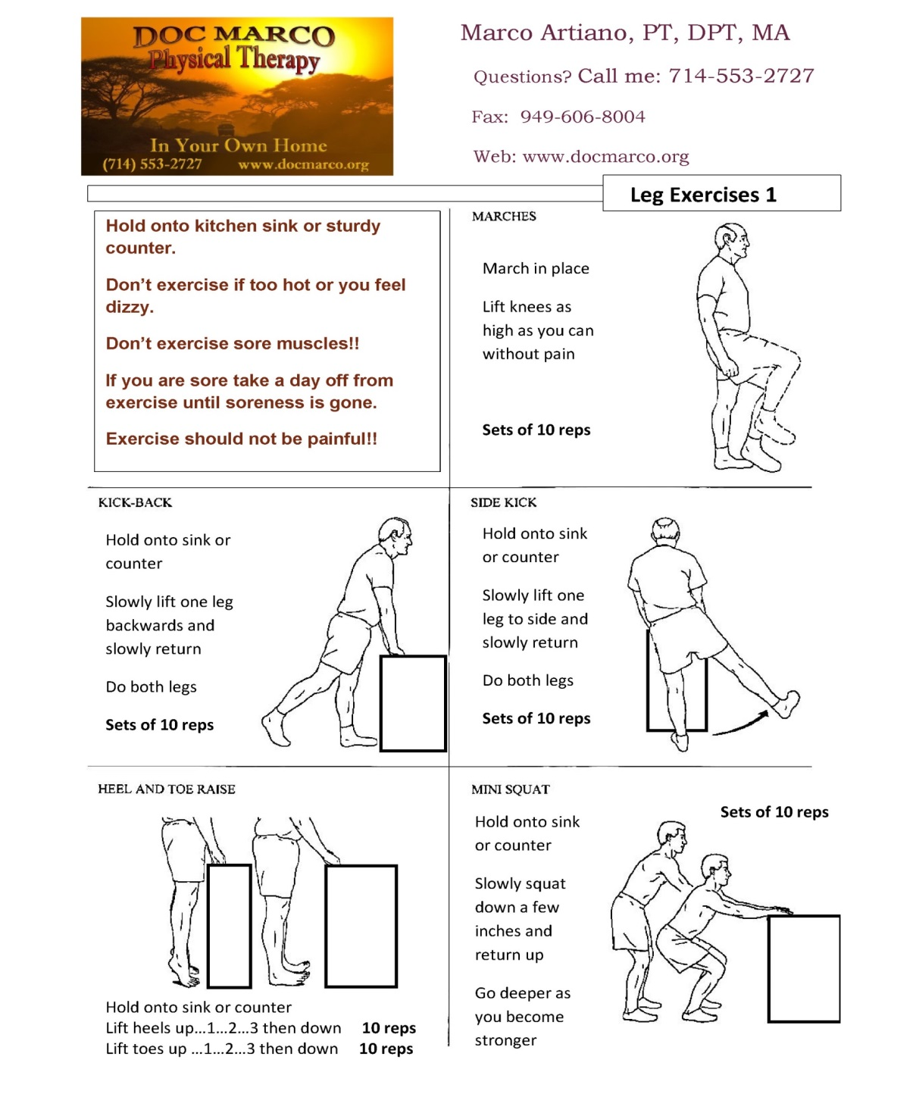
Wall exercises
Lower
Extremity
Exercise

Slide 26
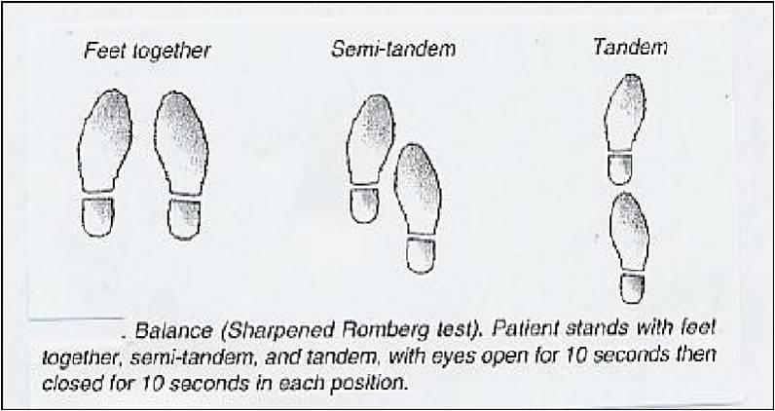
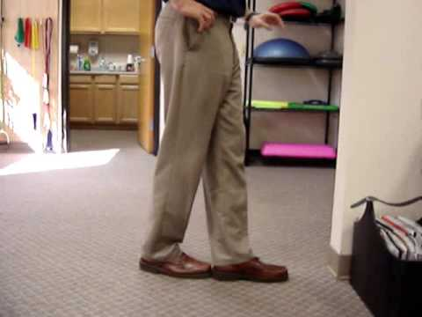
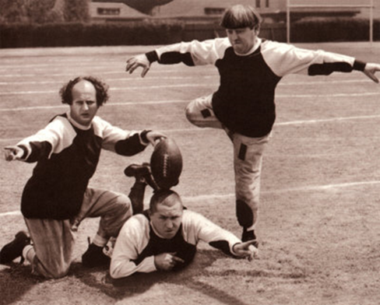
Balance training
Balance training – tandem stance

Slide 27
REFERENCES
Burt CW, Fingerhut LA. Injury visits to hospital emergency departments: United States, 1992-95. Vital Health Stat 13 1998:1-76.
Runge JW. The cost of injury. Emerg Med Clin North Am 1993;11:241-53.
Weigelt JA. Trauma. In: Advanced trauma life support for doctors: ATLS. 6th ed. Chicago: American College of Surgeons, 1997:26.
Greenhouse AH. Falls among the elderly. In: Albert ML, Knoefel JE, eds. Clinical neurology of aging. 2d ed. New York: Oxford University Press, 1994:611-26.
Tibbits GM. Patients who fall: how to predict and prevent injuries. Geriatrics 1996;51:24-8,31.
Sattin RW. Falls among older persons: a public health perspective. Annu Rev Public Health 1992; 13:489-508.
Dial LK. Falls. In Sadovsky R, ed. Conditions of aging. Baltimore: Williams & Wilkins, 1999:119-26.
Capezuti E. Falls. In: Lavizzo-Mourey RJ, Forciea MA, eds. Geriatric secrets. Philadelphia: Hanley & Belfus, 1996:110-5.
Dunn JE, Rudberg MA, Furner SE, Cassel CK. Mortality, disability, and falls in older persons: the role of underlying disease and disability. Am J Public Health 1992;82:395-400.
Kiel DP, O'Sullivan P, Teno JM, Mor V. Health care utilization and functional status in the aged following a fall. Med Care 1991;29:221-8.

Slide 28
Tinetti ME, Liu WL, Claus EB. Predictors and prognosis of inability to get up after falls among elderly persons. JAMA 1993;269:65-70.
Tinetti ME, Inouye SK, Gill TM, Doucette JT. Shared risk factors for falls, incontinence, and functional dependence. Unifying the approach to geriatric syndromes. JAMA 1995;273:1348-53.
Rabin DW. Falls and gait disorders. In: Abrams WB, Beers MH, Berkow R, eds. The Merck manual of geriatrics. 2d ed. Rahway, N.J.: Merck Sharp & Dohme Research Laboratories, 1995:65-78.
Hirsch CH, Sommers L, Olsen A, Mullen L, Winograd CH. The natural history of functional morbidity in hospitalized older patients. J Am Geriatr Soc 1990;38:1296-303.
King MB, Tinetti ME. A multifactorial approach to reducing injurious falls. Clin Geriatr Med 1996: 12:745-59.
Mahoney JE. Immobility and falls. Clin Geriatr Med 1998;14:699-726.
Rizzo JA, Friedkin R, Williams CS, Nabors J, Acampora D, Tinetti ME. Health care utilization and costs in a Medicare population by fall status. Med Care 1998;36:1174-88.
Coogler CE, Wolf SL. Falls. In: Hazzard WR, et al., eds. Principles of geriatric medicine and gerontology. 4th ed. New York: McGraw-Hill, 1999:1535-46.
Sloan JP. Mobility failure. In: Protocols in primary care geriatrics. 2d ed. New York: Springer, 1997:33-8.
Studenski S, Wolter L. Instability and falls. In: Duthie EH Jr, Katz PR, eds. Practice of geriatrics. 3d ed. Philadelphia: Saunders, 1998:199-206.

Slide 29
Tinetti ME, Doucette J, Claus E, Marottoli R. Risk factors for serious injury during falls by older persons in the community. J Am Geriatr Soc 1995; 43:1214-21.
Tinetti ME, Baker DI, McAvay G, Claus EB, Garrett P, Gottschalk PT, et al. A multifactorial intervention to reduce the risk of falling among elderly people living in the community. N Engl J Med 1994; 331:821-7.
Rubenstein LZ. Falls. In: Yoshikawa TT, Cobbs EL, Brummel-Smith K, eds. Ambulatory geriatric care. St. Louis: Mosby, 1993:296-304.
Svensson ML, Rundgren A, Larsson M, Oden A, Sund V, Landahl S. Accidents in the institutionalized elderly: a risk analysis. Aging [Milano] 1991; 3:181-92.
Wells BG, Middleton B, Lawrence G, Lillard D, Safarik J. Factors associated with the elderly falling in intermediate care facilities. Drug Intell Clin Pharm 1985;19:142-5.
Thapa PB, Gideon P, Cost TW, Milam AB, Ray WA. Antidepressants and the risk of falls among nursing home residents. N Engl J Med 1998;339:875-82.
Kiel DP. The evaluation of falls in the emergency department. Clin Geriatr Med 1993;9:591-9.
Speechley M, Tinetti M. Falls and injuries in frail and vigorous community elderly persons. J Am Geriatr Soc 1991;39:46-52.
Steinweg KK. The changing approach to falls in the elderly. Am Fam Physician 1997;58:1815-23.
Vellas BJ, Wayne SJ, Romero L, Baumgartner RN, Rubenstein LZ, Garry PJ. One-leg balance is an important predictor of injurious falls in older persons. J Am Geriatr Soc 1997;45:735-8.
Podsiadlo D, Richardson S. The timed "Up & Go": a test of basic functional mobility for frail elderly persons. J Am Geriatr Soc 1991;39:142-8.
Mathias S, Nayak US, Isaacs B. Balance in elderly patients: the "get-up and go" test. Arch Phys Med Rehabil 1986;67:387-9.
VanSwearingen JM, Paschal KA, Bonino P, Chen TW. Assessing recurrent fall risk of community-dwelling, frail older veterans using specific tests of mobility and the physical performance test of function. J Gerontol A Biol Sci Med Sci 1998;53: M457-64.
Close J, Ellis M, Hooper R, Glucksman E, Jackson S, Swift C. Prevention of falls in the elderly trial (PROFET): a randomised controlled trial. Lancet 1999;353:93-7.

Slide 30
Biography
Dr. Marco Artiano graduated with honors from Chapman University earning three simultaneous Bachelors degrees in Biomolecular Science, Medical Sociology, and Biomedical Ethics. He later attended a dual masters program at Loma Linda University in Bioethics and Clinical Ministry receiving the MA degree in Biomedical & Clinical Ethics. Dr. Artiano also attended the College of Osteopathic Medicine of the Pacific where he learned Osteopathic Manual Manipulation before returning to Chapman University to obtain the Doctorate Degree in Physical Therapy.
His clinical experience includes a background in Orthopedics, Geriatrics and treating Neurological patients including those with Traumatic Brain Injury. Aside from his clinical Orthopedic Physical Therapy practice, he provides Home Health services to home-bound seniors. With experience in Family Practice & Pediatric medicine, Dr. Artiano has an understanding of Pathology, acute care medical treatment and Pharmacology.
As a Physical Therapist with experience in Clinical Ministry and Clinical Bioethics, Dr. Artiano is focused on treating the whole patient as an individual with dignity and respect. He believes that a strong patient –provider relationship alongside manual therapy, exercise and modalities yields the best Physical Therapy results.
Dr. Artiano continues to lecture on Bioethics and Medicine while mentoring science students into medical programs. Several of his students are in Nursing schools and graduate level Medical schools. Teamed with his wife Marilyn, a Registered Nurse with years of experience, they enjoy providing Home Healthcare services to home bound seniors.
Dr. Artiano enjoys woodworking, photography, and teaching Anatomy. He continues daily training in bodybuilding and Martial Arts with his family at their home gym, and particularly enjoys long hikes alongside Marilyn and Little Hannah.

Slide 31
Leg Exercises

Slide 32
