Slide 1
ENGAGE INQUIRY APPROACH
Barbara J. Smith, PhD.
Zpd school & curriculum design

Slide 2
ENGAGE for RESEARCH-BASED INQUIRY
E – Explore
N – NARROW
G – GATHER
A – ANALYZE
G – GENERATE
E - EDUCATE

Slide 3
EXPLORE
Browse images/artifacts
Search through books/newspapers/magazines
Browse web pages…

Slide 4
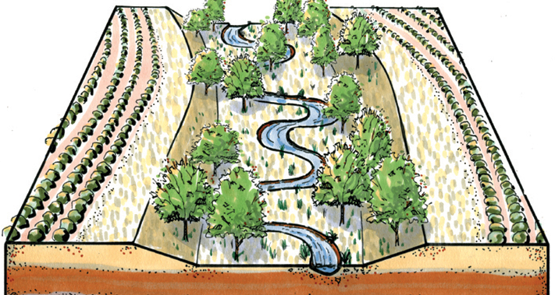
NARROW
focus of interest
Brainstorm on own/with others
Think about value of project

Slide 5
GATHER
Gather data
Immerse in books and web articles
Summarize notes from Informational texts (books. Web)
Design interview questions and conduct interview(s)
Design items for survey/ questionnaire

Slide 6
analyze
by comparing:
informational text
expert quotes
and perceptions

Slide 7
generate
GENERATE Findings
Conclusions/Connections/Theories/Symbols
Recommendations
Admit bias/limitations
Future research possibilities

Slide 8
educate
Create visual art, musical score, drama or dance to be used as a teaching aid to help others understand project method and findings
Generate an inquiry report to be published for others to reference in the future
Generate a visual representation using technology to teach others about project
Develop a quiz to check for understanding that peers were actively listening to and learning about project from presentation

