Slide 1
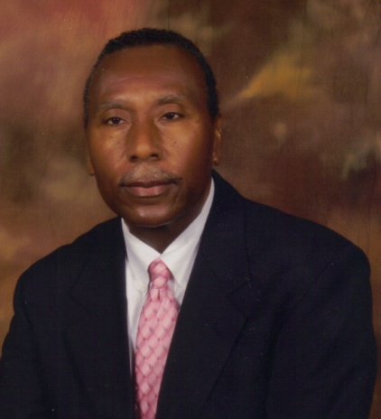
Politics and Policy Development in Education by Dr. Douglas L. Ragland

Slide 2
Professional Experiences
Alabama Educational Television Commissioner
Alabama Commissioner for the Military Interstate Compact Commission
National Commission for the Military Interstate Compact Commission
UAB National Alumni Society Board of Director
UAB Regional In-service Board Member
School Board Member
Superintendent
Hearing Officer
Personnel Coordinator
Principal
Assistant Principal
Teacher

Slide 3

Introductory Perspective

Slide 4

Personal Pledge
Character-Values and Beliefs

Slide 5

Core Values
Integrity
Accountability
Diligence
Perseverance
Discipline
Honesty
High Expectations

Slide 6

6 P’S
Prayer
Principles
Perseverance
Patience
Progress
Planning

Slide 7

Principal Challenge 1
Student and Parent Classroom Placement

Slide 8
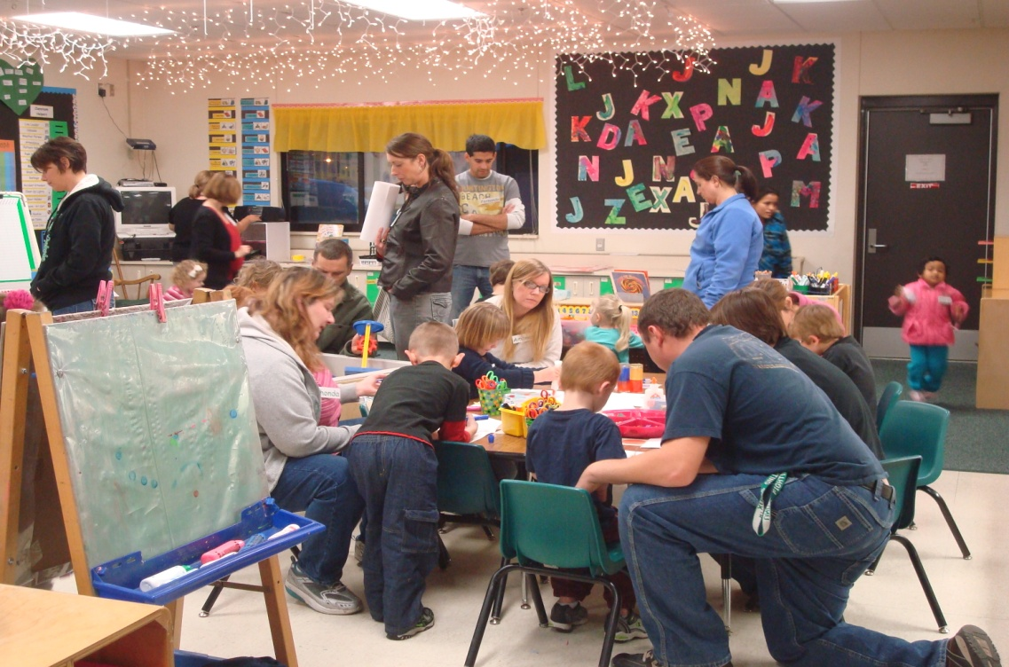
Principal Challenge 2
Parental and Community Involvement

Slide 9

Principal Challenge 3
Passage of New Ad-Valorem Tax Referendum

Slide 10
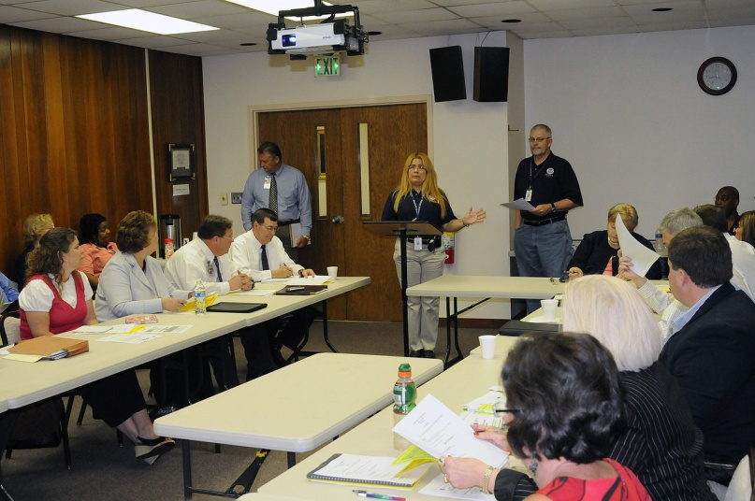
Superintendent Challenge 1
School Board Composition
State Intervention
Reorganization
Certified and Highly Qualified Personnel
Academic, and Extra-Curricular Successful Endeavors
Community Success

Slide 11
Superintendent Challenge 2
Passage of Renewal of Existing Tax Referendum for 30 years.
County Commission Financial Commitment

Slide 12

Superintendent Challenge 3
Policies
Goals
Strategic Plan
Political Leaders
Educational Summit
Tough and Fair Decisions
Student Priority

Slide 13
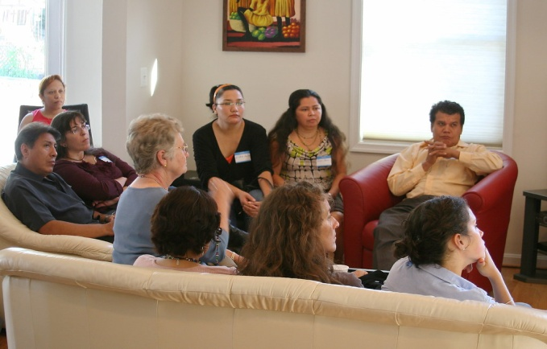
Board Member Challenges
Policy Development and Fiduciary Responsibility
Roles and Responsibilities
Board Relations
Communication to and working with Stakeholders
Ad valorem Tax
Superintendent, CFO, Board Attorney
Ethical Violations

Slide 14

Tips for Personal and Professional Success
Forgive Others
Ask for Forgiveness
Say Thank you
Apologize
Show Love
Note: Your personal values and experiences will be reflective in your professional actions.

Slide 15
Synopsis
Character
Decision Making Predicated on Learning
Courage
Humility
Fairness
Due Diligence
Spirit of Excellence
Accessibility
Collaboration

Slide 16

Famous Saying
“Courage is doing what you are afraid to do”. By Eddie Richebacher

Slide 17

Acknowledgments
Thank you Dr. Jane Cobia and your wonderful class for the opportunity to share!!

Slide 18

Questions

