Slide 1
Grizzly Professional Development-Be Berry BEAR Aware

Slide 2
This can be a POLARizing issue, so BEAR with me…

Slide 3
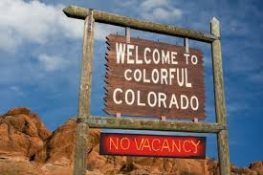
Types of bears
Most bears in Colorado are American black bears, even though some may not have black fur. It's not unusual for black bears to possess brown, cinnamon-colored or even blond fur!
The last known Grizzly sighting was in 1979 BUT WE KNOW that Colorado has seen an influx of transplants we must be proactive and take appropriate measures. Keep Colorado Great!

Slide 4
Bear with me…
Disclaimer: This professional development is not responsible for injury or death if you approach a bear or engage a bear in conflict.

Slide 5
This is a Brown Bear

Slide 6
This is a Grizzly Bear

Slide 7
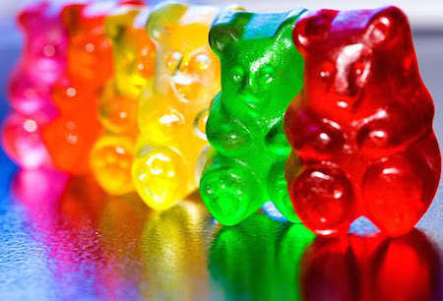
These are Gummy Bears
Usually Harmless except in some states that have legalized you know what….

Slide 8
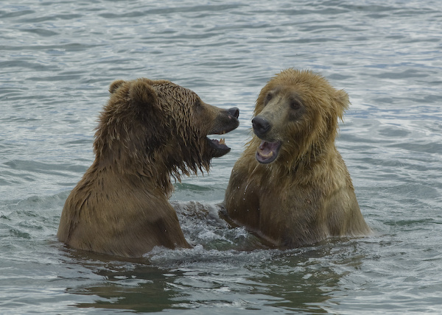
Turn and Talk
With your shoulder partner please share your fears of Grizzly bears moving into Brown bear areas! Use prior knowledge and current events to guide your discussion.

Slide 9
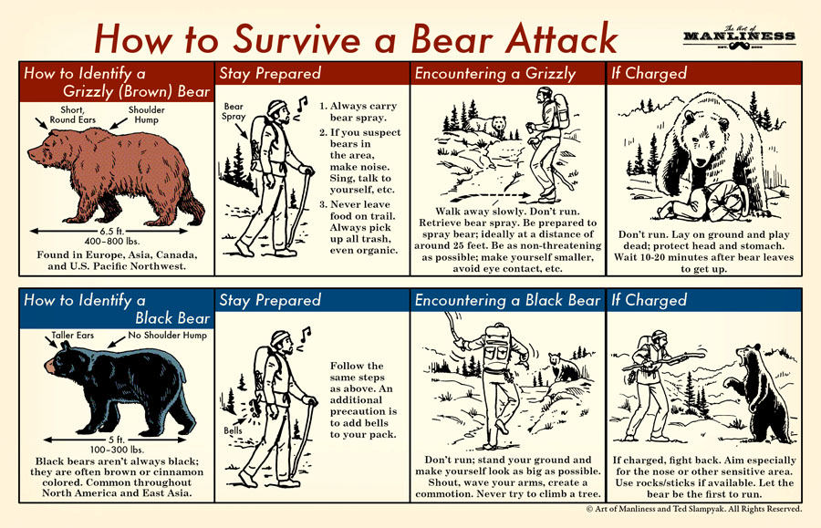
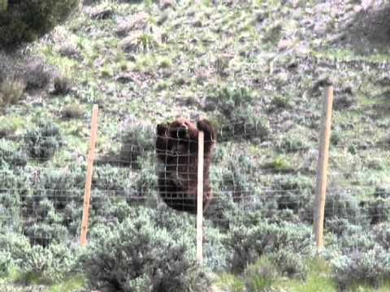
Active Bear Training
Don’t Run!
Drop to the ground in a fetal position
Play Dead
BEARricades also work well

Slide 10
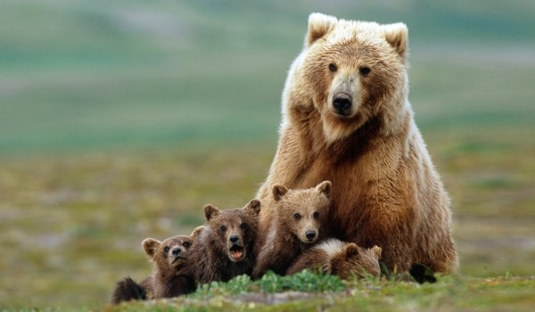
Bear Aware….
Bears protect their young (hence the term Mama bear, their food and their territory.
This is the reason FOOD NOT
ALLOWED IN CLASSROOMS!

Slide 11
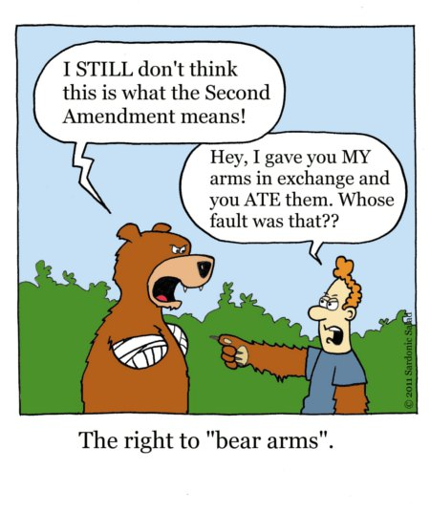
Bears and the 2nd Amendment

Slide 12
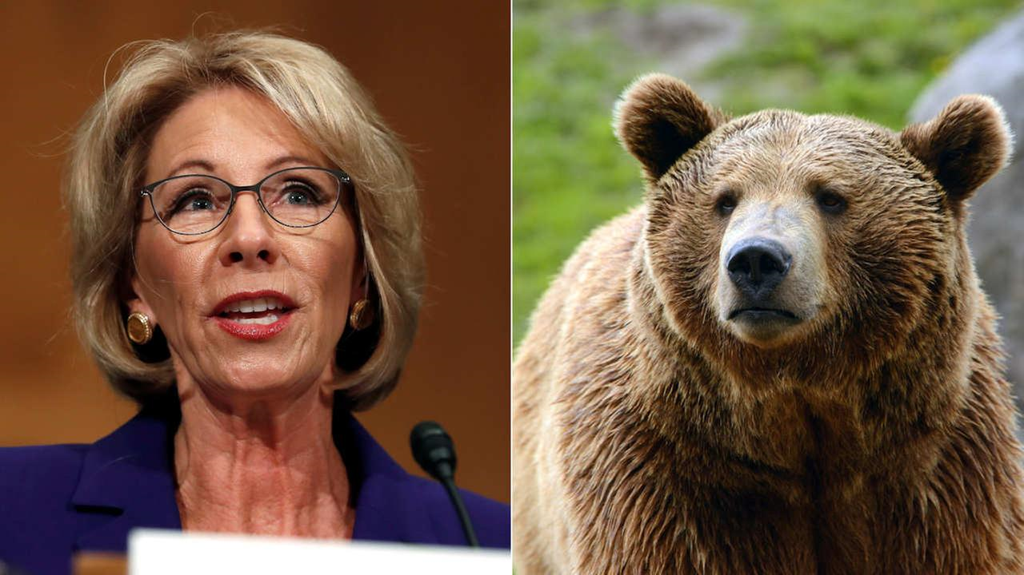
PAWS and reflect
Who is more harmful to public schools?

Slide 13
STAY SAFE MY FRIENDS
This BEARS Repeating-Public schools have always and will always be what MAKES AMERICA GREAT! Public School Teachers Make America great! We know the challenges go beyond what happens in the classroom and you should be proud of the work you do with students. You are the Mama and Papa bears who speak for those without a voice! Keep up the good work.

