Slide 1
Case Studies & Home Care Protocol Recommendations
Notes:
Image slide.

Slide 2
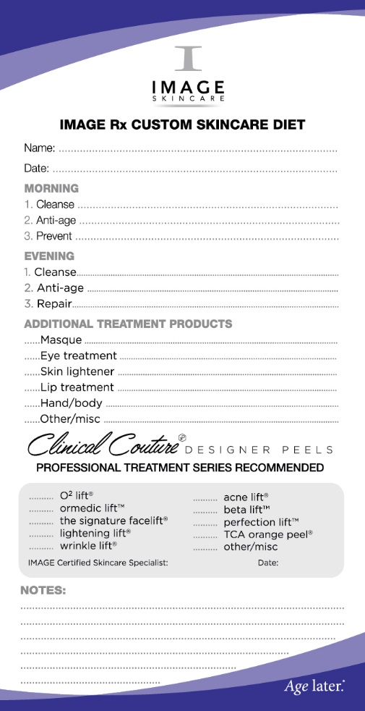
Case Studies & Home Care Protocol Recommendations
Deliberate Practice
What would you prescribe?
Case Study
55 Years Old
Fitzpatrick 2
Fine Lines and Wrinkles
Loss of Volume
Crow’s Feet
Dry
Prefers Squeaky clean cleanser
Notes:
Deliberate practice – what would you prescribe?

Slide 3
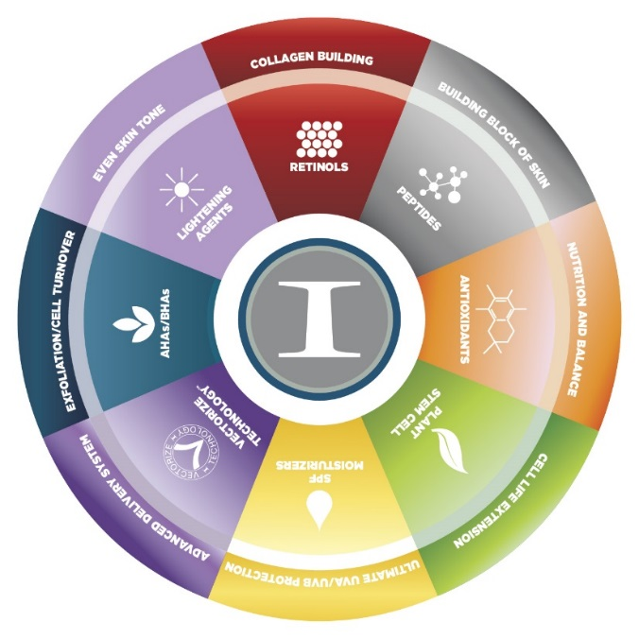
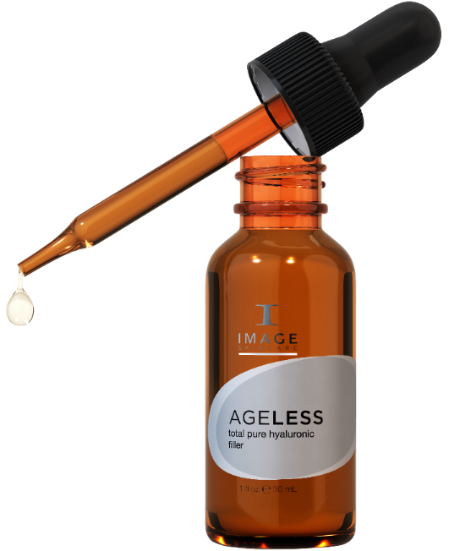
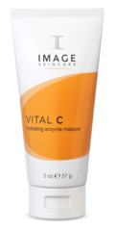
Customized Daily
Program
Daily Hydrating Moisturizer SPF 30
Max Cleanser
Total Hyaluronic Filler
Total Repair Crème
Stem Cell
Eye Cream
Eye Lift Crème
+
AM/PM
AM/PM
AM
PM
4
1-3 x per week
1
2
3
Notes:
Suggested customized daily regimen of a balanced diet per the previous case study.

Slide 4
Deliberate Practice
What would you prescribe?
Case Study
55 Years Old
Fitzpatrick 2
Fine Lines and Wrinkles
Loss of Volume
Crow’s Feet
Very Dry
Prefers Creamy Cleanser
Notes:
Deliberate practice – what would you prescribe?

Slide 5
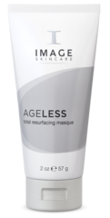
Customized Daily
Program
Total Anti-aging Serum
Daily Hydrating Moisturizer SPF 30
Vita C Cleanser
Hydrarting Intense Moisturizer
Stem Cell
Eye Cream
or
AM/PM
AM/PM
AM
PM
4
Ageless Resurfacing
Mask
Total Retinol
Cream
1
2
3
1-3 x per week
Notes:
Suggested customized daily regimen of a balanced diet per the previous case study.

Slide 6
Deliberate Practice
What would you prescribe?
Case Study
48 Years Old
Fitzpatrick 4
Fine lines and wrinkles
Loss of volume
Sensitive to AHA and Retinol
Spends weekends on boat
Prefers Squeaky clean
Notes:
Deliberate practice – what would you prescribe?

Slide 7
Customized Daily
Program
Ultimate
Protection
Moisturizer
SPF 50
Stem Cell Facial
Cleanser
Stem Cell Serum
Stem Cell Eye Crème
Stem Cell Crème
And/or
AM/PM
AM
AM
PM
1-3 x
per week
As tolerated
1
2
3
4
1-3 x per week
Notes:
Suggested customized daily regimen of a balanced diet per case study.
Note that retinol was left out because she spends weekends in the sun on a boat.

Slide 8
Deliberate Practice
What would you prescribe?
Case Study
48 Years Old
Fitzpatrick 4
Fine lines and wrinkles
Loss of volume
Sensitive to Retinol
Spends weekends on boat
Very Dry
Prefers Creamy Cleanser
Notes:
Deliberate practice – what would you prescribe?

Slide 9
Customized Daily
Program
Ultimate
Protection
Moisturizer
SPF 50
Vital C Cleaner
Stem Cell Serum
Hydrating
Intense
Moisturizer
Max
Serum
Stem Cell Eye Crème
And/or
AM/PM
AM/PM
AM
AM
PM
1-3 x
per week
As tolerated
1
2
3
4
1-3 x per week
Notes:
Suggested customized daily regimen of a balanced diet per case study.
Note that retinol was left out because she spends weekends in the sun on a boat.

Slide 10
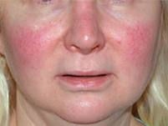
Deliberate Practice
What would you prescribe?
Case Study
42 Years Old
Fitzpatrick 1
Rosacea
Redness in cheeks and nose
Flakey skin
Dryness and itching
Prefers Creamy Cleanser
Notes:
Deliberate practice: what would you prescribe?

Slide 11
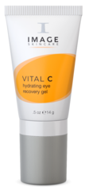
Customized Daily Program
Daily Hydrating Moisturizer SPF 30
Hydrating Facial
Cleanser
Total
Anti-Aging
Serum
Vital C Hydrating Eye cream
Hydrating Repair Crème
AM/PM
AM/PM
as tolerated
AM
PM
1-3 x per week
3
4
1
2
Notes:
Suggested customized daily regimen of a balanced diet per the previous case study.
Eye Cream: Vitamin C – free radical fighter, Poly- peptide complex – argiline, Snake – smooths wrinkles 52%, eyeliss – firming, hyaluronic, retinol palmitate
Hydrating Intense: Aqualance, hyalronic, shea butter, BVOSC
Hydrating anti aging serum: poly peptide complex, 15% blend of vitamin C including BVOSC, Hyaluronic, pephatite, reversatrol
Cream: 20% blend ACE including BVOSC, Hyalronic, Super oxide dismutase and reersatrol (grape seed etract) – anti oxidants

Slide 12
Deliberate Practice
What would you prescribe?
Case Study
42 Years Old
Fitzpatrick 1
Rosacea
Redness in cheeks and nose
Oily Skin
Irritated Skin
Doesn’t like Creamy;
Notes:
Deliberate practice: what would you prescribe?

Slide 13
Customized Daily Program
Ormedic
Balancing
Cleanser
Total
Anti-Aging
Serum
Matte
Prevention +
Hydrating
Anti-aging
Serum
Vital C Hydrating Eye cream
AM/PM
AM/PM
as tolerated
AM
PM
1-3 x per week
3
4
1
2
Notes:
Suggested customized daily regimen of a balanced diet per the previous case study.
Eye Cream: Vitamin C – free radical fighter, Poly- peptide complex – argiline, Snake – smooths wrinkles 52%, eyeliss – firming, hyaluronic, retinol palmitate
Hydrating Intense: Aqualance, hyalronic, shea butter, BVOSC
Hydrating anti aging serum: poly peptide complex, 15% blend of vitamin C including BVOSC, Hyaluronic, pephatite, reversatrol
Cream: 20% blend ACE including BVOSC, Hyalronic, Super oxide dismutase and reersatrol (grape seed etract) – anti oxidants

Slide 14
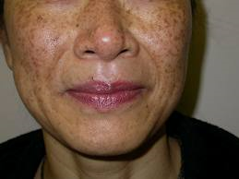
Deliberate Practice
What would you prescribe?
Case Study
52 Years Old
Fitzpatrick 4
Hyperpigmentation
Photo-Aging
Dry skin
Sensitivity
Doesn’t like creamy cleanser
Notes:
Deliberate practice – what would you prescribe?

Slide 15
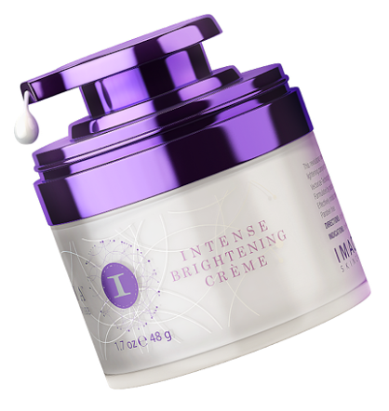
Customized Daily
Program
Ultimate Daily Moisturizer SPF 50
Intense Lightening Serum
Intense Brightening Crème
and
AM/PM
PM
AM
PM
1-3 x
per week
1
AM/PM
2
AM
3
Notes:
Suggested customized daily regimen per case study.

Slide 16
Deliberate Practice
What would you prescribe?
Case Study
52 Years Old
Fitzpatrick 4
Hyperpigmentation
Photo-Aging
Very Dry skin
Sensitivity
Likes creamy cleanser
Notes:
Deliberate practice – what would you prescribe?

Slide 17
Customized Daily
Program
Ultimate Daily Moisturizer SPF 50
Iluma
Brightening
Cleanser
Total anti-aging
serum
Intense Lightening Serum
Intense Brightening Crème
+
AM/PM
PM
Total Hyaluronic
Filler
AM/PM
AM
1
2
AM
3
PM
Notes:
Suggested customized daily regimen per case study.

Slide 18
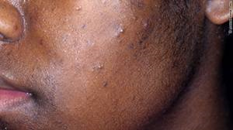
Deliberate Practice
What would you prescribe?
Case Study
24 Years Old
Fitzpatrick 6
Grade II acne
PIH
Oily skin
Dehydration
Prefers squeaky clean
Notes:
Deliberate practice – what would you prescribe?

Slide 19
Customized Daily Program
Daily
Matte Moisturizer SPF 32
Hydrating
Anti-aging
Serum
Salicylic Gel
Cleanser
Total Repair Crème
Intense Lightening Serum
Iluma
Brightening
Eye Crème
PM as tolerated
AM/PM
AM/PM
PM
1
2
AM
3
4
Notes:
Suggested customized daily regimen of a balanced diet per case study.
Some acne responds better to Retinol over BP

Slide 20
Deliberate Practice
What would you prescribe?
Case Study
24 Years Old
Fitzpatrick 6
Grade III - IV acne
Oily skin
Dehydration
Doesn’t like creamy cleanser
Notes:
Deliberate practice – what would you prescribe?

Slide 21
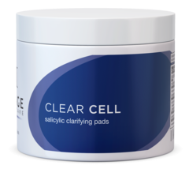
Clear Cell System
Daily
Matte Moisturizer SPF 32
Hydrating
Anti-aging
Serum
Medicated Acne Lotion
Clear Cell
Scrub
AM/PM
PM
AM
PM
1
2
3
Salicylic (gly)
Clarifying Pads
Notes:
Suggested 4 product daily regimen of Clear Cell products per case study.

Slide 22
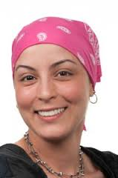
Deliberate Practice
What would you prescribe?
Case Study
35 Years Old
Fitzpatrick 3
Unbalanced skin
Post Chemotherapy
Dull looking skin
Dehydration
Wants natural products
Wants sulphate free/squeaky clean
Notes:
Deliberate practice – what would you prescribe?

Slide 23
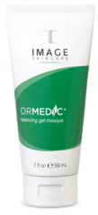
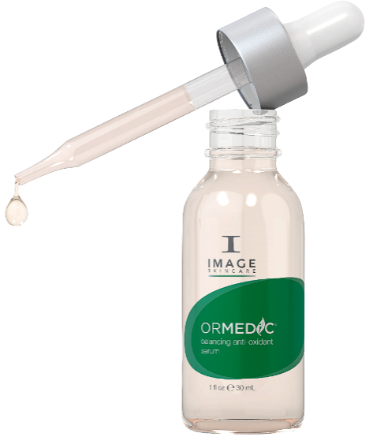
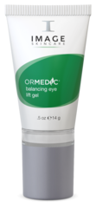
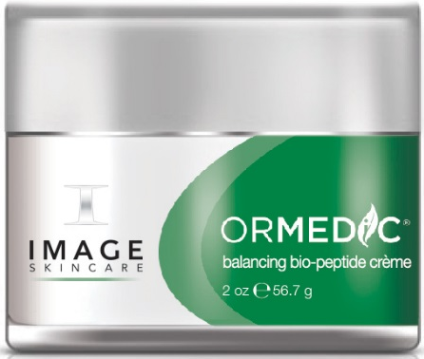
Customized Daily
Program
Balancing Facial
Cleanser
Daily
Tinted Moisturizer SPF 30
Ormedic Eye Lift Cream
Balancing
Anti-Oxidant
Serum
Balancing
Bio-peptide
Crème
Ormedic Balancing Mask
AM/PM
AM
3-4 x
per week
AM/PM
PM
AM/PM
1
2
3
4
Notes:
Suggested customized daily regimen of a balanced diet per case study.

