Slide 1
Mentorship Program Kickoff Luncheon, November 14, 2019
Adriene R. Walker, MA/MSM
CEO, A+ Academic Resources
Phone: 210.849.1737
Email: Adriene@aplusacademicresources.org
Website: www.aplusacademicresources.org

Slide 2
Overview
The definition of Mentorship & Mentoring
Mentoring Characteristics
Importance of Mentorship
A+ Academic Resources Programs
A+ Academic Resources
Services
Testimonials
Positive Impact of Mentorship

Slide 3
Definition of Mentorship & Mentoring
Mentorship is the guidance provided by a mentor who is an experienced person in a company or educational institution (Oxford Dictionary).
Mentorship is a relationship in which more experienced/knowledgeable person guides less experienced/knowledgeable person (Wikipedia).
Mentorship is a learning/development partnership between someone with vast experience and someone who wants to learn (Wikipedia).
Mentoring: development strategy for successful path to adulthood
A supportive individual works with a child to build a relationship by offering guidance, support, and encouragement to cultivate positive/healthy development (Azuine & Singh, 2019).

Slide 4
Mentoring Characteristics
Structured one‐to‐one relationship that focuses on the mentee needs and encourages her/him to meet their potentials---Aim High!
Mentoring comprises 4 core characteristics:
(1) Active interaction between 2 individuals over extended timeframe
(2) Inequality of experience, knowledge, or power between the mentor and mentee; mentor has greater share of experience
(3) Mentee is in a position to imitate and benefit from the knowledge and experience of the mentor through role modeling.
(4) Absence of the role inequality between mentor and mentee that typifies most helping relationships (Azuine & Singh, 2019)

Slide 5
Importance of Mentorship (1)
School-based mentoring (SBM) programs are fastest growing mentoring programs.
They reach a unique population of students since referrals come from teachers rather than parents.
SBMs provide a unique mentor pool of younger adults/college students (Coller & Kuo, 2014).
Combats underachievement and drop-out (Azuine & Singh, 2019).
Caring and supportive one-to-one relationships built on trust; one-to-one matches truly empower youth and strengthen communities (https://www.bbbs.org).
Transformational relationships--Growth & development transpire!

Slide 6
Importance of Mentorship (2)
The absence of a mentor was significantly associated with low school engagement among students
Students without mentors were more likely to hurt others in a fight
Mentoring may be a pathway for providing programs that prevent bullying and improve educational outcomes among school‐aged children.
Students with mentors were more likely to complete high school and attend college (Azuine & Singh, 2019).

Slide 7
Positive Impact of Mentorship
Personal/educational improvement among both mentor and mentee participants
Improvements in attitudes, classroom behavior and attendance
Longer than usual relationship lengths and evidence of high relationship quality
SBM Program---effective and low-cost strategy to support vulnerable/at-risk children (Coller & Kuo, 2014).

Slide 8
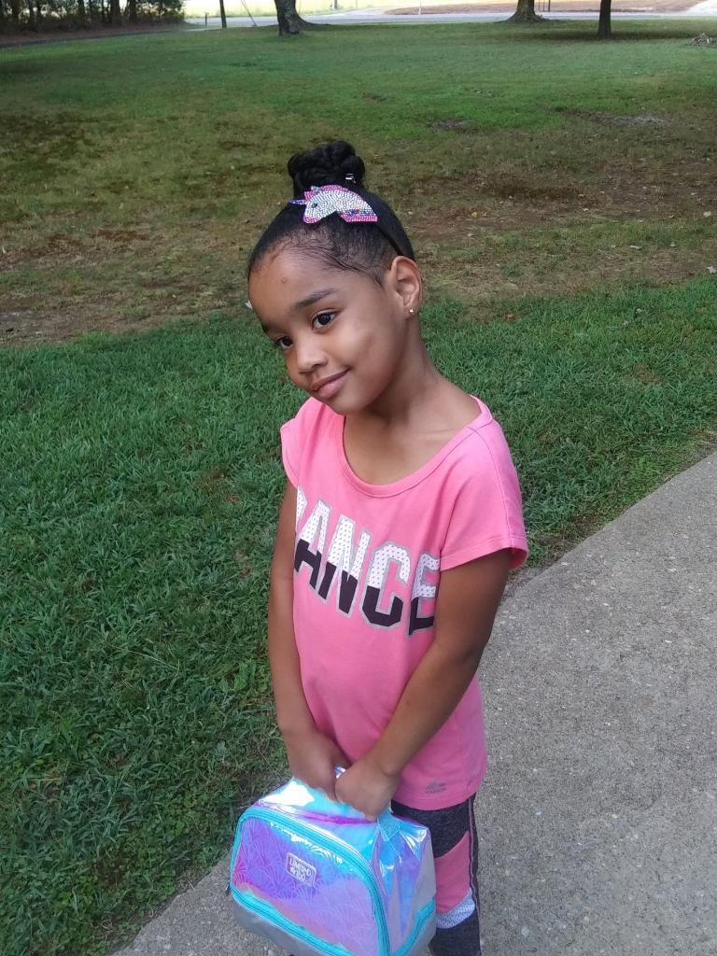
A+ Academic Resources Programs
Academic Resources:
Students receive academic resources---school uniforms, gym shoes, backpacks, books and school supplies.
We collaborate with Principals, Teachers and Counselors.
Snacks & Meals:
We assemble and deliver small Snack Packs to schools with
children who lack adequate snacks at school.
Large Box Meals for children who lack adequate food supply during weekends/holidays
College & Career Track:
College, Corporate and Military Recruiters brief students on opportunities/challenges.
Students are informed about qualifications/requirements for College, Corporate or Military.
College visits & Base tours coordinated for students.
Career counseling offered for High School students (https://aplusacademicresources.org)

Slide 9
A+ Academic Resources Services
Tutoring Services:
Academic Volunteers provide individualized/group tutoring.
Counselors/Educators help students overcome test anxiety and learn test taking strategies.
Academic achievement is tracked with quality performance metrics to keep students on target.
Writing Services:
Writing Coaches help students improve their research/writing skills.
Editing/proofreading provided for writing assignments
Students receive academic resources---research and writing guides, textbooks and writing supplies to enhance their writing skills.
Educational Consulting & Counseling Services:
Academic Advisers/Guidance Counselors help students select courses and programs that align with school requirements and student skills and interests.
Students receive academic advising/coaching to ensure academic success https://aplusacademicresources.org.

Slide 10
Testimonials (1)
"I was having trouble with algebra class because I missed lots of school during surgery and I had to go to summer school to catch up. My mom was wor​ried so she called Ms. Adriene. She matched me with a tutor who was patient, kind and a math whiz. With her help, I got an A!“ - Timothy
"Being a Social Worker has been my dream like forever. It cannot happen without college. I had to write a letter for college. My GPA was good, but I wasn't accepted into the top colleges. I couldn't get my words to show how much helping families means to me. Ms. Odom listened to my story and helped me pu​t my passion into words. My #1 choice for college said Y-E-S!" - Michelle
Thank you so much! You devote so much of your time and energy to doing this that aren't always easy. but that makes a big difference. Thank you for the shoes! I am so greatful!" - Elementary School Student
This Photo by Unknown Author is licensed under CC BY-NC

Slide 11
Testimonials (2)
"Thank you for giving us some shoes your so kind. you make me happy and full of Joy. I hope I can see you again someday. you are the best. I know you spent all that money on us, but thank you." - Miranda
"I feel grateful that members from our community donated to fund our project. It started as an idea and quickly blossomed into excitement and hope when we were in the process of writing the grant. Gonzales ECEC is in its third year and we have limited resources for our students, regardless we feel that our students deserve the best. Thanks to A+ Academic Resources that is exactly what they got! Our student sensory path will greatly benefit ALL of our students on campus and future eagles as well!" - Ms. Olguin, Gonzales ECEC Teacher
"Thank you for giving us new shoes all of us are very thankful. We want to let you know that we thank you for the shoes. Since you gave us shoes we did something in return we will give you a thank you letter! Your Super Shoelastic! Cinderella is proof that a new pair of shoes can change ur life Thank you for the shoes bye!"- Elementary School Student
This Photo by Unknown Author is licensed under CC BY-NC

Slide 12
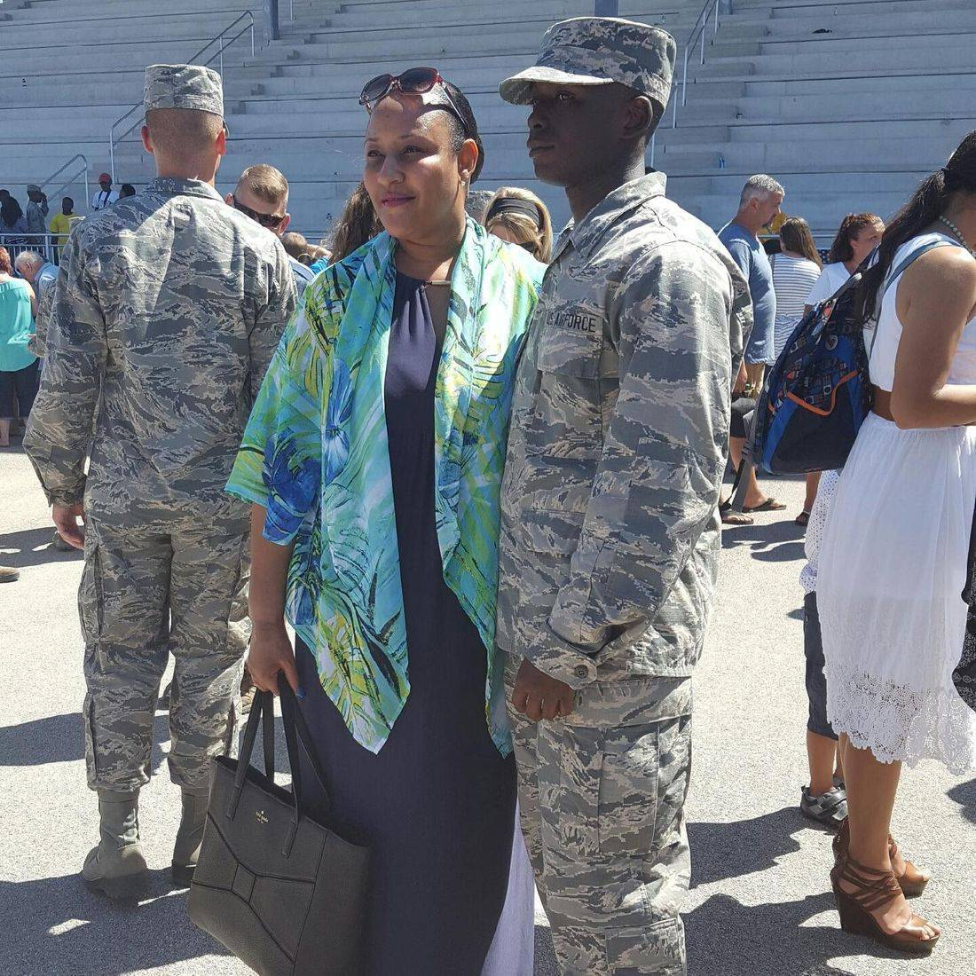
Conclusion
Mentorship & Mentoring Defined
Mentorship Characteristics
Mentorship Importance
Positive Impact
Programs
Services
Testimonials---Grow & Develop---S-U-C-C-E-S-S!

Slide 13
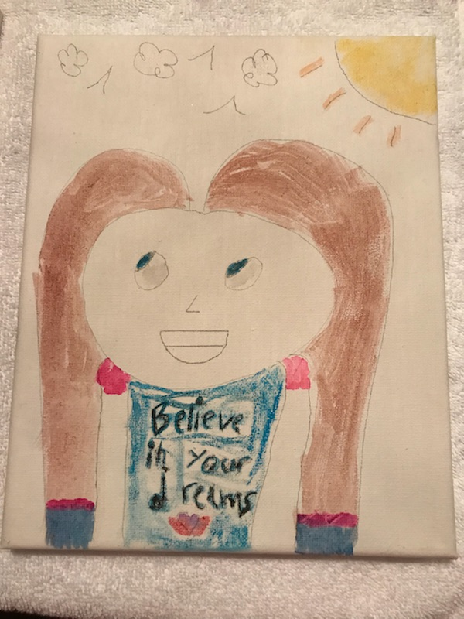
Inspiring Quotes
“Believe you can & you’re halfway there..” - Theodore Roosevelt
"Education is the most powerful weapon you can use to change the world" - Nelson Mandela

Slide 14
References
A+ Academic Resources. (2019). Retrieved from https://aplusacademicresources.org
Azuine, R.E. & Singh, G.K. “Mentoring, Bullying, and Educational Outcomes Among US School-Aged Children 6-17 Years.” The Journal of school health. 89.4 (2019): 267–278. Web.
Big Brothers Big Sisters of America. (2019). Retrieved from
https://www.bbbs.org
Coller, R.J. & Kuo, A.A. J Community Health (2014) 39: 316. https://doi-org.ezproxy.liberty.edu/10.1007/s10900-013-9762-

Slide 15
Questions

