Slide 2
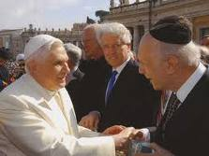
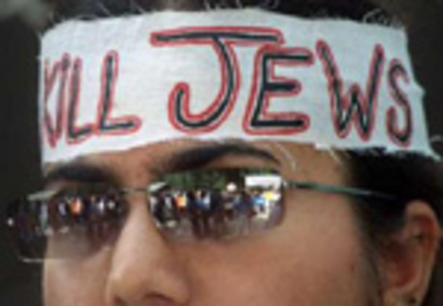
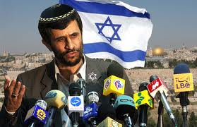
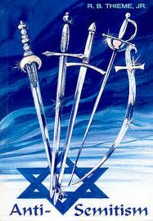
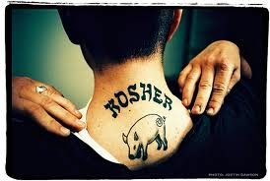
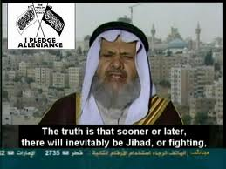
Could America Be Following The Same Path As The Jews

Slide 3
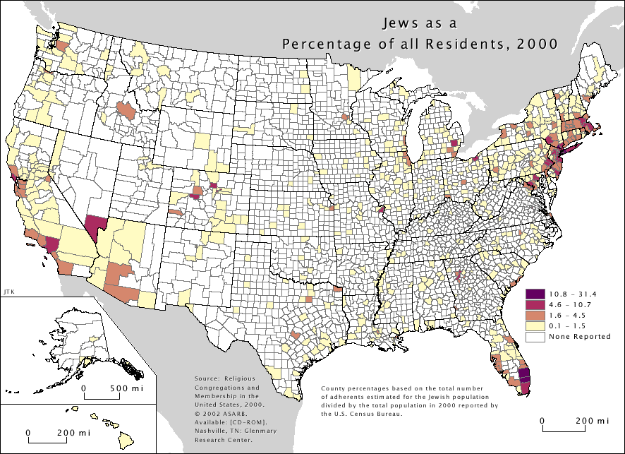

Slide 4
Looking Back To Their beginning
The Jews trace their heritage back to a very righteous man called Abraham
Gen 26:23-25 Then he went up from there to Beersheba. 24 And the Lord appeared to him the same night and said, "I am the God of your father Abraham; do not fear, for I am with you. I will bless you and multiply your descendants for My servant Abraham's sake."

Slide 5
Glory of God to Abraham
Acts 7:2-8 And he said, "Brethren and fathers, listen: The God of glory appeared to our father Abraham when he was in Mesopotamia, before he dwelt in Haran, 3 and said to him, 'Get out of your country and from your relatives, and come to a land that I will show you.' 4 Then he came out of the land of the Chaldeans and dwelt in Haran. And from there, when his father was dead, He moved him to this land in which you now dwell. 5 And God gave him no inheritance in it, not even enough to set his foot on. But even when Abraham had no child, He promised to give it to him for a possession, and to his descendants after him..

Slide 6
6 But God spoke in this way: that his descendants would dwell in a foreign land, and that they would bring them into bondage and oppress them four hundred years. 7 'And the nation to whom they will be in bondage I will judge,' said God, 'and after that they shall come out and serve Me in this place.' 8 Then He gave him the covenant of circumcision; and so Abraham begot Isaac and circumcised him on the eighth day; and Isaac begot Jacob, and Jacob begot the twelve patriarchs

Slide 7
Abraham Justified Before Circumcision
Rom 4:9-10 Does this blessedness then come upon the circumcised only, or upon the uncircumcised also? For we say that faith was accounted to Abraham for righteousness. 10 How then was it accounted? While he was circumcised, or uncircumcised? Not while circumcised, but while uncircumcised.

Slide 8
Rom 4:11-12 And he received the sign of circumcision, a seal of the righteousness of the faith which he had while still uncircumcised, that he might be the father of all those who believe, though they are uncircumcised, that righteousness might be imputed to them also, 12 and the father of circumcision to those who not only are of the circumcision, but who also walk in the steps of the faith which our father Abraham had while still uncircumcised.

Slide 9
Why We Need To Be Wiser Than Jews
Rom 4:13-15 For the promise that he would be the heir of the world was not to Abraham or to his seed through the law, but through the righteousness of faith. 14 For if those who are of the law are heirs, faith is made void and the promise made of no effect, 15 because the law brings about wrath; for where there is no law there is no transgression.

Slide 10
What The Jews Failed To Consider
Matt 12:33-37 "Either make the tree good and its fruit good, or else make the tree bad and its fruit bad; for a tree is known by its fruit. 34 Brood of vipers! How can you, being evil, speak good things? For out of the abundance of the heart the mouth speaks. 35 A good man out of the good treasure of his heart brings forth good things, and an evil man out of the evil treasure brings forth evil things. 36 But I say to you that for every idle word men may speak, they will give account of it in the day of judgment. 37 For by your words you will be justified, and by your words you will be condemned."
Their life choices had become a liability before God

Slide 11
Today Many Christian Forget …
Rom 4 is still binding on us today
We have to be faithful like father Abraham was before Israelites were known as Jews
The Law of Christ tells us how we are to live by faith.
Jesus calls the Jews a “Brood of Vipers” why had they turned into a “bag of snakes”
They quit listening to God – They no longer cared what God thought about their decisions. They felt responsible only to themselves

Slide 12
The Promise Was To The Faithful
It was not a promise to Abraham
It was not a promise to the Jews
It was a promise to all men that were willing to be righteous through their faith in God
If it were by heritage, which many today still believe is true, faith becomes void, nothing matters but your nationality.
Romans 4: 13-15 makes it clear that if we obey God’ s law we are righteous and to disobey makes us unrighteous and unworthy.

Slide 13
What Happened To The Jews
Matt 13:37-41 "He who sows the good seed is the Son of Man. 38 The field is the world, the good seeds are the sons of the kingdom, but the tares are the sons of the wicked one. 39 The enemy who sowed them is the devil, the harvest is the end of the age, and the reapers are the angels. 40 Therefore as the tares are gathered and burned in the fire, so it will be at the end of this age.

Slide 14
Matt 13:41-43 The Son of Man will send out His angels, and they will gather out of His kingdom all things that offend, and those who practice lawlessness, 42 and will cast them into the furnace of fire. There will be wailing and gnashing of teeth. 43 Then the righteous will shine forth as the sun in the kingdom of their Father. He who has ears to hear, let him hear!

Slide 15
What is happening now?
People have become close minded & rebellious when it comes to submitting to the authority & will of God.
Obviously the world (as a whole) is not serving God as they have been commanded to do
Those that appear religious seem to be inclined to serve themselves yet saying they are doing it to God’s Glory even though it is to please them instead of God
Has the world forgotten how the Jews lost their relationship with God & are we following the same path?

