Slide 1
Using Literature in Fluency Therapy
NSA 2018
Jeffrey J. Glessing, M.A., CCC-SLP

Slide 2
What is Bibliotherapy?
A fancy term for using books to help to teach people things that we want them to believe and understand
If you like the professional explanation: the use of selected reading materials as therapeutic adjuvants in medicine and in psychiatry; also : guidance in the solution of personal problems through directed reading

Slide 3
Goal of Bibliotherapy
The goal of bibliotherapy is to broaden and deepen the client's understanding of the particular problem that requires treatment. The written materials may educate the client about the disorder itself or be used to increase the client's Read more: http://www.minddisorders.com/A-Br/Bibliotherapy.html#ixzz3Un8diprS

Slide 4
A little about me
A person who stutters
Adjunct Instructor at Minnesota State University, Mankato in the area of stuttering.
An SLP and fluency consultant with the Rochester Public Schools
24+ years experience in the schools
Managing his own stuttering for 40+ years
Speaker Disclosure: Financial: Jeffrey has published a fictional book related to stuttering and is currently publishing a supportive clinical guide. He is not receiving an honorarium from NSA to speak. Non-Financial: Jeffrey has no existing nonfinancial relationships relevant to the content of his presentation.

Slide 5
What is everyone’s comfort level with stuttering treatment? What is your experience with using fictional works during therapy?
Notes:
----- Meeting Notes (4/6/15 20:42) -----
Ask what everyone's comfort level is
: Total comfort: I am a fluency therapy god…..comfortable………..enough knowledge to be dangerous………scared out of my mind

Slide 6
Why my thoughts are important in today’s talk
As we discuss these books together, you’re going to understand my ‘bias’ towards certain themes or traits that are related to my overall thoughts on the problem of stuttering in general.

Slide 7
My Thoughts on Stuttering
For 99% of PWS, stuttering cannot be beaten/cured, but the negative impacts can.
Stuttering can be managed and communication can be improved
Stuttering can go away as a child matures for those usually under age 8
Stuttering will change and is variable over time
Everyone has their own needs and their own things that will help them in their communication journey.
Quality stuttering therapy has the potential to change a person’s life more than any other therapy we do with children

Slide 8
Stuttering therapy is:
Hard
Complicated
Confusing
Woefully misunderstood
A low incidence disorder
Highly variable based on each clients wants and needs
Scary-

Slide 9
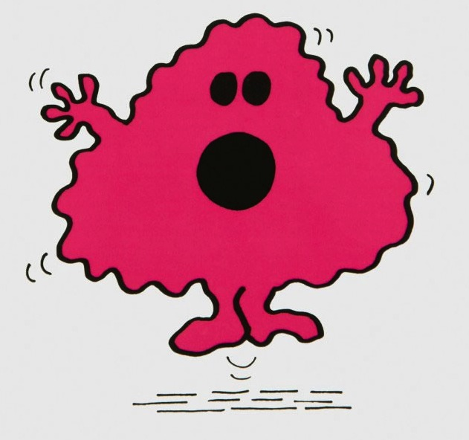
Don’t hurt them!!!!!
There is a common thought that you are going to do something to “make the stuttering worse”
Notes:
----- Meeting Notes (4/6/15 20:46) -----
Sometimes people work from their comfort level or work on PWR and Prolongations only.
It is important to work on the whole CWS rather than just the surface behaviors

Slide 10
Take Risks
Step outside your comfort level so they can step outside of theirs
Stuttering is a complex disorder but your clients who stutter depend on you to be the knowledgeable expert
Working on Part Word Repetitions and Prolongations alone are not adequate for most, especially older CWS.
SLPs feel pressure from many sources to work on “strategies”. In my opinion, this is usually a misguided way to go about things for the long-term communicative health of your client.
Notes:
It’s ok if you are learning together

Slide 11
Cognitive Behavioral Therapy (CBT)
http://www.stutteringhelp.org/introduction-cognitive-therapy
Cognitive Therapy is not concerned with teaching clients to 'think positively' or to be more 'rational'. It is concerned with helping people to understand the way in which their thinking affects them on a day-to-day basis, and to cope with difficulties more effectively by being more flexible in how they look at and respond to situations, developing more effective problem-solving skills, maximising the use of more helpful self-talk, and developing life-enhancing core beliefs. It provides a structure for therapists to explore their own negative thoughts, emotions and responses, and to understand parents' anxieties better.

Slide 12
Why is CBT important to our talk today?
Books can be used to augment the child’s perception of his stuttering situation.
Books can be used to aid in our understanding of a problem.
Helping people change their perspectives is vital to any improvement in life.
Laying the groundwork early to analyze problems in this manner can help long term success

Slide 13
Why use books?
It deflects conversation away from being too personal and about them….kids open up more when the conversation is about a character and not themselves.
They can feel through the character that they are not alone in their thoughts and actions.
It can help them better understand how their communication interacts with their personality.
Notes:
Can’t see the forest through the trees

Slide 14
How did I get here?
The Mystery of the Mistakes in Mulligan’s Mouth
I’ve been using my own fictional book in a variety of ways over the past 12 years.
A book for kids with a supportive guide for the SLP and parents to ask and answer questions with the Child Who Stutters for each chapter. Also includes classroom activities for a read aloud by the teacher.
Learned through trial and error how using stories can be beneficial.
Notes:
----- Meeting Notes (4/6/15 20:55) -----
Trial and Error = Chapters, rewrites, Serial
Give kids a hook or a nice way to start/end therapy

Slide 15
What have I learned?
Some kids really enjoy it, others may not
There are a lot of misconceptions about stuttering by students, parents and adults….and some authors for that matter
Talking about characters can get the dialogue going between kids, parents and SLPs
There has to be more quality ways to help us accomplish our long term goal of happy, stable communicators
Almost each and every time I review or include a book in therapy, I learn something new about the client, their family and or the book itself.

Slide 16
What themes should a quality fictional book with a character who stutters show?
Notes:
Take Questions and Answers
----- Meeting Notes (4/6/15 21:02) -----
Take a few minutes to discuss this with the person next to you.

Slide 17
Share your thoughts
What clients could I use this tool with?
How can I get them to buy into reading books with characters who stutter?
What do I want the client to learn?
What characteristics should the protagonist portray?
Notes:
Turn to your partner and share

Slide 18
Thoughts on what a quality fictional book with a character who stutters should show.
Is not a pity party
Does not bring forth negative feelings to too great a degree in the client
Helps them think of things in a new perspective
Makes them root for the main character
Is something they can relate to
Is easy to read
Is entertaining

Slide 19
How should a good book help the client?
Communication is the key goal of speech, not getting rid of stuttering.
Don’t let stuttering rule you
Standing up for yourself
Learning what stuttering is and what stuttering isn’t
Shows stuttering as just an aspect of the character and not the definition of him.
Even a book that treats stuttering in a non-positive light or a character that behaves in a non-healthy way towards their stuttering has value because it can open up conversation between you and your client.
Notes:
Movies- the guy gets a bump on the head and all of the sudden no longer stutters.

Slide 20
Get Stuttering out of the closet

Slide 21
What can a book offer parents, siblings or those who do not stutter?
What stuttering is…and isn’t
Understanding that stuttering is more than PWR and Prolongations.
Reveals the inter-monologue of CWS and may dismiss the thought of “he’s shy” or “it’s word finding”.
Understanding the Stuttering Iceberg
How much fluency can affect the daily thoughts and lives of the people that stutter
Gives them a way of communicating their feelings about their own beliefs about what is happening to their loved one.
Gets their focus away from “statagies” and getting rid of the stuttering and more on a direction of getting their kid’s communication “healthy”.
Notes:
Talk about this stuff…like any other difference

Slide 22
Review of The Stuttering Iceberg
Notes:
How many of you in grad school got instruction on how to treat or help with the issues that lie below the surface. Help with the isolation.

Slide 23
Parent/Child Interactions about stuttering
Get client and parent talking about stuttering
Give the client and the parent something to DO other than working on techniques, and controls and being the stuttering police.
Speech practice can be entertaining
The kids are required to read anyway…why not give them something that can apply and relate to their everyday life.
Notes:
Many want drills or practice pages. These encourage the: Stuttering must end mentality.

Slide 24
Let’s review of sample of the books available:
http://www.mnsu.edu/comdis/kuster/kids/kids.html#books
http://www.mnsu.edu/comdis/kuster/kids/kidsbooks.html
This website is amazing
Notes:
My snuggy blanket for resources and ideas, Like an old friend.

Slide 25
Books for Children 8 years and under
Stuttering Stan Takes a Stand
Ben Has Something to Say: A Story About Stuttering
Adventures of a Stuttering Superhero
Hooray for Aiden
A Boy and His Jaguar
Wendy Witch
The Teacher Who Made a Difference

Slide 26
Stuttering Stan Takes a Stand Artie Knapp

Slide 27
Stuttering Stan Takes a Stand Artie Knapp
Recommended Ages K to 3rd Grade
Reading Level: Second…With audio option.
https://www.youtube.com/watch?v=dQvZZQZIALQ
Story Summary: Stan has to stand up to a bully named Raker, who loves to make fun of others.
Notes:
Not the biggest fan of the Title but it’s a nice story.

Slide 28
Stuttering Stan Takes a Stand Artie Knapp:: Uses
Video Story is nice change of pace for kids and allows this to be viewed by other younger kids or non readers
How to handle bullying
How pretending to be someone else can cause difficulty socially
Teasing and forgiveness to those who have harmed you
How stuttering doesn’t matter to true friends
How kids questions about stuttering can just be curiosity and not teasing
Notes:
Say what you want to say not how you say it.

Slide 29
Ben Has Something to Say Laurie Lears
Notes:
Ben looks sad…but this book is great.
My daughters and

Slide 30
Ben Has Something to Say Laurie Lears
Recommended ages: 5 to 9
Reading Level: Second Grade
Nice forward by Nina Reardon, MS, CCC-SLP
Story Summary: Ben is a boy who doesn’t like to talk because he stutters. At a junk yard he takes care of a dog and eventually finds a way to bring him home.
Notes:
Kids love animals. This was my daughters favorite

Slide 31
Issues Addressed
Stuttering can influence you to not say anything at all
Stuttering can influence you at school
Parent’s understanding can help. The dad does not speak for the protagonist.
Notes:
Dad didn’t talk for the child

Slide 32
Adventures of a Stuttering Superhero Adventure #1 Interrupt-itis
Notes:
There is a Adventure #2 but I have not reviewed this at the current time.

Slide 33
Adventures of a Stuttering Superhero Adventure #1 Interrupt-itis Kim Block
Recommended Ages 5 to 8
Reading Level: Second Grade
Story Summary: Melissa is a brave stuttering superhero who confronts a student who is interrupting her and finishing her sentences.

Slide 34
Issues Addressed/Themes to Discuss
Character is open about her stuttering
Asks trusted adults for help
Interrupting and what to do about it
May be helpful for parents who interrupt their CWS
Notes:
Adventures #2 has been released but Melissa Meets her Stamily. Just released I have not reviewed

Slide 35
Hooray for Aiden Karen Hollet

Slide 36
Hooray for Aiden Karen Hollet
http://www.hooraypublishing.com
Recommended Ages: 4 to 9
Reading Level: Second Grade
Story Summary: When her family moves to a new town, the main character, Aiden, becomes worried about how her new second grade classmates will react to her stutter. At first, Aiden tries to hide her stutter from her classmates. This makes her very sad. But soon, with a little help from a caring teacher, Aiden learns that it’s OK to be herself….it’s OK to stutter!

Slide 37
Issues Addressed/Themes to Discuss
Starting in a new school when you stutter
Isolation due to stuttering
How being open about stuttering helps
Adults who stutter and careers
Advertising your stuttering

Slide 38
Wendi’s Magical Voice Brit Kohls Stuttering Foundation, 2010

Slide 39
Wendi’s Magical Voice Brit Kohls, Stuttering Foundation, 2010
Recommended Ages: 5 to 8
Reading Level: Second Grade
Story Summary: A witch is scared to talk in her classroom and has difficulty believing in herself.

Slide 40
Issues/Themes to Discuss
How fear can lead to avoidance
How people are different in a wide variety of ways
Why saying your name can be difficult
What is bravery and how does it relate to stuttering
What to do when you get made fun of
It’s not important whether you stutter or not it is what you say that is important.
Stuttering is just one way that people can be different

Slide 41
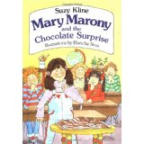
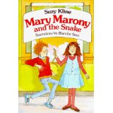
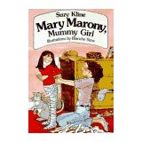
Mary Marony Books Suzy Kline, 1994

Slide 42
Mary Marony Books Suzy Kline, 1994
Recommended ages: 6 to 9
Reading Level: Second Grade
Story Summary: Mary is a second grader who moves to a new school and encounters the fear of stuttering and “M” words, while confronting a bully named Marvin.
Of Note: Subtle addressing of stuttering and enjoyable for non-stuttering children.
Notes:
I like these books because they are written by a professional author.
Regular Kid who just so happens to stutter
Same trials and tribs as other kids her age.

Slide 43
Issues Addressed
While stuttering is a part of Mary’s character it is one of the themes, not the only theme of the book
Mary faces challenges in the books such as her parent’s financial situation, lying, cheating and other themes.
Word/Sound Specific Stuttering
Notes:
Subtle.
Enjoyable to non stuttering children

Slide 44
Themes to Discuss/Uses
Feared sounds and words
Anxiety
Talking in front of the class
Telling the truth
Talking about stuttering with your parents
How the character is just a regular kid who has regular kid problems
May be good for classmates of kids who stutter or as a read aloud

Slide 45
A Boy and A Jaguar Alan Rabinowitz, 2014

Slide 46
A Boy and A Jaguar Alan Rabinowitz, 2014
Recommended ages: 5 to 10
Reading Level: Second to Third Grade
Story Summary: A boy with a severe stutter tells of how he can only speak fluently with animals. He then becomes more fluent as an adult and becomes an advocate for Jaguars.

Slide 47
Issues Addressed
Dark…Fearful nature of what lies below the surface of stuttering
The all consuming nature of stuttering
Loneliness of stuttering
Notes:
Talks about a school for disturbed children

Slide 48
Themes to Discuss
Avoidance of speaking
The importance of a message over fear of stuttering
Being alone to avoid talking
With older kids, how stuttering can effect your career path

Slide 49
Other Notes
Read to a child, so you can change around some of the dark language
Very adult themes….hard for kids to understand the story
Nice pictures and about animals

Slide 50
The Teacher Who Made a Difference Corinne Litzenberg, 2013

Slide 51
The Teacher Who Made a Difference Corinne Litzenberg, 2013
Recommended Ages: 7 to 10
Reading Level: Third Grade
Story Summary: A little girl’s secret is out that she stutters and she has to start speech at school. The book tells of how a helping kindergarten teacher was always there for her from then until fourth grade.

Slide 52
Themes to Discuss
Avoidance
The use of techniques in the real world
How people are more than just their communicative difference
How others view those who stutter and have disabilities in general
Tricks and the pros and cons of them
Having people in your life that you can talk about your communication with

Slide 53
Issues Addressed
There are good speech days and bad speech days
Kids don’t like to miss class for speech
Book mentioned breathing, relaxing and mirror exercises
Turtle Talk
Gives the impression that talking fluently means not stuttering
Gives the impression that life events can affect stuttering
Notes:
Remember, the book relates a story of the author from when she was a child and not modern fluency therapy.

Slide 54
Books for kids 8 years to early teen
Gabriela Series
Mystery of the Mistakes in Mulligan’s Mouth
Jackie Ha Ha Series

Slide 55
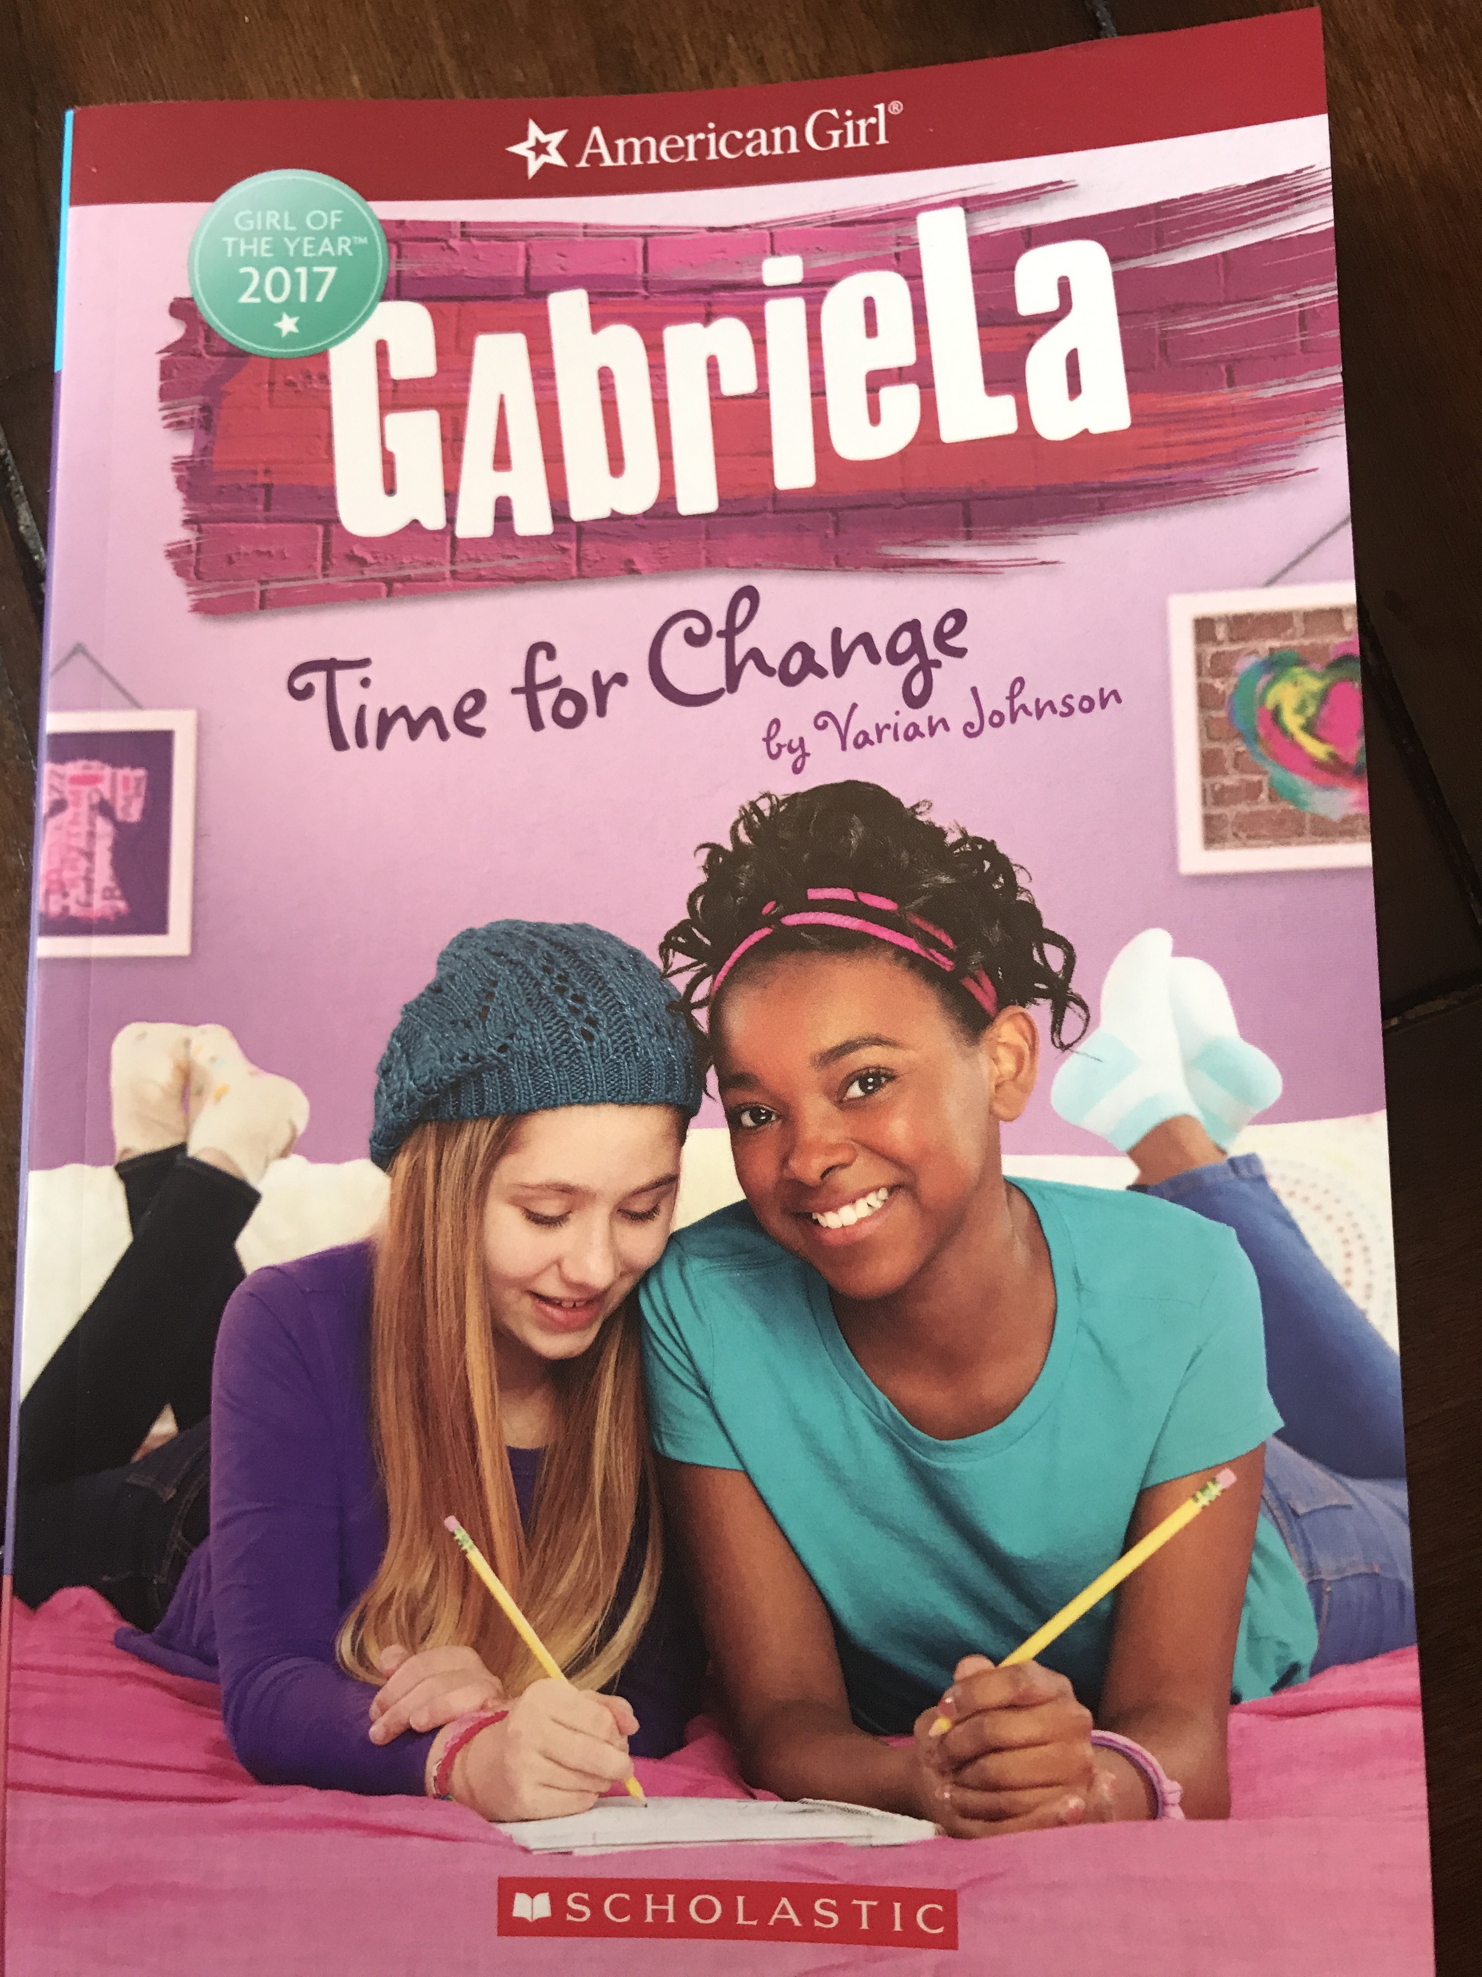
Gabriela Book Series by Teresa E. Harris and Varian Johnson

Slide 56
Gabriela Book Series
Popular American Girl Doll Book Series. 2017 Girl of the Year.
http://play.americangirl.com/play/girl-of-the-year/gabriela/
Does a good job with her stuttering, but there are things that might should be handled differently. They talk about pushing through the stuttering moment a lot.
Does a nice job with Gabriela talking for herself and not letting her well meaning friends finish her words for her.
Addresses fear but shows that she’s a leader and can make positive change around her.

Slide 57
The Mystery of The Mistakes in Mulligan’s Mouth. Jeffrey J. Glessing
https://www.amazon.com/Mystery-Mistakes-Mulligans-Mouth/dp/1517047277#

Slide 58
The Mystery of The Mistakes in Mulligan’s Mouth. Jeffrey J. Glessing
Recommended Ages: 8 to 14
Reading Level: 4th grade
Story Summary: Harry Mulligan is a 6th grade student who stutters who has just moved to his grandfather’s farm in rural Alabama. Harry struggles with his stuttering as well as his relationships with his family. Harry finds a black box on the farm. Can the contents of the box help solve his speech and family difficulties?

Slide 59
The Mystery of The Mistakes in Mulligan’s Mouth. Jeffrey J. Glessing
Chapter by Chapter therapy guide forthcoming along with parent guide, and classroom read aloud guide.
Illustrated by a young woman who stutters.
Communication is the key
Adventure book written from the child’s perspective
Reading Level 4th grade Recommended ages 8 to 14.

Slide 60
The Mystery of The Mistakes in Mulligan’s Mouth. Jeffrey J. Glessing Themes/Things to Discuss
It’s hard to use techniques in the real world
Unfiltered thoughts on speech therapy
How everyone has things in their life they need to improve on
Being more understanding of others
Trusting in yourself and not letting stuttering hold you back from showing your talents.

Slide 61
Jacky Ha-Ha Series James Patterson and Chris Grabenstein

Slide 62
Recommended Ages: 8 to 14
Reading Level: 4th grade
Story Summary: Jackie is a 12 year old girl who stutters and uses her sense of humor to be her claim to fame.

Slide 63
Jacky Ha-Ha Series James Patterson and Chris Grabenstein
Takes place in the 1990’s as the Mom is telling the stories to her daughter
Written in a fun light hearted and amusing style
Fun for parents to read with their child due to the 90’s references. May not appeal to boys.

Slide 64
Jacky Ha-Ha Series Things to Discuss/Issues
Jackie Ha Ha is for Jackie Hart…got the name is preschool
Talks about taming the stutter
Gets advice from her English teacher, not an SLP
Doesn’t stutter when she has things memorized or is acting.
Gives the air that stuttering is caused by being nervous. Might aid stereotypes.

Slide 65
Books for Teenagers to Adults
Tending to Grace
Lost Boys Never Say Die
Paperboy
I Thought My Soul Would Rise and Fly

Slide 66
Tending to Grace Kimberly Fusco

Slide 67
Tending to Grace
http://www.kimberlynewtonfusco.com/knf9_005.htm
Recommended ages: 12 to adult
Reading Level: 6th grade to adult
Story Summary: Grace is a young teenage girl who struggles with stuttering and retreats into the world of books. She is sent by her mother (abandon really) at her accentric great aunt’s house to live.

Slide 68
Tending to Grace
“You know what I say?” the old woman asks. “I say that when you got a voice, you damn well better tell the world who you are. Or somebody else will.”

Slide 69
Tending to Grace: Themes to Discuss
How hiding stuttering can hide who you really are
How everyone has talents to share and can make others better by sharing them
How to handle others reactions to stuttering
The way others just listening can help encourage those who stutter
The importance or idea of not bailing people out of a block and how that can help in the long run.

Slide 70
“Butterflies get strong in the struggle. If you help them out of it’s chrysalis, it doesn’t get to struggle and it’s too weak to fly on it’s own.”

Slide 71
Themes to Discuss
Reading at school
How writing things out is not as true to yourself as speaking…..texting I’m talking to YOU
How avoidance effects others perceptions of a person
Defining and understanding ‘Shyness’
The reward for stuttering and speaking up
The role parents can play in helping or hurting a situation

Slide 72
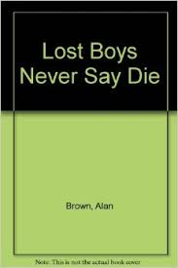
Lost Boys Never Say Die Alan Brown and Grant Forsberg, 1989

Slide 73
Lost Boys Never Say Die Alan Brown and Grant Forsberg, 1989
Reading Level 4th and up
Recommended ages: 6th grade and up
Story Summary: An eleven year old boy ditches his speech summer camp to spend summer at home alone. He joins a theatre group with the help of a new friend he meets.
Note: Teenage themes, smoking and drinking, a little dated
Notes:
Could have been the original inspiration for home alone

Slide 74
Issues Addressed
Character would rather spend the time alone than have to talk to people
Describes being picked on by bullies
A friend in the book who helps him deal with his stuttering and speaking anxiety through acting and singing
Ending gives hope, while remaining realistic

Slide 75
Themes to Discuss with Clients
Being honest when speaking to parents about your speech
How attitude can restrict your actions and the meaning and power of the word “can’t”
How fear and anxiety have a role in stuttering and what can be done to change attitudes

Slide 76
Paperboy Vince Vawter, 2013

Slide 77
Paperboy Vince Vawter, 2013
Recommended Ages: 11 and up
Reading Level 5th and up
Story Summary: A 6th grade boy in Memphis in 1959 takes over his friend’s paper route over the summer. He has new people to meet and dangers to avoid, both stuttering and non stuttering related.
Notes: Talk of the segregated south and violence may need to be discussed before giving this book to a client.
A lifetime stutterer’s memoir …laced with fiction is how the author describes it.
Notes:
Good for parents to read

Slide 78
Issues Addressed
Word Specific Stuttering
The use of techniques in real life and through the eyes of a young adolescent
Say what you want to say
Stuttering and the avoidance of it, consumes the character’s everyday world……and is considered in almost every decision that is made
Notes:
Over use of easy “s” It’s the only sound he likes.
Gentle Air

Slide 79
Themes to Discuss
Saying what you want
Giving classroom presentations
How stuttering can change throughout the years as talking needs and experiences change
What defines success when facing difficult speaking situations.

Slide 80
I Thought My Soul Would Rise and Fly. Joyce Hansen

Slide 81
I Thought My Soul Would Rise and Fly. Joyce Hansen
https://www.scholastic.com/teachers/lesson-plans/teaching-content/i-thought-my-soul-would-rise-and-fly-discussion-guide/
Recommended Ages: 10 to Adult
Reading Level: 5th
Summary: It is a diary of a young girl named Patsy who became free from slavery. It takes place in the South of the Untied States after the Civil War ended. Patsy stuttering and walks with a limp and because of this everyone assumes she is mentally slow. She teaches herself to read and write. The book is written in a diary format.

Slide 82
Issues/Themes to Discuss
How perceptions have changed over time
How finding your passion can help others
How believing in yourself can overcome odds
How believing in yourself despite other’s misconceptions can make positive change.

Slide 83
Other books for adults yet to be reviewed
Black Swan Green by David Mitchell author of Cloud Atlas
Speed by Mark Harris
Upcoming website: www.slpanovelapproach.com

Slide 84
Online digital books and resources
http://www.mnsu.edu/comdis/isad11/papers/dwilliams11/dwilliams11.html
http://www.mnsu.edu/comdis/isad7/papers/badmington7/badmington17.html
http://www.mnsu.edu/comdis/isad12/papers/therapy12/coleman12.html
https://www.moralstories.org/the-cracked-pot/

Slide 85
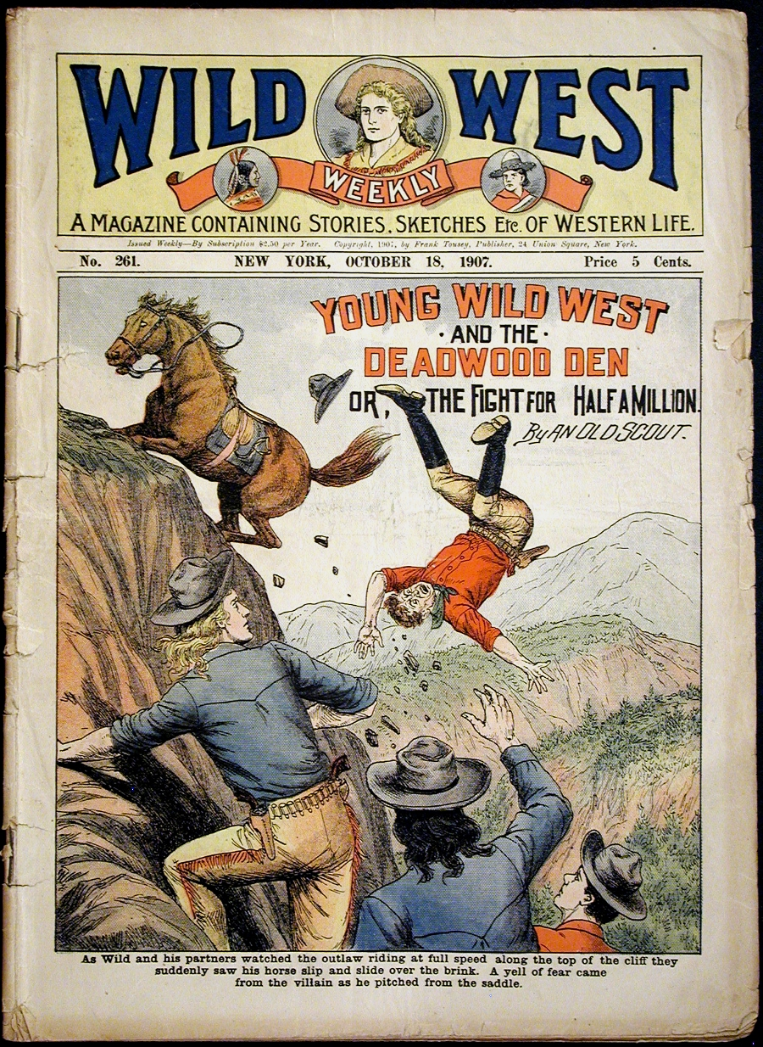
Self Published Books can be useful..but use caution…
The names of these books shall remain secret to protect the guilty

Slide 86
Things to Keep in Mind
PREVIEW MATERIALS….See if they fit your clients belief system, culture and values
For the price of one therapy manual…Most of the books can be tracked down on amazon and/or ebay.
This is not intended to be a replacement for therapy but rather a tool to help in our long term goal to create…..
This is not a comprehensive review of what is out there
Notes:
Iv’e been playing around with this over the past years or so.
Phil Carrot and the Forest of Discord.

Slide 87
Happy Communicators…by

Slide 88
Notes:
One tool to help along their journey to increased communication and living their own lives

Slide 89
Questions
Jeffrey.glessing@mnsu.edu
jeffreyglessing@midwestfluencyservices.com
www.midwestfluencyservices.com
507-272-2752

