Slide 1


The Relapse
The Family Solution Finder Learning Seminars

Slide 2
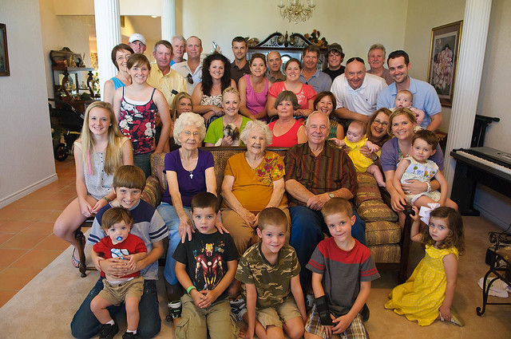
The Relapse
The family needs to understand they are not experts, few families are prepared for this and therefore most will seek assistance from services within their community. The Relapse is a part of most journey’s and to understand its parts helps family members to put the event of a relapse in it proper perspective.
The question is where to gain knowledge about the relapse? We suggest your drug counselor and family therapist. Then on line video’s can be a secondary source.
Relapse is too large a topic for us to complete in these learning session. This topic will take many months of question and answers. Relapse for the family member is a matter of personal perspective.
Notes:
The family Solution Finder has 32 1.5hr seminars coving all the issues a family will likely face in their journey. The family can view these in the monthly meeting or at home. Each issues require a family plan of action

Slide 3
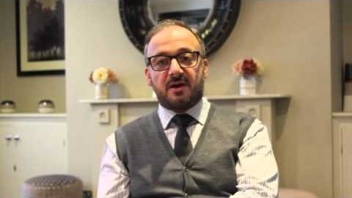

Slide 4

Seminar Overview
The Stages of Relapse
The Causes of Relapse
How a family Responds to a Relapse
Practical Exercise
Supportive Family environment

Slide 5

Relapse happens in the brain

Slide 6
Decisions, and more decisions,
There are decision in every phase of the journey:
  Use the F.T.R. Model to determine your solution
  Use the Value Based Family Decision Making Model to make a decision on your course of action and set up a plan.
  Create a flexible plan on how you will respond to a relapse. Each member of the family would benefit by creating their own individual plan with a part on how they will contribute to the family dynamic in how the family will respond as a family unit.

Slide 7
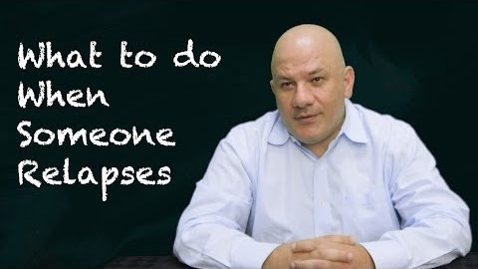

Slide 8
Conclusion
What Causes Relapse
Stages of Relapse
How the Family Members Respond to a Relapse
Complete a “Responding to A Family Issue”

Slide 9
CONTACT US:
Roy Poillon Executive Director/Founder
  Office: 440.385.7605 Mobile: 814.722.8946
  Familiesimpactedbyopioids@gmail.com
  www.Familiesimpactedbyopioids.com
  LinkedIn Roy Poillon
  Facebook: Familiesimpactedbyopioids public group
  Instagram: Families Impacted by Opioids
  ALWAYS SEEK THE ADVICE OF A PROFESSIONAL THERAPIEST BEFORE ACTING ON ANY PART OF THE INFORAMTION PROVIDED IN THESE PROGRAMS.

