Slide 1
IEC National
2014 NEC Update for Electricians
Courtesy of the IEC National Codes and Standards Committee

Slide 2
The 2014 NEC Update for
Electricians
Courtesy of the IEC National Codes and Standards Committee
2

Slide 3
Instructor
Add details about the instructor

Slide 4
Slides with IAEI Copyright were provided by IAEI
www.iaei.org
972-235-1455
Notes:
Acknowledge the International Association of Electrical Inspectors for the use of some of their slides in this presentation and direct the students to IAEI’s website for books, videos, etc.

Slide 5
2014 NEC & IAEI’s Analysis of Change
The two books below are recommended for use with this presentation.
Notes:
Acknowledge the National Fire Prevention Association secretariat of National Electrical Code in this presentation and direct the students to NFPA’s website for books, training, etc.

Slide 6
New Articles to 2014 NEC

Slide 7
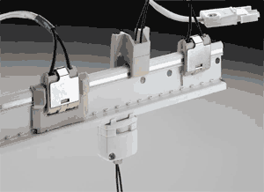
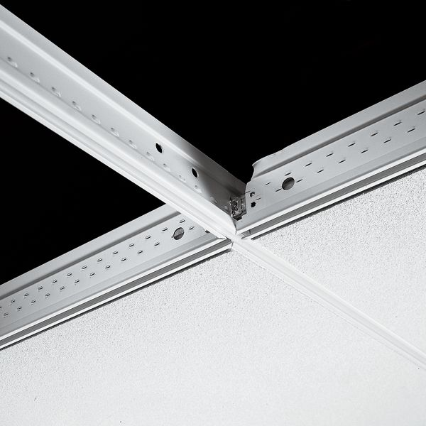
New Article 393 Low Voltage Suspended Ceiling Power Distribution.
393.1
Covers the installation of low voltage suspended ceiling power distribution systems.
Required to be a listed system or an assembly of listed parts.
Notes:
The system serves as a support for finished ceiling surface and consisting of a busbar and busbar support system to distribute power to utilization equipment supplied by Class 2 power supply.

Slide 8
New Article 646 Modular Data Centers
646.1 Section covers modular data centers.
Modular Data Center (MDC).
Notes:
Prefabricated units rated 600 volts or less,
consisting of an outer enclosure housing multiple racks or cabinets of an outer enclosure housing information technology equipment (ITE) and various support equipment such as electrical service and distribution equipment, HVAC systems, and similar equipment.
Required to be listed and labeled or constructed in accordance with the requirements of Article 646.
Provides reduction in working space equipment operating at not more than 30 volts rms, 42 volts peak or 60 volts dc.

Slide 9
New Article 728 Fire Resistive Cable Systems
Fire resistive conductors and components
Fire resistive cables, conductors and components.
General installation requirements for fire resistive cable systems.
Survivability of life safety circuits
Notes:
728.4 General. Fire resistive cables, fire resistive conductors and components shall be tested and listed as a complete system. The cables, conductors, and components shall be designated for use in a specific fire rated system and shall not be interchangeable between systems. Fire resistive cables, conductors, and components shall be suitable for use with the wiring methods in Chapter 3 as applicable.
Provides general installation requirements for fire resistive cable systems.
Survivability of life safety circuits exposed to a fire is dependent on these systems using the specific material and installation methods specified in their listing requirements.

Slide 10
New Article 750 Energy Management Systems
Energy Management System.
Monitor(s), communication equipment
Controller(s)
Timer(s)
Other device(s)
Automatic disconnection creates a hazard.
Notes:
728.4 General. Fire resistive cables, fire resistive conductors, and components shall be tested and listed as a complete system. The cables, conductors, and components shall be designated for use in a specific fire rated system and shall not be interchangeable between systems. Fire resistive cables, conductors, and components shall be suitable for use with the wiring methods in Chapter 3 as applicable.
Provides general installation requirements for fire resistive cable systems.
Survivability of life safety circuits exposed to a fire is dependent on these systems using the specific material and installation methods specified in their listing requirements.

Slide 11
2014 National Electrical Code Changes to Existing Articles

Slide 12
Maximum Voltage Threshold Change
The 600 volts threshold was changed to 1000 volts throughout the NEC .
Look for appropriate UL listing and rating when installing products at the new voltage threshold.
Notes:
Revisions will result in revision to equipment voltage ratings within product standards to accommodate higher operating voltages of systems such as PV and wind.
Example: The present voltage rating for “low voltage” safety switches is incompatible with PV or wind power systems operating over 600 volts.

Slide 13
Article 100 adds “Readily Accessible”
Electrical contractors and electricians should consider this definition when installing dishwashers, vending machines, and other electrical products that requires the GFCI to be readily accessible.
Notes:
“Capable of being reached quickly for operation, renewal or inspection without requiring those to which ready access is requisite to use tools, to climb over or remove obstacles or resort to portable ladders and so forth”.

Slide 14
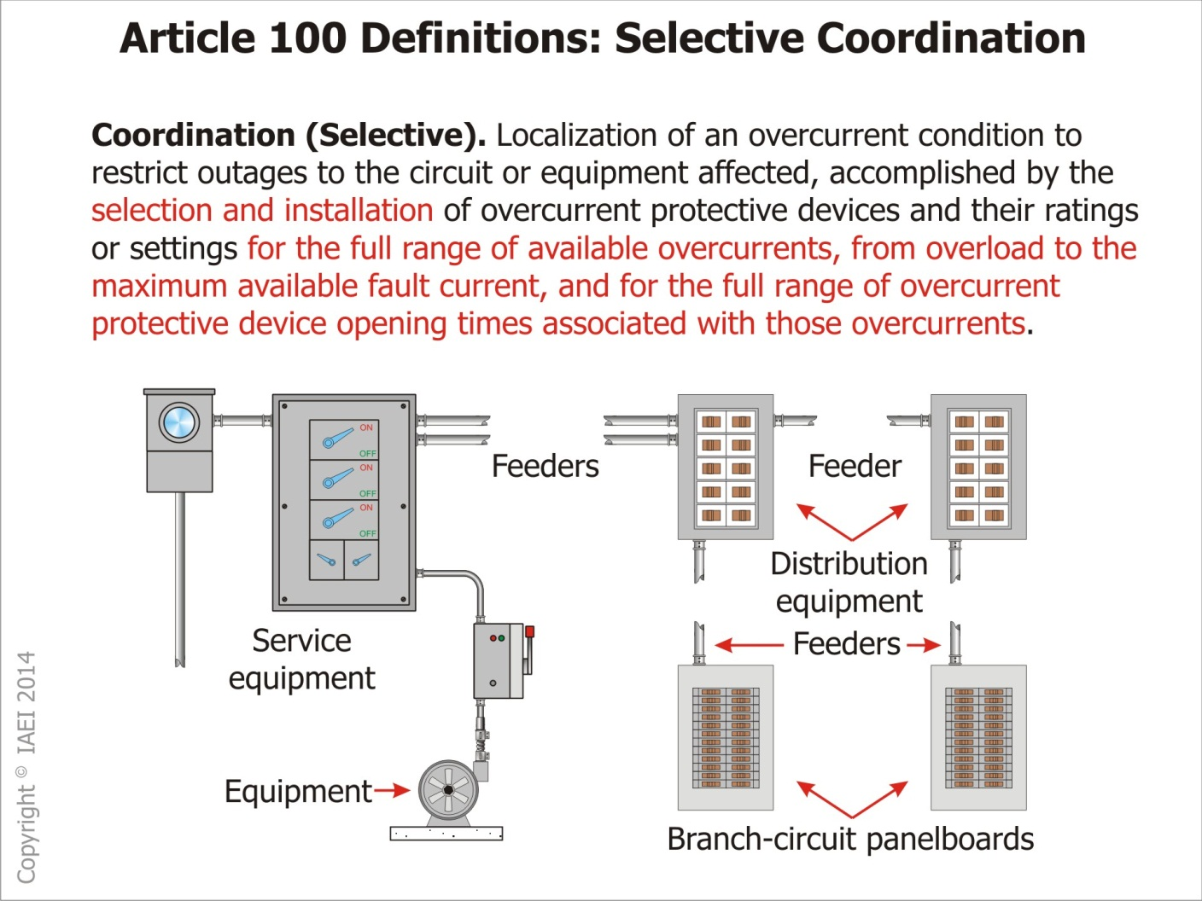

Slide 15
Article 100 Definition – Selective Coordination
Electrical contractors can use curves for fuse and circuit breaker to achieve Selective Coordination. Product engineers working for manufacturers are also very helpful. Worker safety and NFPA 70E should be considered during maintenance
Notes:
“Capable of being reached quickly for operation, renewal or inspection without requiring those to which ready access is requisite to use tools, to climb over or remove obstacles or resort to portable ladders and so forth”.

Slide 16
Article 100 “Retrofit Kit”
A general term for a complete subassembly of parts and devices for field conversion of utilization equipment.
Notes:
New definition applies to listed retrofit kits used for luminaries and signs as referenced by requirements in Article 410 and 600

Slide 17
110.16 Arc Flash Hazard Warning
In the Field
At the Factory
Notes:
New revision adds the words “or Factory” to the rule.
Allows the marking to be applied in the field or at the factory by manufacturer.

Slide 18
110.21(B) Field Marking
Caution, warning or danger signs or labels
Words and or colors and or symbols.
Not be hand written
Durability to withstand the environment.
Refer to ANSI Z535.4-2011 Product Safety Signs and Labels
Notes:
Applies to Code required caution, warning, or danger signs or labels.
The marking shall adequately warn of the hazards using effective words and/or colors and/or symbols.
The label shall be permanently affixed to the equipment or wiring method and shall not be hand written (Exception for markings that are subject to change).
The label shall be of sufficient durability to withstand the environment.
Informational Notes refer to ANSI Z535.4-2011 Product Safety Signs and Labels for guidelines on symbols, colors, location, and durability of safety signs and labels for application to electrical equipment.

Slide 19
110.21(B) Field-Applied Hazard Markings
DANGER indicates a hazardous situation which, if not avoided, will result in death or serious injury.
WARNING indicates a hazardous situation which, if not avoided, could result in death or serious injury.
CAUTION indicates a hazardous situation which, if not avoided, may result in minor or moderate injury.

Slide 20
110.24 Available Fault Current
Note clarifies that the available fault current markings are for equipment rating purposes only and not for arc-flash hazard analysis as required by NFPA 70E
Notes:
New Informational note
Note clarifies that the available fault current markings required by 110.24 are for equipment rating purposes only and not for arc-flash hazard analysis as required by NFPA 70E

Slide 22
110.25 Lockable Disconnecting Means
New section in Article 110 provides consistency for Code rules requiring a disconnecting means that is capable of being locked in the open position.
Notes:
Where a disconnecting means is required to be lockable open elsewhere in the Code, it shall be capable of being locked in the open position. The provision for locking shall remain in place with or without the lock installed
Exception: Cord and plug connection locking provision shall not be required to remain in place without the lock installed.

Slide 23
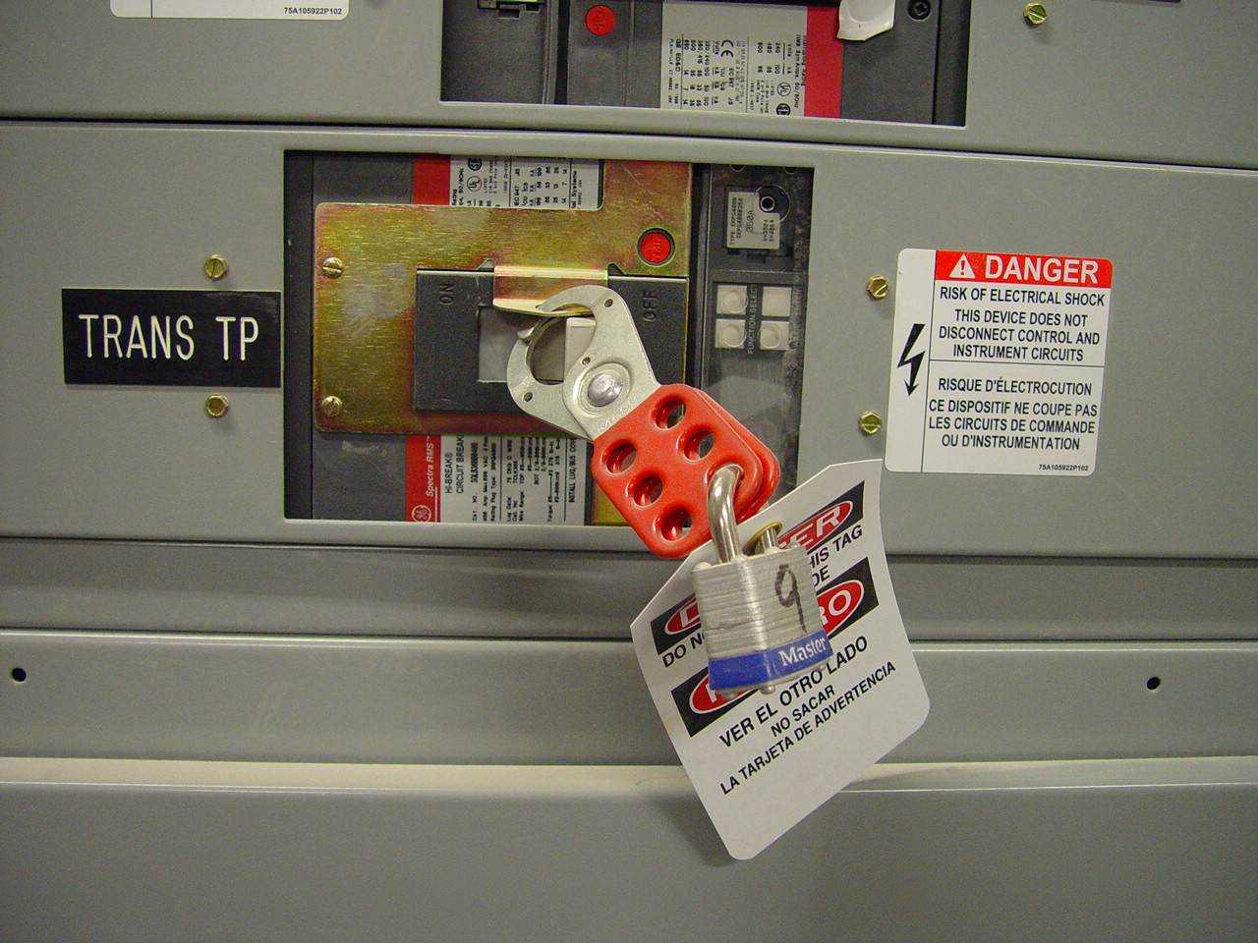

Slide 24
110.26(C)(3) Personnel Doors
This section was revised to require “listed panic hardware” that is consistent with building code requirements.
Notes:
The amperage requirement for equipment with personnel door access requirement has been reduced from 1200 to 800 amperes.
This revision removes the term “simple pressure plates” and other devices that are normally latched but are released under simple pressure
The ampere rating applying to “Large Equipment” in 110.27(C)(2) remains 1200 A or larger.

Slide 25
110.26(E)(2)(b) Outdoor Electrical Equipment
Dedicated Equipment Space
No piping or other equipment foreign to the electrical installation is allowed in this zone.
Notes:
Space equal to width and depth of the equipment
Extending from grade to the height of 1.8 m (6 ft) above the equipment.

Slide 26
200.4(B) Multiple Circuits
Requires grouping or identifying the neutral conductor with its associated ungrounded conductors where contained in the same enclosure with other circuits having a neutral conductor
Notes:
Exception to the equipment where the association between a neutral and its associated ungrounded conductor is obvious.
Cable tie or numbers marking system comply with this section.

Slide 27
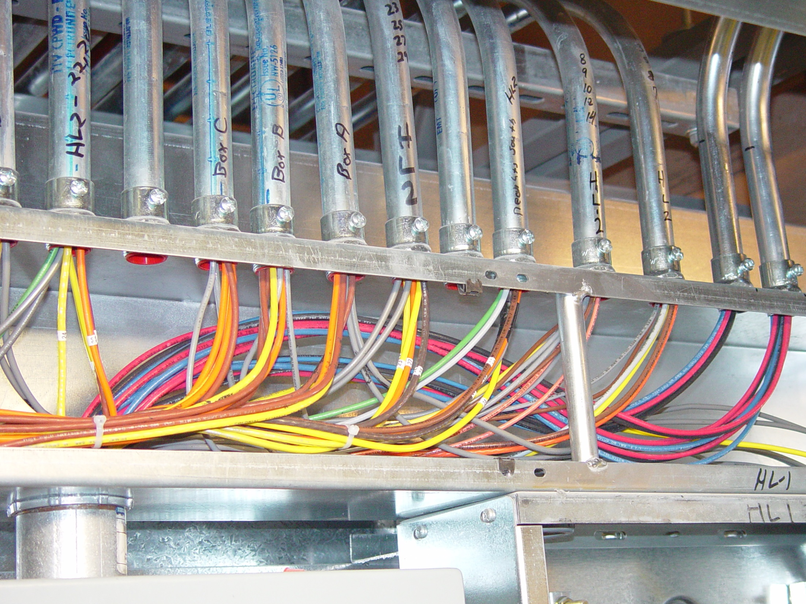

Slide 28
210.5(C) & 215.12(C) Identification of Ungrounded Conductors
New requirement for branch circuit conductor identification in dc systems operating over 50 volts
Notes:
Applies to all conductor sizes with provision for 4 AWG and larger and 6 AWG and smaller.
Conductors will be Red for positive and Black for negative.
Grounded conductors in dc systems are identified per 200.6

Slide 29
210.5(C)(1) Identification of Ungrounded Conductors
New requirement for dc conductors in branch circuit operating at over 50 volts.
Notes:
termination connection and splice points by marking, tagging or other approved means.

Slide 30
210.5(C)(2) Identification of Ungrounded Conductors
Conductors 6 AWG and smaller identified by polarity at termination connection and splice points in accordance with 210.5(C)(2)(a) and (b).
Notes:
(a) Positive Polarity
A continuous red outer field
A continuous red stripe on other than green, white, gray or black insulation.
Imprinted plus (+) sign or the words “Positive” or “Pos” on other than green, white, gray, or black insulation at not more than 24-inch intervals.
(b) Negative Polarity
A continuous black outer field
A continuous black stripe on other than green, white, gray or black insulation.
Imprinted minus (-) sign or the words “Negative ” or “Neg” on other than green, white, gray, or black insulation at not more than 24-inch intervals.

Slide 32
Section 210.8(A)(10) Laundry Area
All 125 volt single phase 15 and 20 ampere receptacles installed in laundry areas are required to be GFCI protected.

Slide 34
Section 210.8(B)(8) Garages
GFCI protection required for all 125 volt single phase 15 and 20 ampere receptacles
Not only garages where electrical diagnostics are to be used
Not required at vehicle exhibition halls and showrooms
Notes:
GFCI protection required for all 125 volt single phase 15 and 20 ampere receptacles installed in all commercial, nondwelling unit garages, service bays, and similar areas.
Not only garages where electrical diagnostic equipment, electrical hand tools, or portable lighting equipment are to be used
Not required at vehicle exhibition halls and showrooms

Slide 35
210.8(D) Kitchen Dishwasher Branch Circuit
All GFCIs must be readily accessible
Notes:
GFCI protection shall be provided for outlets that supply dishwashers installed in dwelling units. (All GFCIs must be readily accessible).

Slide 36
210.12 Arc-Fault Circuit Interrupter Protection
Expanded to include 120 volt 15 and 20 ampere branch in kitchen and laundry area.
AFCI devices required by 210.12 to be installed in a readily accessible location.
Notes:
Expanded to include 120 volt 15 and 20 ampere branch circuits supplying outlets in kitchen and laundry area branch circuits.
New provision added to require all AFCI devices required by 210.12 to be installed in a readily accessible location.
Continues the progression toward “whole house” protection originally sought by CPSC in the 1999 NEC development cycle.

Slide 37
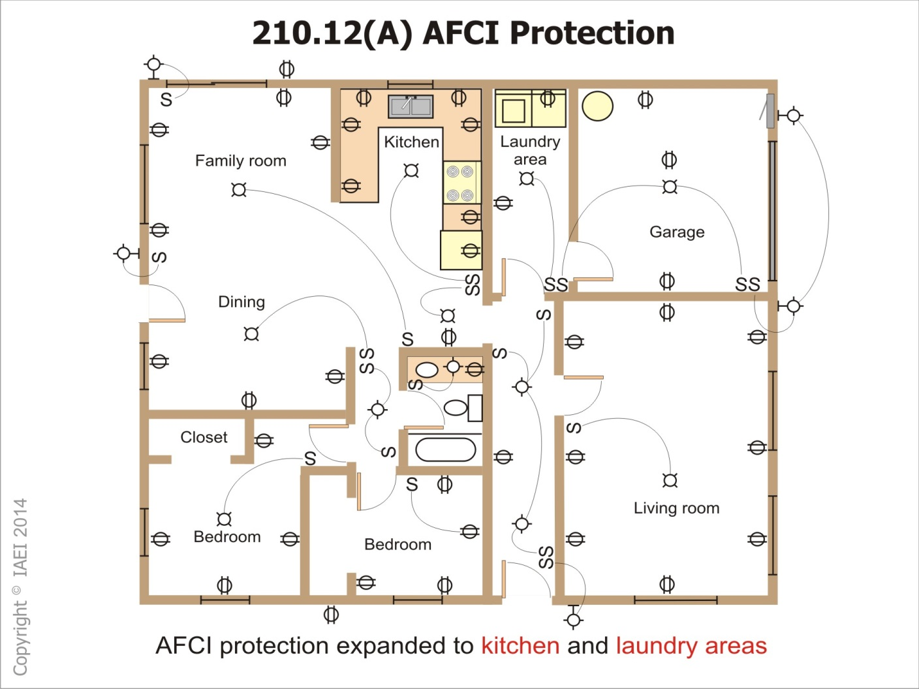
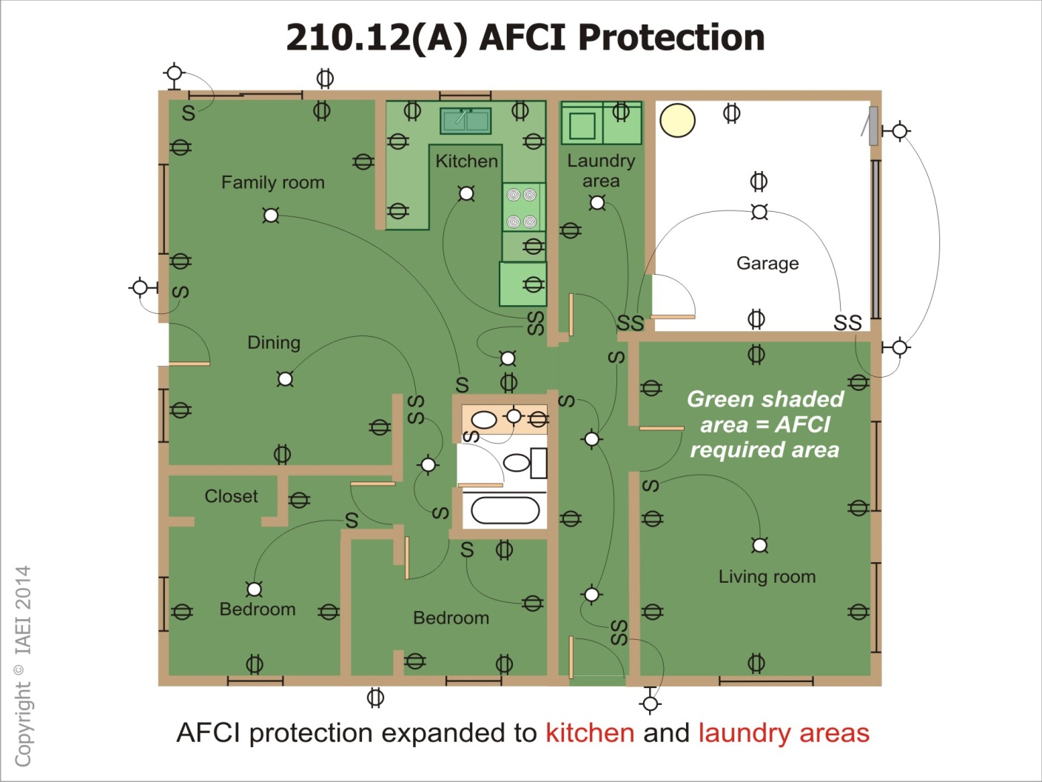

Slide 38
210.12 (AFCI)
First outlet in the circuit
Four specific conditions to apply outlet branch-type AFCI device.
Notes:
Revision recognizes use of circuit breakers or outlet devices at the first outlet in the circuit
Four specific conditions must be met to apply outlet branch-type AFCI device.

Slide 39
210.12 (AFCI)
Conditions for Use of Outlet AFCI Receptacle.
Home run conductor length restricted
Marking of first outlet box
Outlet branch circuit (OBC) AFCI and
Branch circuit OCPD (Over Current Protective Device) provide “System Combination” protection of home run conductors.
Notes:
Conditions for Use of Outlet AFCI Branch Circuit Receptacle.
Home run conductor length restricted; (14 AWG, 50 ft; 12 AWG, 75ft).
Marking of first outlet box in branch circuit
Outlet branch circuit (OBC) AFCI and
Branch circuit OCPD (Over Current Protective Device) listed to provide “System Combination” protection of home run conductors.

Slide 40
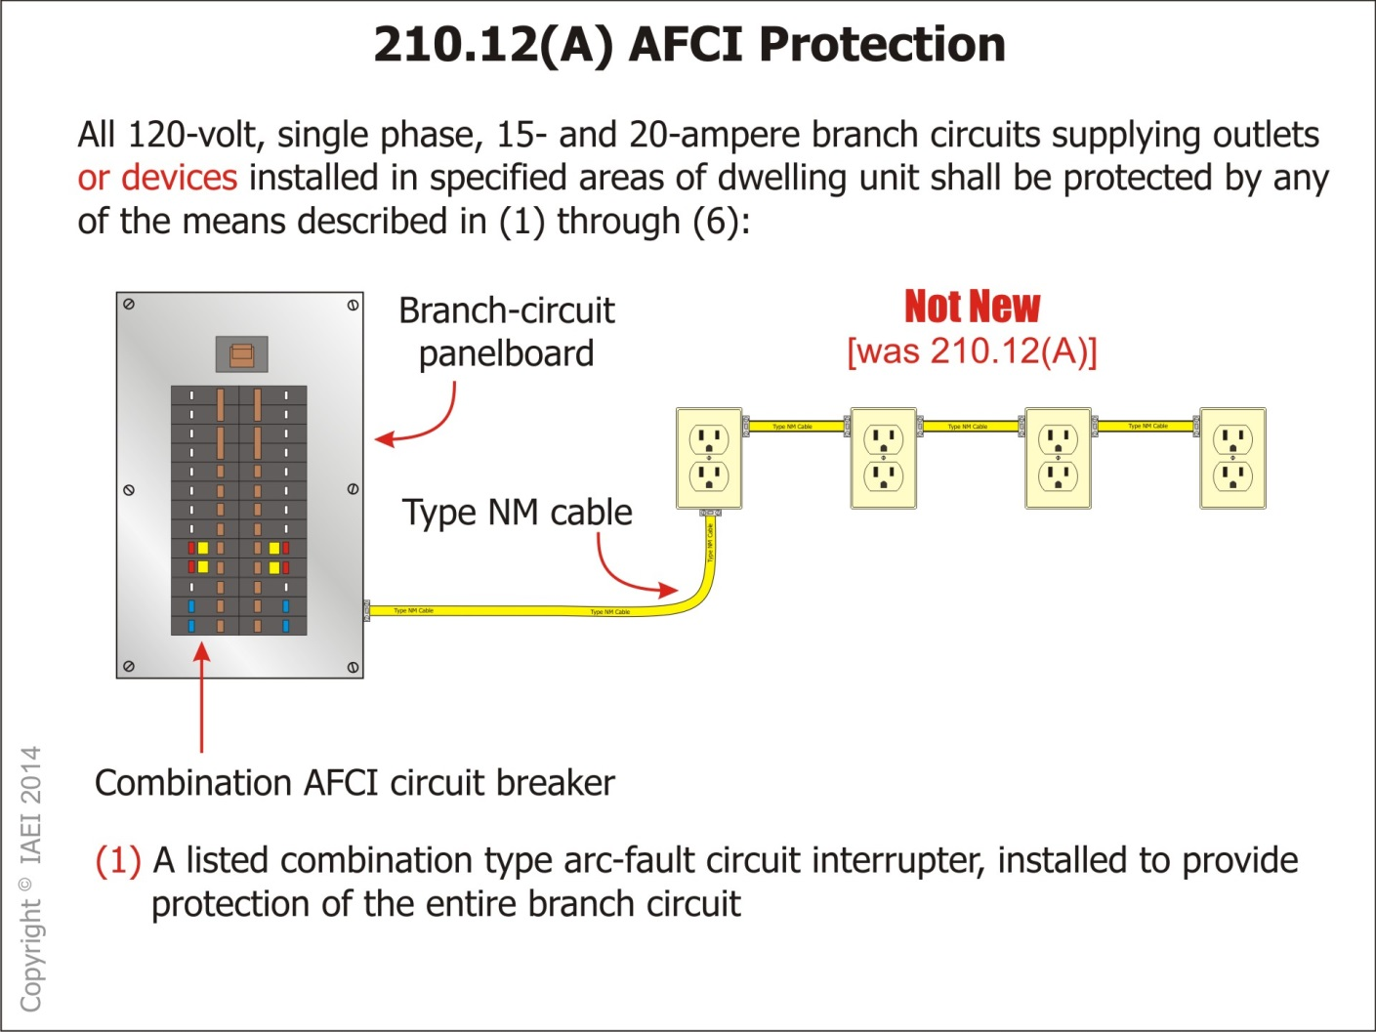

Slide 41
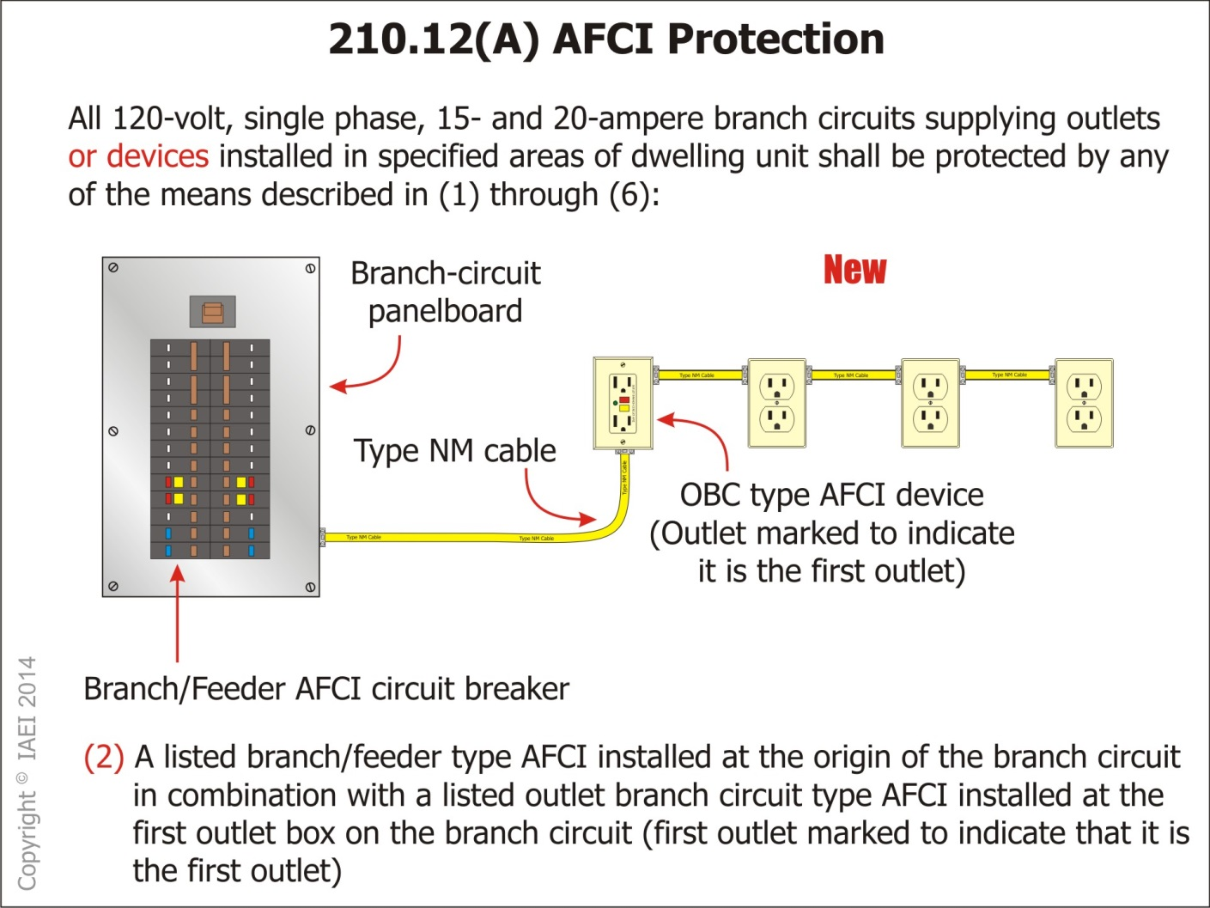

Slide 42
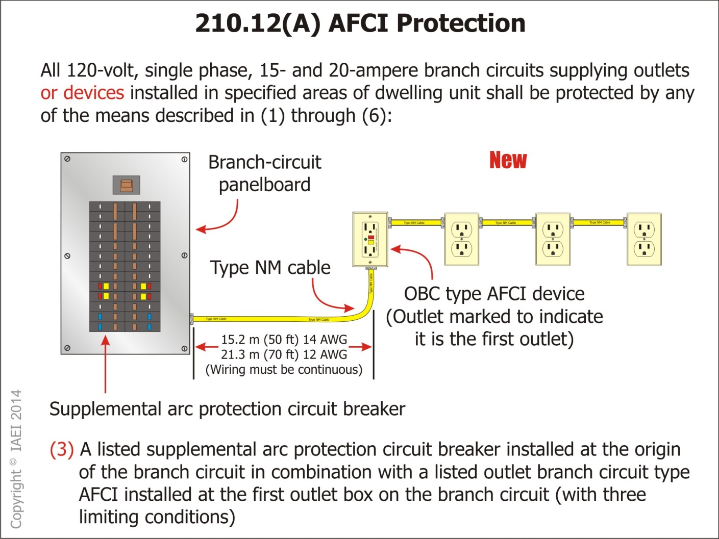

Slide 43
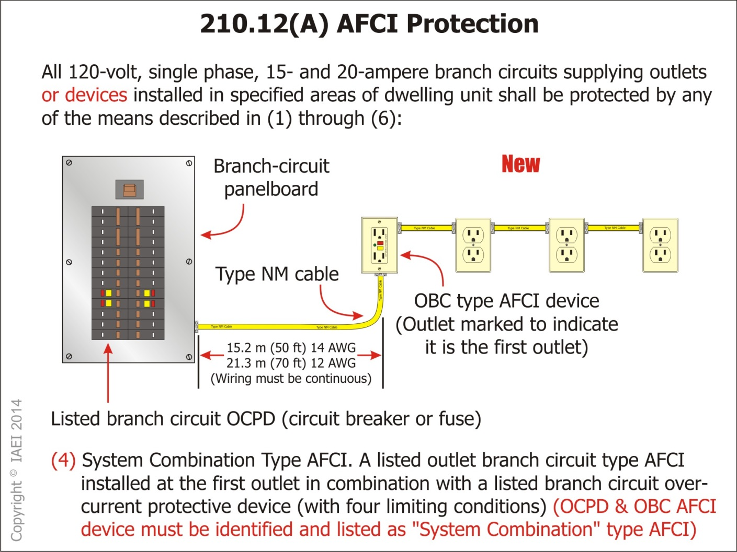

Slide 44
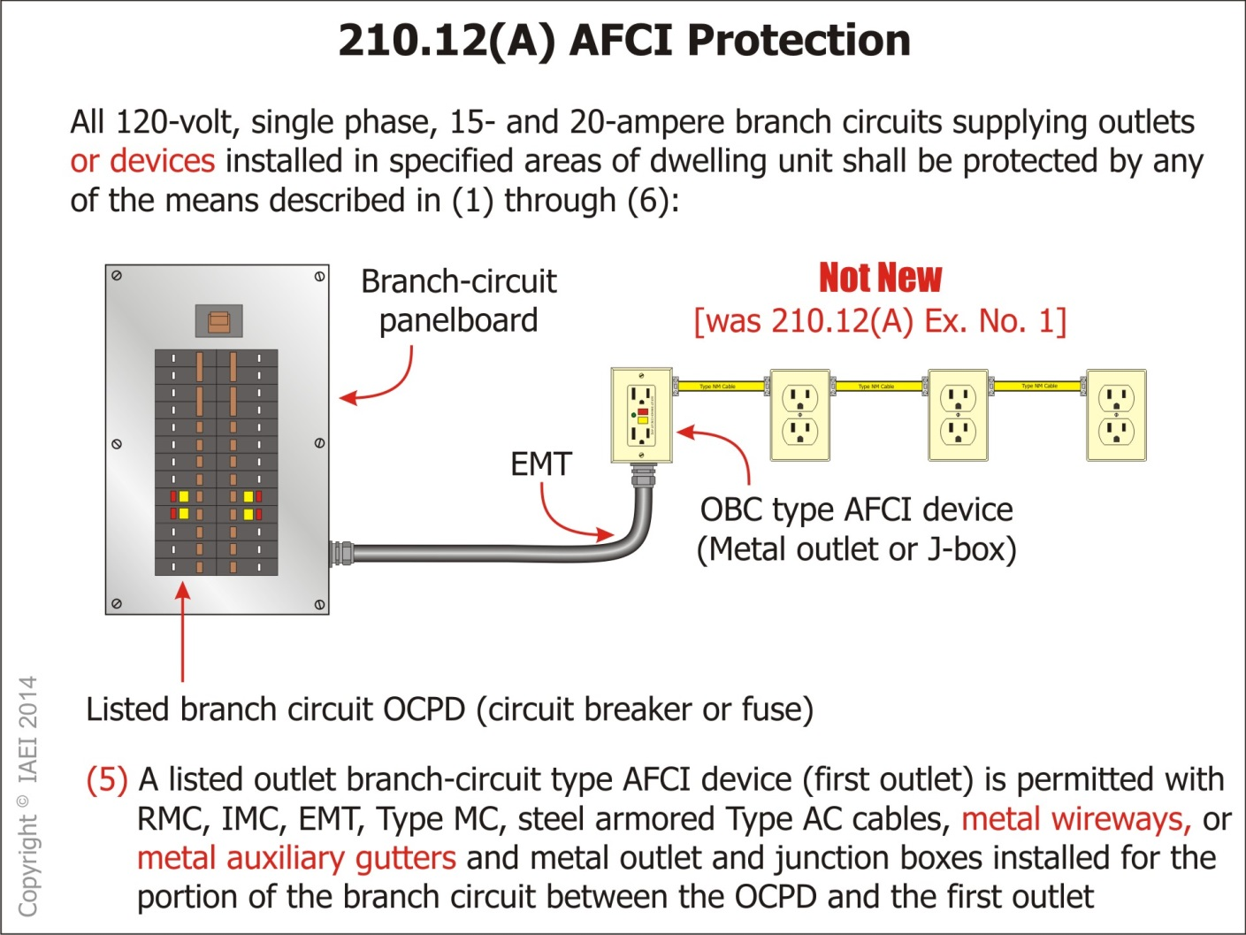

Slide 45
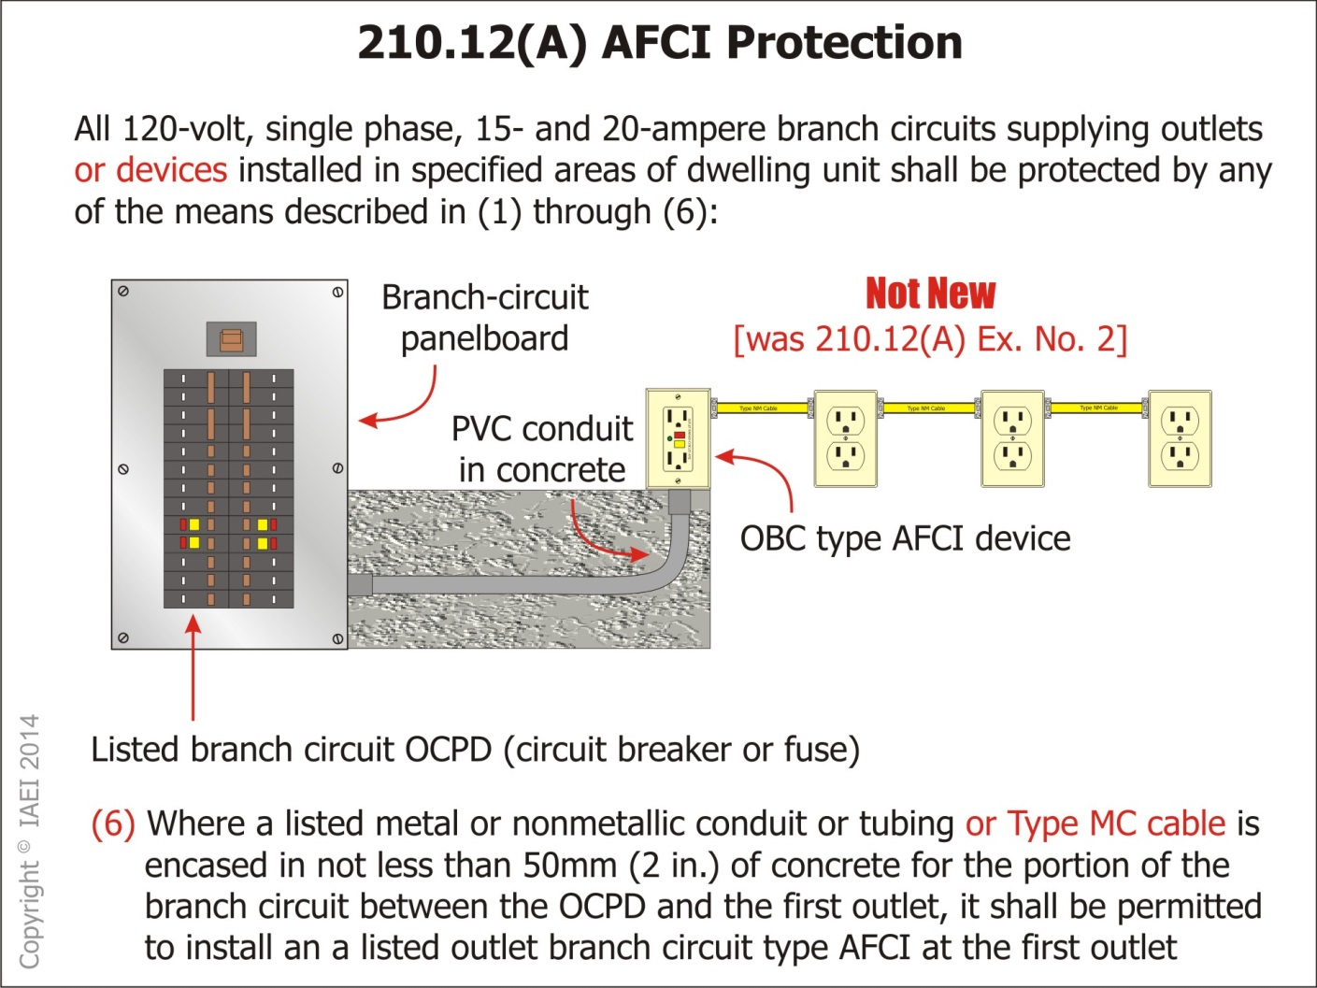

Slide 46
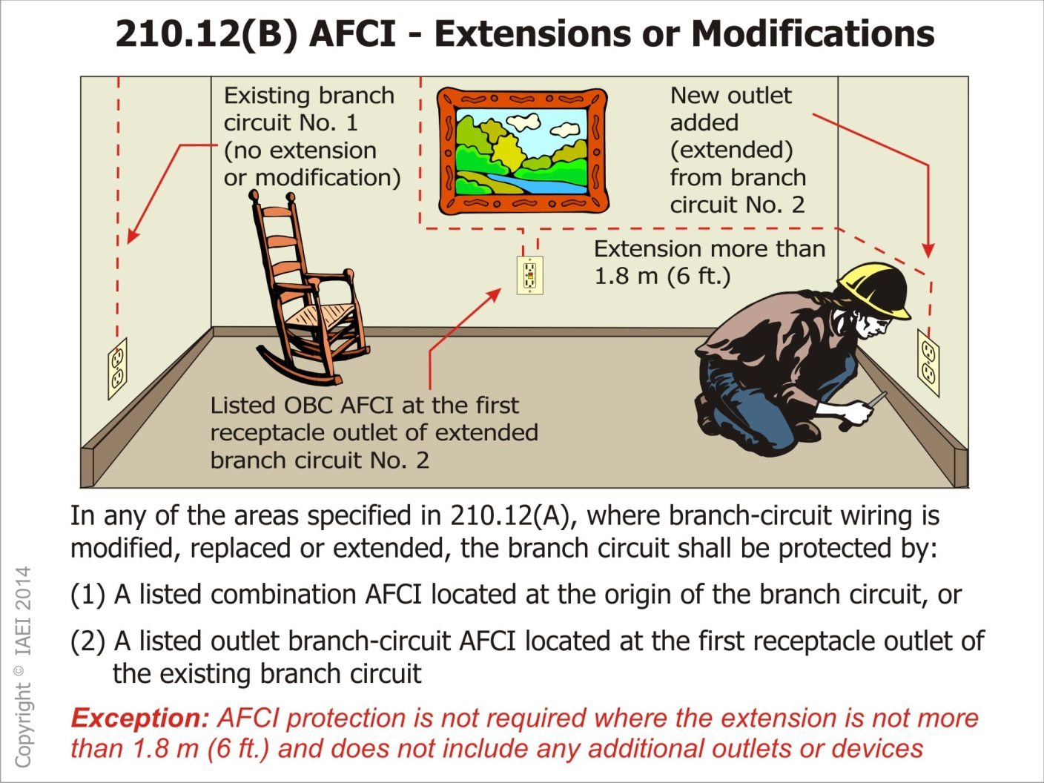

Slide 47
210.12(C) Dormitory Units
Dormitory Units
All 120 volt single phase 15 and 20 ampere branch circuits
Notes:
Dormitory Units – All 120 volt single phase 15 and 20 ampere branch circuits supplying outlets installed in dormitory unit bedroom, living rooms, hallways, closets, and similar rooms shall be protected by a listed arc-fault circuit interrupter meeting the requirements of 210.12(A)(1) through (6) as appropriate.

Slide 48
210.13 Ground Fault Protection Equipment
GFP of equipment now required for branch circuit disconnects
GFPE requirements for branch circuit disconnecting means
Notes:
GFP of equipment now required for branch circuit disconnects meeting provisions described at 230.95
GFPE requirements for each branch circuit disconnecting means that is:
Rated 1000 amperes or more and
Supplied by a solidly grounded wye electrical system operating at more than 150 volts to ground, but not exceeding 600 volts phase to phase and
GFPE provided in accordance with the provisions of 215.10 or 230.95
Applies where not already protected by upstream GFPE.

Slide 49
210.17 Electrical Vehicle Branch Circuit
Electrical Vehicle Branch Circuit Outlets
Notes:
Electrical Vehicle Branch Circuit. Outlets installed for the purpose of charging electric vehicles shall be supplied by a separate branch circuit.
The circuit shall have no other outlets
It should be noted that this new requirement does not demand that an outlet for the specific and sole purpose of charging EV equipment be installed
Informational Note. See 625.2 for the definition of Electrical Vehicle.

Slide 50
210.52(52(G)(1) Garages
“Basements Garages and Accessory Buildings” receptacle provisions revised into list format.
Branch circuit supplying garage receptacles to supply only the garage
Receptacles required for each car space in a garage.

Slide 51
210.64 Electrical Room or Area
Applies to service equipment location in other than one- and two-family dwelling units.
Notes:
At least one 125 volt single phase 15 or 20 ampere receptacle outlet
Located within 50 ft of the service equipment
For servicing of electrical equipment and/or connection of electrical testing and recording equipment

Slide 52
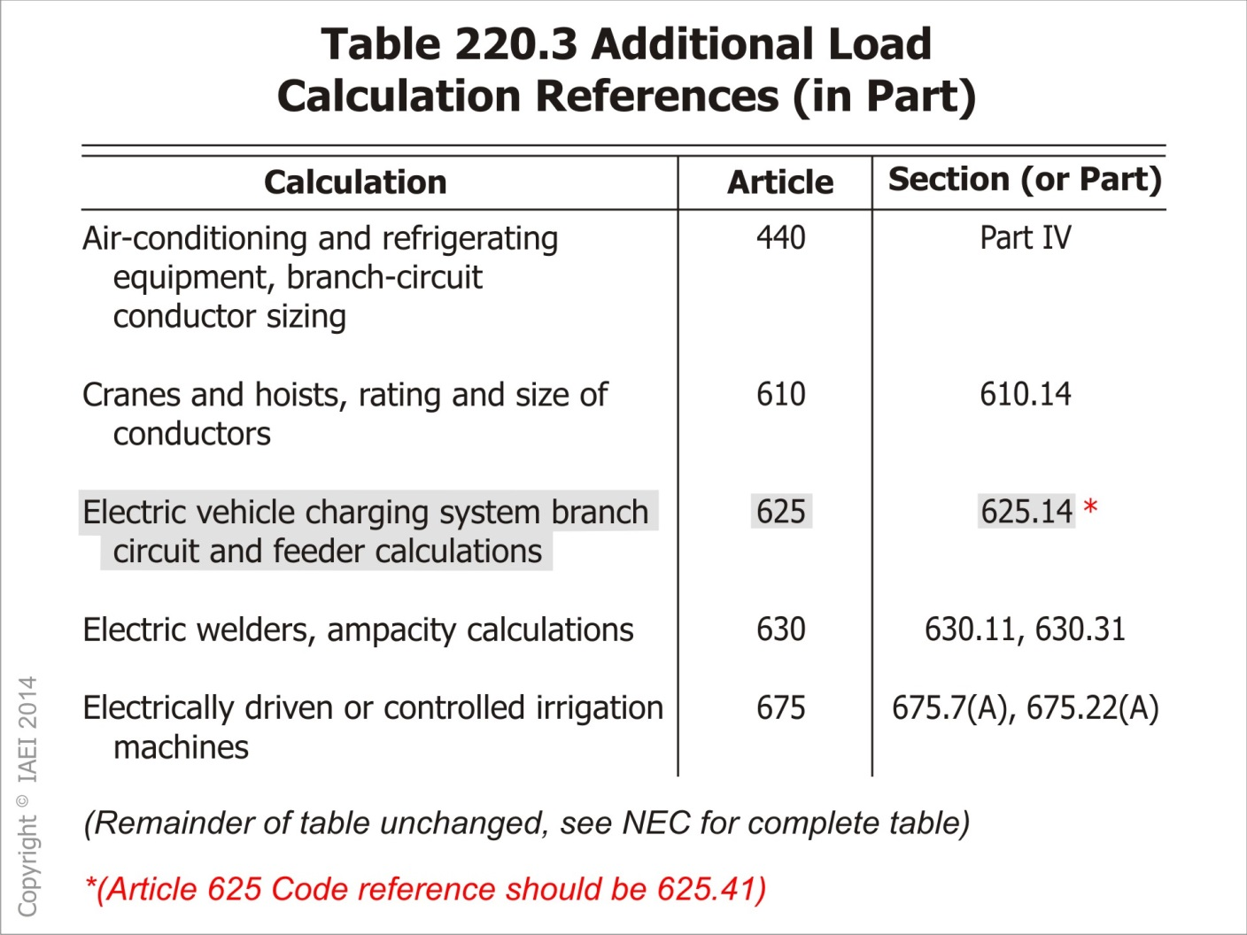

Slide 53
Table 220.3 Electrical Vehicle Charging Equipment
Adds Electrical Vehicle Charging Equipment and a reference to table.
Clarifies branch circuit calculation requirements for circuits supplying EV charging equipment.
Notes:
Adds Electrical Vehicle Charging Equipment and a reference to Section 625.14 to this table.
Clarifies branch circuit calculation requirements for circuits supplying EV charging equipment.

Slide 54
220.12(Exception) Lighting Load for Specified Occupancies
New exception
The general lighting load
Notes:
New exception to permit calculation of the general lighting load to be performed per locally adopted energy codes provided the feeder demand factors permitted by the Code are not applied to the general lighting load.
The general lighting load is required to be continually monitored by equipment with an alerting feature that activates when the load determined through energy code calculation is exceeded.

Slide 55
225.17(B)& 230.28(B)
Feeder service drop or overhead service
A Solid length of conduit is required above last point of securing conduit to building or structure.
Notes:
When a Feeder service drop or overhead service conductors is attached to a mast, there shall not be a coupling above the last securing point.
A Solid length of conduit is required above last point of securing conduit to building or structure.

Slide 57
240.21(B)(1)(1) New Exception
Tap Conductor
Exception
Notes:
The ampacity of a Tap Conductor for a feeder less than 3m (10 ft) long shall be greater than the rating of the equipment containing the overcurrent device.
Exception: Where equipment such as surge suppressors are provided with instructions regarding conductor sizing, the ampacity of the conductors may be based on the manufacturer’s instructions.

Slide 58
240.87 Arc Energy Reduction
Application of this requirement is now based on whether the highest continuous current setting of the trip unit installed in a breaker is or can be set to 1200 amperes or higher.
Notes:
Application of this requirement is now based on whether the highest continuous current setting of the trip unit installed in a breaker is or can be set to 1200 amperes or higher.
Was titled “Noninstaneous Trip”

Slide 60
250.66 Size of ac Grounding Electrode Conductor
Clarification of the term “sole connection” makes it clear that this “sole connection” is related to the grounding electrode conductor and not the number of specified electrode(s) involved.
Example: Grounding electrode conductor is installed to multiple concrete-encased electrodes connected together with a bonding jumper(s).
The maximum size grounding electrode conductor to the first concrete encased electrode or any bonding jumper(s) between the multiple concrete-encased electrode is not required to be larger than a 4 AWG copper conductor.

Slide 61
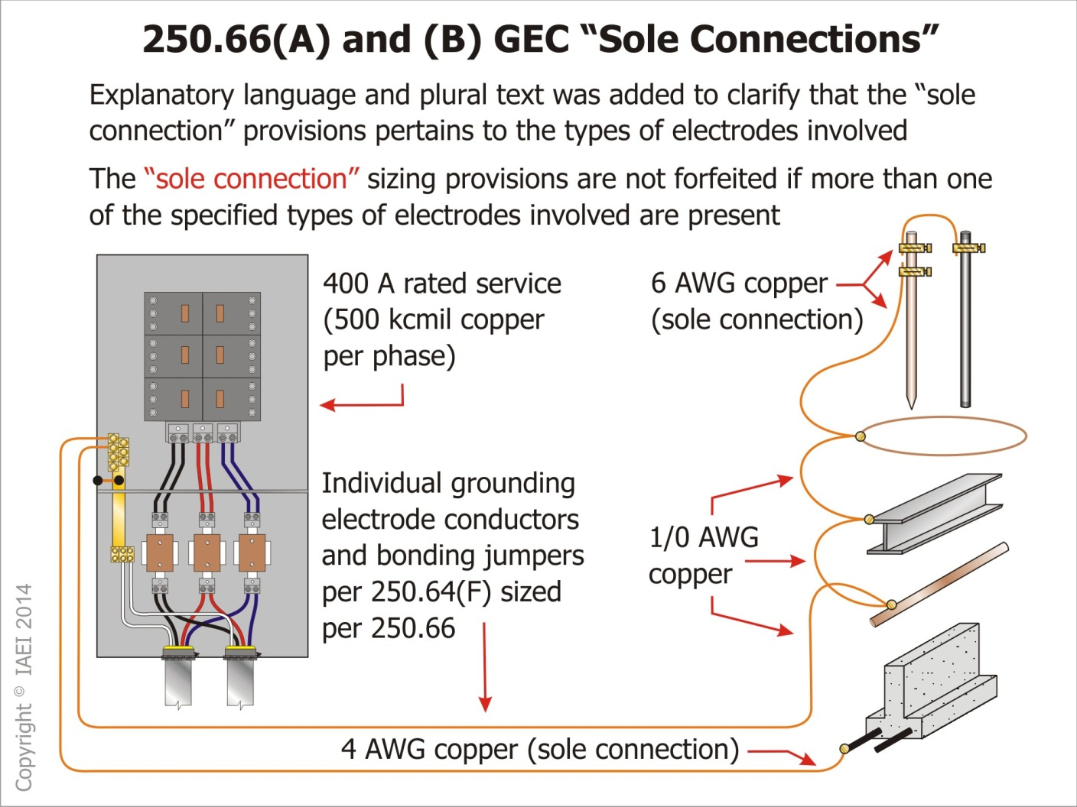

Slide 63
Bonding Jumper(s) for Grounding Electrode System
Grounding electrodes
Notes:
Grounding electrodes connected together with bonding jumpers that are installed in accordance with 250.64(A), (B), and (E)

Slide 64
Individual Grounding Electrode
Individual Grounding electrode conductor
Notes:
Individual Grounding electrode conductor(s) are permitted to be run to any convenient grounding electrode in the grounding electrode system

Slide 65
250.68(C) Grounding Electrode Connections
Extension from a concrete-encased electrode.
Notes:
Language was added to recognize an extension from a concrete-encased electrode as being suitable for the connection of grounding electrode conductor(s) to grounding electrodes such as a concrete-encased electrode.

Slide 66
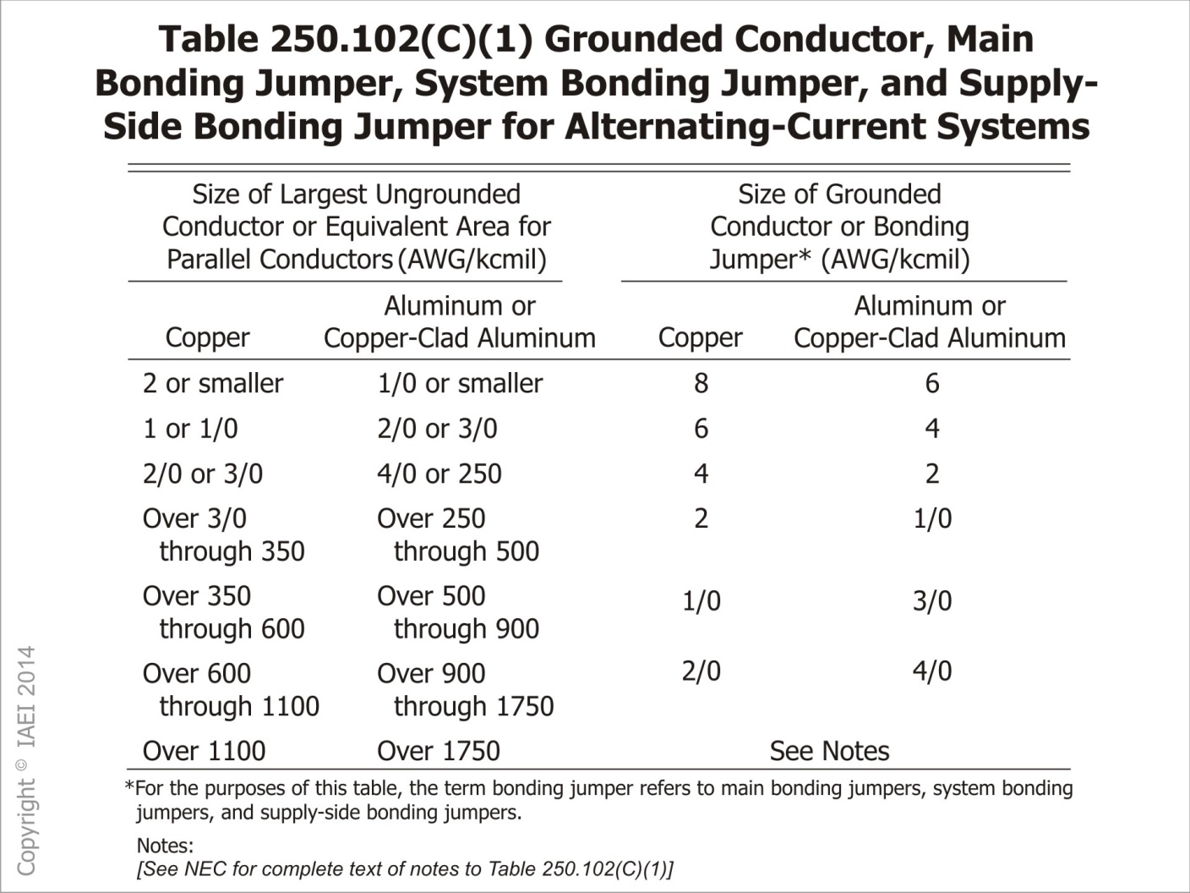
Notes:
Table 250.102(C)Grounding Conductor, Main Bonding Jumper, System Bonding Jumper and Supply Side Bonding Jumper for Alternating - Current Systems

Slide 67
250.121 New Exception
Wire-type equipment grounding conductor (EGC)
Notes:
Wire-type equipment grounding conductor (EGC) also permitted as a grounded electrode conductor.

Slide 68
250.166 Size of dc EGC
Maximum size GEC of dc systems
Notes:
Revised to clarify maximum size required for GEC of dc systems
Revision clarifies maximum size required for GECs installed for dc systems to comply with 250.166 and not required to exceed the value in Table 250.66
(Use NEC Table 250.66 for maximum size)

Slide 69
250.192 Grounding and Bonding of Fence and Other Metal Structures
New rules for bonding and grounding fences and other metal structures around substations.
250.194 Grounding and Bonding of Fences and Other Metal Structures.
Notes:
New section added to Article 250, Part X
New rules for bonding and grounding fences and other metal structures around substations.
250.194 Grounding and Bonding of Fences and Other Metal Structures. Metallic fences, enclosures and other metal structures in or surrounding a substation with exposed electrical conductors and equipment shall be grounded and bonded to limit step, touch, and transfer voltages

Slide 70
300.22(C)(1) Wiring Methods
Nonmetallic cable ties
Notes:
Nonmetallic cable ties used in “Other Spaces for Environmental Air” shall be listed as having adequate fire resistant and low smoke-producing characteristics

Slide 71
300.38 Raceways in Wet Locations Above Grade (New)
Raceways installed in wet locations above grade
Notes:
Applies to raceways installed in wet locations above grade
Interior of such raceways considered to be a wet location.
Insulated conductors and cables installed in raceways in wet locations above grade shall comply with 310.10(C).
Insulated conductors and cables used in wet locations shall follow one of the following:
1. Be moisture-impervious metal-sheathed
2. be type MTW, RHW, RHW-2, TW, THW, THW-2, THHW, THWN, THWN-2, XHHW, XHHW-2, ZW
3. Be of a type listed for use in wet locations

Slide 72
300.45
Relocated from Former 225.70(A)(1)(b)
Notes:
Relocated from Former 225.70(A)(1)(b)
Warning Signs. Warning signs shall be conspicuously posted at points of access to conductors in all conduit systems and cable systems. The warning sign(s) shall be legible and permanent and shall carry the wording:
“Danger-High Voltage-Keep Out”

Slide 73
300.50(A)(2) Underground Installations
Industrial Establishments
Notes:
Industrial Establishments – recognizes the use of, non shielded single-conductor cable with insulations up to 2000 volts that are listed for direct burial. The installation shall be performed by qualified persons.
Common practice in large scale utility solar installations to directly bury 2000 v rated conductors to carry power from combiner boxes to the inverter for PV installations. Such cable is currently marked and listed for this application.

Slide 74
310.15(B)(3)(c) Exception
Adjustments are needed for raceways and cables exposed to sunlight on rooftops.
New exception
Notes:
Adjustments are needed for raceways and cables exposed to sunlight on rooftops. Refer to table 310.15(B)(2)(a).
New exception: Type XHHW-2 insulated conductors shall not be subject to this ampacity.

Slide 75
Table 310.15(B)(7)
Table with conductor size corresponding to service or feeder rating replaced with provision permitting a 83% factor to be applied to the service or feeder rating for the purpose of determining service and feeder conductor ampacity
Notes:
Table with conductor size corresponding to service or feeder rating replaced with provision permitting a 83% factor to be applied to the service or feeder rating for the purpose of determining service and feeder conductor ampacity
Limited to 120/240 volt, single phase three-wire service and feeders rated 100 through 400 amperes.
Feeder conductors supplying an individual dwelling unit are not required to be larger than the “upstream” service or feeder conductors.
New Informational Note points out the ampacity adjustment and/or correction factors may have to be applied to these conductors
New example D.7 added for guidance on using the revised requirement

Slide 77
314.15 Damp or Wet Locations
New provision added to permit field-installed drainage openings in boxes or conduit bodies in accordance with the manufacturers instructions
Notes:
New provision added to permit field-installed drainage openings in boxes or conduit bodies in accordance with the manufacturers instructions
Approved drainage openings “weep holes” not larger than 6mm (1/4 in)
Permitted to be field installed in boxes or conduit bodies listed for use in damp or wet locations
For installation of listed drain fittings, larger openings are permitted to be field installed in accordance with manufacturers instructions

Slide 78
314.25 Covers and Canopies
Drywall screws are not permitted to be used to attach box covers or other equipment fastened to a box. Cover and canopy screws need to be suitable for this purpose.
Notes:
Drywall screws are not permitted to be used to attach box covers or other equipment fastened to a box. Cover and canopy screws need to be suitable for this purpose
Screws used to fasten covers and equipment to boxes are required to be either machine screws corresponding to thread gage of box or screws identified by the manufacturer as suitable for this purpose
Similar revisions made in Article 404 and 406

Slide 79
314.27(1) Vertical Surface Outlets
Requirements of 314.27(A)(1) apply to outlet boxes used to support luminaires and lamp holders mounted on vertical surfaces (not just walls)

Slide 80
314.27(A)(2) Ceiling Outlets
Revision requires boxes with capability to support luminaires weighing more than 50 lbs to be listed and marked on the interior of the box to indicate the maximum weight the box shall be permitted to support.

Slide 81
330.30(D) Unsupported Cable
Type MC cable
Notes:
Type MC cable now permitted to be installed unsupported in lengths not exceeding 900 mm (3 ft) where necessary for vibration reasons or flexibility
Permitted to dampen vibration or to provide flexibility at equipment connections.

Slide 82
348.30(A) Example No. 4
Revision clarifying flexible metal conduit fittings
Notes:
Revision clarifying flexible metal conduit fittings are permitted as the last point of securing the FMC for the purpose of installing 6 foot (or less) “whips” to supply luminaires or other equipment in the space above an accessible ceiling.

Slide 83
350.30(A) Example No. 4
Liquidtight flexible metal conduit fittings
Notes:
Revision clarifying liquidtight flexible metal conduit fittings are permitted as the last point of securing the LFMC for the purpose of installing 6 foot (or less) “whips” to supply luminaires or other equipment in the space above an accessible ceiling.

Slide 84
376.22(B) Adjustment Factors
Ampacity adjustment factors for more than three-current carrying conductors in a raceway
Notes:
Ampacity adjustment factors for more than three-current carrying conductors in a raceway shall only apply to metal wireways where the number of current-carrying conductors exceed 30 (use 40% correction factor) at any cross section of the wireway.

Slide 85
376.56(B)(1) and (B)(5)
Power distribution blocks
Notes:
Power distribution blocks installed in wireways ahead of the service main (line side) must be “listed for the purpose”
Also, conductors in wireways required to be arranged so that power distribution block terminals are unobstructed after their installation.

Slide 86
392.18(H) Marking for Cable Trays
New exception to requirement for marking cable trays containing conductors rated over 600 volts every 10 feet
Notes:
New exception to requirement for marking cable trays containing conductors rated over 600 volts every 10 feet
Labels not required:
To segments that are “not accessible” (as applied to equipment)
Installation to be serviced only by qualified persons
Markings to be applied where necessary to assure safe maintenance and operation.

Slide 87
404.2(C) Switch controlling Lighting Loads
Grounded conductors not required to be installed at switch locations under the following conditions
Notes:
Grounded conductors not required to be installed at switch locations under the following conditions
Where conductors enter the box through a raceway large enough for all contained conductors, including a grounded conductor
Where the box is accessible for the installation of an additional or replacement cable without removing finish materials
Snap switches with integral enclosures complying with 300.15(E)
Where a switch does not serve a habitable room or bathroom
Where multiple switch locations control the same lighting loads such the entire floor area of that room space is visible from the single or combined switch locations
Where lighting in the area is controlled by automatic means
Switch(es) controlling a receptacle load

Slide 88
404.10(B) (Switches) Box Mounted
Screws for attaching a snap switch to a box shall be:
Clarifies that drywall screws cannot be used to fasten switches to boxes.
Notes:
Screws used for the purpose of attaching a snap switch to a box shall be:
Of the type provided with a listed snap switch, or
Machine screws having 32 threads per inch or
Part of listed assemblies or systems, in accordance with the manufacturer’s instructions
Clarifies that drywall screws cannot be used to fasten switches to boxes.

Slide 89
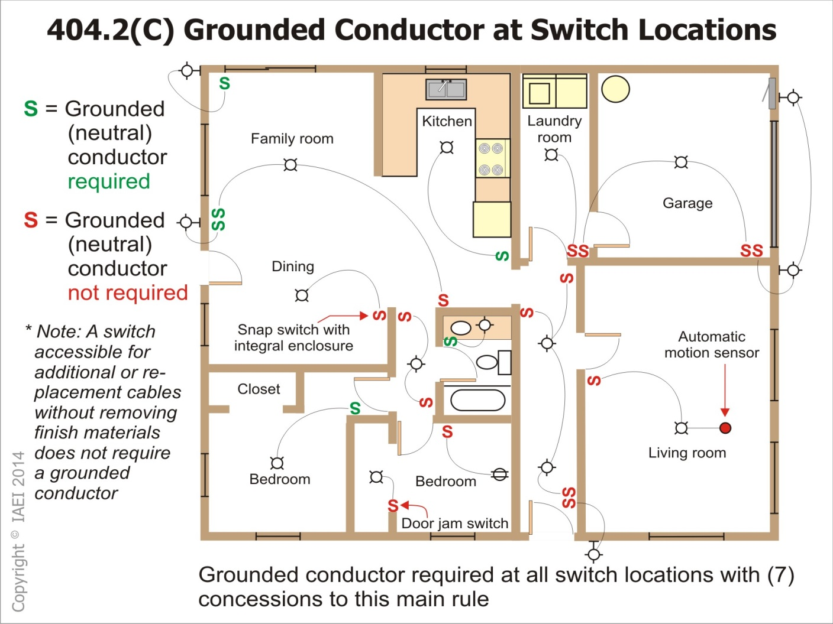

Slide 90
406.3(E) Controlled Receptacle Marking
New marking symbol for receptacle outlets controlled by an automatic control device or by an automatic energy management system
Notes:
New marking symbol for receptacle outlets controlled by an automatic control device or by an automatic energy management system
Controlled Receptacle Marking.
All nonlocking type, 125-volt, 15 and 20 ampere receptacles
Controlled by an automatic control device or incorporate control features that remove power from the outlet for the purpose of energy management or building automation
Shall be marked with the symbol shown in figure 406.3(E)
Located on the controlled receptacle outlet where visible after installation

Slide 91
406.4(D) Replacement
New marking symbol for receptacle outlets controlled by an automatic control device or by an automatic energy management system
Notes:
New marking symbol for receptacle outlets controlled by an automatic control device or by an automatic energy management system
Controlled Receptacle Marking.
All nonlocking type, 125-volt, 15 and 20 ampere receptacles
Controlled by an automatic control device or incorporate control features that remove power from the outlet for the purpose of energy management or building automation
Shall be marked with the symbol shown in figure 406.3(E)
Located on the controlled receptacle outlet where visible after installation

Slide 92
406.5 Receptacle Mounting (Revision)
Restriction to prohibit receptacles from being installed in the face-up position expanded to all occupancies, not just dwelling units
Notes:
Restriction to prohibit receptacles from being installed in the face-up position expanded to all occupancies, not just dwelling units
Listed receptacle assemblies for countertop applications have been recognized for this application as well
Clarifies that drywall screws cannot be used to fasten switched to boxes

Slide 93
406.5(E) Receptacles Installed in Countertops and Similar Work Surfaces
Revision expands requirement prohibiting the installation of Receptacles face-up in counter surfaces to all occupancies (not just dwelling units)

Slide 94
405.5(F) Receptacles in Seating Areas
New provision prohibits receptacles from being installed in a face-up position in seating areas
Notes:
New provision added which prohibits receptacles from being installed in a face-up position in seating areas or similar surfaces unless they are part of an assembly listed for the application
In recent times, benches and seating areas in public locations such as airports are being installed with receptacles installed in and on the seating areas

Slide 95
406.9(B) Receptacles in Wet Locations
“Extra duty” covers
Notes:
“Extra duty” covers now required for all 15 and 20 ampere, 125 and 250 volt receptacles installed in a wet location (not just those supported from grade)
This requirement now also includes dwelling unit wet location receptacles as well

Slide 96
406.12 Tamper-Resistant Receptacles
Requirement for tamper-resistant receptacles at dwelling units has been expanded
Notes:
Requirement for tamper-resistant receptacles at dwelling units has been expanded to guest rooms and guest suites of hotels and motels and child care facilities
406.12 Tamper- Resistant Receptacles
(A)Dwelling Units
(B) Guest Rooms and Guest Suites of Hotels and Motels
(C) Child Care Facilities

Slide 97
406.12 Tamper-Resistant Receptacles
Tamper-resistant receptacles not required for the following:
Notes:
Tamper-resistant receptacles not required for receptacles:
Located more than 1.7 m (5.5 ft) above the floor
That are part of a luminaire or appliance
Located within dedicated space for an appliance
Replacement non grounding type
In all areas specified in 210.52 all nonlocking type 125-volt, 15 and 20 ampere receptacles required to be listed tamper- resistant receptacles

Slide 98
406.15 Receptacles on Dimmer Control
Dimmer-controlled receptacles
Notes:
Dimmer-controlled receptacles now permitted for a plug/receptacle combination in listed nonstandard configuration type
Dimmer Controlled Receptacles. A receptacle supplying lighting loads shall:
Not be connected to a dimmer unless
The plug/receptacle combination is a nonstandard configuration type and
Is specifically listed and identified for each such unique combination

Slide 99
408.55(C) Wire-Bending Space Within an Enclosure Containing a Panelboard (New)
Back Wire Bending Space.
Notes:
(C) Back Wire Bending Space. Where a raceway or cable entry is in the wall of the enclosure opposite a removable cover:
The distance from that wall to the cover shall be permitted to comply with the distance required for one wire per terminal in Table 312.6(A)
The distance between the center of the rear entry and the nearest termination for the entering conductors shall not be less than the distance given in Table 312.6(B)

Slide 101
410.6 Listing Required (Luminaires)
Listing requirements for luminaires and lampholders expanded
Notes:
Listing requirements for luminaires and lampholders expanded to “Retrofit Kits”
A new definition of “Retrofit Kits” has been added to Article100

Slide 102
410.10(F) Luminaires Installed in or Under Roof Decking (New)
Luminaires no longer permitted to be installed within 38 mm (1.5 in) of the lowest metal deck surface
Similar to the rule in 300.4(E)
Cable and raceways (2008 NEC)
Boxes (2011 NEC)
Notes:
Luminaires no longer permitted to be installed within 38 mm (1.5 in) of the lowest metal deck surface
Similar to the rule in 300.4(E)
Cable and raceways (2008 NEC)
Boxes (2011 NEC)

Slide 103
410.23 Covering of Combustible Material at Outlet Boxes
Any combustible wall of ceiling finish exposed between the edge of a luminaire canopy or pan and an outlet box, having a surface of 180 in² or more shall be covered with noncombustible material
Notes:
Any combustible wall of ceiling finish exposed between the edge of a luminaire canopy or pan and an outlet box, having a surface of 180 in² or more shall be covered with noncombustible material
Based on ANSI/UL1598 Standard for Luminaires, a listed canopy style surface or ceiling mounted luminaire does not require a back-plate or back-cover provided the total area for the surface being covered by the canopy is less than 18 in².

Slide 105
422.5 GFCI Protection (New)
GFCI devices providing protection to appliances in Article 422 required to be installed in a readily accessible locations

Slide 106
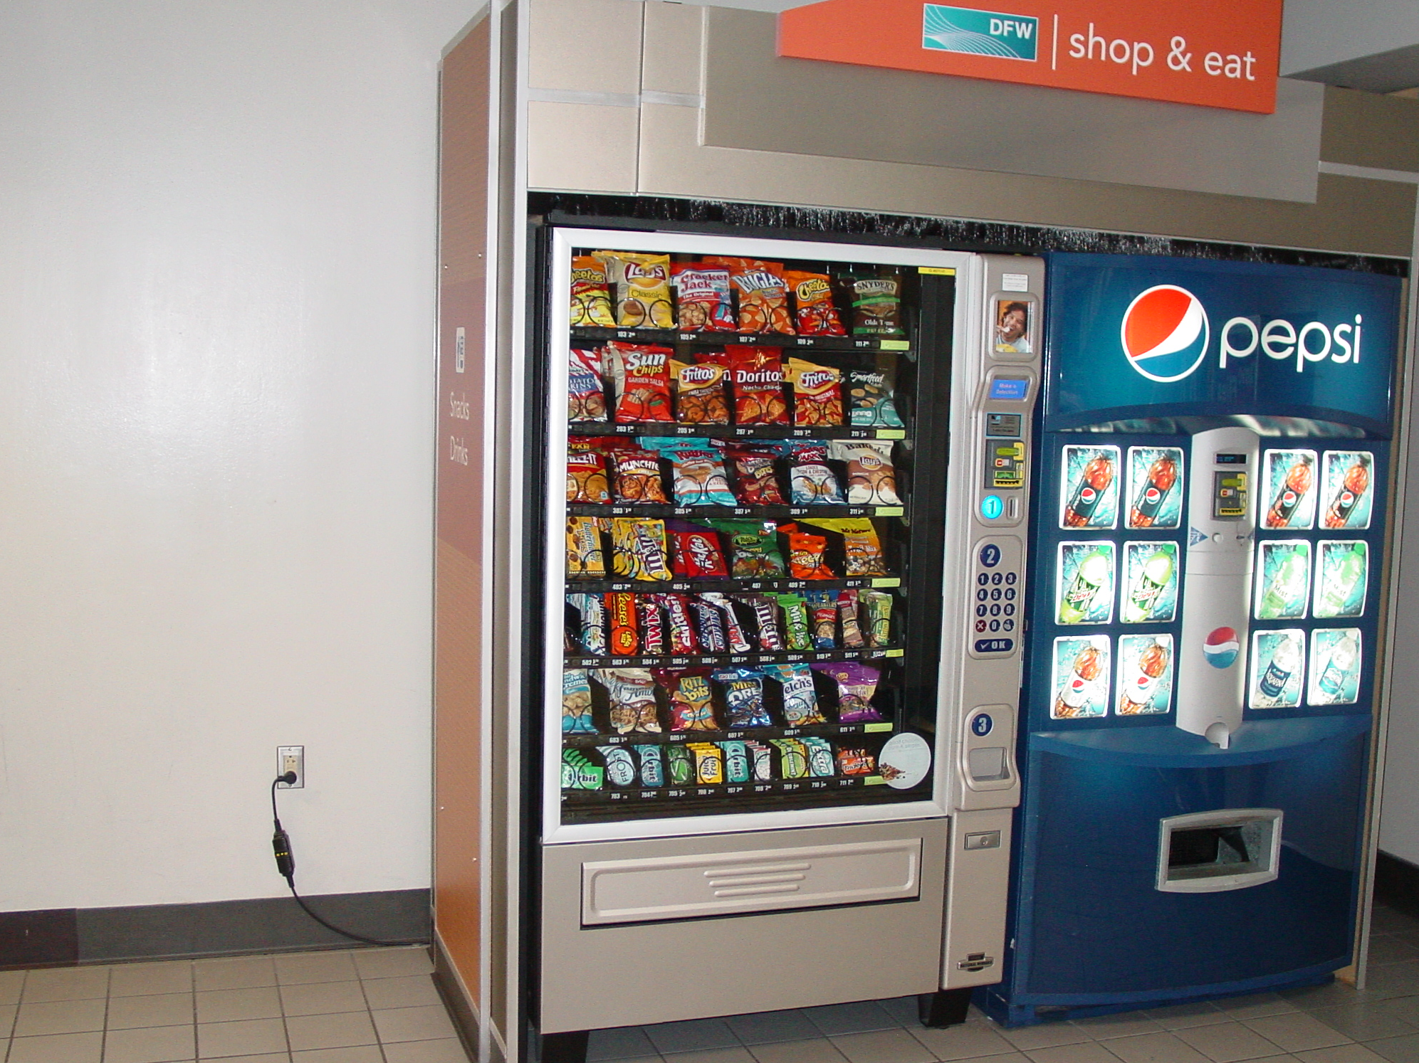

Slide 107
422.23 Tire Inflation and Automotive Vacuum Machines (New)
GFCI protection now required for all tire inflation and automotive vacuum machines provided for public

Slide 108
422.51 Vending Machines
GFCI protection has been expanded to hard-wired vending machines as well as cord and plug-connected vending machines.

Slide 109
424.66(A) Duct Heaters (Revised)
New provisions were put in place to require limited forms of working space about duct heaters for fixed electric space-heating equipment
Notes:
New provisions were put in place to require limited forms of working space about duct heaters for fixed electric space-heating equipment
(A)… Working space around electric enclosures for resistance heating element type duct heaters which are mounted on duct systems and contain equipment that requires examination, adjustment, servicing or maintenance while energized shall comply with Section 424.66(B)

Slide 110
424.66(B) Duct Heaters (New)
Where the enclosure is located in a space above a ceiling
Notes:
(B) Limited Access. Where the enclosure is located in a space above a ceiling, all of the following shall apply:
(1) The enclosure shall be accessible through a lay-in type ceiling or access panel(s)
(2) The width of the working space shall be the width of the enclosure or a minimum of 762 mm (30 in.), whichever is greater
(3). All doors or hinged panels shall open to at least 90 degrees
(4). The space in front of the enclosure shall comply with Table 110.26(A)(1) depth requirements. Horizontal ceiling T-bar is permitted in this space

Slide 111
430.52(C)(5) Power Electronic Devices
“Semiconductor fuses” intended to protect bypass contactors, isolation contactors, and conductors in a solid-state motor control system
Notes:
“Semiconductor fuses” intended to protect bypass contactors, isolation contactors, and conductors in a solid-state motor control system permitted in lieu of devices listed in Table 430.52
“Semiconductor” fuse replaces “suitable” fuses as the term “suitable” is vague and unenforceable

Slide 112
445.11 Marking (Generators)
Marking required for generators to indicate when the neutral of the generator is bonded to the generator frame
Notes:
Marking required for generators to indicate when the neutral of the generator is bonded to the generator frame
Marking on generators rated more than 15 KW to include power factor, impedances, insulation system class, and time rating
Marking if generator is field modified by bonding the neutral to the frame
In order to determine if a generator is a separately derived system or not, installers, enforcers and users of the Code must be able to determine if the neutral conductor of the generator is bonded to the generator frame

Slide 113
445.17 Generator Terminal Housings (New)
New requirement for terminal housings of generators rated 600 volts and less to comply with 430.12

Slide 114
445.18
Requires generators to be provided with a disconnect(s) that is lockable in the open position
Notes:
Requires generators to be provided with a disconnect(s) that is lockable in the open position unless:
The generator is cord – and plug connected or,
The driving means for the generator can be readily shut down, is rendered incapable of restarting, and is lockable in the off position, and,
The generator is not arranged to operate in parallel with another generator or other source of voltage.

Slide 115
445.20 GFCI Protection for Receptacles on Portable Generators
New GFCI requirements for portable
Notes:
New GFCI requirements added for portable generators and associated 125 volt, single phase, 15 or 20 ampere receptacles
Portable generators rated 15 kw and less
GFCI protection for all 125 volt, 15 and 20 ampere receptacles unless:
The generator is equipped with a 125/250 volt locking receptacle(s) and
The 125 volt 15 and 20 ampere receptacles are disabled when 125/250 volt receptacle is in use

Slide 116
450.10 Grounding
(Dry-Type Transformer Enclosures)
Grounding and bonding terminal bar in transformer enclosures not permitted to be installed on or over the vent screen portion of the enclosure
Notes:
Grounding and bonding terminal bar in transformer enclosures not permitted to be installed on or over the vent screen portion of the enclosure
Revision covers equipment grounding and system bonding connections in transformer enclosures
Exception for transformers with pigtail leads used as the connection means

Slide 117
450.11(B) Transformers (New)
Transformers can be supplied at the secondary voltage (reversed wired) only in accordance with the manufacturer’s instructions
Notes:
Transformers can be supplied at the secondary voltage (reversed wired) only in accordance with the manufacturer’s instructions
Manufacture of these “Bi- Directional” transformers will provide installation instructions detailing specific information as how the transformer should be connected when the primary and secondary are reversed
450.11(B) Source Marking. A transformer shall be permitted to be supplied at the marked secondary voltage provided the installation is in accordance with manufacturer’s instructions

Slide 118
500.2 Definitions for Hazardous Locations
Combustible Dust
Notes:
Combustible Dust. Dust particles that are 500 micron or smaller (material passing a US No 35 Standard Sieve as defined in ASTM E 11, Standard Specification for Wire Cloth and Sieve for Testing Purposes) and present a fire or explosion hazard when dispersed and ignited in air.
Revised definition uses a particle size that is used in national and international area classification standards
Definition in 2013 edition on NFPA 499 does not provide an objective particle size benchmark

Slide 119
500.8(C)(4) Equipment Temperature
Revised to specify that the temperature marking on equipment for Class II, Division 1 locations is based on the thermal effect of the equipment being blanketed in dust.
Notes:
Revised to specify that the temperature marking on equipment for Class II, Division 1 locations is based on the thermal effect of the equipment being blanketed in dust.
For equipment installed in a Class II, Division 1 location , the temperature class or operating temperature shall be based on the operation of the equipment when blanketed with the maximum amount of dust that can accumulate on the equipment.
Clarifies that this marking is not based on the equipment being operated in “free air” which could result in potentially dangerous operating temperatures.

Slide 120
501.10(A)(1)(e) Optical Fiber Cable
New provision permitting optical fiber optic cable Type OFNP, OFCP, OFNR, OFCR, OFNG, OFCG, OFN, and OFC in Class I, Division 1 locations.
Notes:
New provision permitting optical fiber optic cable Type OFNP, OFCP, OFNR, OFCR, OFNG, OFCG, OFN, and OFC in Class I, Division 1 locations.
Cables must be installed in raceways per 501.10(A)
These optical fiber cables shall be sealed in accordance with 501.15
Similar provisions added in Articles, 502, 505 and 506.

Slide 121
501.10(B)(2)(3) Flexible Connections
Revised to permit interlocked armor Type MC cable with listed fittings as a method of making a flexible connection in a Class I, Division 2 location.

Slide 122
514.3(C) Motor Fuel Dispensing Stations in Boatyards and Marinas
Requirements for the installation of motor fuel dispensing equipment and associated piping at boatyards and marinas relocated from 555.21

Slide 123
516 Spray Application, Dipping, Coating, and Printing Process
Article 516 was revised and reorganized
The revised correlates with NFPA 33 - 2011

Slide 124
517 Health Care Facilities
517 was revised to be more consistent with NFPA 99 Health Care Facilities Code and NFPA 101 Life Safety Code

Slide 125
517 Use of Isolated Ground Receptacles
Isolated Ground Receptacles are not allowed in a patient care vicinity.

Slide 126
517.18(B) Patient Bed Location Receptacles
Increases the minimum number of receptacles at general care patient bed locations from four to eight.
Notes:
Increases the minimum number of receptacles at general care patient bed locations from four to eight.
Minimum number of branch circuits supplying the bed location remains the same
Correlates with NFPA 99

Slide 127
517.19(B) Patient Bed Location Receptacles
Increases the minimum number of receptacles at critical care patient bed locations from six to 14
Notes:
Increases the minimum number of receptacles at critical care patient bed locations from six to 14
Minimum number of branch circuits supplying the bed location remains the same.
Correlates with NFPA 99.

Slide 128
517.19(C)Operating Room Receptacles (New)
Minimum number of receptacles required in an operating room is 36.
Notes:
Minimum number of receptacles required in an operating room is 36.
At least 12 receptacles must be connected to either the normal system or a critical system branch circuit supplied by a different transfer switch than the one supplying other receptacles at this location.

Slide 129
517.26 Application of Other Articles
The Life Safety Branch of the essential electrical system
Notes:
The Life Safety Branch of the essential electrical system shall meet the requirements of Article 700, except as amended by Article 517

Slide 130
517.30(E) Receptacle Identification
Applies to receptacles supplied from the essential electrical system.
Notes:
Applies to receptacles supplied from the essential electrical system.
Currently requires cover plate or receptacle to be distinctively colored or marked.
New requirement for nonlocking-type 125, 15 and 20 ampere receptacles to have illuminated face or indicator light to indicate there is power to the receptacle.

Slide 131
517.30(F) Coordination
Overcurrent devices for the essential electrical system required to be coordinated
Notes:
Overcurrent devices for the essential electrical system required to be coordinated for fault events that exceed 0.1 seconds.
Correlates with NFPA 99 requirements covering coordination of overcurrent protective devices.
Informational Note added to explain that coordination as used in this section does not cover the full range of overcurrent conditions.

Slide 132
547.5(F) Separate Equipment Grounding Conductor (Agricultural Buildings)
An insulated or covered aluminum or copper equipment grounding conductor (EGC) is now permitted for underground agricultural building installations.
Notes:
An insulated or covered aluminum or copper equipment grounding conductor (EGC) is now permitted for underground agricultural building installations.
Previously language only permitted a copper EGC due to corrosion and oxidation, and exposure to the many contaminates present in and around livestock facilities.
This EGC for underground use must be insulated or covered; therefore, the metal used inside the insulated material is irrelevant since the conductor is protected by this insulation.
It should be noted that 250.120(B) requires aluminum conductors to not be terminated within 450 mm (18 in.) of the earth.

Slide 133
555.15(B) and (C) Type and Sizes of EGCs (Marinas and Boatyards)
An insulated aluminum or copper equipment grounding conductor (EGC) is now permitted at marinas and boatyards.
Notes:
An insulated aluminum or copper equipment grounding conductor (EGC) is now permitted at marinas and boatyards.
Previous language only permitted copper EGCs in this application.
Limiting EGCs used in marina and boatyard wiring systems to copper only is not justifiable.
Aluminum conductors are well-suited for the application and commonly available.
Aluminum ungrounded and grounded neutral conductors have operated satisfactorily for decades in marina and boatyard installations.

Slide 134
590.4(D)(2) Temporary Installations
(D)(2) Receptacles in Wet Locations. “Extra-duty” receptacle covers required for temporary installations at one- and two-family dwellings
Notes:
(D)(2) Receptacles in Wet Locations. “Extra-duty” receptacle covers required for temporary installations at one- and two-family dwellings
Revised to correlate with the deletion of the exception to the “extra-duty” cover requirement for one- and two-family dwellings in 406.9(B)(1)

Slide 135
590.4(J) Temporary Installations - Support
Branch circuits are not to be installed on the floor or the ground.

Slide 136
600.6(A)(1) Disconnects.
At Point of Entry to a Sign Enclosure.
Disconnecting means
Notes:
At Point of Entry to a Sign Enclosure.
Disconnecting means shall be located at the point where sign supply conductor enter the sign enclosure or pole supporting the sign.
Shall disconnect all supply conductors at the point they enter the enclosure of the sign or pole.
Disconnecting means not required for branch circuit or feeder conductor passing through the sign if the conductors are enclosed in a listed Chapter 3 raceway.
Substantiation (in part) As recently as 12 October 2011, a master electrician was electrocuted while performing maintenance on a sign in Centerville, MN.

Slide 137
Article 600.32(A)(1) Installation
Revised by deleting PVC and RTRC
Notes:
Revised by deleting PVC and RTRC from permitted wiring methods for the installation of neon secondary conductors operating at over 1000 v.
Operating temperature of GTO cable 105⁰ C or 120⁰ C exceeds the 90⁰ C operating temperature of these two nonmetallic raceways.

Slide 138
Article 605.2 Office Furnishings
Cubicle panels, partitions, study carrels, work stations, desks, shelving systems, and storage units that may be mechanically and electrically interconnected to form an office furnishing system.
Notes:
605.2 Office Furnishings. Cubicle panels, partitions, study carrels, work stations, desks, shelving systems, and storage units that may be mechanically and electrically interconnected to form an office furnishing system.
Revised to expand scope of the office furnishings covered by the requirements of Article 605 to more than just lighting accessories and wired partition.

Slide 139
610.31 Runway Conductors & 610.32 Disconnecting Means
Runway conductor, crane, and monorail hoist disconnecting means
Notes:
Revised to require runway conductor, crane, and monorail hoist disconnecting means to be one of the types specified in 430.109
Revised to require disconnecting means to be able to be locked in the open position in accordance with 110.25.

Slide 140
620.22(B)
(B) Air-Conditioning and Heating Sources.
Notes:
(B) Air-Conditioning and Heating Sources. A separate branch circuit shall supply the air-conditioning and heating units on each elevator car. The overcurrent device protecting the branch circuit shall be located in the elevator machine room or control room/machinery space or control space.
Revise to correlate with similar Article 620 requirements in which the term “separate“ is used.

Slide 141
620.62
system of selective coordination be:
Notes:
Revised to require system of selective coordination be:
Selected by a licensed professional engineer or other qualified person engaged primarily in the design, installation, or maintenance of electrical systems.
Documented and made available to those authorized to design, install, inspect, maintain, and operate the system.

Slide 142
625.41 Rating (formerly 625.14)
Load management system
Notes:
Where an automatic load management system is used the maximum electric vehicle supply equipment load on a service feeder shall be the maximum load permitted by the automatic load management system.

Slide 143
625.44 EVSE Equipment Connections
Cord and Plug
(A) Nonlocking, 2-pole, 3-wire grounding-type receptacle outlets
(B) Nonlocking, 2 pole, 3 wire and 3 pole, 4 wire grounding type receptacle outlets
Other electric vehicle supply equipment
Notes:
Cord and Plug
(A) Nonlocking, 2-pole, 3-wire grounding-type receptacle outlets rated 125 V single phase 15 and 20 amperes or from a supply of less than 50 volts dc.
(B) Nonlocking, 2 pole, 3 wire and 3 pole, 4 wire grounding type receptacle outlets rated not more than 250 volts and 50 amperes.
EVSE is fastened in place to facilitate any of the following:
Ready removal for interchange
Facilitation of maintenance and repair
Reposition of portable, moveable or EVSE fastened in place
Power supply cord length limited to 1.8 m (6 ft)
Receptacles located to avoid physical damage to flexible cord.
All other electric vehicle supply equipment shall be permanently wired and fastened in place.

Slide 144
625.52(B)(4)
New provision covering EVSE supplied by dc circuits of less than 50 volts
Notes:
New provision covering EVSE supplied by dc circuits of less than 50 volts
Allow for charging systems associated with smaller EVs such as neighborhood vehicles
Equipment must be provided with ventilation marking per 625.17(C)
Ventilation rates for dc charging equipment including in Tables 625.52(B)(1) & (B)(2)

Slide 145
645.4 Information Technology Equipment
New exception permitting alternative to automatic shutdown of air circulations systems in room containing critical operations data systems.
Notes:
New exception permitting alternative to automatic shutdown of air circulations systems in room containing critical operations data systems.
Information Technology Equipment can incur significant damage within minutes of air circulation system shutdown
Critical operations date systems are required to be staffed 24/7 so there are personnel available to carry out a manual shutdown procedure
Procedure can allow for specific protocols based on the type and degree of the fire hazard

Slide 146
645.15 Grounding
New provision added covering the use of auxiliary grounding electrodes for ITE equipment
Notes:
New provision added covering the use of auxiliary grounding electrodes for ITE equipment
Installation must comply with 250.54

Slide 147
680.21(C) GFCI Protection
GFCI protection of single phase 120 through 240 volt
Notes:
Required for GFCI protection of single phase 120 through 240 volt circuits supplying pool pump motors have been expanded to cover all circuit ampere rating.

Slide 148
680.22 Lighting Receptacles and Equipment
Receptacles that provide power for water-pump motors or for other loads directly related to the circulation and sanitation system.
Notes:
Revision deletes “locking-type” requirement for receptacles that provide power for water-pump motors or for other loads directly related to the circulation and sanitation system.

Slide 149
680.22(A)(3) Other Receptacles Location
15 or 20 ampere, 125 volt, convenience receptacle outlet to be installed not less than 6 from all permanently installed swimming pools regardless of occupancy type.
Notes:
Revision requires a 15 or 20 ampere, 125 volt, convenience receptacle outlet to be installed not less than 6 from all permanently installed swimming pools regardless of occupancy type.

Slide 150
680.25(A)(1) Exception
Exception: A feeder within a one-family dwelling unit or two-family dwelling unit between a remote panelboard and service
Notes:
Exception: A feeder within a one-family dwelling unit or two-family dwelling unit between a remote panelboard and service equipment shall be permitted to run in flexible metal conduit or an approved cable assembly that includes an insulated equipment grounding conductor within its outer sheath. The equipment grounding conductor shall comply with 250.24(A)(5)

Slide 151
680.42(A)(1)Exception
Removes the 6 ft length restriction for liquidtight flexible metal or liquidtight flexible nonmetallic conduit or external to the hot tub enclosure.

Slide 152
680.42(B) Bonding
Equipotential bonding of perimeter surfaces in accordance with 680.26(B)(2) is no longer required for spas and hot tubs installed outdoors
Notes:
Equipotential bonding of perimeter surfaces in accordance with 680.26(B)(2) is no longer required for spas and hot tubs installed outdoors where:
The spa or hot tub shall be listed as a self-contained spa for aboveground use.
The spa or hot tub shall not be identified as suitable only for indoor use.
The installation shall be in accordance with the manufacturer’s instructions and shall be located on the above grade.
The top rim of the spa or hot tub shall be at least 71 cm (28 in) above all perimeter surfaces that are within 76 cm (30 in) measured horizontally from the spa or hot tub. The height of nonconductive external steps for entry to or exit from the self-contained spa shall not be used to reduce or increase this rim.

Slide 153
690.12 Rapid Shutdown of PV Systems on Buildings
PV system circuit installed on or in buildings shall include a rapid shutdown function that controls specific conductors
Notes:
PV system circuit installed on or in buildings shall include a rapid shutdown function that controls specific conductors
Applies only to PV system conductors of more than 1.5 m (5 ft) in length inside a building, or more than 3 m (10 ft) from a PV array.
Controlled conductors limited to not more than 30 volts and 240 volt amperes within 10 seconds of rapid shutdown initiation
Voltage and power measured between any two conductors and between any conductor and ground
Rapid shutdown initiation methods must be labeled in accordance with 690.56(C)
Rapid shutdown equipment must be listed and identified.

Slide 154
690.47(D) Additional Auxiliary Electrodes
Restores requirement in 690.47(D) of 2008 NEC
Notes:
Additional grounding electrode installed per 250.52 and 250.54
Located at ground-and pole mounted PV arrays and as close as practicable to roof-mounted PV array.
Electrode to be connected directly to the array frame(s) or structure.
Grounding electrode conductor sized per 250.166
Not permitted as substitute for required equipment bonding or equipment grounding conductor.
The structure of a ground-or pole mounted PV array permitted as grounding electrode if it meets 250.52
Roof-mounted PV arrays permitted to use metal frame of a building or structure if frame meets 250.52(A)(2)
Not required where load served by the array is integral with the array.
Not required if located within 1.8 m (6 ft) of premises-wiring electrode
Main function – lightning protection
Restores requirement in 690.47(D) of 2008 NEC

Slide 155
690.56(C)Facilities With Rapid Shutdown
Apply to a building or structure with a utility service and a PV system
PHOTOVOLTAIC SYSTEM EQUIPPED WITH RAPID SHUTDOWN
Notes:
Where conditions specified in 690.12 apply to a building or structure with a utility service and a PV system, a permanent plaque or directory must be installed and read
-PHOTOVOLTAIC SYSTEM EQUIPPED WITH RAPID SHUTDOWN
Plaque or directory to be reflective,
All letters capitalized
Minimum height of 3/8 in.
While letters on red background
Location of plaque not specified – must be acceptable to AHJ

Slide 156
694 – Wind Electric Systems
694.1 Scope.
Notes:
694.1 Scope. The provisions of this article apply to the wind (turbine) electric systems that consist of one or more wind electric generators. These systems can include generators, alternators, inverters and controllers.
No Longer limits individual turbines to 100 KW or less (small wind electric system)

Slide 157
695.3(F)(2) Overcurrent Device Selection
Permits use of instantaneous trip circuit breaker (magnetic only)
Notes:
Permits use of instantaneous trip circuit breaker (magnetic only) in lieu of overcurrent devices rated to carry the locked rotor current of fire pump indefinitely (695.4(B)(2)(a)(2).
Must be part of a transfer switch assembly listed for fire pump service that complies with 695.4(B)(2)(a)(2)
Instantaneous trip circuit breaker use is controlled by 430.52(C)(3),

Slide 158
695.6(D) Pump Wiring
Electrical connections at motor terminal boxes must be made with listed means of connection.
Notes:
Electrical connections at motor terminal boxes must be made with listed means of connection.
Twist-on, insulation-piercing-type, and soldered wire connectors not permitted.
Vibration of motor could compromise these types of connections.
Consistent with requirements for motor connections in NFPA 79.

Slide 159
700.8 Surge Protection
Surge protection required to be installed in or on all emergency switchboards and panelboards

Slide 160
700.12(B)(6), 701.12(B)(5) & 702.12 Outdoor Generator Sets
Disconnecting means that meet 445.18
Notes:
Revised to recognize a disconnecting means that meet 445.18
Section 225.36 only applies when the conductors terminate in a disconnecting means at the building or structure

Slide 161
700.16 Emergency Illumination
Emergency illumination, indoor at disconnects
Notes:
Revised to require emergency illumination at indoor areas where disconnects required by 225.31 & 230.70 when the building or structure is provided with and emergency system

Slide 162
700.27 & 701.27 Selective Coordination
Ground Fault Protection
Must be selected by a licensed professional engineer or other qualified persons
Notes:
Must be selected by a licensed professional engineer or other qualified persons
Engaged primarily in the design, installation, or maintenance of electrical systems
The selection is documented and made available to those authorized to design, install, inspect, maintain, and operate the system.

Slide 163
700.19 Multiwire Branch Circuits (New)
Multiwire branch circuits
Notes:
Prohibits multiwire branch circuits from supplying emergency lighting and power loads
To reduce the possibility of complete loss of emergency lighting or power in an area if the circuit disconnecting means is opened

Slide 164
700.24 Directly Controlled Luminaires
The directly controlled luminaire (typically dimmable LED)
Notes:
Where the luminaire responds to an external control (typically dimmable LED)
The directly controlled luminaire and external bypass controls must be individually listed for use on emergency systems.

Slide 165
700.7(B), 701.7(B) & 702.7(B) Marking Requirements
Labels must comply with 110.21(B)

Slide 166
702.7(C) Power Inlet
Required Warning
WARNING
FOR CONNECTION OF A SEPERATELY DERIVED (BONDED NEUTRAL) SYSTEM ONLY OR
FOR CONNECTION OF A NONSEPARATELY DERIVED (FLOATING NEUTRAL) SYSTEM ONLY
Notes:
Requires a marking of the system type at a flanged inlet
WARNING
FOR CONNECTION OF A SEPERATELY DERIVED (BONDED NEUTRAL) SYSTEM ONLY OR
FOR CONNECTION OF A NONSEPARATELY DERIVED (FLOATING NEUTRAL) SYSTEM ONLY

Slide 167
702.12 Disconnecting Means
Disconnecting Means not required at flanged inlets or other cord and plug connections for 15 kW or less portable generators

Slide 168
705.31 Location of Overcurrent Protective Device
Power production sources connected on the line side of service disconnecting means
Notes:
Applies to power production sources connected on the line side of service disconnecting means
Overcurrent protection must be not more than 10 ft. from interconnection location
Protects other power production source conductors from primary utility source fault current
Exception permits cable-limiters or current-limited circuit breakers where OCPD cannot be located within 10 ft.

Slide 169
725.3(K) and (L) Installation of Conductors / Corrosive, Damp or Wet Locations
(K) Cables installed in raceways or cable trays shall not be run with any pipe, tube, or equal for steam water, air, gas, drainage, or any service other than electrical
(L) Class 2 and Class 3 cables installed in corrosive, damp, and wet locations shall be suitable for use
Notes:
(K) Cables installed under Article 725 in raceways or cable trays shall not be run with any pipe, tube, or equal for steam water, air, gas, drainage, or any service other than electrical (See 300.8)
(L) Class 2 and Class 3 cables installed in corrosive, damp, and wet locations shall be suitable for use in these conditions and comply with 110.11, 300.5(B), 300.6, 300.9 and 310.10(G)

Slide 170
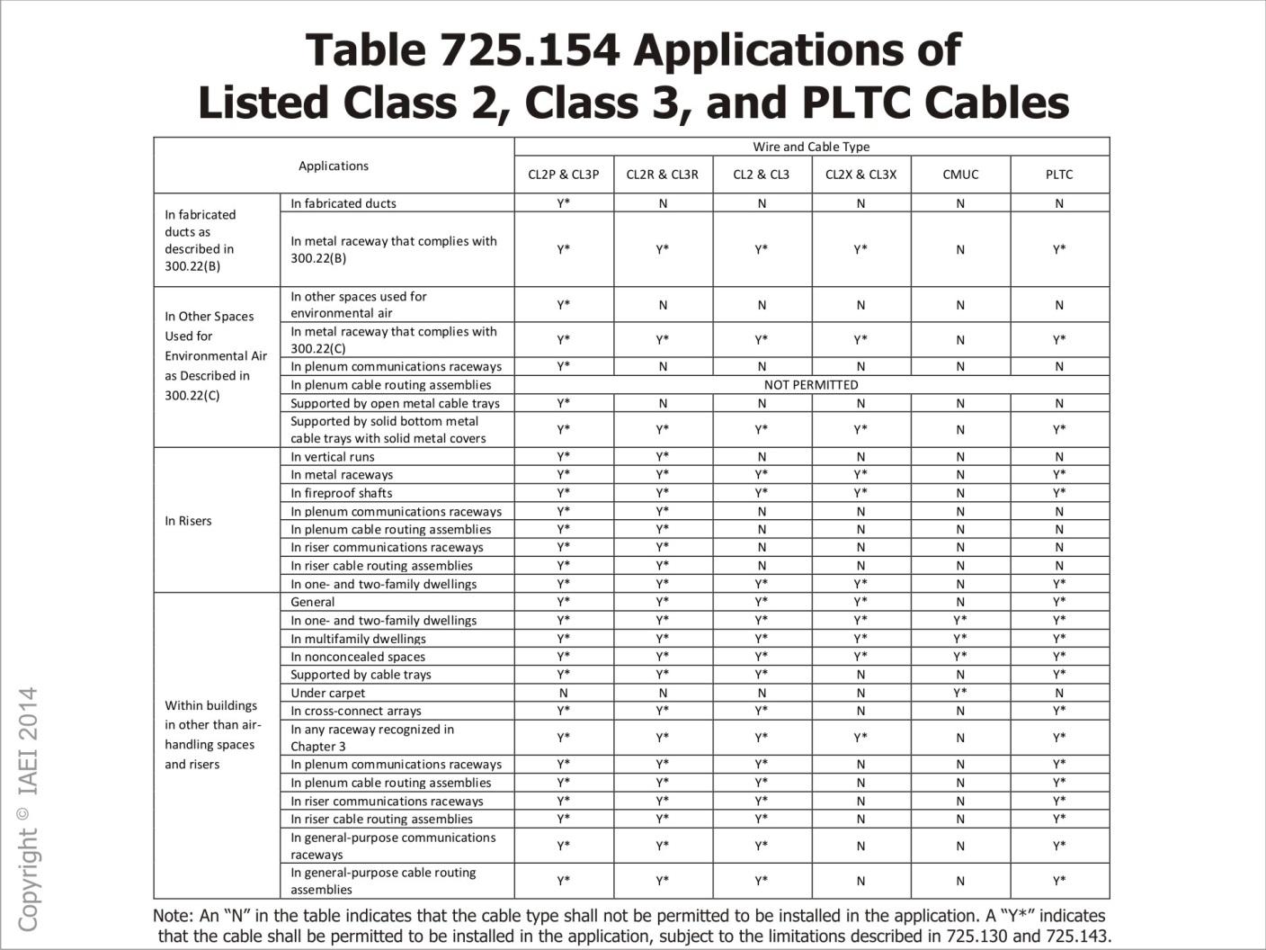

Slide 171
725.154 and Table 725.154
Applications of Listed Class 2, Class 3, and PLTC Cables
Table 725.124 Applications of Listed Class 2, Class 3, and PLTC Cables in Buildings
Notes:
725.154 now covers Class 2 and Class 3 cable substitutions, Class 2, Class 3, PLTC circuit integrity (CI) cable or electrical circuit protective systems, and thermocouple circuits.
Much of what was covered in 725.154 was moved to new 725.135 titled, “Installation of Class 2, Class 3 and PLTC Cables.”
New Table 725.154 titled, “Applications of Listed Class 2, Class 3 and PLTC Cables in Buildings” with simplified, descriptive requirements is in an easy-to-read table format.

Slide 172
725.154 and Table 725.154 Applications of Listed Class 2, Class 3, and LTC Cables in Buildings - Changes
Was Now
Plenums 725.135 (B) and (C)
Risers 725.135 (D), (F) and (G)
Cable Trays 725.135 (H)
Industrial Establishments 725.135(J)
Other Wiring Within Buildings 725.135 (K), (L) and (M)
Cross Connect 725.135 (I)
Class 2 and 3 Substitutions 725.154 (A)
Class 2, 3 PLTC and CI 725.154 (B)
Thermocouple Circuits 725.154 (C)

Slide 173
760.3(D) Corrosive, Damp, or Wet Locations
Cables installed in corrosive, damp, and wet locations shall be suitable for use.
Notes:
Cables installed in corrosive, damp and wet locations shall be suitable for use in these conditions and comply with 110.11, 300.5(B), 300.6, 300.9, and 310.10(G).

Slide 174
760. 53(B)(3)Multi-conductor NPLFA Cables
(B)(3) Cables installed in vertical runs and penetrating one or more floors or cables installed in vertical runs in shafts, shall be Type NPLFR.
Notes:
(B)(3) Cables installed in vertical runs and penetrating one or more floors or cables installed in vertical runs in shafts shall be Type NPLFR. Floor Penetrations requiring Type NPLFR shall contain only cables suitable for riser plenum use.
This section now requires cables that "penetrate from floor to floor” to be “Riser Rated”. The previous language only required a “Riser Rated Cable” if the vertical run penetrated “more than one floor”.
760.135(D) for PLFA cables

Slide 175
770.24 Mechanical Execution of Work
Revised to require cable ties used to secure optical fiber plenum cables in other space used for environmental air (plenums) to be listed as having low smoke and heat release properties.
Notes:
Revised to require cable ties used to secure optical fiber plenum cables in other space used for environmental air (plenums) to be listed as having low smoke and heat release properties.
For correlation with existing requirements in NFPA 90A for ceiling cavity and raised floor plenums. Also added to 800.24, 820.24, and 840.24

Slide 176
800.113(C) Other Spaces for Environmental
Air (Plenums)
Types CMP, CMR, CMG, CM, and CMX cables
Notes:
Types CMP, CMR, CMG, CM, and CMX cables
Installed in plenum communication raceways, riser communications raceways, and general purpose communication raceways
Supported by solid bottom metal cable trays with solid metal covers (no ventilating openings)
Provides alternative to CMP cable and plenum communication raceways in ceiling and floor air handling spaces.

Slide 177
820.100(B)(3)(2)
Covers acceptable grounding electrodes in buildings or structures without an intersystem bonding termination or grounding means.
Revised to prohibit the use of :
Hot water pipes
Steam pipes
Air terminal conductors
Notes:
Covers acceptable grounding electrodes in buildings or structures without an intersystem bonding termination or grounding means.
Revised to prohibit the use of :
Hot water pipes
Steam pipes
Air terminal conductors
Only acceptable grounding electrodes are those covered in 250.52(A)(1) through (4) and (A)(5), (A)(7), & (A)(8).

Slide 178
830.113(C) Other Spaces for Environmental Air (Plenums)
Type BLP, BMR, BM, BL, and BLX cables
Notes:
Type BLP, BMR, BM, BL, and BLX cables
Installed in plenum communications raceways, riser communications raceways, and general purpose communication raceways.
Supported by solid bottom metal cable trays with solid metal covers (no ventilating openings).
Provides alternative to BLP cable and plenum communication raceways in ceiling and floor air heating spaces.

Slide 179
END

Slide 180
Questions?

Slide 181
Reviewed by
CMP 1 David Hittinger
CMP 1 Ben Dunford
CMP 2 Steve Thorwegen
CMP 3 Adam Corbin
CMP 6 Jerry Kent
CMP 7 Chris Fahrenthold
CMP 8 Ken Hengst
CMP 9 Kevin Breen
CMP 11 Terry Cole
CME 11 Terry Cromer
CMP 14 Robert Jones
CMP 16 Luigi Prezioso
CMP 19 David Johnson

