Slide 1
Advanced PAP Titrations
Karin Johnson, MD
Vice Chair and Associate Professor,
Department of Neurology, UMMS- Baystate
Medical Director, Baystate Health Regional Sleep Program
@drsleepykarin

Slide 2
Disclosure
No Disclosures
I will be comparing protocols/functionality of different PAP devices from specific manufacturers
http://www.petpoisonhelpline.com/poison/beta-blockers/

Slide 3
Summary
How Advanced PAP works
Titration Tips
Insurance Criteria
Titration Case

Slide 4
Advanced PAP Settings
Mode
BPAP ST | Constant EPAP, IPAP, PS all night Backup rate ensures breath within time period Control inspiratory/expiratory lengths
SV | Fixed or auto EPAP in response to obstruction Variable IPAP/PS targeting recent volumes or ventilation Backup rate and inspiratory/expiratory control
VAPS | Fixed or autoEPAP in response to obstruction Variable IPAP/PS targeting set goal volume or ventilation Backup rate and inspiratory/expiratory control

Slide 5
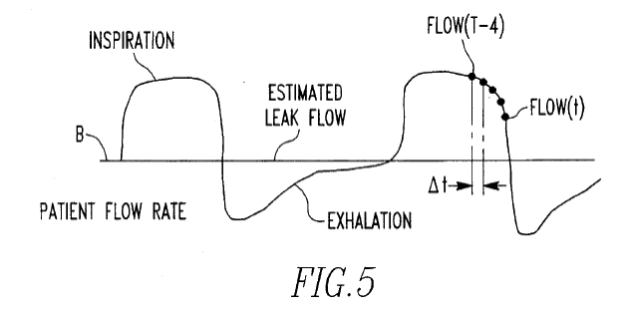
Inspiration Expiration Decision Circuitry
Flow | Rate of change | Fuzzy Phase
Zero | Increasing | Start Inspiration
Small positive | Increasing slowly | Early Inspiration
Large positive | Steady | Peak Inspiration
Small positive | Decreasing slowly | Late Inspiration
Zero | Decreasing fast | Start Expiration
Small Negative | Decreasing slowly | Early Expiration
Large Negative | Steady | Peak Expiration
Small Negative | Increasing slowly | Late Expiration
Zero | Steady | Expiratory phase
Inline sensor measuring flow or pressure drop across a restriction in the air delivery tube
Start of exhalation: Flow into lungs = 0
Inhalation- Flow(t) > average flow rate
Exhalation- Flow(t) < average flow rate
Sanders, US Patent 5,433,193
Berthon Jones, US Patent 8857430

Slide 6
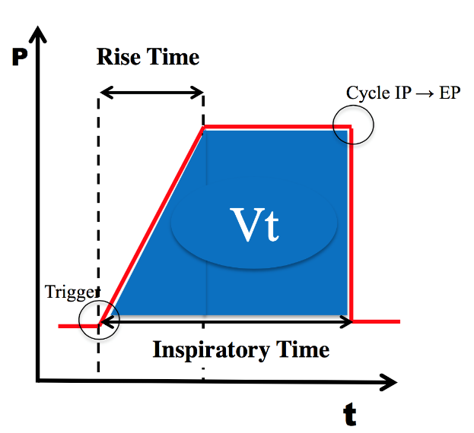
Respiratory Control Settings
Tigger sensitivity
inspiratory flow above which EPAP -> IPAP
Cycle sensitivity
inspiratory flow below which IPAP -> EPAP
Rise time
length of time to transition from EPAP to IPAP
Inspiratory Time
Time spent in inspiration

Slide 7
Respiratory Control Settings
Setting | Normal | COPD | Obesity Hypoventilation | Restrictive/ Neuromuscular
Ti | 0.3 sec-2.0 sec | 0.3-1.0 sec | 0.8-2.0 sec | 0.8-1.5 sec
Rise Time | 300 ms | 150 ms | 150-300 ms | 300 ms
Trigger | Medium | Medium | Medium-High | High
Cycle | Medium | High | Low-Medium | Low
COPD - Chronic obstructive pulmonary disease; sec - second; Ti - inspiration time Adapted from ResMed Sleep Lab Titration Guide
Start with normal settings then add to see if helps comfort or breathing metrics

Slide 8
Differences in BPAP ST
Respironics
Spontaneous breaths are not affected by Ti settings
Resmed
Spontaneous breaths are affected by Ti settings
Can use respiratory control settings on both BPAP and BPAP ST

Slide 9
Physiology affecting COPD Titrations
AutoPEEP and Dynamic Hyperinflation
Narrowed bronchiole and decreased elastic recoil
Slower flow in and out of lung
More collapse on expiration when positive pressure
More compliant alveoli
Inspiratory flow remains higher longer especially when on BiPAP
May require active exhalation when on BiPAP to cycle
More dead space
Higher minute ventilation to clear CO₂
+
+
Elastic Recoil
Airway supported by connective tissue
NORMAL
Excess mucus, hypertrophy of submucosal glands, abnormal epithelium
+
+
Decreased Elastic Recoil = Slower expiratory flow
+
Broken alveolar attachments =
Airway collapse worse on expiration
COPD
Notes:
Broken alveolar attachments, abnormal epithelium, excess mucus, hypertrophy of submucocal glands- airway doesn’t stay open on expiration

Slide 10
Titrating COPD patients
Look for improvement in Tidal Volumes first and then reductions in CO2
Preventing dynamic hyperinflation
If worsening with increasing EPAP or PS then likely inducing hyperinflation
Titration change | Improved Physiology | Mechanism
Higher EPAP | AutoPEEP | Kept airways more open by offsetting AutoPEEP
High IPAP | Airway Collapse Work of Breathing | Prevent airway collapse
High Cycle And/or Shorter Ti | Decreased Elastic Recoil Work of Breathing AutoPEEP | Limit Inspiratory Flow Prolong Exhalation
Slower RR | Impaired exhalation | Prolong Exhalation

Slide 11
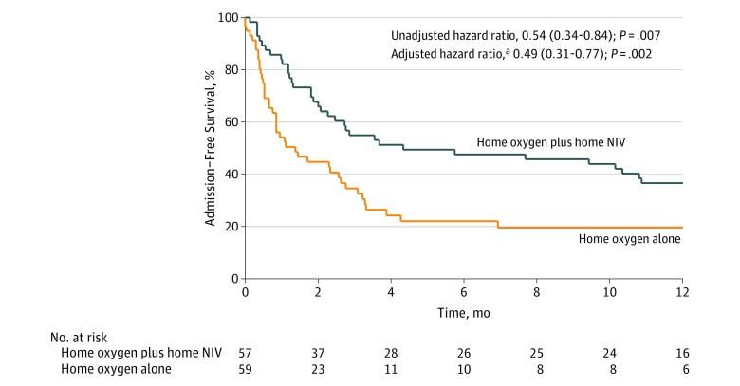
Hi-PPV in COPD
Patients with chronic COPD with frequent exacerbations
Severe COPD mean PaCO2 57
12-month risk of readmission or death
63% in O2 +Hi-PPV
80% in O2 alone
ARR 17% (NNT 6)
34% reduction in acute exacerbation frequency
BiPAP ST
Ti 0.8-1.5 RT 150-200 ms
Started 18/4 RR 14-16
Mean IPAP 24 (22-26)
BPPV targeted to goal ↓PaCO2 3-7 mmHg and SpO2 >88%
Murphy JAMA 2017

Slide 12
CO2 targets by Disease
COPD: to reduce by 3-7 mmHg or 20% or <48 mmHg (Murphy 2017)
Obesity Hypoventilation: to get tidal volume over 6-8 ml/kg (NIPPV task force)
Neuromuscular: aim to keep CO2 at wake levels

Slide 13
Advanced PAP Settings
Mode
BPAP ST | Constant EPAP, IPAP, PS all night Backup rate ensures breath within time period Control inspiratory/expiratory lengths
SV | Fixed or auto EPAP in response to obstruction Variable IPAP/PS targeting recent volumes or ventilation Backup rate and inspiratory/expiratory control
VAPS | Fixed or autoEPAP in response to obstruction Variable IPAP/PS targeting set goal volume or ventilation Backup rate and inspiratory/expiratory control

Slide 14
Problem with CPAP/BPAP/BPAP ST
Breathing patterns that change breath to breath
Periodic breathing
Breathing patterns/ ventilation that change throughout the night
Too high pressures in NREM or lateral position inducing
Central events
PAP intolerance
Mask leak
Hyperinflation in COPD
Too high pressure drops CO₂ levels and increases breathing instability triggering periodic breathing
Not enough pressure to ventilate in REM and supine
Not enough pressure to prevent obstruction

Slide 15
Tip 1: Watch for BPAP ST lengthening Rhythmic Central apneas
BPAP
BPAP ST
Longer central apneas
Flow is backup rate kicking in
More instability/arousals

Slide 16
Tip 2: Watch for Oxygen Banding Pattern
Sign of periodic breathing
Rhythmic desaturations to similar degree
Rarely below 80%
Improves in REM

Slide 17
Tip 3: Score Central Hypopneas
30% reduction in pressure transducer for 10 seconds with arousal or 3% O₂ desat AND NO
Snoring OR
Flow limitation OR
Paradoxical breathing

Slide 18
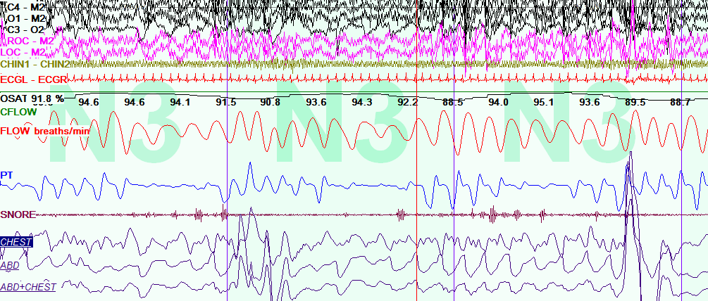
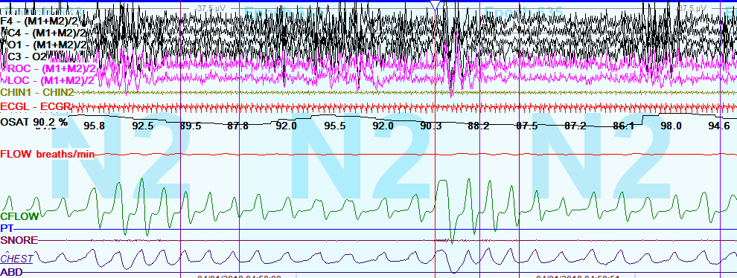
Tip 4: Watch for Mixed Events
Decreased drive often causes airway collapse
BPAP may can squaring of flow signal
Think central physiology even if a little snoring and flow limitation if
Worse NREM/Better REM
Symmetric periodic waxing and waning of both flow and effort
Worsening with increasing PAP pressures
Arousals at height of respiratory effort

Slide 19
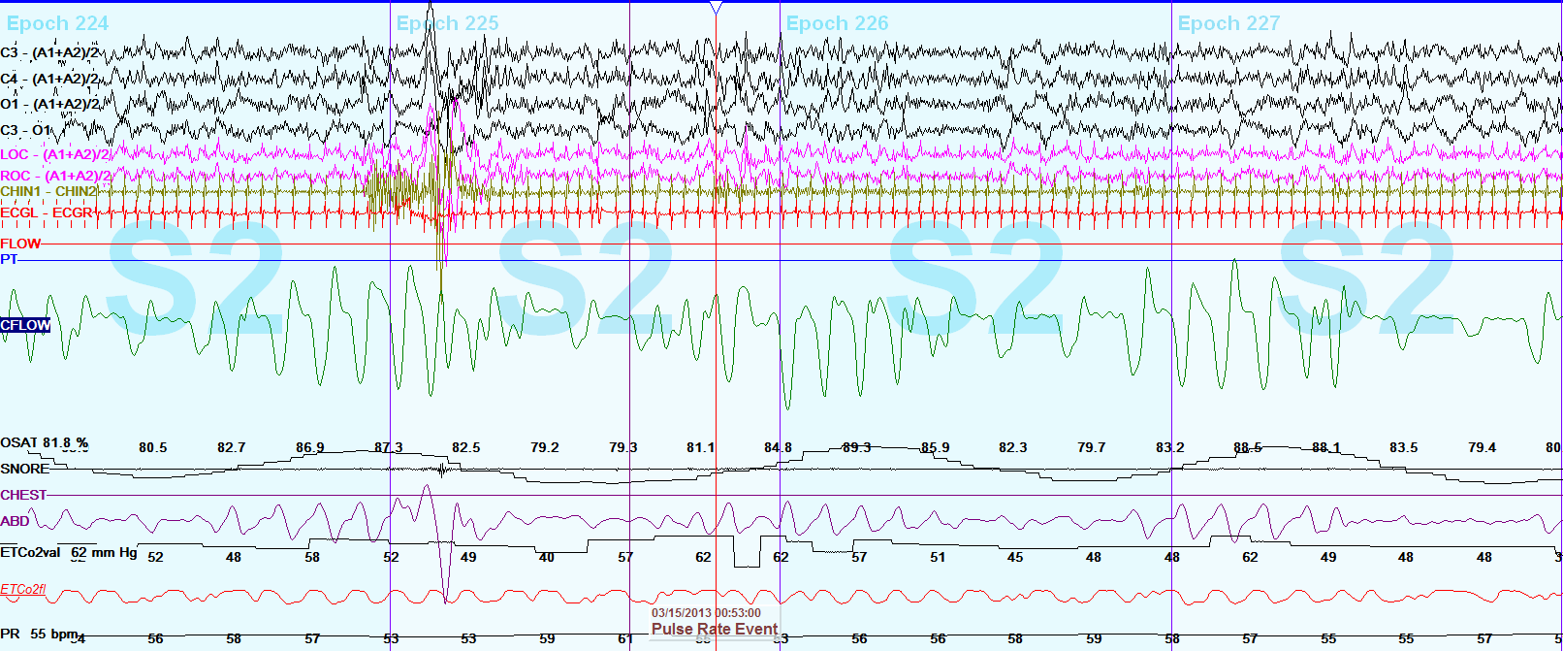
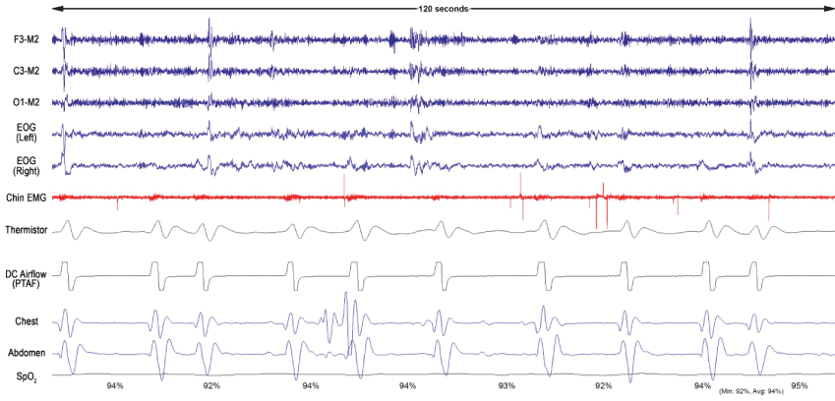
Tip 5: Recognize Different Types of Central Physiology
Rhythmic
High loop gain, driven by CO₂ fluctuations
Backup rate can worsen
Irregular
Driven by central breathing suppression (narcotics)
Neuromuscular
Backup rate can help

Slide 20
Servoventilation (SV)
Pressure Profile | Goal | Uses/ Cautions
Fixed or auto EPAP in response to obstruction Variable IPAP/PS targeting recent volumes or ventilation Backup rate +/- Inspiratory/expiratory control | Stabilize breath by breath variation | Periodic breathing Cheyne Stokes Respiration Treatment induced central sleep apnea Can worsen hypoventilation

Slide 21
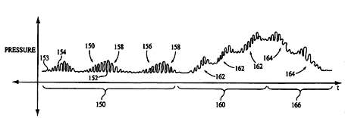
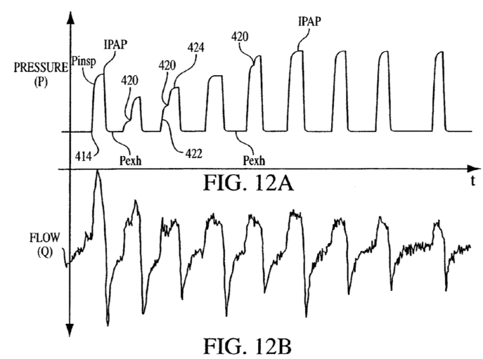
Servoventilation (SV)
ResMed ASV
Targets 90% recent minute ventilation
Adjusts PS every 1/50th seconds
AutoASV adjusts EPAP for OSA
Patient Flow
Apnea
ASV pressure
ASV turned on
Respironics BiPAP AutoSV
Targets 90-95% recent tidal volume
Mid-inspiration adjustment
EPAP adjustment for sustained periodic breathing or OSA
Hill Patent 2008/ 0000475

Slide 22
Titrating ASV
Typically start EEP 4-5 unless severe obstruction
Slowly increase EEP for events or instability
Generally keep PS min at 3 and PS max at 15
If difficulty tolerating pressure decrease PS max to 10
If can’t eliminate centrals can try PS min of 0
Make sure NO mask leak
If hypoventilation switch to VAPS
If ASV doesn’t work try AutoSV and vice versa

Slide 23
Volume Assured Pressure Support (VAPS)
Pressure Profile | Goal | Uses/ Cautions
Fixed or autoEPAP in response to obstruction Variable IPAP/PS targeting set goal volume or ventilation Backup rate Inspiratory/expiratory control | Stabilize breath by breath variation Ensure stable ventilation throughout entire night | Combination of periodic breathing and hypoventilation Supine or REM dominant disease Hypoventilation Neuromuscular

Slide 24
iVAPS vs AVAPS
 | iVAPS | AVAPS
EPAP Adjustment | Fixed EPAP AutoEPAP (Astral) | SystemOne AVAPS- fixed EPAP Trilogy AVAPS- AE- set EPAPmin and max with REMstar AutoCPAP-like protocol
PS Adjustment | PS adjustments are made every 1/50th sec throughout inspiration to achieve goal alveolar ventilation with smooth transition. | Determines average PS provided over prior 2 min to achieve volume. If target volume differs from average recent ventilation (6 breaths), PS for next breath is changed at rate of 1/min if recent stable breathing and 0.5/min if unstable breathing. (AE mode allows maximum rate of pressure change from 1-5/min).

Slide 25
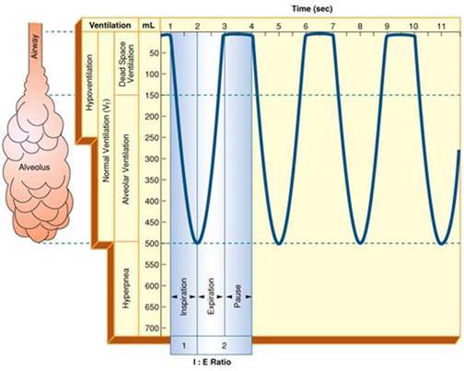
Minute ventilation, alveolar ventilation and tidal volume
Tidal volume (BiPAP AutoSV and AVAPS)
Volume to lung and anatomical dead space
If ↑ respiratory rate, alveolar ventilation ↑
Minute Ventilation (ASV target)
Respiratory rate X tidal volume
If ↑ respiratory rate, alveolar ventilation ↓
Alveolar ventilation (iVAPS target)
Minute ventilation – dead space ventilation
If ↑ respiratory rate, then TV ↓ and alveolar ventilation is constant

Slide 26
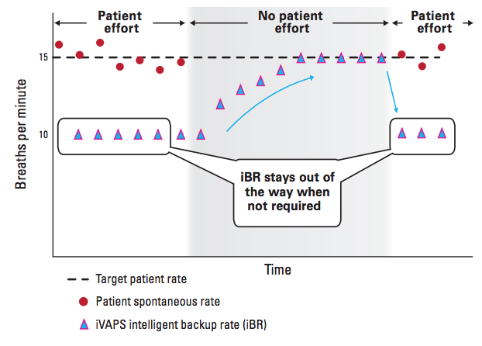
AVAPS-AE and iVAPS backup rate
AVAPS-AE backup rate
Fixed or Autoset which is 2 breaths per min below average rate of recent 6 spontaneous breaths
iVAPS patient rate
Patient rate drops to 2/3rd of set rate during spontaneous breathing and increases to set rate during period of apnea
From resmed.com

Slide 27
Titrating VAPS
Start with EPAP at pressure preventing very severe obstructive events although lower may work
Start TV/ TVa per body weight chart
Start PS min 4 and PSmax of 15-20
Start RR/Patient Rate at respiratory rate
COPD has more dead space ventilation so expect to use higher Tva/TV
Start normal but try adding in ventilatory control settings in appropriate patients- ie, COPD, neuromuscular
Don’t just keep increasing EPAP and Tva/TV
Record tidal volumes and PS min and max achieved by patient throughout titration
Watch for setting increases that lead to lower patient TV for a given setting change

Slide 28
Tip 6: Follow Tidal Volumes and IPAP max values when titrating iVAPS
Note: IPAP Max is maxed out for further increases of TVa at this point not significantly changing TV or lowering CO₂
If increase patient rate, can increase ventilation

Slide 29
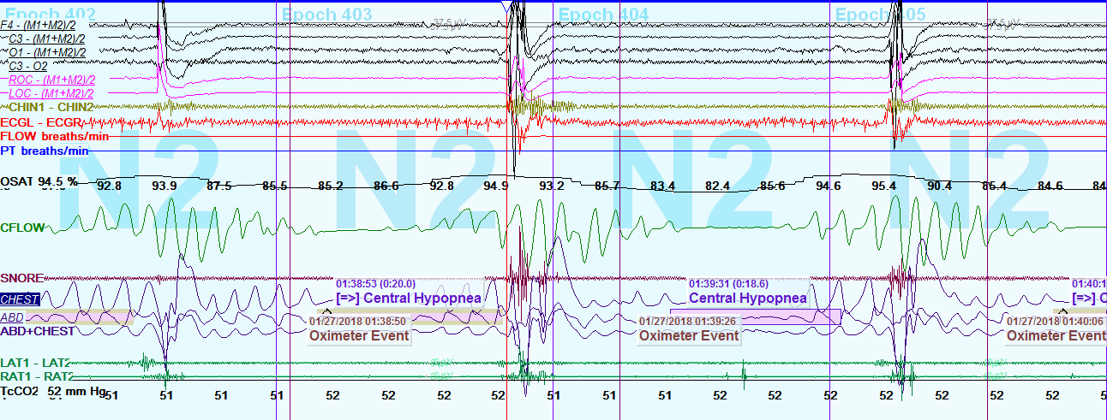
Case 1: Hypoventilation/Hypoxia with Treatment emergent centrals on BPAP
BPAP 16/9 in REM
Stable Breathing
O₂ Sat: 84%
TCCO2: 56
BPAP 17/9 in NREM
Treatment induced centrals
O2 Sat: 92%
TCCO2: 51

Slide 30
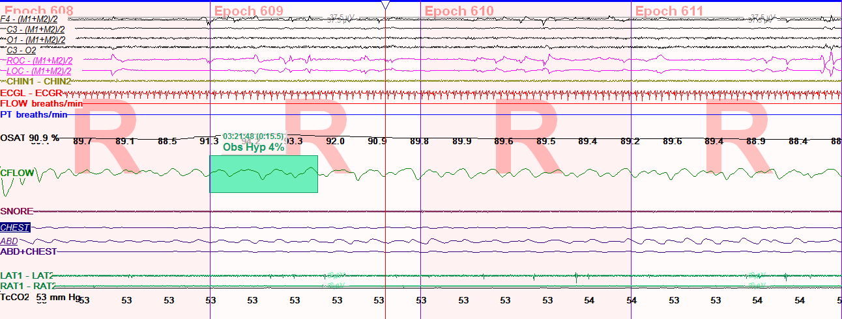
Case 1: ASV treats treatment emergent centrals
ASV EEP 7:
O₂ saturations improved to 93%
Breathing most stable in NREM
TCCO2 still 50
ASV EEP 8:
O₂ saturations drop in REM to 88-89%
TCCO2 increases to 53
….but worsens hypoventilation

Slide 31
Case 1: iVAPS improves centrals and hypoventilation
iVAPS EPAP 9 TVa 6 PR 20

Slide 32
RAD Criteria for SV/VAPS/BPAP ST
To qualify for an E0471 Respiratory Assist Device (RAD)- BiPAP ST, ASV, iVAPS, AVAPS
1. Central sleep apnea at baseline with CAHI >5 with OAHI < 5
2. Treatment emergent centrals with CAHI > 5 with OAHI < 5 on BiPAP (If get centrals on CPAP, also get them on BiPAP before switching to backup rate machine)
This must be present on at least 1 BiPAP pressure without higher pressures with either OAHI > 5 or higher pressures with overall AHI <5
3. Hypoventilation Criteria on BiPAP- Requires ABG on BiPAP

Slide 33
Ventilator Criteria For VAPS
To qualify for ventilator (Astral or Trilogy with iVAPS/AVAPS or BiPAP settings)
Medical documentation of chronic respiratory failure
ABG with PCO2 > 52 if COPD or obesity hypoventilation or PCO2>45 or MIP < 60 if Neuromuscular
In this case do not need to meet either central criteria or 5 minutes below 88% on oxygen criteria
Expensive monthly rental fee
Must have persistent chronic respiratory failure to stay on
No compliance requirements to keep the machine

Slide 34
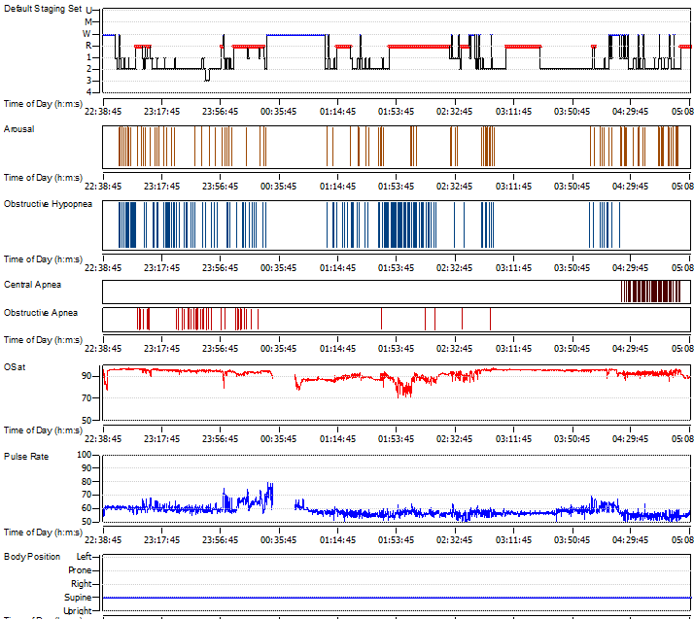
Case 2: OSA/Hypoventilation/Hypoxia
69 yo male with DM, HTN, Morbid obesity (BMI 49), CAD s/p triple bipass admitted for CHF exacerbation in 2013
In 2005, dx with severe OSA and hypoventilation and didn’t tolerate CPAP 6
Split Study
Baseline on 4 L oxygen
AHI 37
Lowest O₂ sat 77%
Average ETCO₂ 52
Peak ETCO₂ 89
Titration
Lowest O₂ sat 70%
Peak ETCO₂ 99

Slide 35
Case 2: PSG on 4 liters oxygen
What about the CO2 levels?

Slide 36
Tip 7: Check ETCO₂ waveform
ETCO₂ signal can be affected by
Apnea: no airflow to the sensor
Hypnopnea: if don’t reach end expiration
Reduced tidal volume: don’t reach end expiration
Obstruction: due to air trapping/lack of equilibration
Mask leak: loss of signal
High PAP flow: diluting signal
ETCO₂ correlates poorly with ABG in specific patient populations
COPD
Small lung volumes
Obesity
Acute respiratory illnesses
Noninvasive monitoring of CO2 during polysomnography: a review of the recent literature Christopher A. Gerdung, Adetayo Adeleye, and Valerie G. Kirk Curr Opin Pulm Med 2016, 22:527–534

Slide 37
Case 2: BPAP 16/6 with 4 L O₂
Why are saturations in 70s on BiPAP with 4L oxygen, when they were in 90s with 4L oxygen?

Slide 38
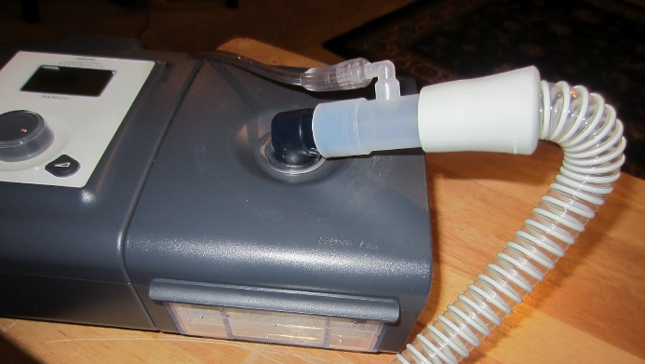
Tip 8: Be aware of oxygen dilution with PAP
Oxygen flow diluted by room air flow (21% FiO₂) from the machine
Higher pressure, more O₂ flow needed for same FiO₂
If the patient is on daytime O₂, make sure they are switching to the appropriate (higher) level with PAP

Slide 39
Case 2: BPAP ST 20/14 RR14 4 L O₂
REM hypoventilation with BPAP
Overall:
Treatment emergent centrals
Prolonged centrals with BiPAP ST
Persistent Hypoxia
Persistent Hypoventilation
Tip: BPAP can cause squared airflow pattern that can be confused for obstruction

Slide 40
Next day AVAPS titration
Next day comes back for AVAPS titration
AVAPS with EPAP of 14, IPAP min of 18, IPAP max of 30, TV of 550 and 4 liters of oxygen and backup rate of 14 with a heated humidifier.

Slide 41
Case 2: AVAPS EPAP 14 min TV 550 IPAPmin 18 IPAPmax 30 rate 10 O₂ 4L
Persistent central events
Oxygen Banding in NREM

Slide 42
Case 2: AVAPS EPAP 14 min TV 550 IPAPmin 18 IPAPmax 30 rate 10 O₂ 4L
Persistent Hypoventilation worse in REM

Slide 43
Case 2: AVAPS Followup
Uses AVAPS 4 L O2 nightly
“Fights with it all night”
Sleeps 4-5 hours on machine with awakenings after about 2 hours then has to take it off
Difficulty falling asleep and staying asleep, daytime fatigue, nocturia

Slide 44
Case 2: iVAPS EPAP 10 TVa 5.6 PR 12 with 2 liter O₂

Slide 45
Case 2: Sleep Clinic Follow-up
Recommend iVAPS
EPAP of 9 qnd TVa of 5.6
PS min of 4 and PS max of 20
Patient Rate of 14
Ti min 0.3, Ti max 2, High Cycle
2 liters oxygen
Took over 1 month to get approval to switch to iVAPS
“Great sleep on iVAPS”, ESS 5-> 0, sleeping 9:30-5 AM
Average use 6h57 min, 26/30 days over 4 hours,
Residual AHI 2.3

Slide 46
Tip 9: Fixing hypoventilation helps hypoxia
Alveolar Gas Equation
PAO₂ = FiO₂(Barometric Pressure – PH₂O) – PACO₂/Respiratory Quotient 760 47 0.8
The more space CO₂ takes up the less space for O₂ in the alveola
PAO₂ = 0.21 (760 -47) – 40/0.8 = 99 mm Hg ~ > 95% SaO₂
PAO₂ = 0.21 (760 -47) – 60/0.8 = 74 mmHg ~ 92% SaO₂
PAO₂ = 0.21 (760 – 47) – 80/0.8 = 49 mmHg ~ 80% SaO₂
Image from Becker Anesthesia Progress 2009

Slide 47
6 titration elements
Element | Exacerbating Factors
Obstruction | Worse REM, Supine
Hypoventilation | Worse REM/ Supine
Periodic breathing (PB)/Cheyne Stokes respiration (CSR) | Worse NREM/Supine Worse higher pressures Worse hypoxia/hypoventilation Worse backup rate
Irregular centrals (narcotic) | Narcotic effect could be worse at start of night
Insufficient effort (Neuro) | Worse REM/Supine
Baseline Hypoxia | Worse REM/Supine

Slide 48
Titration hierarchy
Obstruction
CPAP
Hypoventilation
BPAP +/-respiratory control
Hypoxia
BPAP- w/ hypoventilation
Periodic Centrals
SV – w/o hypovent
VAPS- w hypovent
O2- w/o hypoventilation
VAPS

Slide 49
Obesity Hypoventilation Titration
OSA
Hypoventilation only
No OSA
BiPAP/BiPAP ST/VAPS
Long Ti
Short rise time
May need large pressure support
Many need increased backup rate
CPAP
Central events or Persistent ↑CO₂ or Persistent ↓O₂
BiPAP +/- respiratory control settings
Central criteria or ↑CO₂ on max BiPAP
Suboptimal response to everything including lateral positioning
VAPS
Persistent ↓O₂
VAPS + O₂
BiPAP ST +/- O₂

Slide 50
CHF Titration
*Vary to meet insurance qualifications
Baseline CSA only
Normal O2
+/- ↑CO₂
OSA +/- ↓O₂
+/- ↑CO₂
Mixed CSA + OSA +/- ↓O₂
+/- ↑CO₂
Hypoventilation +/- ↓O₂
Baseline CSA only
With ↓O₂
Normal CO₂
Hypoxia normal CO₂
Persistent ↓O₂
Persistent CSA
CPAP
Oxygen
Central criteria w/ nl CO₂ but primarily CSA at baseline in patients with EF < 30%
Persistent ↑CO₂ +/- central criteria
BiPAP
CPAP + O₂
Central criteria
w/ Nl CO₂
Persistent ↓O₂
Central criteria
BiPAP + O₂
SV if normal CO₂ and not primarily CSA at baseline in patients with EF < 30%
Suboptimal response to everything else including lateral positioning
VAPS
Persistent Centrals with nl CO₂
Persistent Centrals
CPAP or SV with end expiratory rebreathing space +/- O₂
Persistent ↓O₂
VAPS + O₂
BiPAP ST +/- O₂

Slide 51
COPD Titration
*Vary to meet insurance qualifications
OSA +/- hypoxia and +/- hypoventilation
Hypoventilation +/- Hypoxia
Hypoxia without hypoventilation
BiPAP/BiPAP ST/VAPS
short Ti
high cycle
short rise time
Watch for EPAP or pressure support that start making CO₂ rise more or lower TV as sign of worsening hyperinflation
Increase patient rate if hypoventilation despite recorded IPAP during titration at PSmax
Persistent ↓O₂
CPAP
Oxygen
Persistent ↑CO₂ +/- central criteria
CPAP + O₂
Central criteria
Normal CO₂
BiPAP
Central criteria or ↑CO₂ on max BiPAP
Persistent ↓O₂
w/ normal CO₂
SV
Persistent centrals
BiPAP + O₂
VAPS
Persistent ↓O₂
Central criteria
VAPS + O₂
Suboptimal response to everything else including lateral positioning
BiPAP ST + O₂

Slide 52
Final Titration Tips
Beware of snore artifact and BPAP “squaring” leading to overtitration and missing central physiology
O2 may be able to be reduced once treat hypoventilation
VAPS and SV often need lower EPAP than BPAP
If one SV or VAPS device doesn’t work, try another
Higher pressures are not always better, but some evidence that COPD may require high PS

Slide 53
Insurance Qualification Summary
Score central hypopneas to qualify for BPAP with backup (BPAP ST, SV, VAPS)
If VAPS best for controlling hypoventilation, but doesn’t qualify, consider if meets ventilator criteria
Almost impossible to switch from one Backup rate machine to other

Slide 54
Final Titration Tips
Tech’s goal should be to show setting options in different stages and positions
MD may need to extrapolate optimal setting and follow adherence data residual AHI, oximetry and ABG to adjust after set-up
Think about the underlying physiology interacts with PAP
You may not be able to fix everything
Some patients can never be fixed in supine position

Slide 55
Good luck titrating
Karin.johnson@baystatehealth.org
@drsleepykarin
For more information regarding how PAP modes work
Johnson & Johnson Treatment of sleep disordered breathing with positive airway pressure devices: technology update. Medical Devices: Evidence and Research 2015:8: 425-437.

