Slide 1
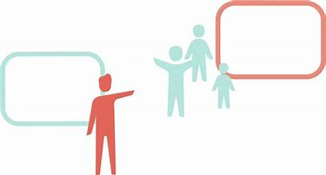
SLEEP DIAGNOSTICS & THERAPY: THE NEXT 20 YEARS
Joseph Anderson, CCSH, RPSGT, RST, RPFT, CRT-NPS
Certified Clinical Sleep Health Educator, NPI # 1548820244
Sleep / EEG Patient Care Coordinator
SOVAH Health – Martinsville, Virginia
Director of Education
Priority Health Education.com

Slide 2
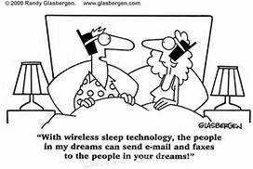
OBJECTIVES
Future Technology
Keeping the Doors Open
The Sleep Technologist of the Future

Slide 3
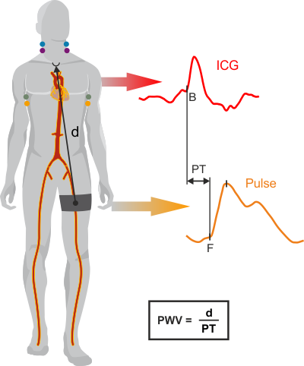
Technology - PTT
Pulse Transit Time
The PTT is the time taken for the pulse wave to travel from the aortic valve to the pulse waveform detected by a plethysmographic probe

Slide 4
Technology - PTT
Pulse Transit Time
The occurrence of apneas & hypopneas is associated with cyclic fluctuations of the autonomic nervous system
Parasympathetic activity increases during apneas
Sympathetic activation occurs at the end of an apnea

Slide 5
Technology - PTT
Pulse Transit Time
In individuals with OSA, intrathoracic pressure swings are incrementally larger with progressively increasing effort to breathe against an obstructed airway
Therefore, the changes in PTT are exaggerated, with a progressively increasing PTT accompanying increasing effort
Then a sudden drop in PTT accompanying relief of the obstruction

Slide 6
Technology - PTT
Pulse Transit Time
Studies have been conducted to verify the ability of the autonomic correlates of apnea (i.e., heart-rate variability, changes in blood pressure, peripheral arterial tone), and pulse-wave amplitude to detect sleep disordered breathing (SDB) in a clinical setting
Sympathetic activation increases blood pressure and vascular tone and stiffens the arterial wall, causing the PTT to shorten

Slide 7
Technology - PTT
Pulse Transit Time
The advantages of PTT is that it is less invasive, some say more practical, and cheaper than currently used tests such as PSG and is easier to use in an ambulatory setting
Studies conducted on PTT in a middle-aged population and children have demonstrated its good accuracy (91%) and sensitivity (95%)

Slide 8
Technology - PTT
Pulse Transit Time
PTT could serve as a screening tool for the presence of disruptive events during sleep
Or as a tool with which to provide objective measurement of change after CPAP or another intervention
Though the role of this tool is yet to be defined, data would suggest that further efforts to evaluate are probably warranted

Slide 9
Technology - PTT
Pulse Transit Time
Limited clinical or epidemiologic studies have evaluated the use of PTT for SDB screening in the elderly

Slide 10
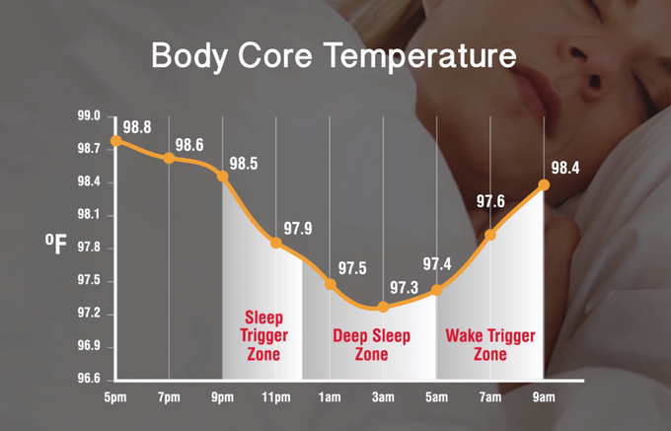
Technology – Core Body Temperature
Core Body Temperature
Human beings are endotherms, which means we are able to thermoregulate, or maintain our body temperature.
Body temperature is regulated through a balance of heat absorption, production & loss.

Slide 11
Technology – Core Body Temperature
Core Body Temperature
Human temperature must be maintained within a fairly small range, up or down from the resting temperature of around 98.6.
Temperatures above 104.9 degrees Fahrenheit or below 92.3 degrees generally cause injury or death.

Slide 12
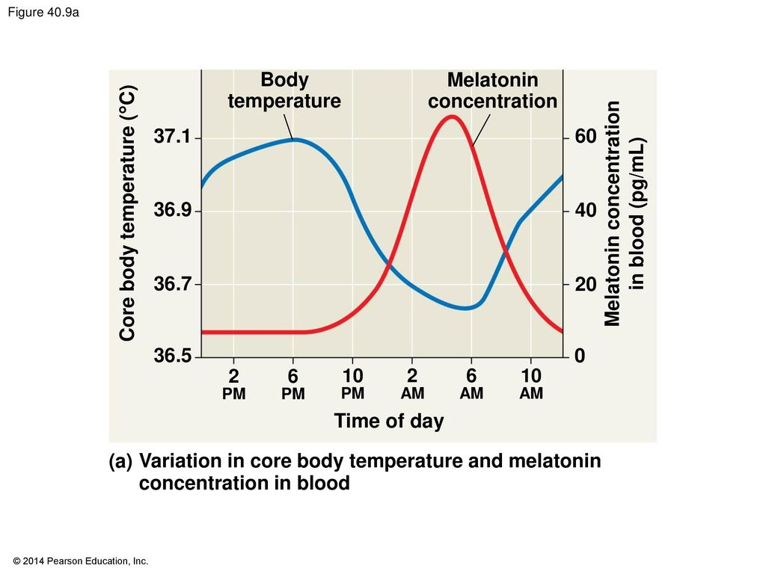
Technology – Core Body Temperature
Core Body Temperature
The hypothalamus regulates body temperature over each 24 hour cycle.
During the normal human circadian rhythm, sleep occurs when the core temperature is dropping.
Sleep usually begins when the rate of temperature change and body heat loss is maximal.

Slide 13
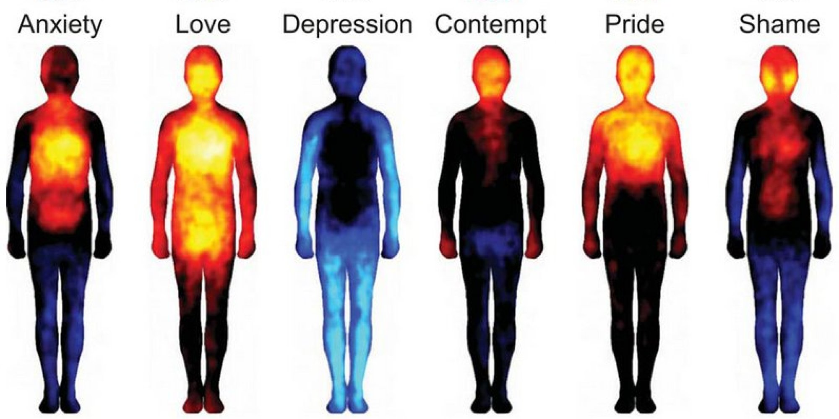
Technology – Core Body Temperature
Core Body Temperature
Humans have two zones to regulate, their core temperature and their shell temperature.
The temperature of the abdominal, thoracic, and cranial cavities, which contain the vital organs, is called the core temperature.

Slide 14
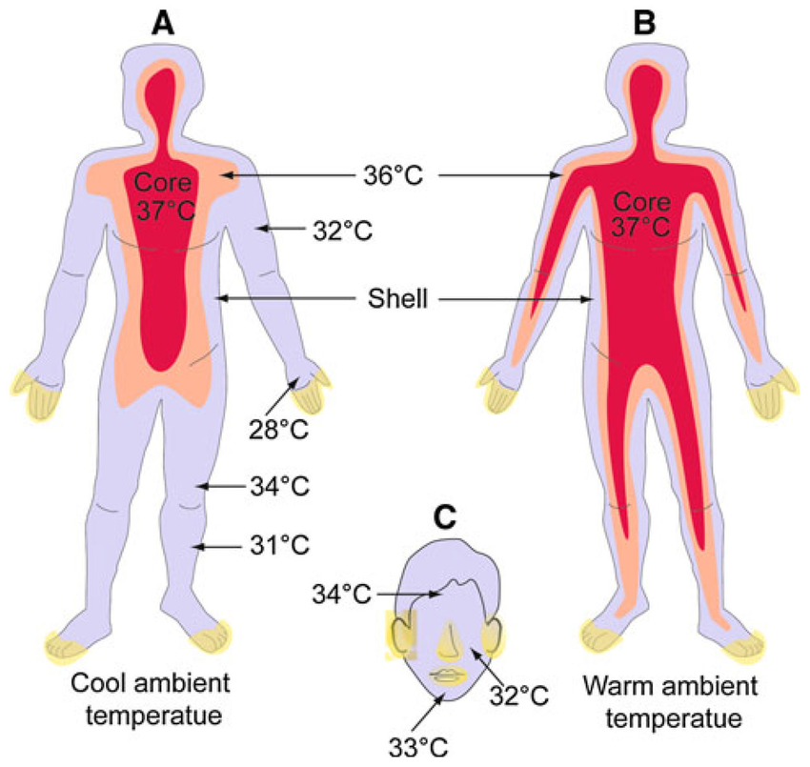
Technology – Core Body Temperature
Core Body Temperature
The shell temperature includes the temperature of the skin, subcutaneous tissues, and muscles, and it is more affected by external temperature.
The core is able to conserve or release heat through the shell.

Slide 15
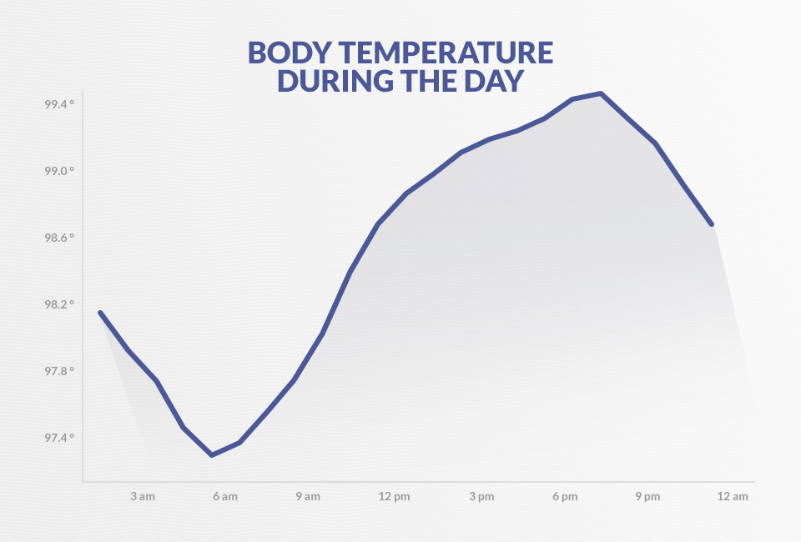
Technology – Core Body Temperature
Core Body Temperature
When you wake up, your body temperature is at its baseline of around 98.6 degrees.
Over the course of the morning through the late afternoon, your hypothalamus works to drive that temp up.

Slide 16
Technology – Core Body Temperature
Core Body Temperature
This rise in body temperature gives you energy, helping you stay alert.
This partly why working out is so energizing – the rise in body heat makes you feel awake.

Slide 17
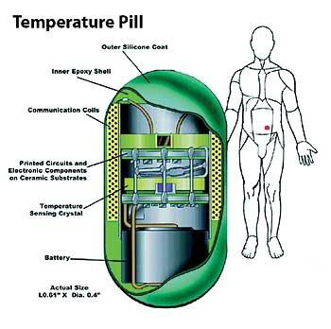
Technology – Core Body Temperature
Core Body Temperature
The 2 pm slump isn’t just an excuse dreamed up by cubicle workers – it’s a real phenomenon.

Slide 18
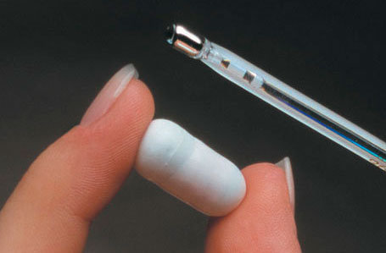
Technology – Core Body Temperature
Core Body Temperature
In the mid-afternoon, your body starts to lower your body temperature to prepare you for sleep. At around 5 am, a few hours before waking up, you’re at your lowest body temperature.

Slide 19
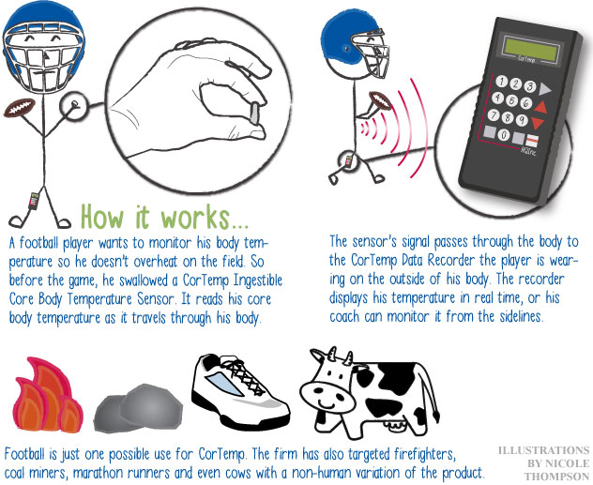
Technology – Core Body Temperature
Core Body Temperature
Even if you don’t tend to sleep hot or cold, you probably have some idea that your body temperature changes throughout the night.
Body temperature correlates with overall sleep quality.

Slide 20
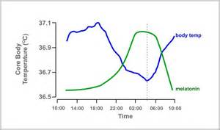
Technology – Core Body Temperature
Core Body Temperature
Decreases during the night & increases in the morning
Melatonin goes in the opposite direction

Slide 21
Technology – Core Body Temperature
Core Body Temperature
Thermoregulation is less efficient during deep sleep and REM than light sleep.
This is why having a too warm or too cold bedroom temperature can affect your sleep and cause you to wake up during the night.
A cooler core body temperature is associated with sleep. Conversely, a warmer core temperature is energizing.
Human performance scientists have found a higher internal body temperature correlates with more alertness, better memory, and improved reaction times.

Slide 22
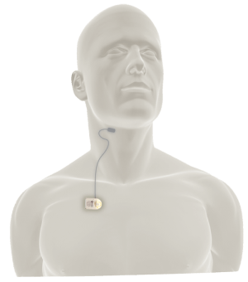
Technology – Neurostimulation
Hypoglossal Neurostimulation Therapy –
OSA
Hypoglossal neurostimulation therapy was designed for the treatment of patients with moderate to severe OSA who have been unable or unwilling to use continuous positive airway pressure (CPAP) therapy.
Implant therapy was specifically designed to deliver muscle tone to key tongue muscles, effectively controlling upper airway flow and significantly reducing or eliminating sleep apnea.

Slide 23
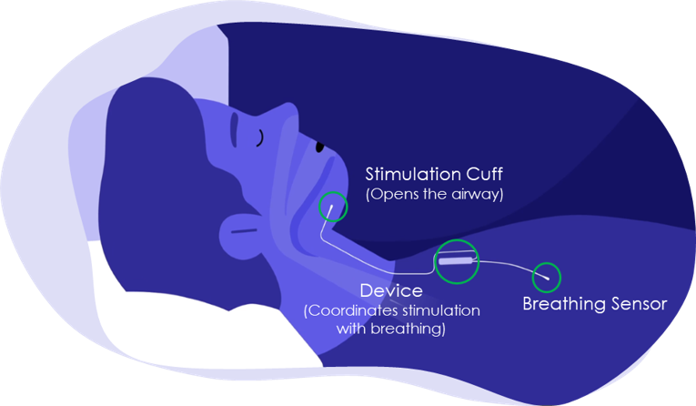
Technology – Neurostimulation
Hypoglossal Neurostimulation Therapy - OSA
A clinical trial, involving 126 Obstructive Sleep Apnea (OSA) patients across the United States and Europe, began in 2010 to evaluate the safety and efficacy of a specific brand of therapy.
One-year trial results were published in the New England Journal of Medicine, in January 2014, and the device received approval by the United States Food and Drug Administration (FDA) in April of that year.

Slide 24
Technology – Neurostimulation
Hypoglossal Neurostimulation Therapy - OSA
Five-year clinical outcomes show that sleep apnea patients receiving therapy experienced significant and sustained reductions in sleep apnea events and significant improvements in both quality of life (QOL) and daytime functioning, as measured by various questionnaires.
Quality of life information and procedure outcomes are being collected from patients in a voluntary patient registry. This registry represents the largest cohort of patients from clinical practice and will enroll 5000+ patients.

Slide 25
Technology – Neurostimulation
Hypoglossal Neurostimulation Therapy - OSA
A Belgium company has developed the first and only lead-free neurostimulator, capable of delivering bilateral hypoglossal nerve stimulation for moderate to severe OSA patients.
The implanted battery-free stimulator only requires a small incision. It is externally powered by an activation chip, connected to a disposable patch, which is positioned on the patient's chin at night.

Slide 26
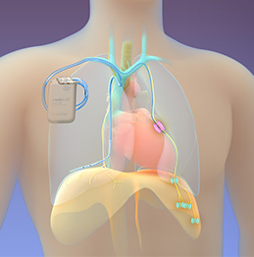
Technology – Neurostimulation
Neurostimulation Therapy - CSA
An implantable system that stimulates a nerve in the chest (phrenic nerve) to send signals to the large muscle that controls breathing (the diaphragm).
These signals stimulate breathing in the same way that the brain signals breathing.

Slide 27
Technology – Neurostimulation
Neurostimulation Therapy - CSA
The system is placed during a minimally invasive outpatient procedure by a cardiologist.
The system is a battery powered device placed under the skin in the upper chest area with two small thin wires (leads), one to deliver the therapy (stimulation lead) and one to sense breathing (sensing lead).

Slide 28
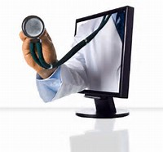
Technology – Tele-Sleep
Tele-Sleep
Tele-Sleep services makes it possible for those suffering from many types of sleep disorders to have evaluations when this type of specialized exam is not readily available closer to home.

Slide 29
Technology – Tele-Sleep
Tele-Sleep
TeleSleep uses video conferencing and other specialized telemedicine equipment.
This allows a sleep provider to complete a thorough examination as if he or she was in the same room as the patient.

Slide 30
Technology – Tele-Sleep
Tele-Sleep
Using two computer monitors – one located in the remote location and one located in the providers location – the patient and the provider can see each other.
The patient, and the provider and any family members who are present can interact with the provider – just like any typical provider's visit.

Slide 31
Technology – Tele-Sleep
Tele-Sleep
Just about any initial exam that can be done in person can be done remotely thanks to high-tech telehealth equipment and the assistance of a tele-presenter.
A tele-presenter is a specially trained tech who helps conduct the evaluation and transmits critical information to the sleep medicine provider.

Slide 32
Technology – Tele-Sleep
Tele-Sleep
Some of the conditions that may be evaluated via Tele-Sleep include:
Snoring
Sleep apnea
Circadian Rhythm
Daytime sleepiness
Insomnia

Slide 33
Technology – Tele-Sleep
Tele-Sleep
Some of the conditions that may be evaluated via Tele-Sleep include:
Narcolepsy
Parasomnia
Restless legs syndrome
Shift work/jet lag
Sleep terrors
PAP Compliance

Slide 34
Technology – Tele-Sleep
Tele-Sleep
Reimbursement is changing and the future will certainly bring better reimbursement through payers
Rural initiatives such as tele-sleep will decrease the cost of care once technology, acceptance, and training become the norm.

Slide 35
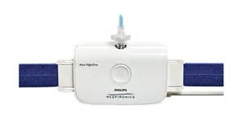
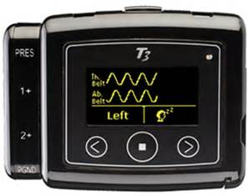
Technology – Home Testing
Home Sleep Testing
A home sleep test (HST) is a sleep study (or screener) tool that is used for the diagnosis of obstructive sleep apnea (OSA).
Most HST devices are portable – about the size of a telephone handset.
Home sleep testing is also called an “Unattended Sleep Study.”

Slide 36
Technology – Home Testing
Home Sleep Testing
They usually measure the following biologic parameters and more:
Nasal and/or Oral Airflow or Pressure
Respiratory Effort
Oximetry
Pulse
Snoring
Body Position

Slide 37
Technology – Home Testing
Home Sleep Testing
Some even measure the following biologic parameters and more:
EEG
EKG
EMG
Actigraphy

Slide 38
Technology – Home Testing
Home Sleep Testing
Increasingly accepted within the sleep industry
A patient is usually ordered a home sleep test or ‘Sleep Study’ by his or her provider who suspects that the individual has obstructive sleep apnea (OSA).

Slide 39
Technology – Home Testing
Home Sleep Testing
The patient usually applies the above mentioned sensors to the body before sleep time and sleeps with the equipment for 1 – 3 nights.
The equipment is returned to the lab where the data is downloaded and scored by a sleep technologist and processed for interpretation by a sleep physician.

Slide 40
Technology – Home Testing
Home Sleep Testing
Some systems now interface with PAP devices through cellular, blue tooth, or Wi-Fi technology.
This store-it-forward technology is often used in rural initiatives and/or in tele-sleep programs.

Slide 41
Technology – Home Testing
Home Sleep Testing
Systems are becoming smaller and easier for the patient to use
Additional advances may include :
Biometrics (in limited use now)
Audio communication with the SDC

Slide 42
Technology – Home Testing
Future Technology
Home Sleep Testing
Increased battery life
Core Body Temperature Sensor
Pulse Transit Time Sensors

Slide 43
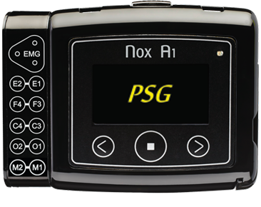
Technology – Home Testing
Future Technology
Home Sleep Testing (PSG)
Full/Complete PSG
Portable polysomnography system that simplifies the task of performing a sleep study while delivering more secure and precise measurements than ever before.

Slide 44
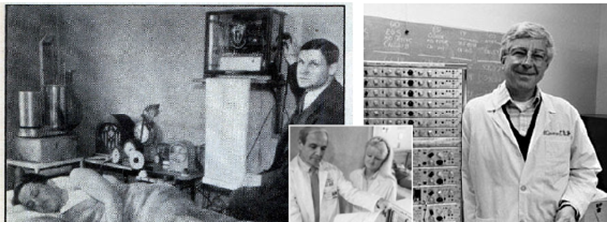
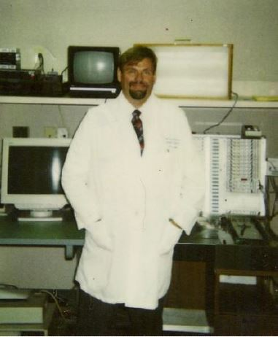
From INK…to the COMPUTER… to the HOME… to the Cloud

Slide 45
Keeping the Doors Open
Retaining Good Employees
This is a key for the Labs Success
Job Titles: Be Creative
Manager
Lead Tech
Daytime Coordinator
CPAP Coordinator
Scorer
Shift Lead

Slide 46
Keeping the Doors Open
Retaining Good Employees
This is a key for the Labs Success
Reward with Increased Responsibility
Scheduling
Trainer / Educator

Slide 47
Keeping the Doors Open
Retaining Good Employees
This is a key for the Labs Success
Individual Evaluations
Quarterly / Annually
Established criteria
Be consistent

Slide 48
Keeping the Doors Open
Retaining Good Employees
This is a key for the Labs Success
Increases in Pay
Even minor increases
Performance bonuses
Simple “Thank You”
This simple but effective tool is sometimes all that is needed

Slide 49
Keeping the Doors Open
Eliminating Bad Employees
This is a key for the Labs Success
Downsizing
Reduce UNDER performing staff
Reduce non-career staff
Reduce hours

Slide 50
Keeping the Doors Open
Recruit
This is a key for the Labs Success
Recruit
Recruit 24 / 7 / 365
Maintain resumes / CV’s of past applicants

Slide 51
Keeping the Doors Open
Recruit
This is a key for the Labs Success
Recruit
Increase Part Time & Per Diem staff
Use social media
Facebook
Twitter

Slide 52
Keeping the Doors Open
Diversify
Increase your use of Out of Center Sleep Testing (Home Sleep Testing)
Add Pap-Naps during the day to use the empty sleep rooms AND increase patient PAP compliance

Slide 53
Keeping the Doors Open
Diversify
Consider participation in research and acquiring research dollars
Is Tele-Sleep something that could work for your lab
Share Resources with Sister Labs

Slide 54
Keeping the Doors Open
Communication
Reach out to other labs, even competitor labs to:
Identify mutual problems and potential solutions
Consider developing a local “buyers group” for purchasing POWER

Slide 55
Increasing Your Value as a Tech
Make This Your Career and Not Just a Job
Why Did You Get Into This Profession?
Was this your first choice; second choice; or not your choice at all?
Where Did You Come From?
Allied or Non-allied health
School or specialized training
From within the department or facility itself

Slide 56
Increasing Your Value as a Tech
Make This Your Career and Not Just a Job
Do You Plan To Stay in This Career?
What are your short AND long term plans
Is this just a temporary pathway to something different
Waiting for something better or different to come along

Slide 57
Increasing Your Value as a Tech
Make This Your Career and Not Just a Job
Do You Go that Extra-Mile for Both the Patients AND the Lab?
Come in early
Stay late
Score
Inventory & stock
Explain PAP therapy and do a proper mask fit

Slide 58
Increasing Your Value as a Tech
Make This Your Career and Not Just a Job
Do You Go that Extra-Mile for Both the Patients and the Lab?
Measure for 10-20 placement
Positive attitude
Don’t argue with patients
Don’t argue with staff in front of patients
Don’t gossip

Slide 59
Increasing Your Value as a Tech
Make This Your Career and Not Just a Job
Do You Go that Extra-Mile for Both the Patients and the Lab?
Good Grooming
Bath (sad but true)
Clean hair
Shave
Teeth in good repair

Slide 60
Increasing Your Value as a Tech
Make This Your Career and Not Just a Job
Do You Go that Extra-Mile for Both the Patients and the Lab?
Dress appropriately
Scrubs or business casual
No excessive jewelry
Don’t sleep while working
There is a lot of controversy on this
Fire-able offense???

Slide 61
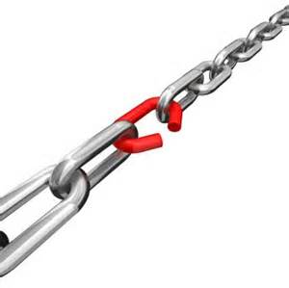
Increasing Your Value as a Tech
Make This Your Career and Not Just a Job
Don’t Be the Weakest Link in the Lab
When hard times come you WILL be one of the first to go
You might not even know you are the weakest link until its too late
Your performance evaluations and appraisals are important guides for you

Slide 62
Increasing Your Value as a Tech
Make This Your Career and Not Just a Job
Continuing Education
Maximize your opportunities
Always, always, always stay current
Consider developing some education programs for your lab

Slide 63
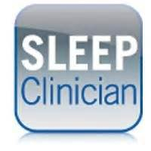
Increasing Your Value as a Tech
Become a Clinician in Your Scope of Care
Be The “Go-To” Person in Your Lab
There are many RPSGT’s and RST’s looking for work
You need to standout
Think outside the box
Volunteer for any additional training or workshops that are offered

Slide 64
Increasing Your Value as a Tech
Become a Clinician in Your Scope of Care
Be The “Go-To” Person in Your Lab
Volunteer and participate in employee functions with your lab or hospital
Health fairs
Community events

Slide 65
Increasing Your Value as a Tech
Become a Clinician in Your Scope of Care
Be The “Go-To” Person in Your Lab
Attend education meetings, such as this one, to stay current on technology and clinical processes
Attend staff meetings
Develop “mentors” such as the docs, lab management, venders, and other staff
Become a “mentor” for others

Slide 66
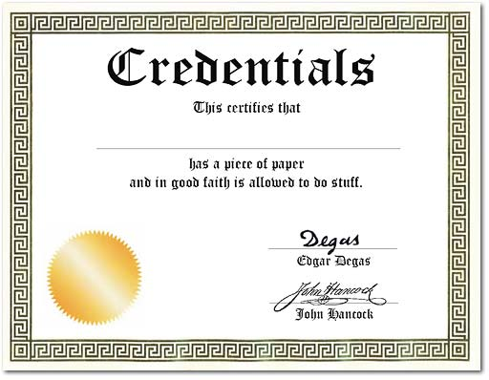
Increasing Your Value as a Tech
Get Multi-Credentialed & State Licensed
RPSGT
RST
EMT
PhD
CRT
NP
DO
RN
RRT
ALS
RCP
R. EEG T.
MD
PA
LPN
CCSH
Endorsements

Slide 67
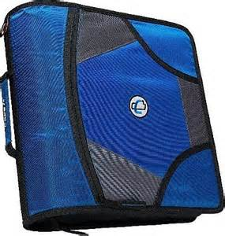
Changing Jobs
Develop a “Brag Book (portfolio)”
Credentials – Medical
Copies of everything credential related
Letters of Recommendations
Credentials – Education
Copies of all schools you have attended & diplomas

Slide 68
Changing Jobs
Develop a “Brag Book (portfolio)”
Performance Reviews / Evaluations
Excellent tool for potential employers
Publications / Writings
Anything you have ever written or contributed to
Speaking Engagements
All lectures, presentations, health fairs, etc.

Slide 69
Changing Jobs
Develop a “Brag Book (portfolio)”
A Great Resume or CV
Use professional help if needed
Continuing Education
Copies of all continuing education offerings completed
Online or offline

Slide 70
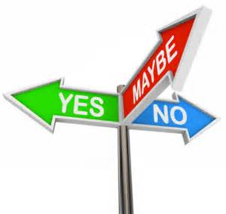
Changing Jobs
Maybe Yes; Maybe No
Advancement opportunities
Salary / Hourly
Overtime opportunities
Employment Contract
Contract or at-will
Bonuses
Performance
Group or Personal
Clearly defined

Slide 71
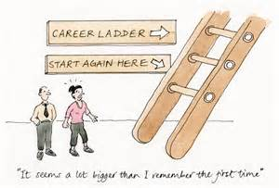
Changing Jobs
Don’t Change Too Often
Too many job changes in a short period of time is not looked on favorably by a potential employer
Even if for a promotion or for advancement

Slide 72
It Takes A Team Approach
Our jobs as Health Care Providers whether we are Physicians, Technologists, Technicians, Educators, or Students is to improve OUR Quality Of Life (QOL) as well as our PATIENTS Quality of Life QOL.
Priority Health Education.com
Professional Training & Learning Resource Center
JosephAnderson57@gmail.com
Notes:
72

