Slide 2
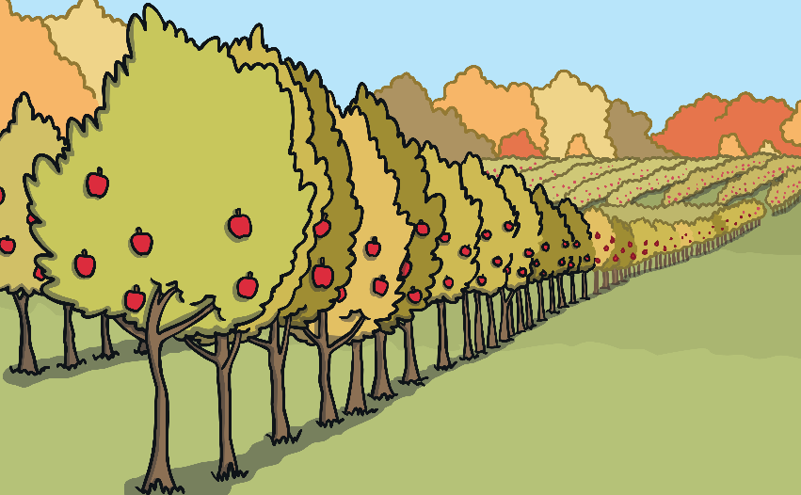
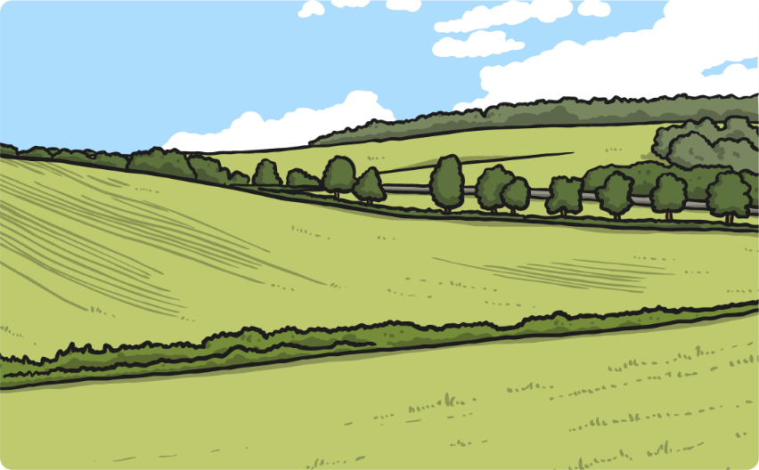
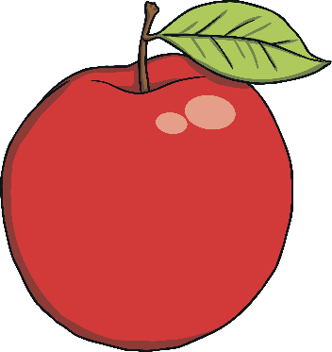
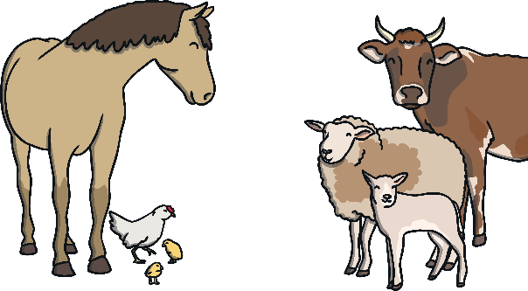
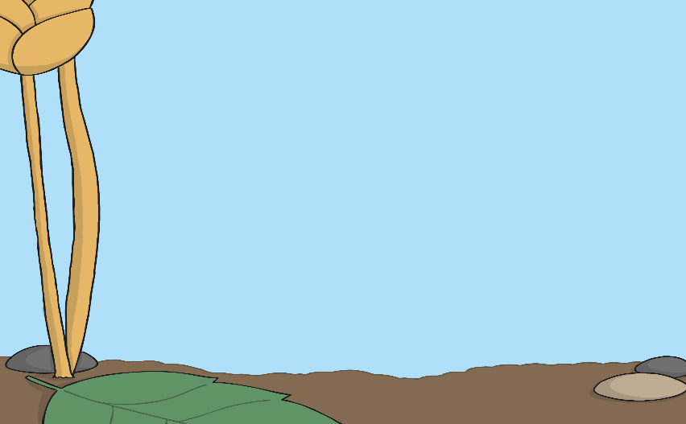
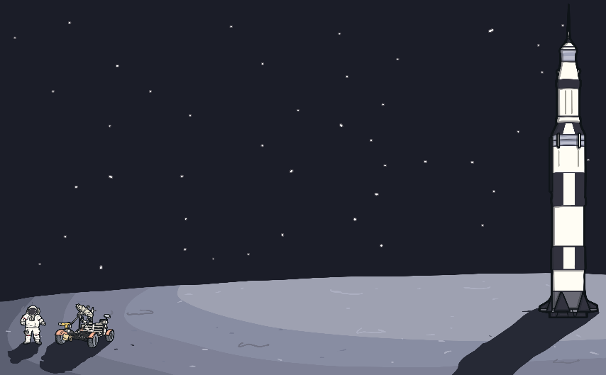
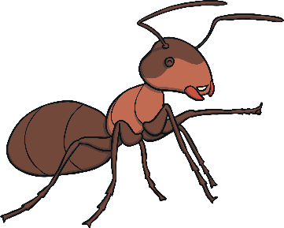
a
What can you think of that starts with an ‘a’?
apple
animals
ant
astronaut

Slide 3
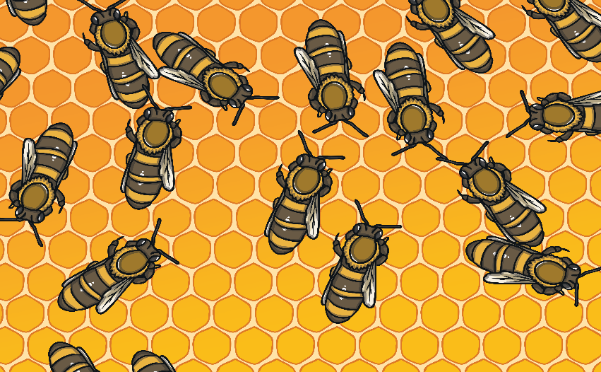
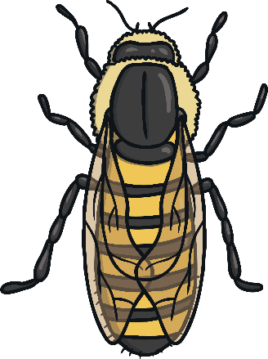
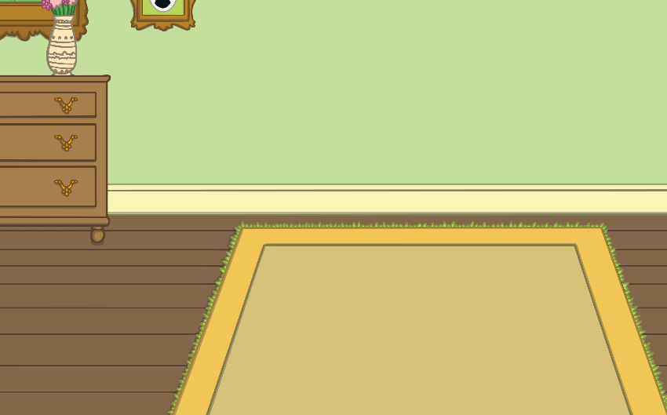
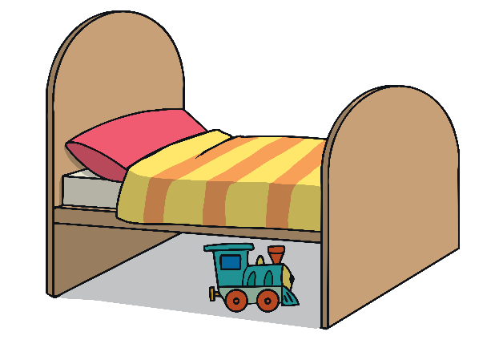
b
What can you think of that starts with a ‘b’?
bee
book
bed
ball

Slide 4
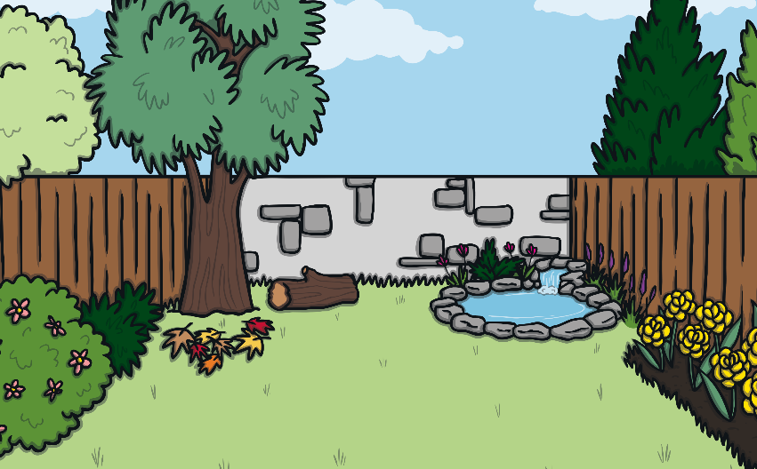
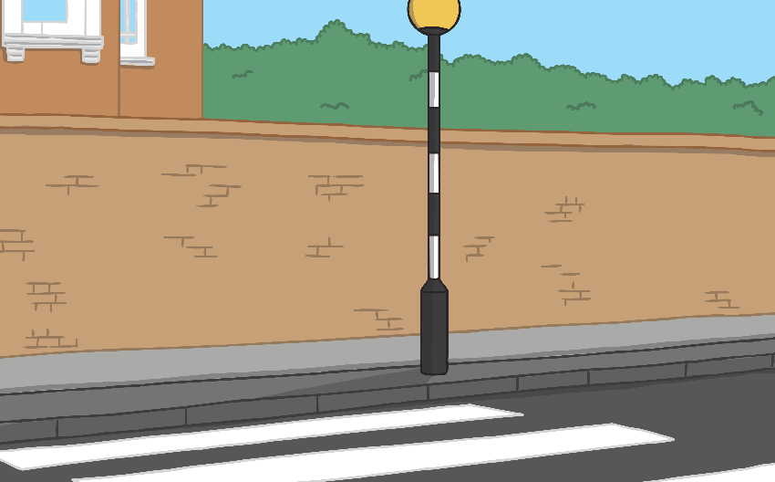
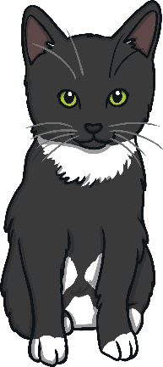
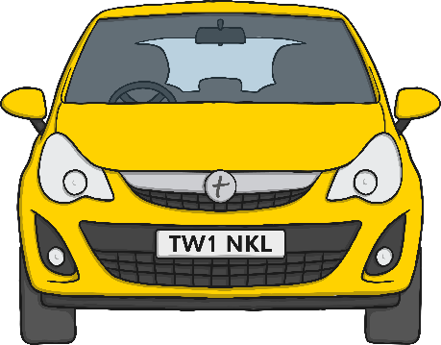
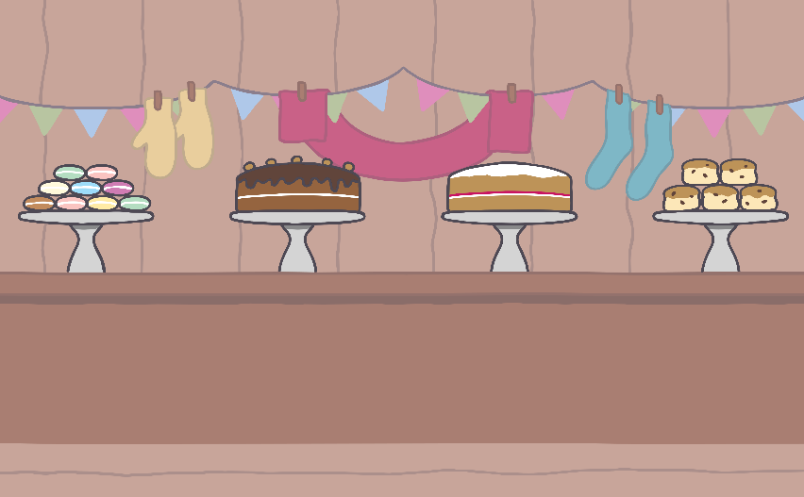
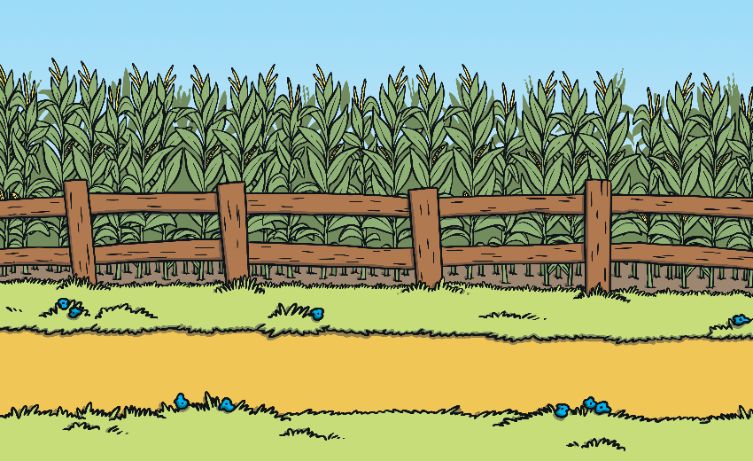
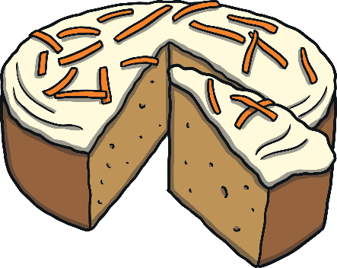
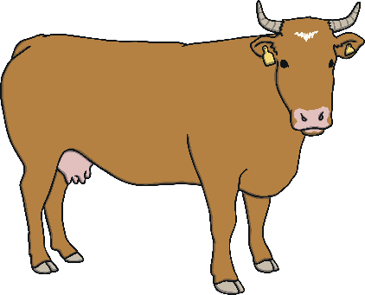
c
What can you think of that starts with a ‘c’?
cat
car
cake
cow

Slide 5
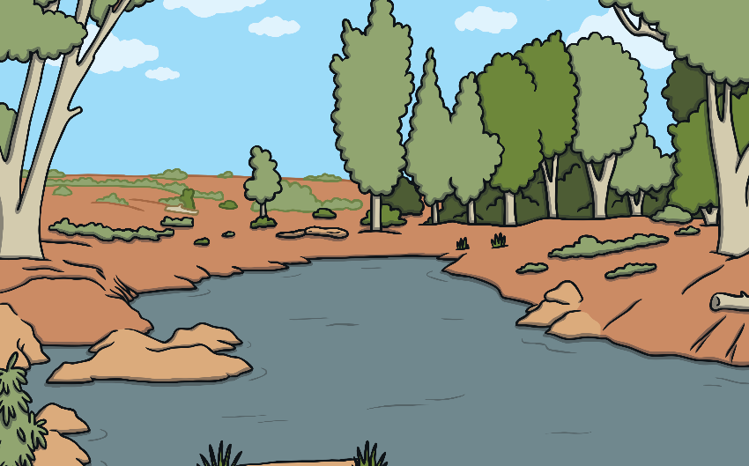
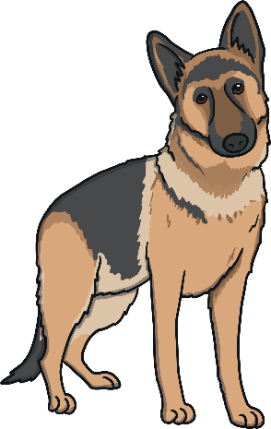
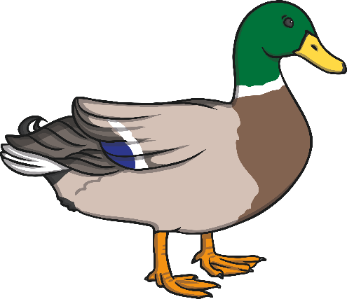
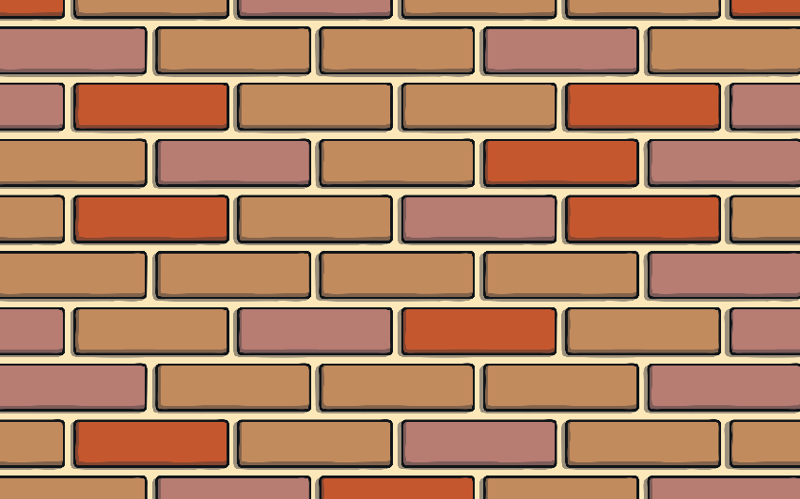
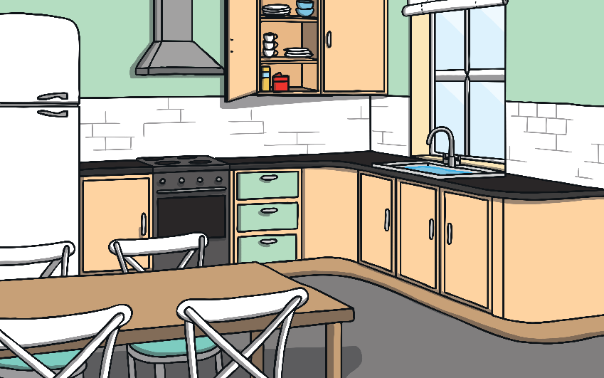
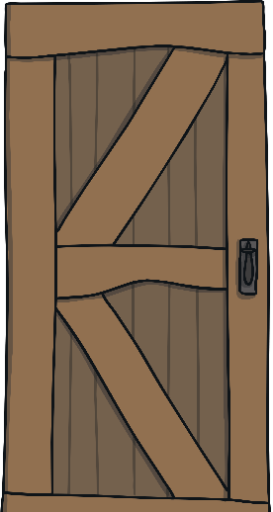
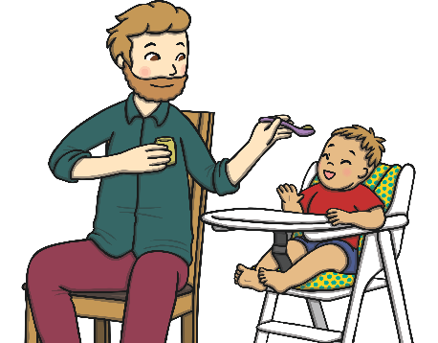
d
What can you think of that starts with a ‘d’?
dog
duck
door
dad

Slide 6
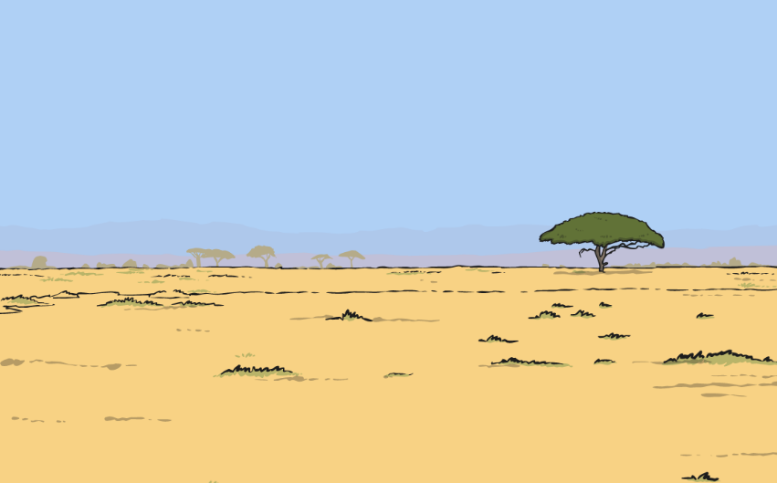
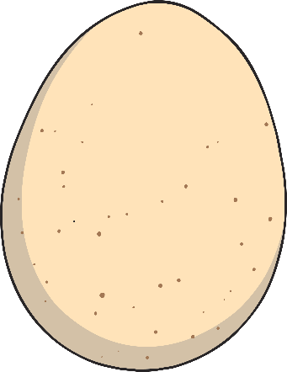
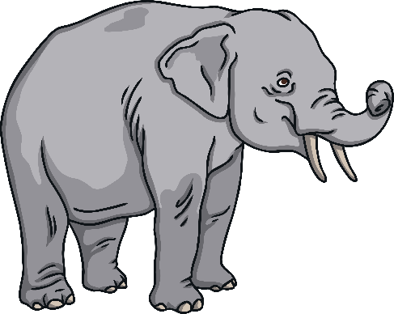
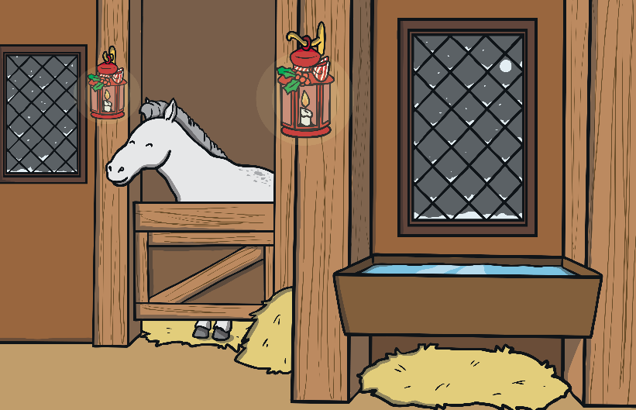
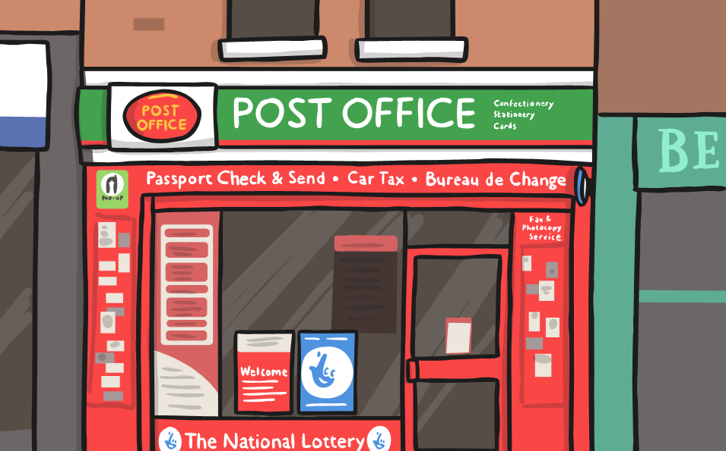
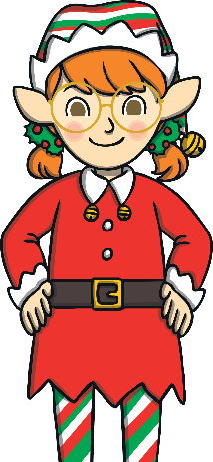
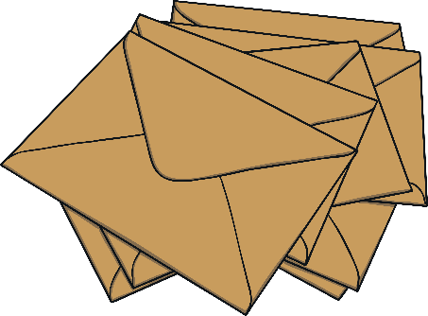
e
What can you think of that starts with an ‘e’?
egg
elephant
elf
envelope

Slide 7
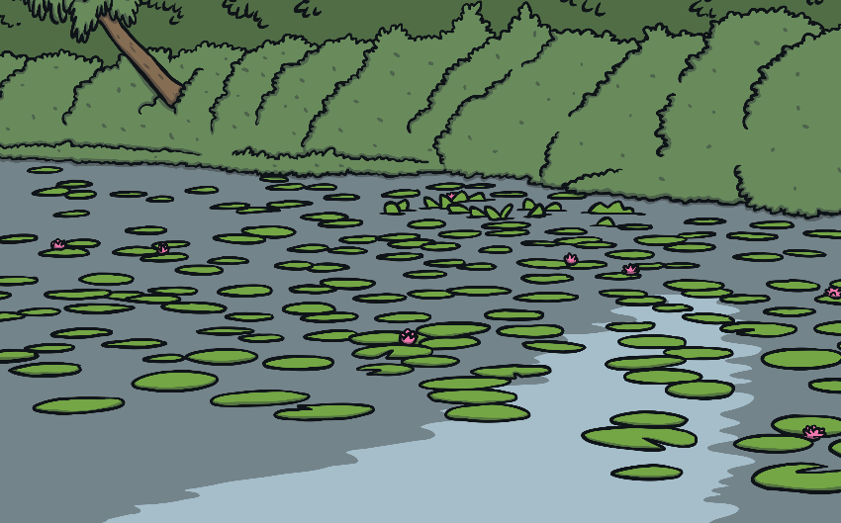
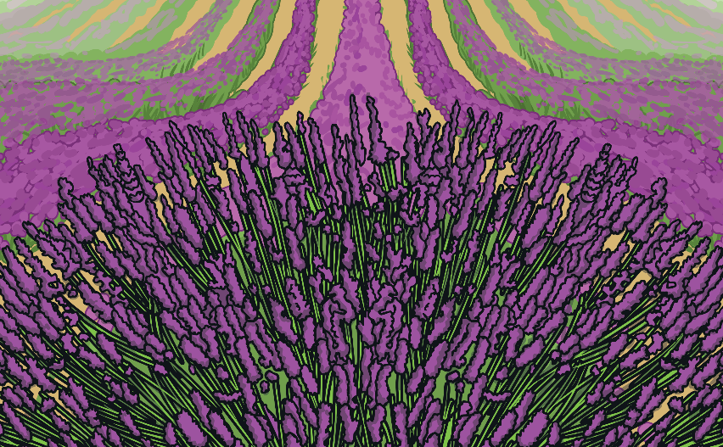
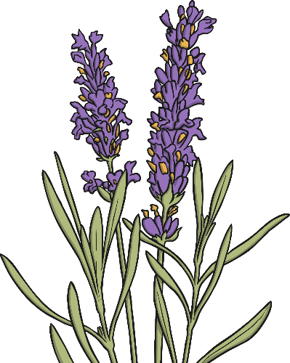
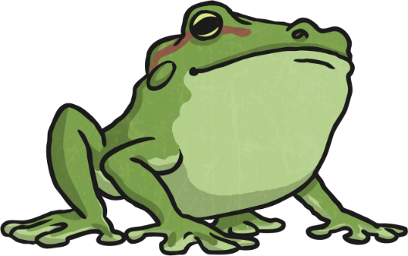
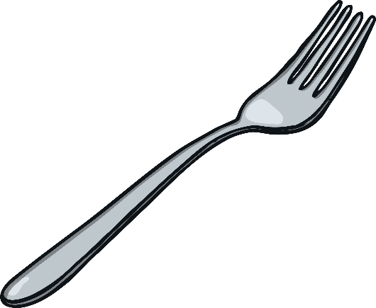
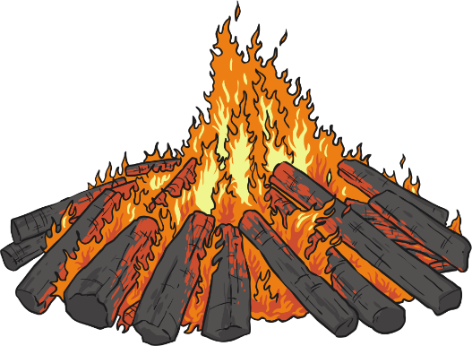
f
What can you think of that starts with a ‘f’?
frog
flower
fire
fork

Slide 8
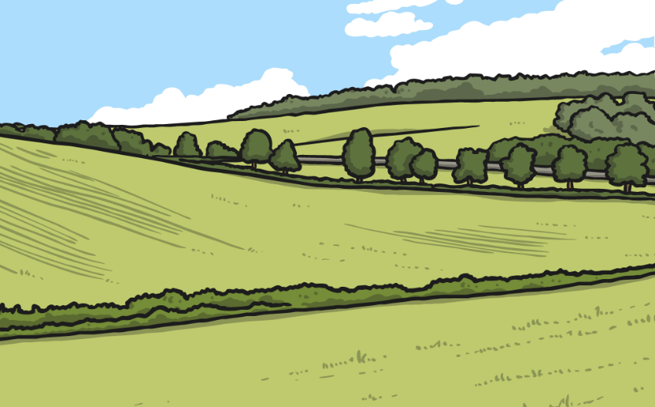
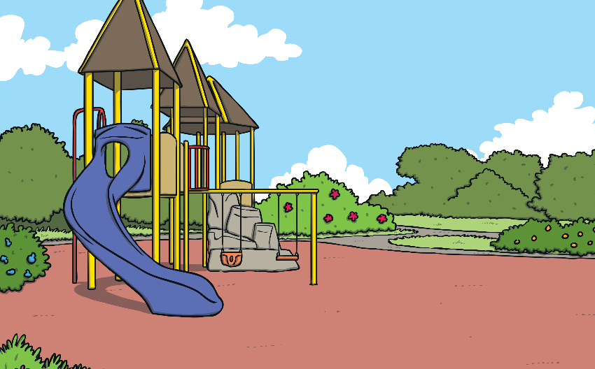
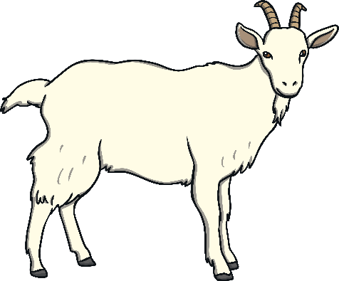
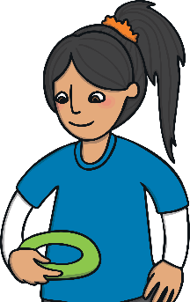
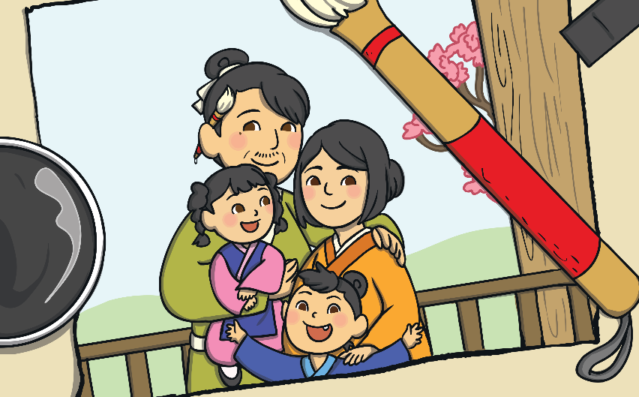
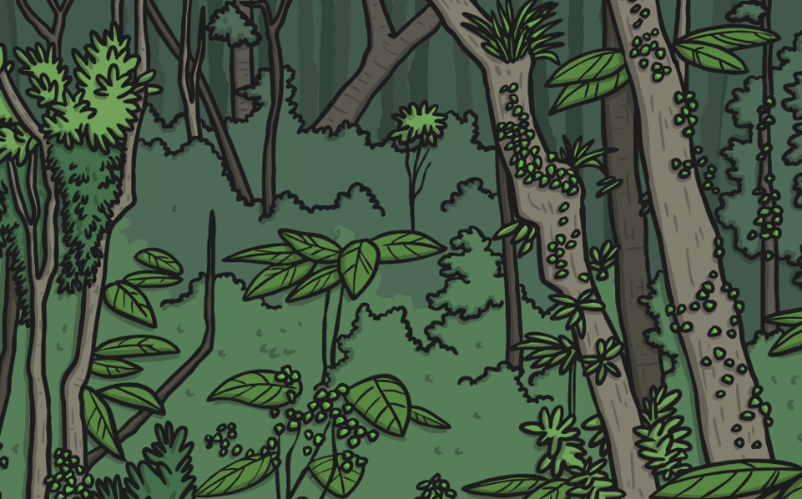
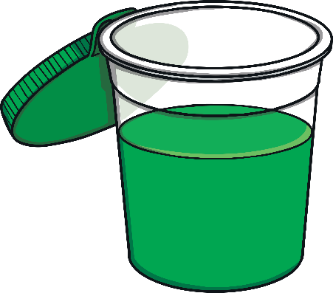
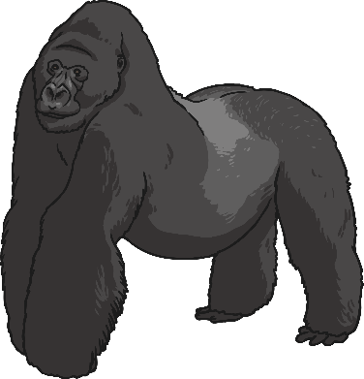
g
What can you think of that starts with a ‘g’?
goat
girl
green
gorilla

Slide 9
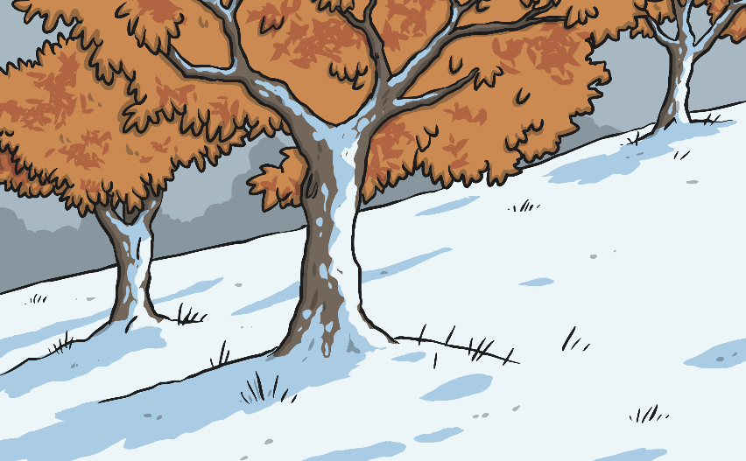
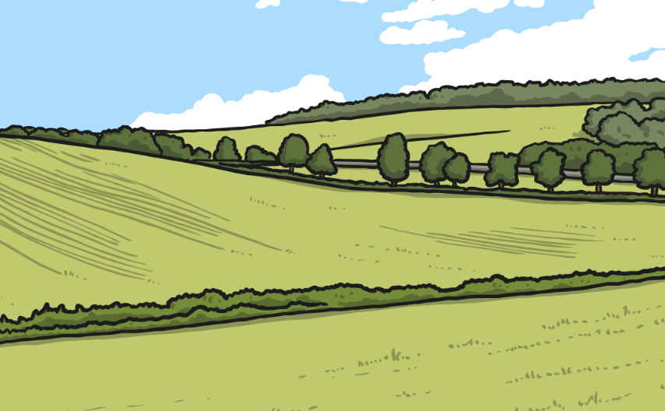
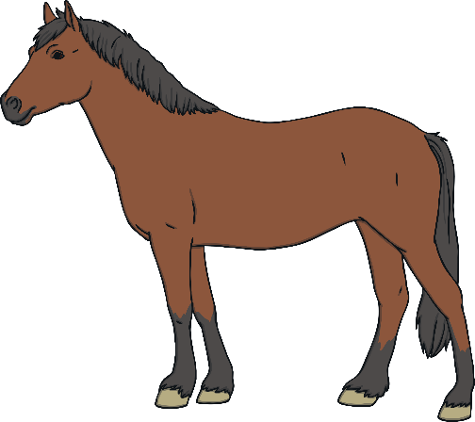
h
What can you think of that starts with a ‘h’?
hat
horse
head
hen

Slide 10
i
What can you think of that starts with an ‘i’?
ink
insect
igloo
imp

Slide 11
j
What can you think of that starts with a ‘j’?
jelly
jug
jam
jet

Slide 12
k
What can you think of that starts with a ‘k’?
king
kite
key
kiss

Slide 13
l
What can you think of that starts with a ‘l’?
lemon
light
lips
log

Slide 14
m
What can you think of that starts with a ‘m’?
milk
moon
man
mug

Slide 15
n
What can you think of that starts with a ‘n’?
nose
note
net
nurse

Slide 16
o
What can you think of that starts with an ‘o’?
orange
octopus
ostrich
otter

Slide 17
p
What can you think of that starts with a ‘p’?
pear
puppy
pin
peas

Slide 18
q
What can you think of that starts with a ‘q’?
queen
quokka
quill
Quack

Slide 19
r
What can you think of that starts with a ‘r’?
rabbit
ring
rose
rain

Slide 20
s
What can you think of that starts with a ‘s’?
sun
soup
sock
seal

Slide 21
t
What can you think of that starts with a ‘t’?
toes
tea
tie
tap

Slide 22
u
What can you think of that starts with an ‘u’?
umbrella
underwear
udder
up

Slide 23
v
What can you think of that starts with a ‘v’?
van
vase
vet
violin

Slide 24
w
What can you think of that starts with a ‘w’?
wheel
worm
watch
witch

Slide 25
x
What can you think of that starts with an ‘x’?
X-ray
xylophone

Slide 26
y
What can you think of that starts with a ‘y’?
yo-yo
yellow
yoghurt
yak

Slide 27
z
What can you think of that starts with a ‘z’?
0
zebra
zero
zip
zoo

Slide 28
Lets Play!
Look at the picture that comes up on the screen and say the letter sound it starts with!
Start

Slide 29
?
k
Answer
Next

Slide 30
p
?
Answer
Next

Slide 31
?
b
Answer
Next

Slide 32
c
?
Answer
Next

Slide 33
s
?
Answer
End

