Slide 1
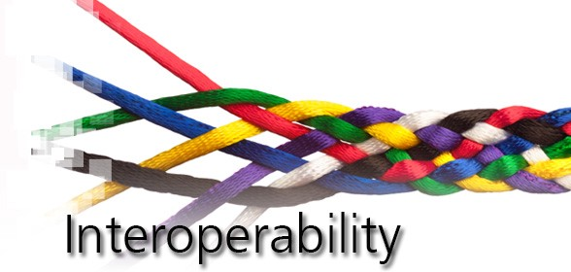

Slide 2
Your Speaker Today
Somnoware is an early-stage startup headquartered in the
Bay Area.
We provide “critical middleware” to physicians and healthcare systems.
The platform brings in data from over 150 sources and extracts actionable insights.
10% of the pulmonologists in the U.S. are already using our software.
Irene Dilinila
Sr. Business Dev. Manager, National and Strategic Accounts Somnoware Healthcare Systems, Inc.
Notes:
Critical middleware – physicians, healthcare systems, essentially all stakeholders (schedulers, night techs, lab managers, scorers, physicians all the way through DME providers.
Over 150 sources – from EMR, diagnostic systems, HST devices, software versions, wearables, compliance data under one roof.
Actionable insights – next steps for the patients

Slide 3
Topics
What is Interoperability
Why is it important
Current State of Medical Devices and Interoperability Standards
Case studies due to lack of Interoperability
Methodology – how is it accomplished
Outcome of Interoperability
Summary

Slide 4
Presentation Objectives
Participants will be able to:
Describe Interoperability
Identify silos and challenges
How to accomplish interoperability (what do you need to get started)
Discuss the potential impact and benefits of using a “middleware” platform

Slide 5
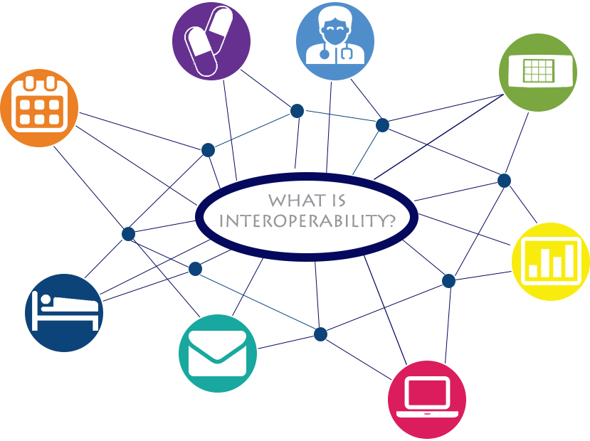
What is “Medical Device” Interoperability
Information sharing from one device to another or between devices and Electronic Health Records (EHR/EMRs.)
Communicate
Exchange data or services
Any technology that enables networked devices to exchange information and perform actions without the manual assistance of humans.

Slide 6
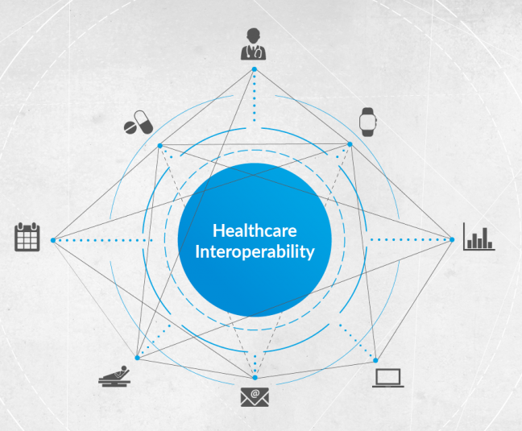
Why is Interoperability Important?
Interoperability would enable clinical medical devices to communicate in a consistent, predictable and reliable way.
Allowing for the exchange of data with other medical devices and with patient data repositories, EHRs, etc.

Slide 7
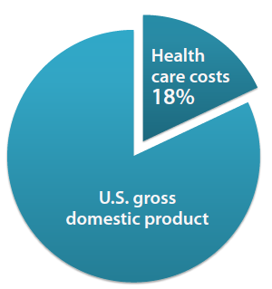
Overview
Health care costs continue to consume an ever-increasing proportion of U.S. spending significantly outpacing the growth of our economy for each of the last four decades, reaching as high as 18% percent of gross domestic product.*
According to recent estimate, more than $700 billion of the $2.4 trillion in health care spending has been identified as “wasteful spending”. *
Waste takes many forms including inefficiency, unnecessary service and missed prevention opportunities. *
* Source: The Value of Medical Device Interoperability; West Health Institute.
GDP - the total value of goods produced, and services provided in a country during one year.
Notes:
Here’s a white paper West Health Institute
GDP – gross domestic product

Slide 8
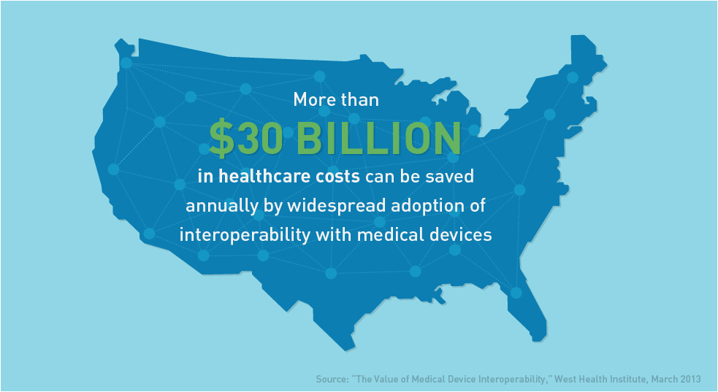
* Source: The Value of Medical Device Interoperability; West Health Institute.

Slide 9
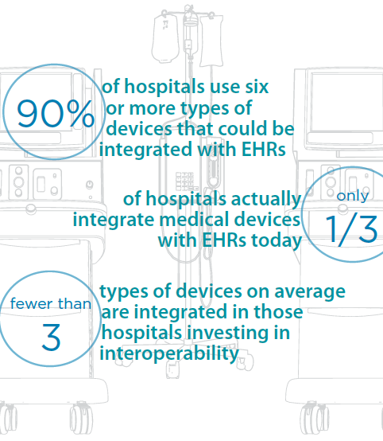
Current State of Medical Device and Interoperability Standards
The cost of medical device integration has been estimated as much as $6,000-10,000.00 per bed in one-time cost - this is high.
* Source: The Value of Medical Device Interoperability; West Health Institute.
Notes:
Need creative ways of interfacing with devices like a middle ware.

Slide 10
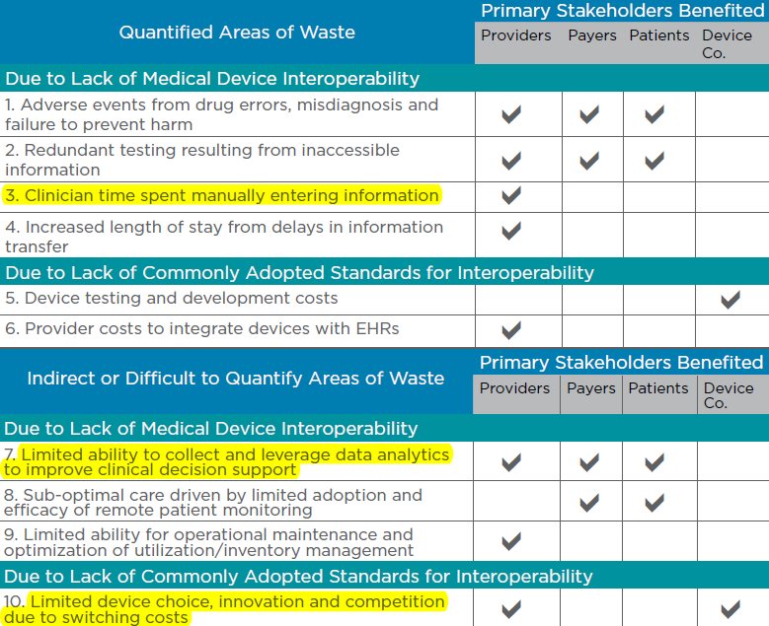
* Source: The Value of Medical Device Interoperability; West Health Institute.

Slide 11
What are the obstacles?
Wide range of methods used by device vendors
Some vendors use distinct proprietary and closed communication methods even among their own devices.
Some standards are loosely specified
Too many options for configuration
Customization can be difficult

Slide 12
* Source: The Value of Medical Device Interoperability; West Health Institute.

Slide 13
* Source: The Value of Medical Device Interoperability; West Health Institute.

Slide 14
Device Integration Architecture: Two Options
Direct EHR Integration
With Somnoware
5 HL7 interfaces for each device
(ADT, Orders, SIU Results, Charge Capture)
Sleep lab
Sleep lab
Somnoware
Built-In Integrations
New Device
NOX T3
Airview
New Device
NOX T3
Alice NightOne
WatchPAT
Airview
Future PFT
Nonin
Future PFT
Encore
Anywhere
Brightree
MPR
Carefusion
WatchPAT
Polysmith
Encore
Anywhere
Remlogic
Polysmith
Brightree
Remlogic
Embletta MPR
Alice NightOne
Carefusion
Note: Consider high interface cost per vendor and no communication between devices via middleware.
Note: Low cost, one-time fee via Somnoware eliminates the need for individual interface

Slide 15
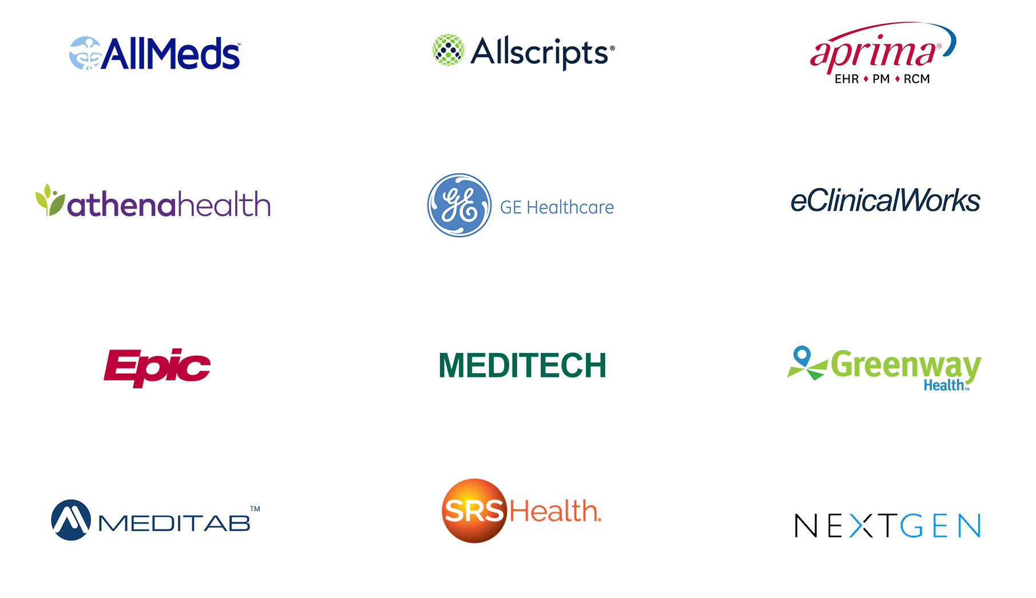
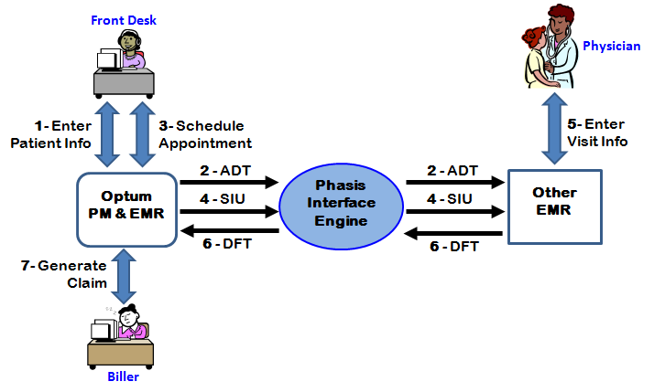
Methodology – how is it accomplished?
API
HL7 Interface
Data Exchange

Slide 16
Application
Programming
Interface
Enables software program to interact with other software.
Desktop
App
Wearables
EMR
Dx & PAP Devices
API
Billing Platform
Compliance Data
Database

Slide 17
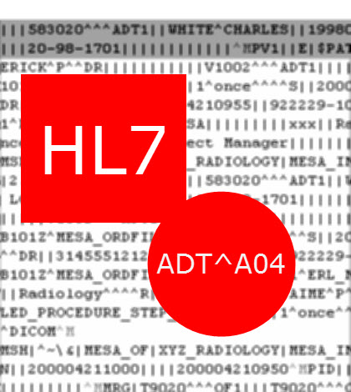
HL7 Interface
ADT – Admission, Discharge, Transfer
ORM – Order Message
SIU – Scheduling Information
DFT – Financial Transaction
ORU – Observation Results
Integrate and exchange data with any Disparate healthcare systems.

Slide 18
Data Exchange in EPIC
Shared Instance – An organization using Epic can share its instance with another provider
EPIC
Sleep
Pulmonary
Neurology

Slide 19
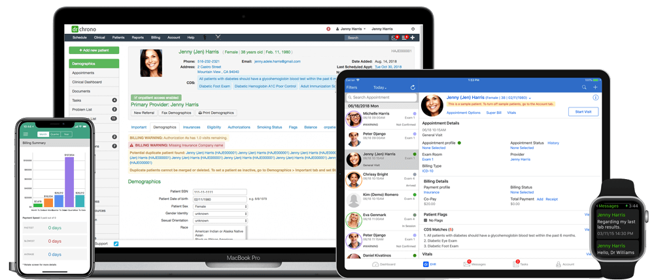
Data Exchange
Web Link - EpicCare Link: Community providers can access the patient chart via a web portal, so that they can follow the patient's care across the health system, schedule appointments, place orders, send notes and more.

Slide 20
Data Exchange
C-CDA Push/Pull Interoperability - Care Everywhere: Wherever patients go, their charts goes with them.
Notes:
This is what people traditionally think of as "interoperability," he said. When a patient shows up for care at a health system using Epic, Care Everywhere sends out requests to other health systems, receives the standardized summary (C-CDA) and incorporates the new data within the patient's record. In addition, Care Everywhere can receive an automated request and send the summary to the requesting health system

Slide 21
Outcome of Interoperability

Slide 22
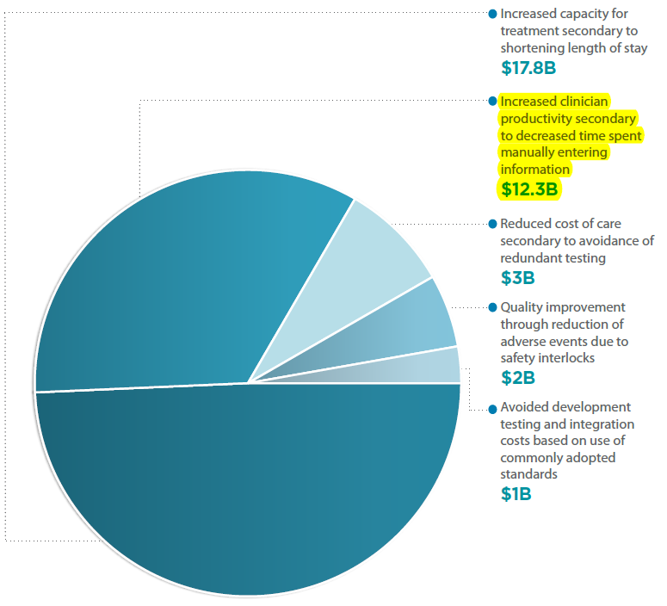
Breakdown of estimated benefits from Medical Device Interoperability
* Source: The Value of Medical Device Interoperability; West Health Institute.

Slide 23
Case Study: Truman Medical Centers
10 bed hospital lab
Decreased overall average process time from 22 days to 7 days – 68% reduction.
Saved $27k/year in dictation fees and $26k/year in IT costs
Referrals and study volume increased by over 50%
Added DME clinic without adding staff
”
In less than six months, we returned a scoring time of 24 hours and less than 52 hours for final interpretations. Productivity reports, scheduling, HL7 interfacing, and AASM accreditation have all been easily accomplished — thanks to our partnership with Somnoware.
Marvin E. Johnson, Senior Director, Truman Medical Center

Slide 24
Case Study: Well Necessities
Multi-location independent test facility with 52 beds
Decreased overall average process time from 20 days to 6 days – 70% reduction.
Eliminated IT costs of servers used for data storage
Significantly improved the physician experience by delivering shorter test cycles and providing remote data access

Slide 25
Summary
Widespread Medical Device Interoperability can eliminate $36B of waste in health care system
Interoperability leads to increased efficiency
Lower cost
Better quality of care
Notes:
1 )quality of care through adverse events due to safety interlocks (1.9 billion)
2) reduced cost of care secondary to avoidance of redundant testing (1.5 billion)
3) increased clinician productivity secondary to decreased time spent manually entering information (12 billion)
4) increased capacity for treatment

Slide 26
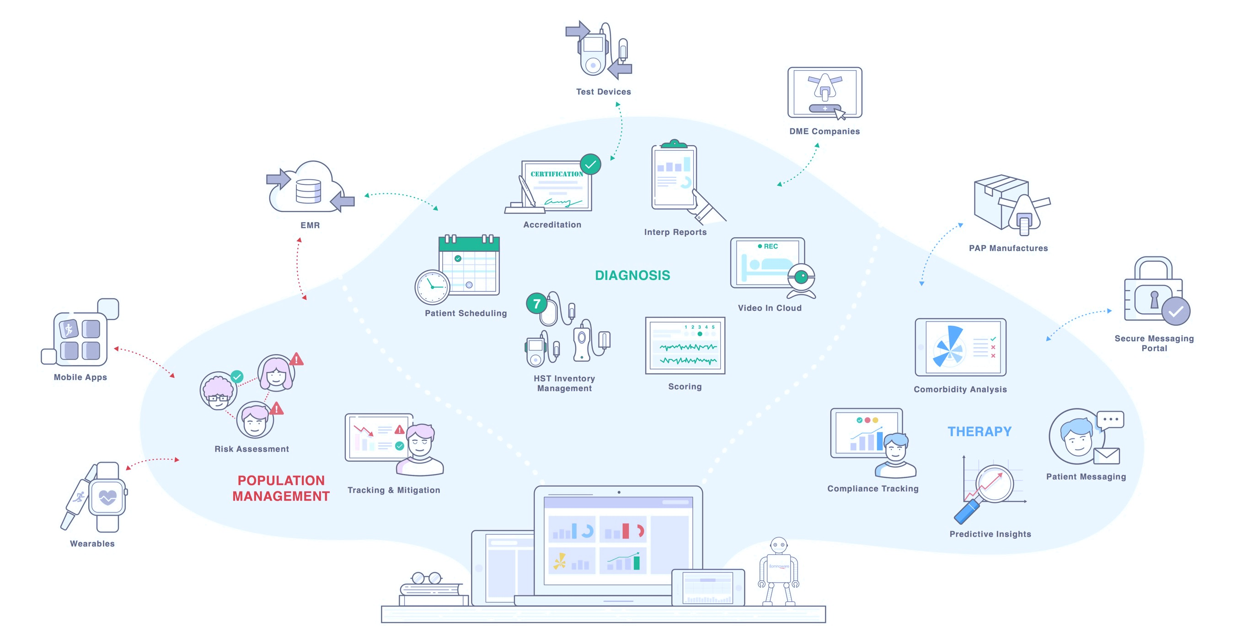
The Power of Interoperability via “middleware”

Slide 27
Questions?
irened@somnoware.com

