Slide 1
That I May Dwell Among Them Why The Tabernacle?
Exodus 25:8-9

Slide 2
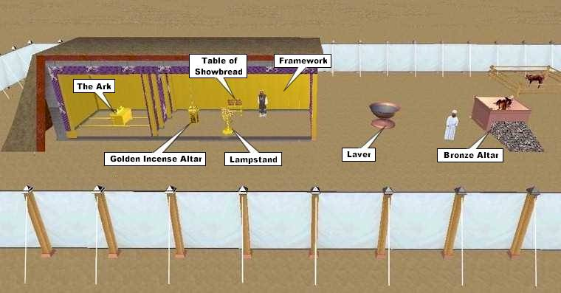

Slide 3
We Learn Lessons About
The Person Of God
The Character of God
The Accessibility of God

