Slide 1
The Nose
Anatomy, function and relationships to SDB
NEPS
September 6, 2019
Noah S Siegel, MD

Slide 2
Outline of talk
Overview of upper airway examination
The nose
  Functions
  Examination
The nose and sleep disordered breathing
Treatment of the nose
Surgical therapy for the nose
The impact of nasal interventions on SDB

Slide 3
The Nose
More questions than answers
Does nasal obstruction cause sleep apnea?
Can treating nasal obstruction improve OSA?
Does improving nasal obstruction improve CPAP compliance?
Does improving nasal obstruction improve OA efficacy?
Can treating nasal obstruction result in a decrease in CPAP pressures?

Slide 4
Outline of talk
Overview of upper airway examination
The nose
  Functions
  Examination
The nose and sleep disordered breathing
Treatment of the nose
Surgical therapy for the nose
The impact of nasal interventions on SDB

Slide 5
Who Needs An Upper Airway Examination?
Everyone?
Some individuals?
  Children
  Upper airway symptoms
  Craniofacial anomalies
  OSA out of proportion to BMI
  Unable to tolerate CPAP or oral appliance
  Those with nasal obstruction

Slide 6
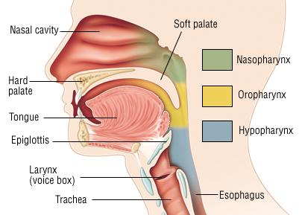
Sleep Apnea Examination
  Nasal cavity/nasophayrnx
  Oral cavity
  Oropharynx
  Hypopharynx/larynx
  Skeletal
  Body Habitus

Slide 7
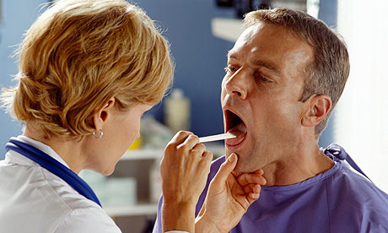
Physical Examination
Headlight/mirror ⎯ direct examination

Slide 8
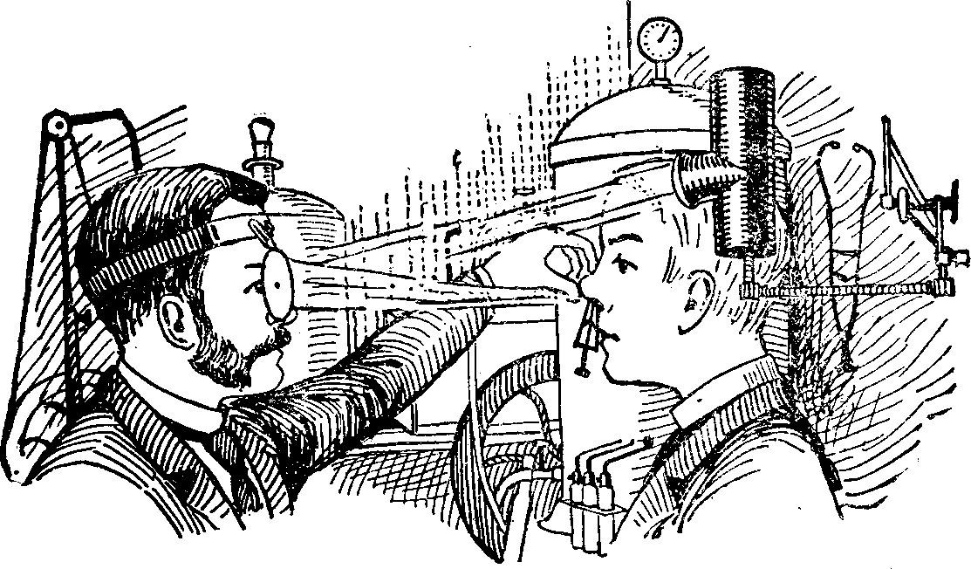

Slide 9
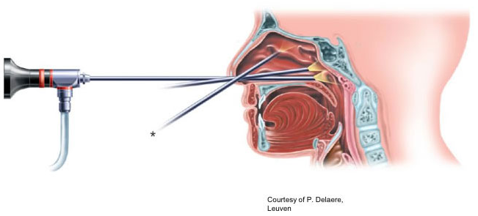
Nasal Endoscopy – rigid scope

Slide 10
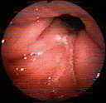
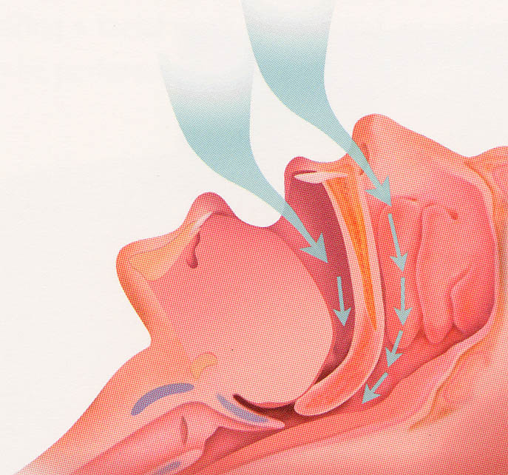

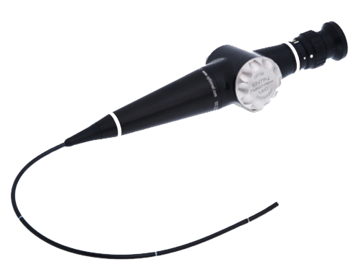

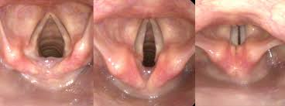
Fiberoptic Exam and Mueller Maneuver

Slide 11
Outline of talk
Overview of upper airway examination
The nose
  Functions
  Examination
The nose and sleep disordered breathing
Treatment of the nose
Surgical therapy for the nose
The impact of nasal interventions on SDB

Slide 12
Functions of the nose
Airway
Warm and humidify the air (turbinates)
Filter the air
Resonation ‘chamber’ for voice
Olfaction

Slide 13
Examination of the nose
External
Internal

Slide 14
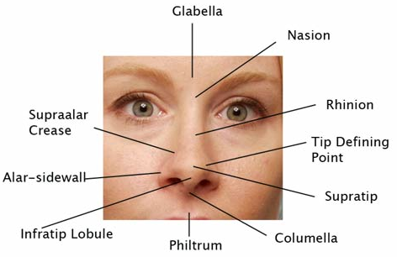
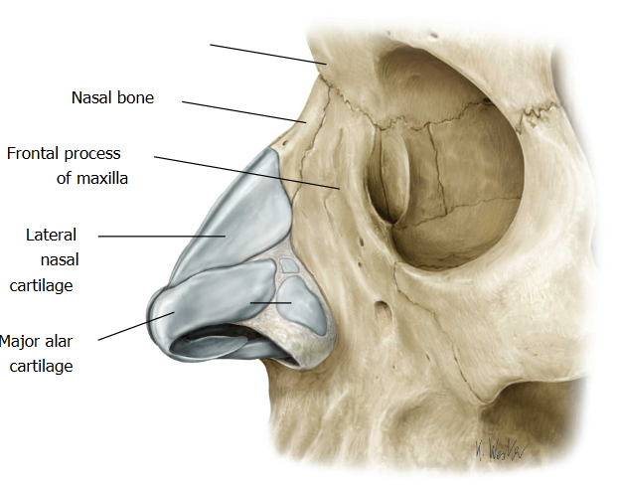
External nasal anatomy

Slide 15
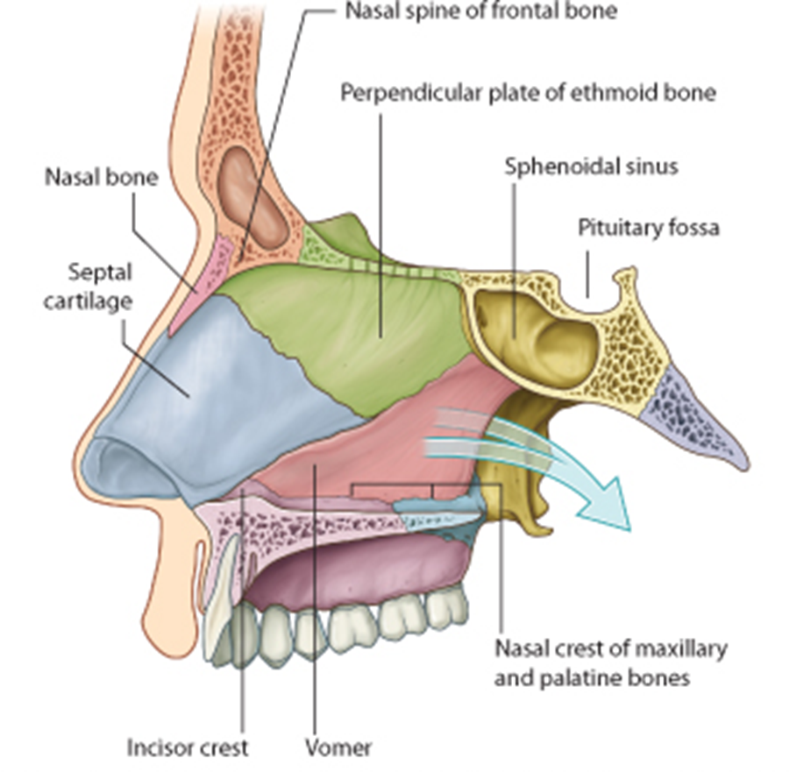
Internal midline nasal anatomy (septum)
Perpendicular plate of the ethmoid.
Septal cartilage.
Vomer
Incisor (maxillary) crest
  Epistaxis

Slide 16
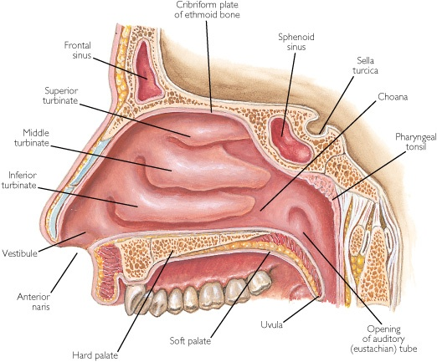
Internal lateral nasal anatomy
LATERAL WALL OF NASAL CAVITY
3 curved long projections called nasal conchae:
  Superior turbinate
  Middle turbinate
  Inferior turbinate
The space below each of these conchae is called nasal meatus

Slide 17
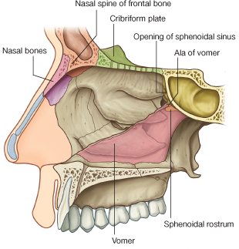
Internal nasal anatomy - roof
Narrow
Formed by:
  Cribriform plate of the ethmoid bone
  Nasal and frontal bones, and posteriorly sphenoid Bone.

Slide 18
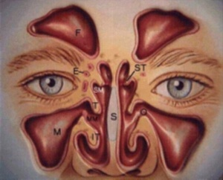
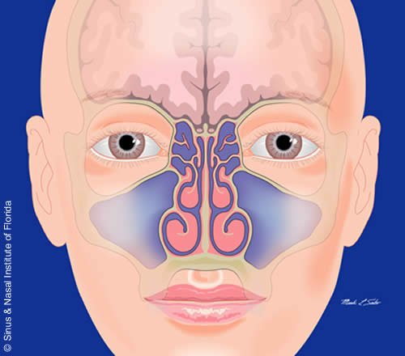
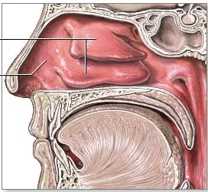
Rhinology ⎯ Paranasal Sinuses
  Frontal
  Maxillary
  Ethmoid
  Sphenoid

Slide 19

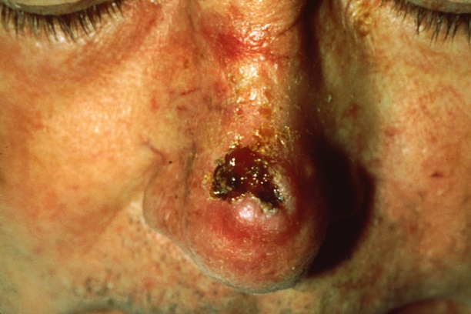
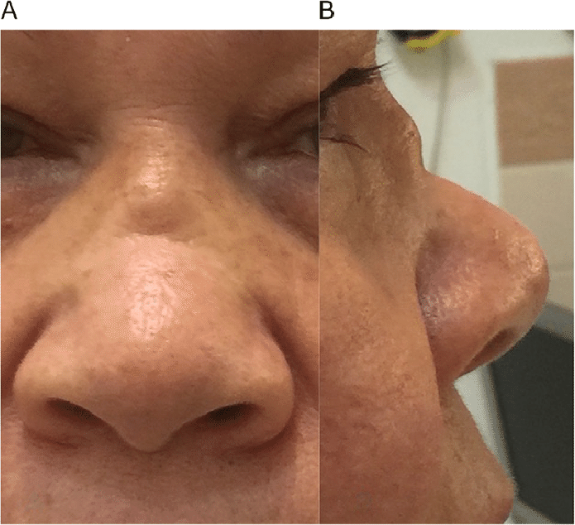
External Nasal Examination
Straight?
Skin lesions?
Projection?

Slide 20
External findings provide clues to internal anatomy

Slide 21
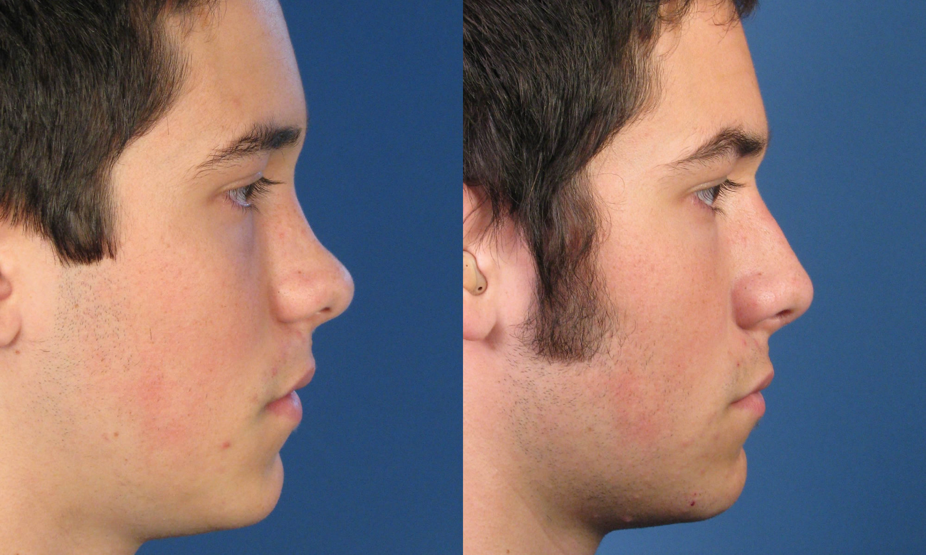

Slide 22
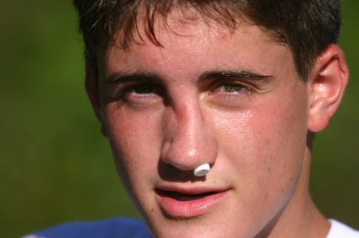
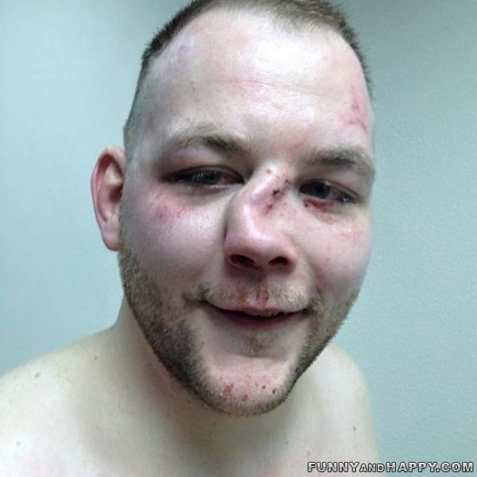
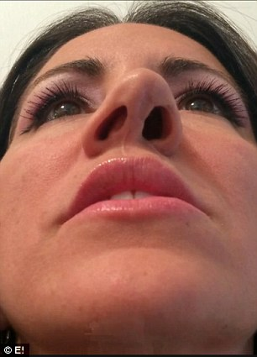

Slide 23
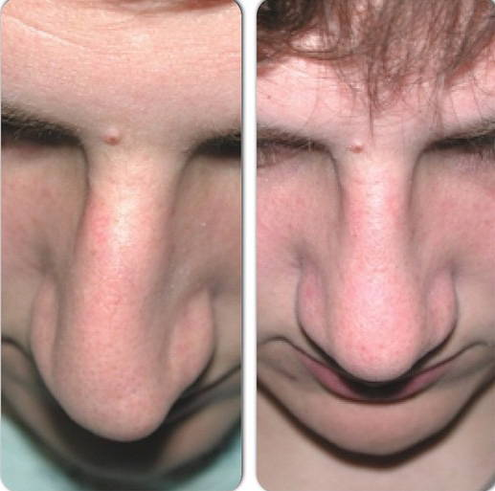

Slide 24
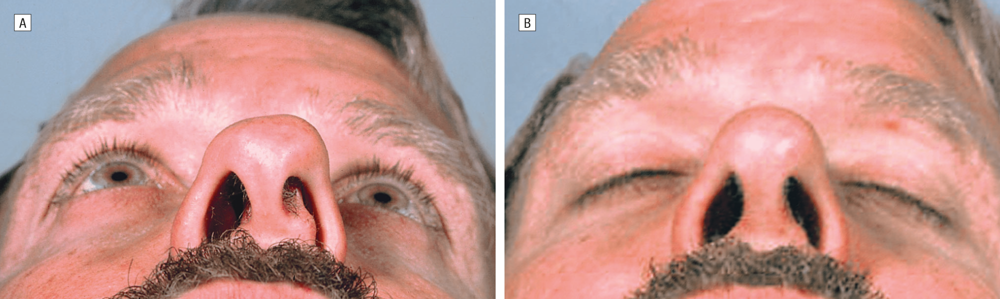
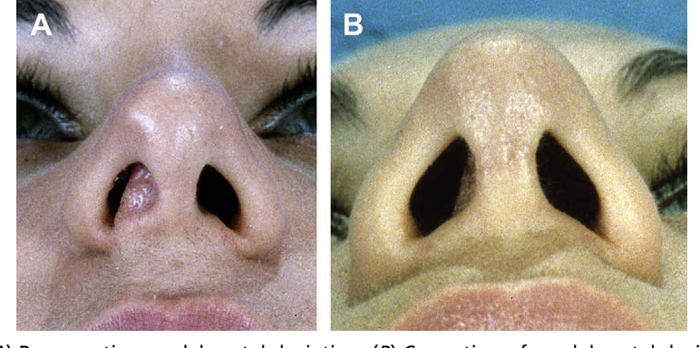

Slide 25
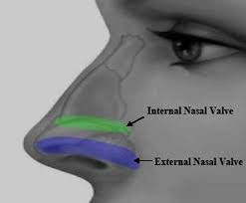
If it is narrow, widen it. If it is floppy, stabilize it.

Slide 26
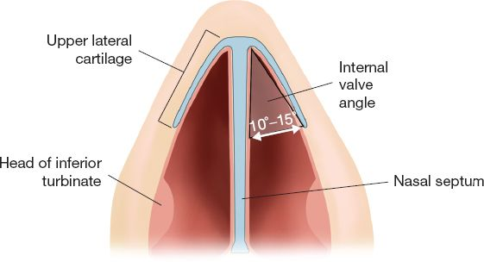
Nasal valve

Slide 27
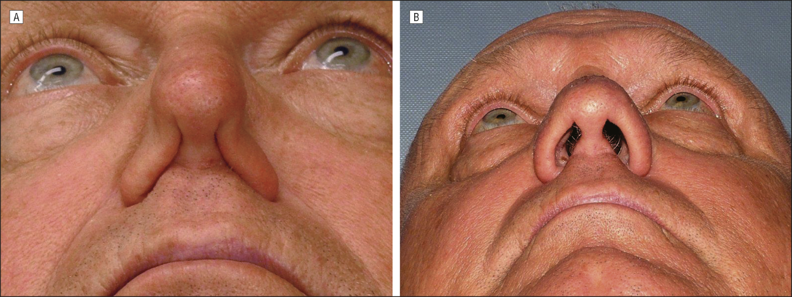
Nasal valve

Slide 28
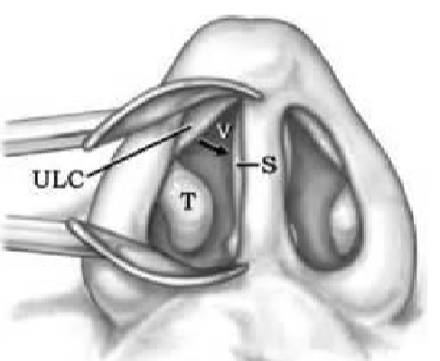
Nasal Exam
Key to nasal exam = nasal valve
ULC = upper lateral cartilage
S = septum
T = inferior turbinate
Normal angle V;
10 to 15 degrees
At narrowest part of upper airway
50% of nasal resistance
Slide courtesy of Raj Dediah

Slide 29
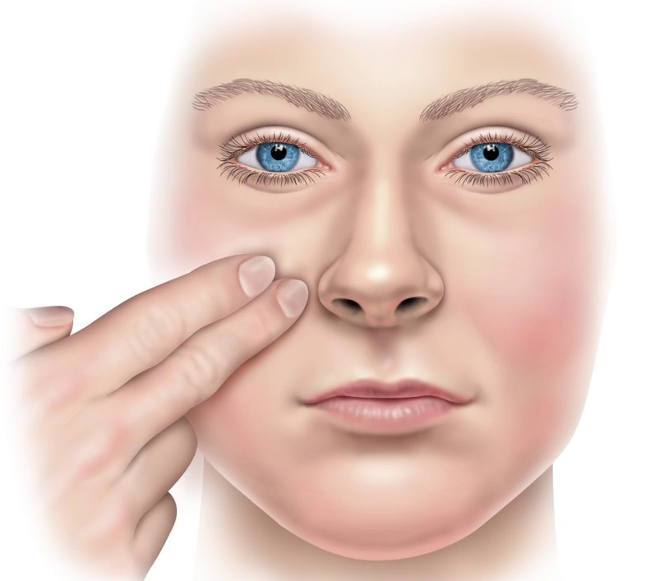
Cottle Maneuver

Slide 30
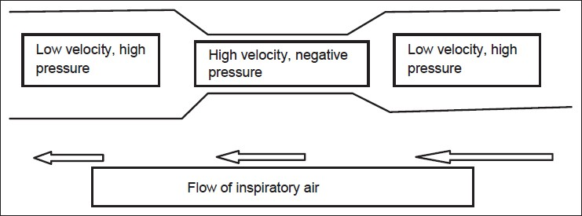
Bernoulli Effect

Slide 31
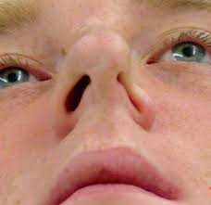
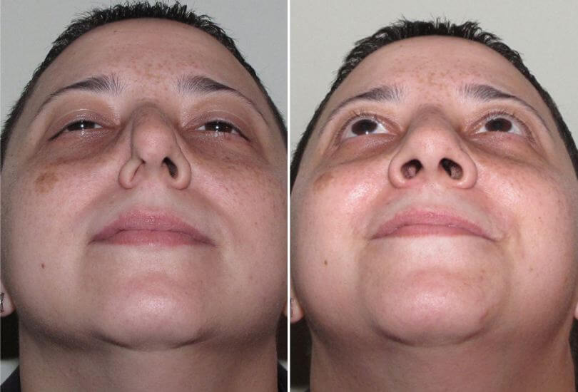

Slide 32
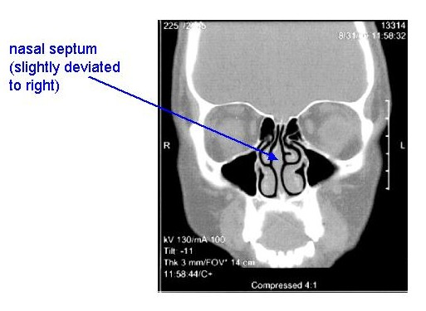
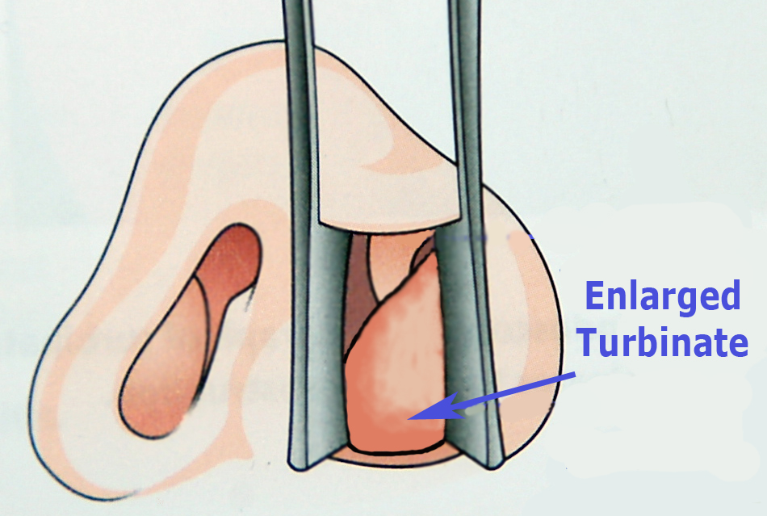
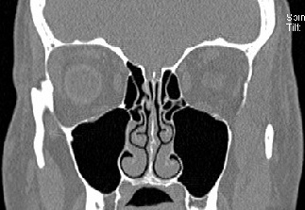
Intranasal exam

Slide 33
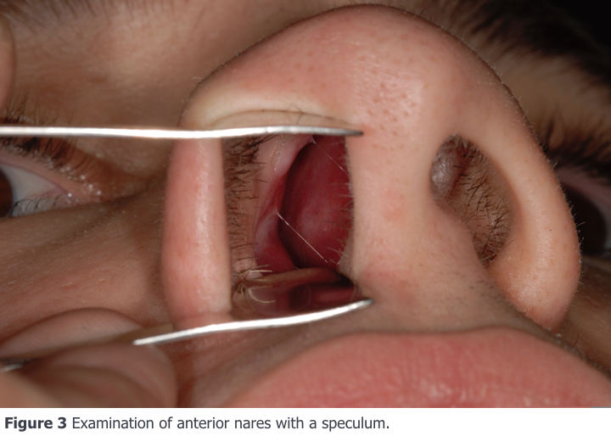

Slide 34
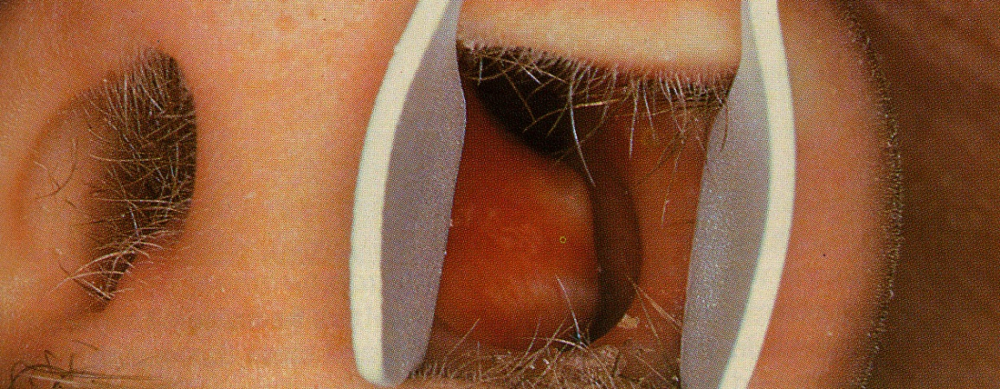
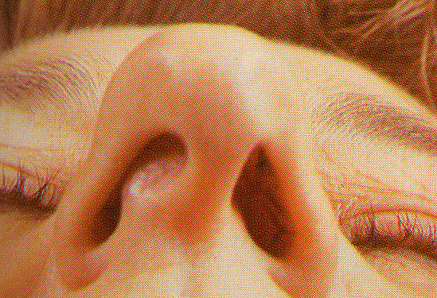
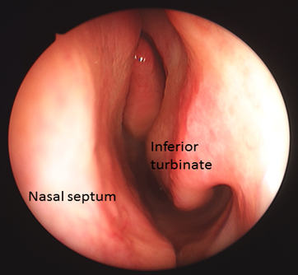
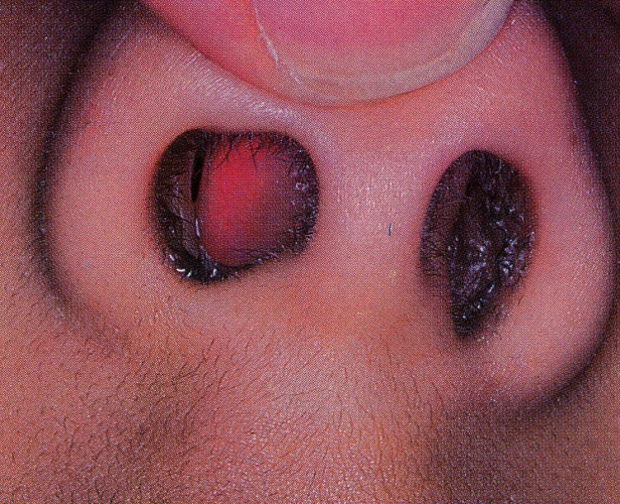
Deviated Septums

Slide 35
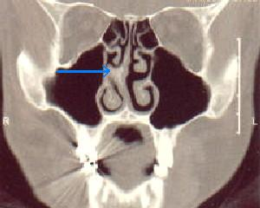
Deviated septum

Slide 36
Turbinates - DYNAMIC
Nasal cycle
Respond to:
  Allergies
  Colds
  Chemical exposures
  Body position
  Temperature
  hormones

Slide 37
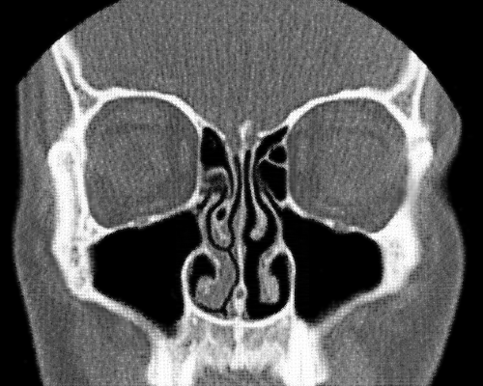
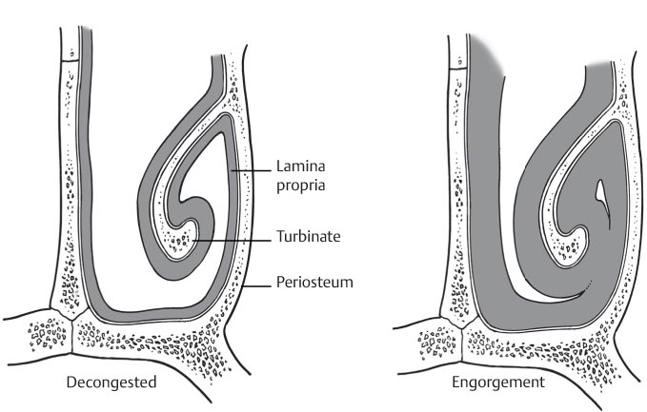

Slide 38
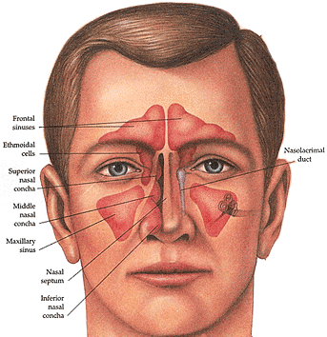
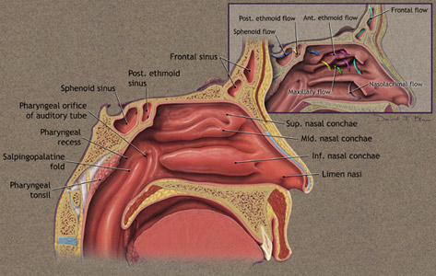
Nasal/Sinus Anatomy

Slide 39
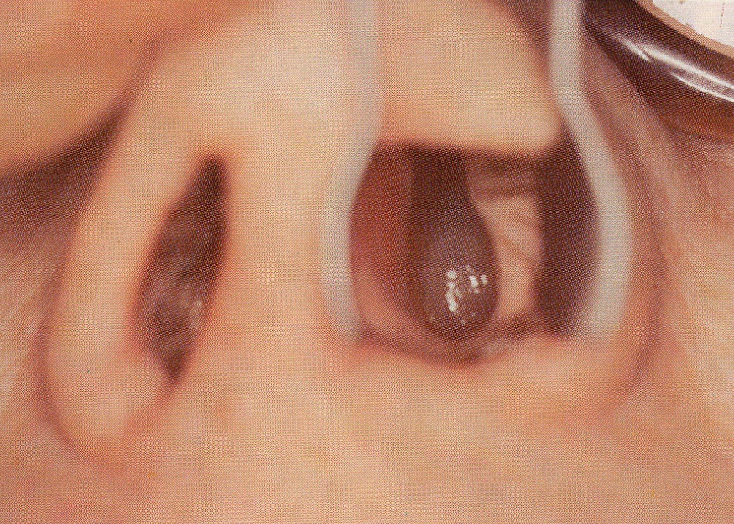
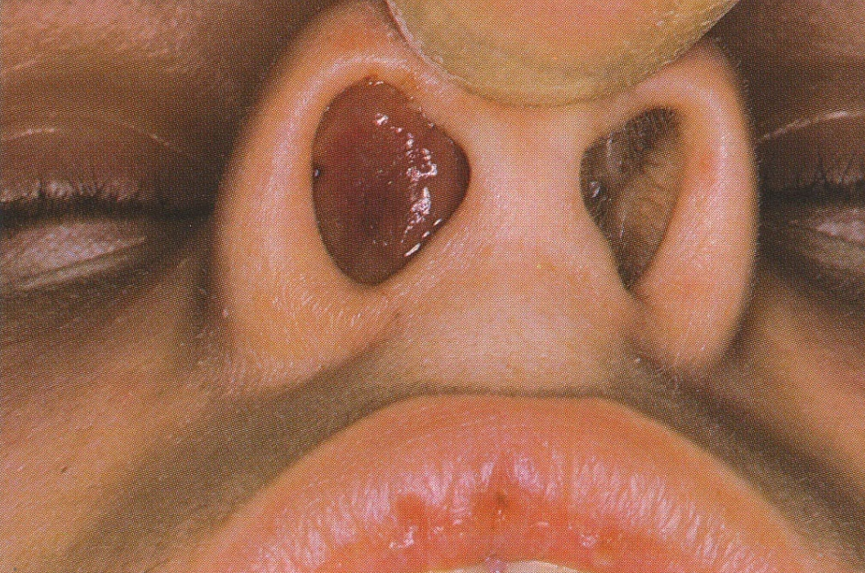
Nasal Polyps

Slide 40
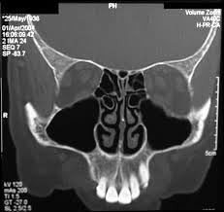
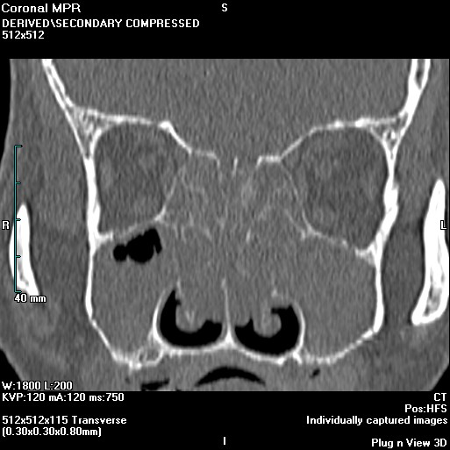
Normal vs. Nasal polyps

Slide 41


Enlarged Adenoid

Slide 42
Outline of talk
Overview of upper airway examination
The nose
  Functions
  Examination
The nose and sleep disordered breathing
Treatment of the nose
Surgical therapy for the nose
The impact of nasal interventions on SDB

Slide 43

Nasal Airway Resistance
Narrowest part of the upper airway
20-50% of airway resistance
20-60 mm2

Slide 44

Poiseuille’s Law

Slide 45

Starling Resistor Model
Negative pressure leads to pharyngeal collapse

Slide 46

Upper airway resistance (UAR) during oral and nasal breathing while awake and asleep.
M.F. Fitzpatrick et al. Eur Respir J 2003;22:827-832
©2003 by European Respiratory Society
Notes:
Upper airway resistance (UAR) during oral and nasal breathing while awake and asleep. Data are presented as mean±sem. **: p<0.01. n=10 for each category.

Slide 47

Effect of breathing route on upper airway resistance (UAR) during supine stage two sleep.
Oral breathing UAR was > 2 x higher vs. nasal breathing.
M.F. Fitzpatrick et al. Eur Respir J 2003;22:827-832
©2003 by European Respiratory Society
Notes:
Effect of breathing route on upper airway resistance (UAR) during supine stage two sleep. Data are presented as mean±sem. #: p=0.012.

Slide 48

Effect of breathing route on sleep apnoea severity in the supine position.
M.F. Fitzpatrick et al. Eur Respir J 2003;22:827-832
©2003 by European Respiratory Society
Notes:
Effect of breathing route on sleep apnoea severity in the supine position. Data are presented as mean±sem. **: p<0.01 oral versus nasal breathing route.

Slide 49
Nasal Pressure Reflex
With nasal breathing, negative pressure stimulates upper airway afferent nerves that increase the upper airway dilator muscle activity.
Oral breathing leads to decrease muscle dilator activity
Horner RL Afferent pathway(s) for pharyngeal dilator reflex to negative pressure in man: a study using upper airway anaesthesia. J Physiol. 1991;436:31e44.
Pierce R Upper airway collapsibility, dilator muscle activation and resistance in sleep apnoea. Eur Respir J. 2007;30: 345e353.
Fitzpatrick MF Partitioning of inhaled ventilation between the nasal and oral routes during sleep in normal subjects. J App Psyc. 2003;94:883e890.

Slide 50
Nasal Ventilatory Reflex
Nasal airflow increases spontaneous ventilation
Higher minute ventilation
Douglas NJ, White DP, Weil JV, Zwillich CW. Effect of breathing route on ventilation and ventilatory drive. Respir Physiol. 1983;51:209e218.
Berry RB, Kouchi KG, Bower JL, Light RW. Effect of upper airway anesthesia on obstructive sleep apnea. Am J Respir Crit Care Med 1995 Jun;151(6):1857-61.

Slide 51
The Nose and OSA
Nasal obstruction (NO) is associated with snoring and mild OSA.
50% of CPAP users have nasal complaints
OSA increases in allergy season
  Am J Resp Crit Care Med 165:1217,2002
However, no clear correlation between severity of NO and OSA.
  Lofaso 2000. European Resp Journal, 16 (4)
  Surratt 1986. Chest 90(3)
  Lavie 1983. Acta Otolaryngoligica, 95 (1-2)
  Young 1997. Journal of Allergy and Clinical Immunology, 99(2)
  Basner 1989. Journal of Applied Physiology, 66(4)

Slide 52
Nasal Obstruction and Sleep Disordered Breathing
Case series 1 (Lavie Acta Otolaryngol 92;529, 1981)
  14 patients with AR and chronic nasal obstruction
  Disordered breathing in all patients (10 times higher rate than normal controls)
    Micro-arousals
    Hypopneas irregular breathing
    Snoring
Acute nasal obstruction (Lavie Acta Otolaryngol 95;161, 1983)
  10 subjects ⎯ induced acute nasal obstruction
  Apnea was induced in all patients
  Most apneas were central

Slide 53
Potential Nasal Pathophysiology and OSA
Michels 2014. International Journal of Otolaryngology
Model | Explanation
Startling resistor model | Increased nasal resistance results in negative oropharyngeal pressure (suction)
Instability of mouth breathing | Significant increase in nasal resistance results in mouth breathing and unstable airway (tongue and pharyngeal muscles)
Nasal Ventilatory reflex | Decrease in nasal airflow results in less activation of nasal receptors and, consequently inhibition of muscle tone, respiratory rate and minute ventilation
Nitric Oxide (NO) | Decrease in nasal flow generates lower concentration of pulmonary NO and reduced ventilation-perfusion ratio.

Slide 54
Outline of talk
Overview of upper airway examination
The nose
  Functions
  Examination
The nose and sleep disordered breathing
Treatment of the nose
Surgical therapy for the nose
The impact of nasal interventions on SDB

Slide 55
Treatment of The Nose
Medical:
  Identify and treat allergy
  environmental factors – smoke, chemicals
Surgical:
  Deviated septum
  Enlarged turbinates
  Nasal valve collapse
  Sinus surgery/polypectomy
  Adenoidectomy

Slide 56
Goals of Nasal Treatment for OSA
Improve nasal airway
Resolve snoring
Improve sleep disordered breathing subjective symptoms
Cure OSA?
Improve CPAP or OA compliance
  Lower CPAP pressure requirement

Slide 57
Surgical therapies
Septoplasty
Turbinate reduction
Sinus surgery/nasal polyp removal
Repair of nasal valve
Adenoidectomy

Slide 58

Repair of Deviated Septum

Slide 59
Turbinate Reduction
Traditional techniques:
  Cautery and outfracture
  Submucous resection
  Excision or partial excision
Radiofrequency reduction:
  Coblation
  Somnoplasty

Slide 60


Turbinate Reduction

Slide 61


Slide 62





Slide 63

Removal of Nasal Polyps

Slide 64



Non-Surgical Stabilization of the Nasal Valve

Slide 65


Surgical Stabilization of Nasal Valve

Slide 66



Removal of Adenoids

Slide 67
Outline of talk
Overview of upper airway examination
The nose
  Functions
  Examination
The nose and sleep disordered breathing
Treatment of the nose
Surgical therapy for the nose
The impact of nasal interventions on SDB

Slide 68
Impact of treating the nose on:
Sleep quality
SDB
Oral Appliance therapy
CPAP

Slide 69
Nasal Surgery and Sleep Quality
Stapelton et al Otolaryngol Head Neck Surg. 2014 Nov;151(5):868-73
67 adults prospective
Complaint: nasal obstruction
Surgical procedure: At least septoplasty and turbinate reduction
3 months Post OP
  PSQI 7.8 to 4.6 (p<0.001)
  ESS 7.5 to 5.3 (P<0.001)

Slide 70
Impact of treatment of AR on OSA
Topical intranasal steroids
5 studies (1 pediatric)
  3/5 showed improvement in AHI
  3/3 showed improvement in ESS
  Kiely JL, Nolan P, McNicholas WT. Intranasal corticosteroid therapy for obstructive sleep apnoea in patients with co-existing rhinitis. Thorax. 2004;59(1):50-5.
  Lavigne F, Petrof BJ, Johnson JR, Lavigne P, Binothman N, Kassissia GO, et al. Effect of topical corticosteroids on allergic airway inflammation and disease severity in obstructive sleep apnoea. Clin Exp Allergy. 2013;43:1124-33.
  Meltzer EO, Munafo DA, Chung W, Gopalan G, Varghese ST. Intranasal mometasone furoate therapy for allergic rhinitis symptoms and rhinitis-disturbed sleep. Ann Allergy Asthma Immunol. 2010;105:65-74.
  Acar M, Cingi C, Sakallioglu O, San T, Fatih Yimenicioglu M, Bal C. The effects of mometasone furoate and desloratadine in obstructive sleep apnea syndrome patients with allergic rhinitis. Am J Rhinol Allergy. 2013;27:e113-6.
  Brouillette RT, Manoukian JJ, Ducharme FM, Oudjhane K, Earle LG, Ladan S, et al. Efficacy of fluticasone nasal spray for pediatric obstructive sleep apnea. J Pediatr. 2001;138:838-44

Slide 71
Impact of treatment of AR on OSA
Leukotriene modulators - kids
3 studies (all pediatrics)
  2/3 showed positive results (decrease AHI)
  2/2 showed improved AI.
  Goldbart AD, Goldman JL, Veling MC, Gozal D. Leukotriene modifier therapy for mild sleep-disordered breathing in children. Am J Respir Crit Care Med. 2005;172:364-70.
  Goldbart AD1, Greenberg-Dotan S, Tal A. Montelukast for children with obstructive sleep apnea: a double-blind, placebo-controlled study. Pediatrics. 2012;130:e575-80.
  Kheirandish L1, Goldbart AD, Gozal D. Intranasal steroids and oral leukotriene modifier therapy in residual sleep-disordered breathing after tonsillectomy and adenoidectomy in children. Pediatrics. 2006;117:e61-6.

Slide 72
Nasal Surgery and OSA
Hsueh-Yu Li Archives Otolaryngology HNS 134(4), April 2008
Patients with OSA and c/o nasal obstruction
Post-op improvement (statistically significant)
  Snore Outcomes Survey
  Epworth Sleepiness Score
  SF-36 score
  ‘Role-physical’ QOL subscale

Slide 73
Nasal Surgery and OSA
Li 2008. Laryngoscope 118(2) and Li 2008. Archives of Otolaryngology 134(4)
  52 patients
  Nasal surgery resolved snoring in 12% of patients
  Significant improvement in snoring and QOL
    Snore Outcomes Survey (by 43.1%)
    Epworth Sleepiness Scale (by 27.3%)
    Generic SF-36 role-emotional (by 30.4%)
    Role-physical (by 20.7%)
  No statistically significant change in PSG

Slide 74
Nasal Surgery and OSA
Wu J, Zhao G, MD, Li Y, et al (2017: Meta-Analysis)
18 studies (2002-2016)
  587 patients
    17 evaluated AHI
    11 evaluated ESS

Slide 75

Nasal Surgery and OSA
Wu J, Zhao G, MD, Li Y, et al (2017: Meta-Analysis)

Slide 76

Nasal Surgery and OSA
Wu J, Zhao G, MD, Li Y, et al (2017: Meta-Analysis)
AHI Outcome
Subgroup 1 includes studies providing AHI SD of outcome parameter; subgroup 2 includes studies not providing AHI SD of outcome parameter
Wu J, Zhao G, MD, Li Y, et al (2017: Meta-Analysis)

Slide 77

Nasal Surgery and OSA
Wu J, Zhao G, MD, Li Y, et al (2017: Meta Analysis)
ESS Outcome
Subgroup 1 includes studies providing ESS SD of outcome parameter; subgroup 2 includes studies not providing ESS SD of outcome parameter

Slide 78
The Role of Nasal Obstruction in OSAS – Meta- Analysis Studies
Wu J, et al: 2017 (Meta-Analysis Study)
Conclusions:
  Both AHI (slightly) and ESS improved significantly after isolated nasal surgery
  Supports the role for isolated nasal surgery in carefully selected OSA patientsstudy provide some evidence supporting for isolated nasal surgery in OSA patients

Slide 79
Is the Nose Important For OAT Response?
Marklund et al. Chest. 2004 Apr;125(4):1270-8
  630 patients
  Prospective study
  Determine factors which predict success
Women who complained of nasal obstruction were 9 times less likely to respond to OAT
Mandibular advancement devices in 630 men and women with obstructive sleep apnea and snoring: tolerability and predictors of treatment success
Marlund et al. Chest 2004 Apr;125(4):1270-8

Slide 80

Zheng et al. Sleep 2008; 31(4):543-547
  38 patients
    26 OA responders
    12 OA non-responders
Nasal airway resistance (NAR) by posterior rhinomanometry
  Sitting and supine without OA
  Sitting and supine with OA

Slide 81

Influence of Nasal Resistance on Oral Appliance Treatment Outcome in OSA
Findings: NAR and BMI were most important predictors of OA response
Zheng et al. Sleep 2008; 31(4):543-547

Slide 82
Nasal Obstruction and CPAP
>50% of CPAP users have nasal complaints
Some studies demonstrate improved CPAP tolerance with better nasal airway (not consistent)
  Morris 2006. American Journal of Rhinology 20(2)
  Sugiura 2006. Respiration 74(1)
  So 2009. Clinical and Experimental Otolaryngology 2(4)
  Powell 2001. Laryngoscope 111(10)
Nasal surgery can decrease CPAP pressures
  (9.3 cm → 6.7) ⎯ Friedman 2000. Otolaryngology Head and Neck Surgery 122(1)
  (16.8 cm → 12) ⎯ Nakata 2005. Rhinology 43(4)

Slide 83

Rationale for Nasal Surgery
Lower CPAP Pressure Requirement
(Kempfle et al; Laryngoscope 2017)

Slide 84

Rationale for Nasal Surgery
Improve CPAP Compliance
(Kempfle et al; Laryngoscope 2017)

Slide 85
Nasal Surgery and PAP ⎯ Meta Analysis
Camacho et al. Sleep 2015 Feb 1;38(2):279-86
Study the impact of isolated nasal surgery on PAP
279 patients (18 studies)
Four types of surgical procedures:
  Septoplasty
  Turbinate reduction
  Septoplasty with Turbinate reduction
  Unspecified

Slide 86

Nasal Surgery Meta Analysis
Camacho et al. Sleep 2015 Feb 1;38(2):279-86
Nasal surgery and CPAP pressures

Slide 87
Nasal Surgery and PAP Compliance
Camacho et al. Sleep 2015 Feb 1;38(2):279-86
Number of patients | Presurgery: Regular PAP Users | Post-Surgery: Regular PAP Users | Pre-Surgery: Objective Hours of CPAP use | Post-Surgery: Objective Hours of CPAP use
153 | 36/93 (39%) | 92/102 (92%) | 3.0 +/- 3.1 | 5.5 +/- 2.0

Slide 88
What Can I Do?
Appreciate the importance of the nose
Ask about the nose
Examine the nose
Build relationships!

Slide 89
When Should I Refer?
Patient complains of nasal obstruction
Patient has difficulty with tolerating CPAP and or OA
Overt anatomic findings

Slide 90
The Nose
More questions than answers
Does nasal obstruction cause sleep apnea?
Can treating nasal obstruction improve OSA?
Does improving nasal obstruction improve CPAP compliance?
Does improving nasal obstruction improve OA efficacy?
Can treating nasal obstruction result in a decrease in CPAP pressures?

Slide 91
Summary – Treating the nose CAN
  Treat snoring and SDB
  Improve CPAP compliance/pressures
  Improve oral appliance compliance/efficacy
  Improve quality of life

Slide 92
Thank you

