Slide 1
Surviving the Surveyor
Peter Allen,
BSRC, RRT-NPS-SDS, RST, RPSGT
New England Polysomnographic Society
September 2019

Slide 2
Conflicts of Interest
Clinical Coordinator, Main Line Health System
US Project Manager
Bermuda Center for Sleep Disorders
NBRC Board Exam Consultant
MVAP Medical, Inc

Slide 3
Learning Objectives
Attendee will have a better understanding of inspection preparation and process
Attendee will be better prepared for their next accreditation or other surveyor/consultant site visit.
Attendee will be better able to prepare staff for survey visits.
Attendee will be more aware of the safety and infection control issues being focused on every year.
Attendee will better understand everyone’s role

Slide 4
Presentation Introduction
My Goal
This presentation will act as an outline and resource/ guide to be built upon, for everyone who works at a sleep disorders center.
It is based mostly on my current experiences as my health care system prepared for Site Surveys from The Commission……… and also our most recent re-accreditation with the AASM

Slide 5
JCAHO
Joint Commission on Accreditation of Healthcare Organizations
AASM
American Academy of Sleep Medicine

Slide 6
JCAHO
The mission of The Joint Commission is to continuously improve the safety and quality of care provided to the public through the provision of health care accreditation and related services that support performance improvement in health care organizations.
Unannounced Surveyor Visits
First Sleep Accreditation 1999
Over 4000 hospitals and 19000 health care organizations

Slide 7
Mike Dye Joint Commission
Mike Dye
Senior Business Development Specialist
Ambulatory Care Services
Business Development
The Joint Commission
One Renaissance Boulevard
Oakbrook Terrace, IL 60181
P. 630.792.5259
E-mail: mdye@jointcommission.org
Web: www.jointcommission.org

Slide 8
Joint Commission

Slide 9
AASM
The American Academy of Sleep Medicine is recognized as the Gold Standard for Sleep Disorders Center Accreditation in the United States
First Sleep Accreditation in 1977
Scheduled Surveyor Visits Every Five Years
Accredits sleep facilities, stand alone providers of Home Sleep Apnea Testing and Durable Medical Equipment providers.

Slide 10
Your AASM Advisor
AASM.ORG

Slide 11
ACHC
ACHC.ORG

Slide 12
Fast Track
All Do Fast Track Accreditation

Slide 13
Department of Health
Usually a fast inspection
Services Provided
Hours of Operation
Patient Population
Staffing
Referral Process
Number of Active Patients
Physical Site

Slide 14
Why Accreditation?
Sets Standards
Is required by Centers for Medicaid and Medicare
Required by insurance companies
State Licensure for Hospitals

Slide 15
The Surveyor/Consultant

Slide 16
Mock Surveys
Great Way for Your Facility to Prepare for Surveyors
Either Internal or External Surveyor/Consultants
Or Both
Four Mock Surveys this Year
You never feel ready, kind of like Board Exams

Slide 17
JC Standards/Areas Covered
Environment of Care
Emergency Management
Human Resources
Infection Prevention and Control
Information Management
Leadership
Medication Management in the Sleep Lab
National Patient Safety Goals
Provision of Care, Treatment, and Services
Performance Improvement
Record of Care, Treatment and Services
Rights and Responsibilities of the Individual
Excerpted: Standards Sampler for Sleep Centers/ The Joint Commission

Slide 18
General Standards Notes
Patient Centered
Process Focused
Quality Improvement/QA
Evaluate Organization and Sleep Lab
Provide Staff and Administration Education/Feedback

Slide 19
Environment of Care Checklist
Three Basic Elements
The Building: How arranged, protection of visitors staff and patients.
Equipment: Supports patient care and safe operation of space.
People: Staff, patients and visitors who all play a role in minimizing risks.
Safety, Security, Hazardous Materials, Waste, Fire Safety, Equipment and Untilities.

Slide 20
Emergency Management
Response/Preparedness/Mitigation
Communications
Resources and Assets
Safety and Security
Staff Responsibilities
Utilities
Patient Clinical and Support Activities
(FEMA Training)

Slide 21
Human Resources
Contributes to organizations ability to provide safe, quality care.
HR provides for continuing improvement and assessment of staff competence.
Credentialing Responsibilities/Background Checks

Slide 22
Infection Prevention/Control
Patient safety and quality of care are greatly impacted by how well an organization addresses Infection Control.
2016 Hospital National Patient Safety Goal # 7.
Regular assessment of Infection Prevention and Control processes.
Coordinates its program with the community

Slide 23
Handwashing /Infection Control

Slide 24
Information Management
Health Information is used to provide safe, quality care while ensuring the patients right to privacy.
What plans the organization has in place to effectively utilize patient information and protect privacy will be assessed by the site visit process.
Privacy, integrity, security and the maintenance of accurate patient data will all be reviewed via Tracers.

Slide 25
Leadership
Responsible for Fostering a Culture of Safety for All
Strategic Planning
Resource Planning
Staff Recruitment
Ongoing Evaluation and Improvement
Leadership Structure
Organizational Culture and System Expectations

Slide 26
Medication Management
In the Sleep Disorders Center safe medications management protocols should be in place and understood by all visitors, patients and staff, referral sources and Medical Directors.
Surveyor Questions Abound

Slide 27
National Patient Safety Goals
2016 # 7- Prevent Infection
2008 # 17 Reduce Risk of Post-Operative Complications for Patients with Obstructive Sleep Apnea

Slide 28
Provision/Care,Treatment,Services
Patient Experience Aspects Here
Assessing Patient Needs
Planning, Care, Treatment or Services
Providing Care, Treatment, or Services
Coordinating Care, Treatment, or Services

Slide 29
Performance Improvement
Collection of Data and its Analysis to improve staff performance that results in improved patient care and outcomes is the goal here.
Using a Tracer, the Surveyor will examine the organizations processes to reveal examples of staff performance improvement.
Analysis identifies trends, patterns, and performance levels that show opportunities for improvement.

Slide 30
Record of Care, TX and Services
Complete Clinical Record History
Policies and procedures of the organization will give the surveyor a clear idea of how the patients medical record impacts her/his quality of care and outcomes.

Slide 31
Patient Rights and Responsibilities
The Poster
The Handout
The Signature
All should be a part of each patient’s record who comes through your sleep disorders center
Patients are Informed of Rights, and Respect and Responsibilities regarding their care , treatment or services.

Slide 32
Preparation
Ongoing
And
Never-Ending(Staffing?)
Automation Software ?
Part of Your Normal Routine

Slide 33
AASM Checklist/Lab Standards

Slide 34
Checklists
Make Up Your Checklist(s)
Review P& P Manual O2 Concentrators/Oxygen Safety
Physical Environment Tracer Gas Shut-Off
Patient File Tracer HST Outcomes Log
Staff Binders w Education/Competencies Areas Under Sink Clear of Everything
Staff Meeting Records Cardboard-No, No, No
Q&A Process ---Next Page Doors Not Propped Open
Infection Control Food and Drink Not in Patient Areas
Patient Safety Hand Hygiene Products Available/Current
Laundry Service Label All Open Containers w Product Life Expiration Date
Department of Health Cleaning Protocols-Gluteraldhyde, Pasteurization, other
Fire Drill Records Medication Policy
Patient Emergency, 711, 911, Defib, Rapid Response Best Practices Posted for Safety/Infection Control/Error Prevention
Bio-Med Equipment Records/Stickers Current Patient Experience Training/Posted
Expiration Dates Current on all supplies Patient Refrigerator Log Current
Clutter Gone Cabinets Closed
Hallways Clear Time Out/Questioning Orders
R.A.C.E/P.A.S.S Universal Precautions Posted
Error Prevention Tools Training/Reporting Staff Wearing Badges Above Waist
Patient Experience Training MSDS Hazardous Materials Posted and in Manual

Slide 35
Q & A Example Spreadsheet

Slide 36
AASM 47 Point Checklist

Slide 37
Typical Surveyor Schedule
Meeting with Administration/Owner/Techs/Manager
Safety Management
Security Management
Hazardous Materials Management
Medical Equipment Management
Infection Control
Fire Safety
Emergency Management
Meeting with Administration/Owner

Slide 38
AASM Surveyor Site Visit Sheet

Slide 39
Administrators/Owner Meeting

Slide 40
Safety Management
Management Plan
Annual Evaluation
Environmental Tours
Risk Assessment
Performance Monitoring
Meets w Department Director/Lab Manager/Techs
Tracer Directed

Slide 41
Security Management
Management Plan
Annual Evaluation
Risk Evaluation
Performance Monitoring
Meets w Department Director/Lab Manager/Techs
Tracer Directed

Slide 42
Hazardous Materials Mgmt.
Management Plan
Annual Evaluation
Performance Monitoring
Manifests
Meets Department Director/Lab Manager/Techs
Tracer Directed/MSDS/Safety Data Sheets

Slide 43
Medical Equipment Mgmt.
Management Plan
Annual Evaluation
Performance Monitoring
Preventative Maintenance
Inventory Sample
Bio-Med Labels
Meet w Department Director/Lab Manager/Techs
Tracer Directed

Slide 44
Fire Safety Management
Management Plan
Annual Evaluation
Performance Monitoring
Fire Drill Records
Maintenance, Testing, Inspection of System
Meets w Department Director/lab Manager/Techs
Tracer Directed and Evaluated

Slide 45
Infection Control
Management Plan
Evaluation Reports from Infection Prevention
Performance Monitoring
Review of Universal Precautions
Hand Washing Program
Patient Readmission History Tracer
Meets w Department Director/Lab Manager
Tracer Directed

Slide 46
Microbes Are Ubiquitous….

Slide 47
Emergency Management
Management Plan
Performance Evaluation
All policies both Internal and External Reviewed
Community Aspects
FEMA Training if Applicable
711, 911, Crash Carts, Defib, Rapid Response
Tracer Evaluated

Slide 48
Tracer, Trace What?

Slide 49
Tracer Concept
Typically starts with a patient file/chart
Will then go off to specific well defined areas.
Tracer activity follows patients care, diagnostics, services provided and outcomes.
Review the content areas found in your typical file.

Slide 50
Typical Patient File/Tracer
Patient Demographics/Billing Information
Medical History-H&P
Current and Discontinued Medications
Safety and Infection Control
Sleep Questionnaires
DME w Outcomes
Home Sleep Study Outcomes
All Technical Reports and Interpretations

Slide 51
Staff Tracer Education Exercise
Staff Meeting Exercise
Gets Staff Engaged in Processes
Everyone Gets a File
Keep it Positive
Food Helps

Slide 52
Patient Demographics/Billing
Is it complete? Is Primary language listed?
Two forms, ID? Name, age, DOB used?
If not complete, how do we complete and better yet how do we ensure that files are complete in future.
Who does intake? Insurance information complete?
What does it tell you about the patient?
How is transport to your lab achieved?
Does the paperwork match the prescription?
If not what do we do? What is our process?
How do we resolve concerns regarding paperwork?

Slide 53
Medical History
H&P provided?
Risk assessment done?
Sleep Questionnaires Included?
Special Needs Patients? No Surprises!!!!
Patient needs met the night of Study?
Prescription matched History?
History matches patient?

Slide 54
Medications Aspects
Techs do not administer meds.
Techs do not administer meds
Techs do not administer meds……………………..
What effect will the patient’s meds have on the record.
Can the patient self administer? Tech identification?
Did the Dr want the patient to stop a medication(MSLT)
Review patient medication list.
Did patient need time in morning to wake up?
Safety questions or concerns, Medical Director contacted?

Slide 55
Infection Control
Were universal precautions used?
How was equipment cleaned after patient use?
What was the process used for cleaning?
Technician education records/competencies?
Performance Evaluations/Reviews Posted in Lab?
Manufacturers Instructions Available?
MSDS Manual Posted/Available?
Process for linens/laundry, detail, detail, detail…
Disease State Analysis of Questionnaire?

Slide 56
Disposables
Electrodes
Thermocouple Thermister
Humidifiers
Cost of Distilled Water vs Sterile
One and done paste
One and done skin prep gel
One and done tape
All Belts
Oximeter finger probes
Snore Mics
EKG and Leg Leads
Fans

Slide 57
Safety-Patients and Staff
How do you keep patients safe? Staff?
What are the lab protocols?
Can you show me? Eye wash stations(corrosive)
How are patients transported to lab?
Do your bathrooms have Pull Cords?
Can a tech access a room that is locked?
711, 911, Rapid Response, Security/Panic Buttons in place?
CPR cards are all current? Fire Drill Records Current?
Staff Competencies current and available?

Slide 58
Sleep Questionaires
Who developed/approved your questionaire?
What does it tell you about a patient?
Is it complete?
Does it give you a clear picture of the patient’s medical history?

Slide 59
DME/Outcomes/Compliance
Outcomes are being tracked by private carriers and Medicare.
If lab has its own DME these must be tracked and review for performance improvement and patient experience aspects.

Slide 60
Home Sleep Study Outcomes
AASM Accreditation Standards Require Tracking of Patient Treatment Outcomes

Slide 61
Technical Reports/Interpretations
Who does the scoring at your sleep lab?
Do all technologists working here have current credentials documented in binders w current CPR cards?
Where are your Inter-Scorer Reliability Records kept?????
Does your Dr. Score records for ISR or do you use a program?
Has your Medical Director signed off on your Policy & Procedure Manual and can you review the manual for us today?
Please show us your entire process from referral to treatment…

Slide 62
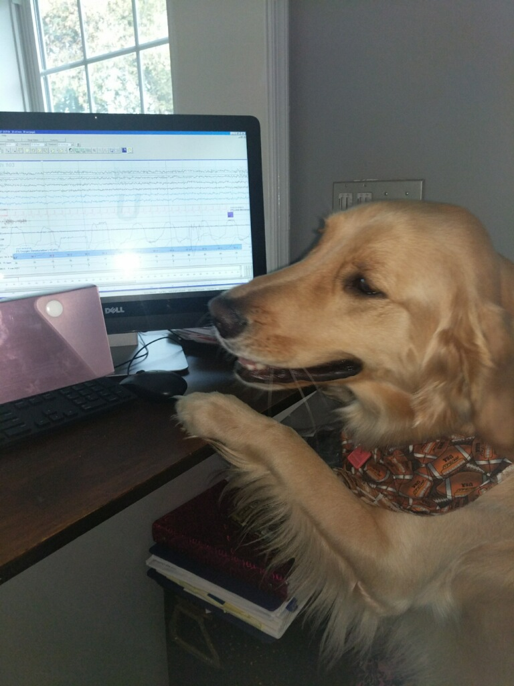
Scoring is so easy……..

Slide 63
Surveyor/Consultant Notes
Surveyors are highly trained and worked within the types of systems that they inspect.
Nursing, Physician, Hospital Administrator, Sleep Lab Technologists and Lab Managers make up the surveyor’s experiences/backgrounds.
Randomly use medical records as their roadmap during survey activities(Tracer Technique).
May speak with anyone present during the survey.
Also may request to observe workers within facility and sometimes speak to patients if available.

Slide 64
AASM Site Visit Notes
Scheduling
Requirements for Site Visit-All Manuals/Binders
Visits are scheduled but the AASM reserves the right to visit at any time without notice.
See AASM Accreditation Manual

Slide 65
Site Visit Toolbox
Lab P&P Manual
AASM Checklist Binder
All Employee Binders
Sample Patient Study Files

Slide 66
Prior to the Survey
Review Checklists
Perform a Mock Survey w Tracers
Review the Mock Survey
Do not offer to pick up the surveyor at the airport.
Do not offer buy the surveyor lunch or dinner.

Slide 67
During the Survey
Upon notification(cell, phones, faxes, email, text) gather your team. Med Director, Dept Director, CC, Lead Tech, Administrative Assistant
Be prepared to walk the surveyor through your typical day if asked.
Be positive, upbeat, do not debate, or act annoyed
Answer questions to the point.
Do not elaborate, stick with the basic facts.
If you do not know an answer(position), refer to someone who does. No lying, No shading, Be Direct

Slide 68
Make Me Great Coach!!!!!
Your Surveyor is Your Consultant/Coach
Think about of all the sites they have seen??
Be a good listener and once again, Be Upbeat
Ask Questions:
“What has your experience been with ….?”
“What have you seen regarding…..?”
Use written policies to show your process.
We and Teamwork oriented responses are best.

Slide 69
Basic Summary/Timelines
Be open/call Surveyor about Strengths/Weaknesses
Use Standards-Submit App 1 year Out
Create Submission Binder plus P&P Manual
Create Checklist Binder-6 Months Out(47 points)
Site Visit Schedule-2 Months Out
File Examples: PSG, PAP, Insomnia, RLS, Five examples. Medical Director to review.
Use example of a successful site visit evaluation(70 Points)
Have both hard and computer copy of all.

Slide 70
Site Visit Report Card
Surveyor will fix what they can during visit
Lab will receive 70 point Report.
Outstanding Provisos listed
2 Months to satisfy
Example: Cardio-Pulmonary Drill
AASM can provide proper form
Two months to document drill

Slide 71
Happy Surveyor Visit Everyone

Slide 72
Resources
Joint Commission Resources
Comprehensive Accreditation Manual for Ambulatory Services(CAMAC)
At www.jcrinc.com
or www.jointcommission.org/Sleep
American Academy of Sleep Medicine
Accreditation Process and Policies
www.aasmnet.org

Slide 73
References/Resources
Accreditation Process and Policies, American Academy of Sleep Medicine , aasmnet.org 2014
www.jointcommission.org/sleep
www.achc.org
www.aadsm.org
www.thecomplianceteam.org
Nave, Jacque RN, BSN
Surviving a Site Visit from The Joint Commission, 2014 A White Paper by HealthcareSource
McLaughlin S: What to know about JCAHO. Health Facilities Management Magazine, March 2006; 35-37
Sleep Review Magazine January 2016 sleepreviewmag.com
Main Line Health System

Slide 74
Stay in Touch
Peter Allen, BSRC, RRT-NPS-SDS, RST, RPSGT
petersleep@comcast.net

Slide 75
Thank You NEPS 2019

