Slide 1
Bacteria Survey Project
Rhian McAloon, Quynh Tran, Kelly Baitinger, Andrea Person, Jing Li

Slide 2
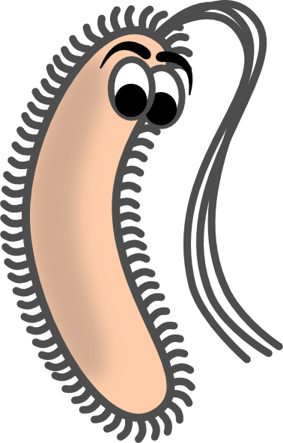
What Are Bacteria?
“Any of a large group of one-celled organisms that lack a cell nucleus, reproduce by fission or by forming spores, and in some cases cause disease.”
Not all are bad!
“They are the most abundant life forms on Earth, and are found in all living things and in all of Earth's environments.”
“Bacteria usually live off other organisms…”
Dictionary.com

Slide 3
Scope of this project
The purpose of this project is to conduct an experiment to test for the presence of bacteria at GMU
This project aims to raise students’ and staffs’ awareness on sanitization for their own health as well as the health of others.

Slide 4
Materials needed
Prefabricated agar petri dishes
Sterile cotton swabs
Incubator
Refrigerator for the bacteria to stop continually growing

Slide 5
Procedure

Slide 7
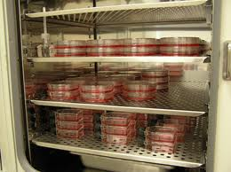
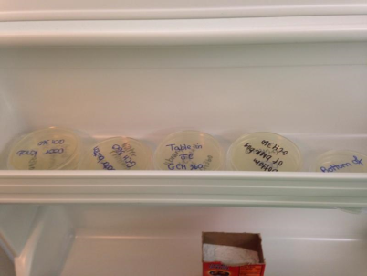
Waiting for the bacteria to grow…
Bacteria samples in incubator for 24 hours
Bacteria samples in refrigerator to stop the growth

Slide 8
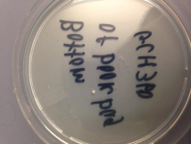
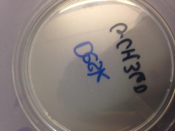
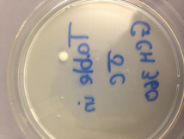
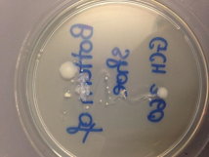
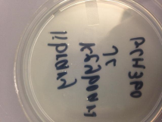
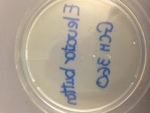
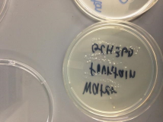
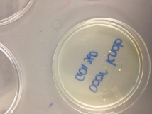
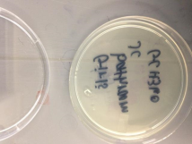
Results
Bottom of backpack
Desk
Table in JC
Bottom of shoe
Library keyboard
Elevator button
Water fountain
Door knob
Girls’ bathroom

Slide 9
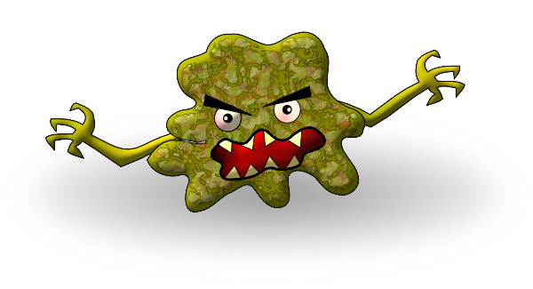
Bacteria and Kids
Knowing about the presence of bacteria from a young age is helpful during development years.

Slide 10
Bacteria and Kids
Kids should know that bacteria is everywhere.
Bacteria can be transmitted by direct/indirect contact, occurs through touching surfaces or objects that have germ on them, such as door handles, toys, desk, computers….
Kids should know how to protect themselves from bacteria
Wash your hands or use an alcohol based hand sanitizer:
After coughing, sneezing and blowing your nose.
Throughout your clinic visit and as you leave clinic.
Before and after eating.

Slide 11
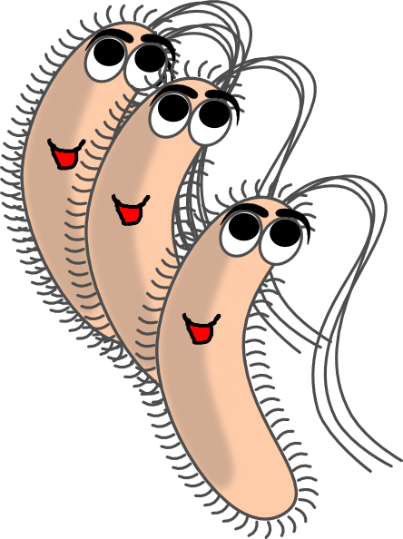
The Dangers of Bacteria
Bacteria is EVERYWHERE; whether it is good or bad
Can make you very sick if ingested
Washing hands is crucial so it can help inhibit the spread of bad bacteria from person to person
Salmonella
E. Coli
Giardia
Strep throat

Slide 12
Why is washing hands important?
Bacteria live everywhere, on every surface and just about every environment.
Aren’t visible to the naked eye.
Every time you touch something you are picking up new bacteria and leaving some behind.
Some bacteria is pathogenic (harmful) and some are nonpathogenic (not harmful)
Hand washing is your first line of defense against the spread of bacteria and illnesses.
http://www.youtube.com/watch?v=MIE0KbGIXjM

Slide 13
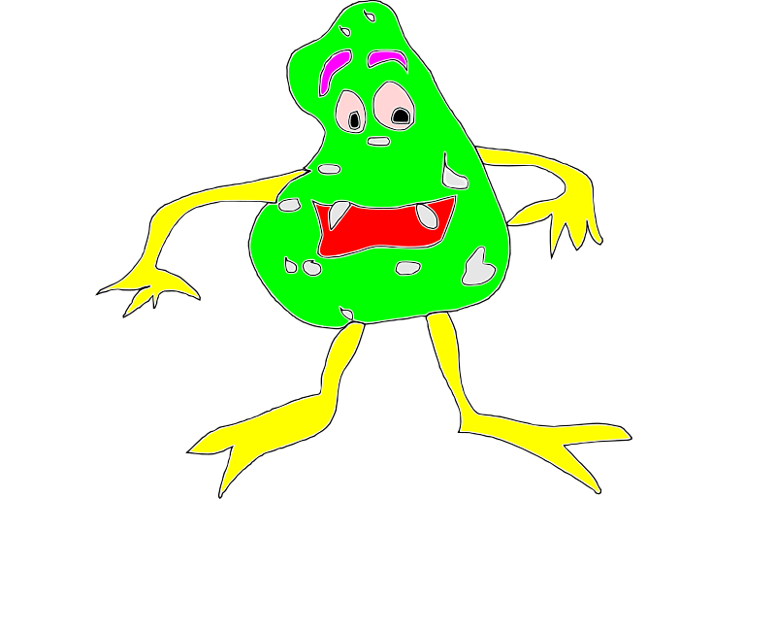
Questions?

