Slide 1

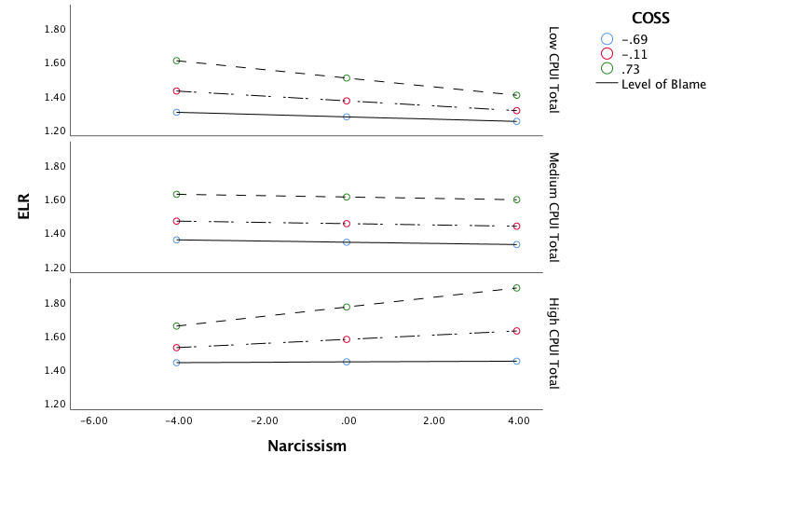
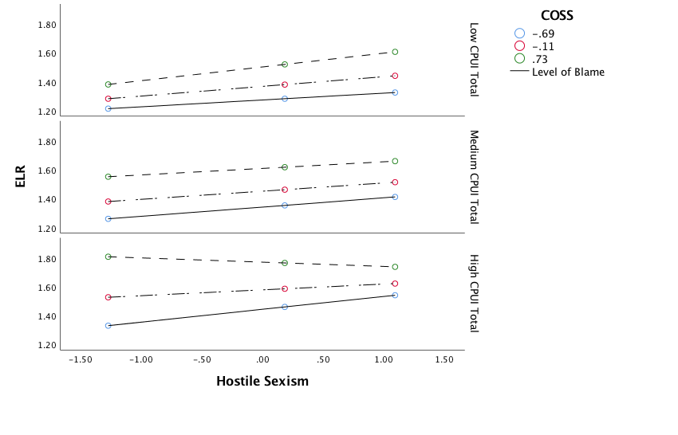
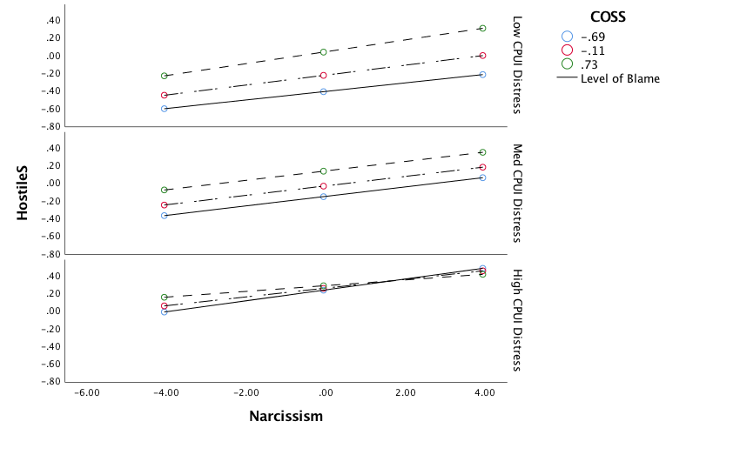

Hostile Sexism’s Role in Narcissistic Tendencies to Rape
Liberty University
Marsh, Kerry; Waggoner, Angela; France, Vivian; Richardson, Latanya
Introduction
Sample
Discussion
Narcissists in general are averse to emotional intimacy and view relationships selfishly (Campbell, Foster, & Finkel, 2002). The literature categorizes this group as high on their pornography use (Kasper, Short, & Milam, 2015). Even worse, Narcissist found to be low in agreeableness and high in past pornography use tend to display attitudes that support violence against women (Hald & Malamuth, 2014). Low agreeableness and anti-woman aggression in this group lends towards an exploratory analysis on the role of Hostile Sexism (HS; Hald & Malamuth, 2014; Tang & Fox, 2016; Zakrisson et al., 2012). The relationship of HS is reflective of the subscales found in the Ambivalent Sexism Inventory (ASI; Tang & Fox, 2016; Zakrisson et al., 2012). Along with other factors HS has been known to predict sexual and general harassment (Tang & Fox, 2016). Men and younger subjects tend to score higher on the ASI (Zakrisson et al., 2012).
Villalobos et al (2018) studied the effect of internet pornography use and its relationship to aggression. Pornography use has been linked to more sexually risky behavior, in particular pornography that depicts actual rape (Harkness et al., 2015; MacKinnon, 2000). The Expanded Likelihood to Rape (ELR) began as a measure of the Likelihood to Rape (LR) scale (Malamuth & Ceniti, 1986). Controversy still exist whether there is a direct link among these factors. Original studies using the LR didn’t find support for exposure to pornography with regards to LR scores (Malamuth & Centi, 1986). However, there was a relationship found overall with aggression, consistent with our use of the HS subscale to determine how states such as hostility may play a role in one’s likelihood to rape (Malamuth & Ceniti, 1986).
For our study, we not only examined the role of the aforementioned constructs of narcissism, hostile sexism, and the expanded likely hood of rape but also what factors contributed to these states and traits. Interestingly enough when extrapolating the Narcissist’s tendency to attack others and their use of pornography we further examined a subscale of the Compass of Shame (COSS; Reid, Harper, & Anderson, 2009) scale, which includes the tendency to blame shift and “Attack Others.” Blame could be considered another characteristic of Narcissism. Cyber Pornography Use Inventory-9 was originally designed to measure compulsivity in the use of internet pornography (CPUI-9; Grubbs, Sessoms, Wheeler, & Volk, 2010). Overall this scale was found to be more reflective of emotional distress than compulsivity (Fernandez et al, 2017 Grubbs, Sessoms, Wheeler, & Volk, 2010). We sought to explore these various relationships.
359 participants surveyed through Mechanical Turk
Measures were subscales that users were asked to complete
Participants received a dollar for their inclusion
We first hypothesized that our independent variable, Narcissism was related to our dependent variable, ELR with HS mediating that relationship. Further we believed that the COSS, in particular the subscale that reflects the tendency to attack others and pornography use would moderate the relationship between Narcissism and the ELR. We conducted a regression analysis on these various interactions. Our results reflect that there was no significance found with regards to the COSS or the CPUI-9 on the relationship between the predictor and the outcome. In these circumstances we would fail to reject the null since there is no direct or significant effect. While we didn’t run the analysis to examine any direct relationship or correlation between Narcissism and the ELR, we did find that Narcissism measured through the NPI, blame measured through the COSS, and the CPUI-9 scores were all predictive of Hostile Sexism. While our findings weren’t statistically significant, they hold implications with regards to the role of these various factors on the presence of Hostile Sexism. Our study provided future opportunities for further analysis examining these variables role on Hostile Sexism.
Methods/Participants
Results
References
Fernandez, D. P., Tee, E. J., & Fernandez, E. F. (2017). Do Cyber Pornography Use Inventory-9 Scores Reflect Actual Compulsivity in Internet Pornography Use? Exploring the Role of Abstinence Effort. Sexual Addiction & Compulsivity, 24(3), 156-179.
Grubbs, J., Sessoms, J., Wheeler, D., & Volk, F. (2010). The Cyber-Pornography Use Inventory: The development of a new assessment instrument. Sexual Addiction & Compulsivity.
MacKinnon, C.A. (2005). Pornography as trafficking. Michigan Journal of International Law 26(4), 993-1012.
Hald, G. M., Malamuth, N. N. (2015). Experimental effects of exposure to pornography: The moderating effect of personality and mediating effect of sexual arousal. Archives of Sexual Behavior, 44, 99-109.
Kasper, T. E., Short, M. B., & Milam, A. C. (2015). Narcissism and internet pornography use. Journal of Sex and Marital Therapy, 41, 481-486.
Malamuth, N. M., & Ceniti, J. (1986). Repeated Exposure to Violent and Nonviolent Pornography: Likelihood of Raping Ratings and Laboratory Aggression Against Women. Aggressive Behavior, 12(2), 129-137.
Reid, R. C., Harper, J. M., & Anderson, E. H. (2009). Coping strategies used by hypersexual patients to defend against the painful effects of shame. Clinical Psychology and Psychotherapy, 16, 125-138. doi: 10.1002/cpp.609
Tang, W. Y., & Fox, J. (2016). Men's harassment behavior in online video games: Personality traits and game factors. Aggressive Behavior, 42(6), 513-521.
Villalobos, O. S., Martínez, L. M., & González, J. I. N. (2018). Techno-addiction to sex in the youth population: Proposal of items for the design of a detection and screening scale. Revista Latina de Comunicación Social, (73), 115-132.
Zakrisson, I., Anderzén, M., Lenell, F., & Sandelin, H. (2012). Ambivalent sexism: A tool for understanding and improving gender relations in organizations. Scandinavian Journal Of Psychology, 53(1), 64-70.
Hypothesis
The purpose of this poster is to explore Narcissism, Hostile Sexism, Shame, Emotional Distress of Pornography Use, and the Likelihood to Rape. We hypothesized that these variables would interact individually and collectively to have a statistically significant effect on the Expanded Likelihood to Rape. .
Table 1 Conditional Process Analysis Results for Narcissism
Source | b | se | t | P | LLCI | ULCI
Hostile Sexism: R = .290, R² = .084, MSE = 1.255, F(4.595), p = .000
Narcissism | .053 | .017 | 3.163 | .002 | .020 | .085
Compass of Sexual Shame Scale (COSS) | .174 | .089 | 1.955 | .051 | -.001 | .350
Cyber-Pornography Use Inventory Total (CPUI) | .203 | .061 | 3.328 | .001 | .083 | .323
Hostile Sexism
CPUI-9
Narcissism
ELR

