Slide 1
Everyday 2D shapes

Slide 2
circle
Click the circle!
NEXT

Slide 3
circle
discs
clocks
NEXT

Slide 4
square
Click the square!
NEXT

Slide 5
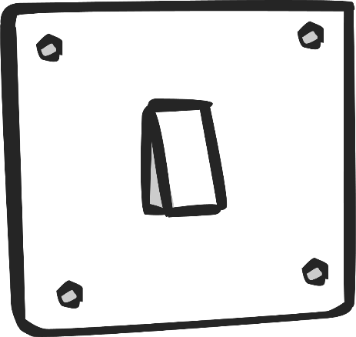
square
light switches
NEXT

Slide 6
triangle
Click the triangle!

Slide 7
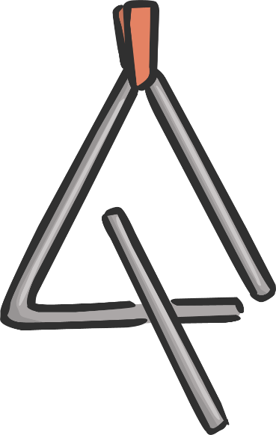
triangle
road signs
triangles
NEXT

Slide 8
rectangle
Click the rectangle!

Slide 9
rectangle
rulers
envelopes
NEXT

Slide 10
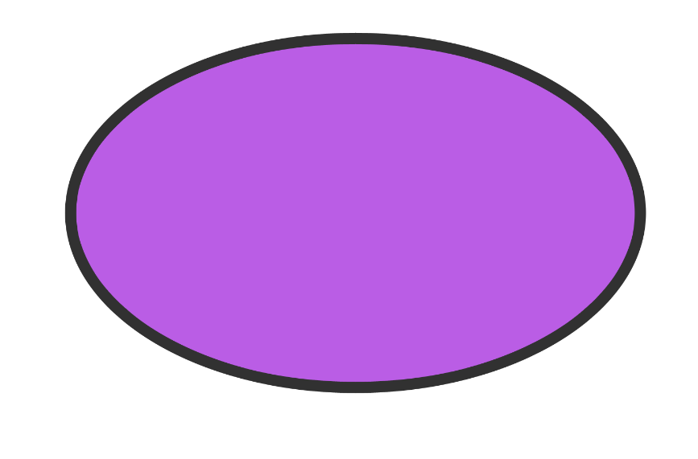
oval
Click the oval!

Slide 11
oval
watermelons
NEXT

Slide 12
THE END

