Slide 1
Strategies For Employers

Slide 2
Who We Are
We are a Medicare specific insurance agency who exclusively works directly with Medicare recipients and group healthcare providers for those age 65 or older.
Columbus
Dayton
Cincinnati
Kettering
www.resourcemedicare.com

Slide 3
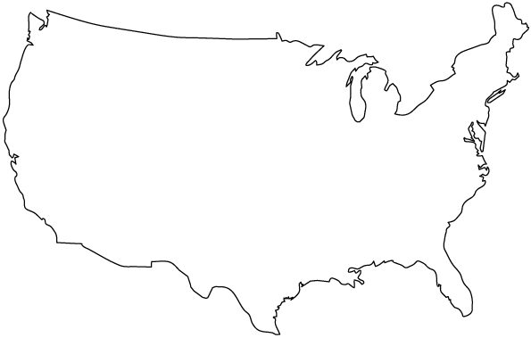
Born 1946 - 1964
Baby Boomers
Pioneers Of A New Paradigm
11,000 baby boomers will turn 65 each day for the next 20 years.*
By 2030, one in every five Americans will be 65 or older.*

Slide 4
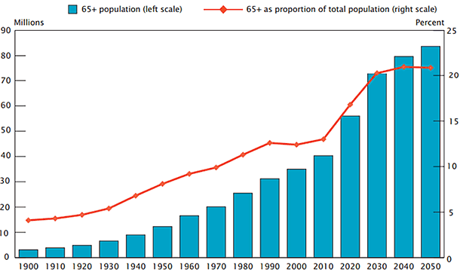
Largest increase of Medicare eligible in history
People choosing to work past age 65 has increased 240% since 1985

Slide 5
Delayed Retirement
Americans are living much longer
Median wages have stagnated
Shift from pensions to a 401K
Full Social Security retirement is age 66 and could increase in the next few years
The Baby Boomers were not savers

Slide 6
Retirement Standard Of Living
Age 66
33%
Standard of living
Gives savings and investments time to grow
More contributions to retirement plan
Delays Social Security benefits
Avoids early withdraws from nest egg
Age 70
75%
Standard of living
Source: National Bureau Of Economic Research

Slide 7
The Labor Force Age Projection 2024
Percent distribution of the labor force by age group
11.3%
22.5%
22.0%
19.4%
24.8%
-5.2%
-3.7%
-4.9 %
+0.8%
+12.9%
16-24
25-34
35-44
45-54
55+

Slide 8
Annual cost to provide healthcare benefits for an employee is $14K
Employees age 65 and older cause group rates to rise
Employees are paying over $5K annually

Slide 9
Healthcare costs for employer sponsored plans are higher than they have ever been

Slide 10
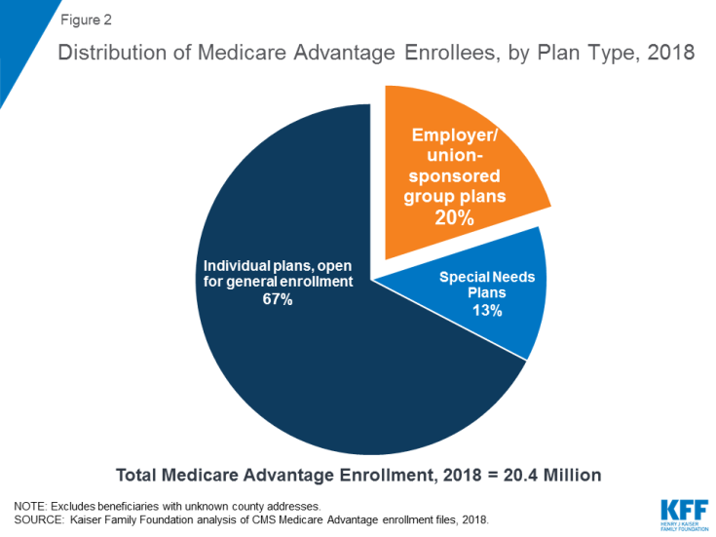
Shifting the financial burden
As healthcare costs rise, employers are beginning to shift their 65+ to Medicare plans

Slide 11
The employer is paying an average $1100 a month for the employee/retiree
The average 65 year old is paying over $500 a month for their group plan

Slide 12
Saves employer thousands
Decreases rates for the group
Individual Medicare Plans
More Options
Better Benefits
Lower Premiums
Employees/Retirees On Group Healthcare Plan

Slide 13
Benefits to going on a Medicare plan
Employers can save as much as 100% on healthcare spending
Employers can get the “highest risk” individuals off of the group plan and lower rates for the under age 65
Employees/Retirees save money in premiums and usually get better coverage
No requirement to work full-time to get benefits

Slide 14
Employers with over 100 age 65
Employers can create a group Medicare plan with their company logo on the card for as little as $0

Slide 15
Gina Giambri
Medicare Employer Relations Officer
614-226-5306
ginagiambri@gmail.com

