Slide 1
Diaphragmatic Breathing
Dr. Ron Mottern

Slide 2
Introduction
Breath is the essence of life. There is a Hindu story that tells of the five senses (hearing, seeing, feeling, smelling, and tasting) and a discussion the senses were having about which one of them was the most important. Each, of course, thout it was superior to the others. They decided, therefore, to have a test, wherein each sense would go away for a week and then at the end of that time, it would return and all of the senses would deliberate about its importance. Sight volunteered to go first. At the end of the week, sight returned and the senses said, "Truly, it was horrible without sight, but we were able to get along." Each of the remaining senses did likewise, and at the end of the time the senses still couldn't decide which was superior. Breath had been listening to the argument going on for the several weeks when it finally spoke up and said, "Truly, all of the senses are valuable and important, but I am more important than any of you." "This is nonsense," said hearing. "You are nothing but a puff of wind." The other senses agreed. Thereupon, breath said that it, too, would leave for a week and then return. The senses agreed, but breath had been gone no more than a few minutes when all of the senses began to fade and die, and they called breath back to them, saying, "Truly, you are more important than any of the five senses. Without you, we cannot survive."

Slide 3
Apart from its obvious life-giving functions, breathing is essential in most all human endeavors that require technique - from running to shooting, from swimming to weightlifting. Proper breathing and breathing rhythm can also regulate thought, emotion, and behavior. Breathing can increase optimal use of strength, and enhance endurance. Improper breathing causes the opposite to happen.

Slide 4
In yoga (i.e., to yoke) it is breathing that "yokes" the mind and body together and allows for optimal health and wellness. This connection between wellness and breath was not limited to Indian thought. Other cultures were aware of this connection, as well.

Slide 5
Proper Breathing
Proper breathing is diaphragmatic breathing. It is called, diaphragmatic breathing, because when properly done, it cause the diaphragm to move up and down. The diaphragm is a muscular partition that separates the upper chest region from the lower body. When using this breathing, when we exhale the diaphragm is pulled down and when we inhale the diaphragm is pulled up. This up and down movement of the diaphragm stimulates the vagus nerve.

Slide 6
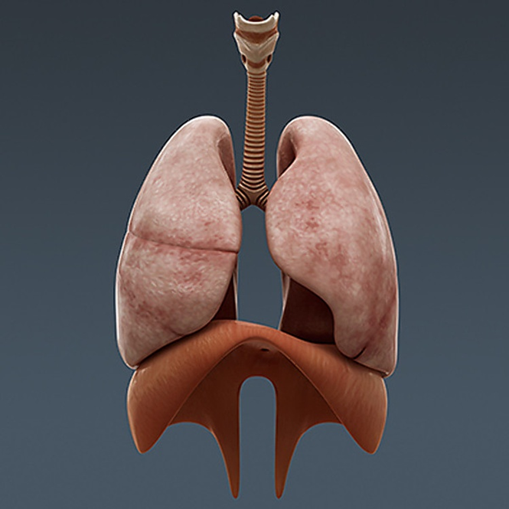
The Lungs and Diaphragm
The diaphragm is the light brown partition below the pinkish lungs

Slide 7
The vagus nerve is the tenth of the twelve cranial nerve (nerves in the brain). The Latin term, vagus, means “wandering” and the vagus nerves (they are actually a pair of nerves, but are usually just called “nerve”) wander throughout the body. Starting in the brain, the nerve affects the function of most of the major organs throughout the body, including the heart, lungs, stomach, spleen, liver, kidney, small intestine, and colon. When the vagus nerve is stimulated it causes the production and movement of Melatonin, Serotonin, and endorphins.

Slide 8
The Vagus Nerve

Slide 9
Melatonin is a hormone that regulates sleep, blood pressure, and reducing stress. It also affects sleep, appetite, and mood. Serotonin is a neurotransmitter that causes feelings of well-being and happiness. Most of the Serotonin in the body (90-95%) is found in the gut (part of the Enteric Nervous System) and is moved to the brain via the vagus nerve. Endorphins are hormones that cause analgesic (pain reducing) effects and feelings of euphoria (pleasure and happiness). By using diaphragmatic breathing with the proper mental attitude, we can physiologically (physically) cause the release and production of these hormones and neurotransmitters, therefore helping us to physically and mentally reduce stress and become more relaxed and calm.

Slide 10
Vagal nerve stimulation is the point of diaphragmatic breathing, and polyvagal theory (While there are other ways to stimulate the vagus nerve besides breathing (including cold therapy and electrotherapy) diaphragmatic breathing is the one technique we can use an any time and in any place to help regulate stress.

Slide 11
If you would like to know why vagal nerve stimulation works, you may see the following video by Porges (2017), The Polyvagal Nerve Theory: The New Science of Safety and Trauma) on polyvagal nerve theory (Video Link: https://youtu.be/br8-qebjIgs).

Slide 12
How to Breathe
Diaphragmatic breathing, also called abdominal breathing, is a simple skill. We all use diaphragmatic breathing when we are infants and children. Find a quiet place comfortably to sit and use the following steps to learn this breathing method:
1. Place your hand on your lower abdomen.
2. Breathe in through your nose for a count of four and relax.
3. While you are breathing in, imagine there is a balloon in your lower abdomen filling up with air as you push the abdomen out.
4. Hold the breath for a count of four and relax.
5. Exhale through the mouth for a count of eight, imagining the balloon losing air while allowing your abdomen to sink back to its natural position and relax.
6. Continue this breathing while thinking happy thoughts until you are relaxed and calm.

Slide 13
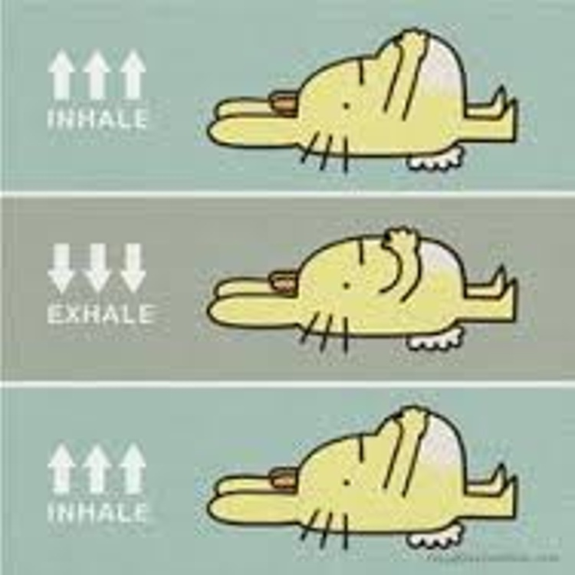
How to do Diaphragmatic Breathing

Slide 14
If your nose is stopped up or you find it difficult to breath through your nose, then breathe through the mouth. However, if you can breathe through the nose, do so. Breathing through the nose has certain advantages. Nose breathing helps retain carbon dioxide, which is essential to breathing. Carbon dioxide is more easily retained when breathing through the nose than when breathing through the mouth.

Slide 15
Other Techniques
There are a couple of tricks you can use to increase your ability to relax, especially when you don’t have a quiet place to sit. These techniques are a form of classical conditioning. As you practice these techniques, and practice your breathing, you relax. Over time, your body will begin to relax as you use the techniques, even without the breathing. When you find yourself feeling stressed and are in a crowded place, you can cause yourself to relax just by using the techniques, even without going through a full breathing and visualization exercise. REMEMBER: Practice these techniques every time you use your breathing and visualization exercises, so that the movements become associated with the relaxation. As you practice your diaphragmatic breathing and visualization, do the following.

Slide 16
Finger Exercise

Slide 17
1. As you inhale through your nose for a count of four, bring the thumb and forefinger of your hand together.
2. As you hold your breath for a count of four, press the thumb and forefinger slightly together.
3. As you exhale through your mouth for a count of eight, let the thumb and forefinger slowly come apart.
This is a tactile exercise that associates the relaxation of the body with the fingers pressing and releasing. With sufficient practice, consciously pressing the fingers together will cause physical relaxation.

Slide 18
Sound Exercise

Slide 19
1. As you inhale through your nose for a count of four, place the tip of your tongue on the roof of your mouth, behind the front two teeth.
2. Hold your breath for a count of four.
3. Exhale through the mouth for a count of eight, letting your tongue relax and making an audible “haah” sound with your breath as you exhale.
This is an auditory association that links relaxing with the “haah” sound of the expelled breath. With practice, simply taking a deep breath and expelling the air with the “haah” sound will automatically cause your body to relax.

Slide 20
References
Hopper, S. I., Murray, S. L., Ferrera, L. R., & Singleton, J. K. (2018, June). Effectiveness of diaphragmatic breathing on physiological and psychological stress in adults A quantitative systematic review protocol. JBI Database of Systematic Reviews and Implementation Reports, 16(6), 1376-1372.
Varvogil, L., & Darviri, C. (2011). Stress management techniques: Evidence based procedures that reduce stress and promote health. Health Science Journal, 5(2), 74-89. Retrieved from http://www.hsj.gr/medicine/stress-management-techniques-evidencebased-procedures-that-reduce-stress-and-promote-health.pdf
Xiao, M., Zi-Qi, Y., ZHu-Qing, G., Hong, Z., Nai-Yue, D., Yu-Tong, S., Gao-Xi, W., & You-Fa, L. (2017, June). The effect of diaphragmatic breathing on attention, negative affect, and stress in healthy adults. Frontiers in Psychology,. Retrieved from https://www.frontiersin.org/articles/10.3389/fpsyg.2017.00874/full
All photos are from Google images. If you own the rights to these images and would like them removed please contact us with verification of ownership and we will happily comply or give you credit (whichever your prefer).

