Slide 1
Aromatherapy for beginners
Objective: to educate participants on the history, fundamentals, properties, precautions, the blending and formulations involved in aromatherapy.

Slide 2
What to expect
We will be covering
History of essential oils
Essential oil properties
Therapeutic values
Oil selection
Combining oils
How to incorporate them into daily use

Slide 3
Question What is aromatherapy?
Answer
non-invasive way to take control of your health and beauty and strengthen your overall health, well being, and vitality.
?????????????????????????????????????????????????????????????????????

Slide 4
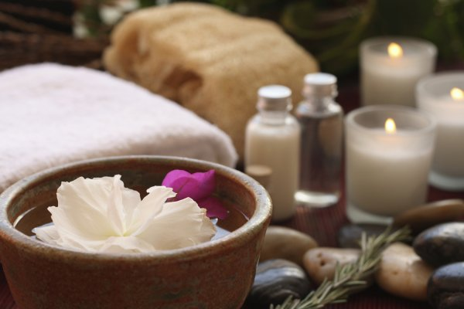
Question Define aromatherapy
Answer
Is a science called psychoneuroimmunology that studies the interactions among the psychological, neurological, and immunological systems. It looks at the effects of both positive and negative experiences on the immune system and the psyche.

Slide 5
Who | What | Where | When | Why/how
Egyptians Imhotep King Zorers chief architect, high priests | Cedar wood cypress | In Egypt on clay tablets and onto papyrus |  | Used in medical practices
Chinese | Ayurvedic medicine | China | Before the birth of Christ | Massage into techniques and pressure points to bring about good health
Indian | Ayurvedic medicine |  |  | Massage techniques, pressure points, to bring about good health
Hippocrates | Medicine | Greece |  | Aromatic baths and massage
Romans | Religious orders | Rome | Middle ages through modern times | Religious orders
Rene Maurice Gattefosse | French chemist | France | 1920’s | In lab accident put arm into a container ago lavender oil accidentally found healing ability.

Slide 6
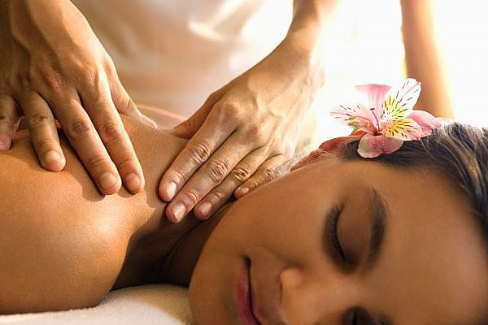
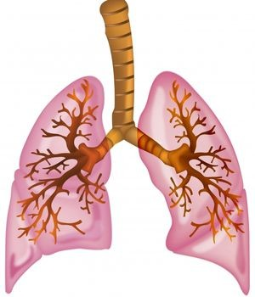
How it works
There are 5 senses that we as humans use everyday; however 2 are involved the use of aromatherapy.
Smell- olfactory system
Touch- massage
Bronchial Tract and Lungs

Slide 7
Olfactory system
Science has confirmed that breathing in pleasant aromas strengthens the body immune system and uplifts the spirit as a part of holistic medicine
Olfactory systems nerve fibers do not pass through the dorsal thalamus instead these nerve fibers run directly to the limbic area of the brain which connects to the thalamus and neo cortex. The limbic system links directly to our memories, stored learned responses, emotions and feelings. It is important to choose scents that are pleasant to you to get the full benefit.
thalamus (the-ms) n. pl. thalami (-m) 1. Anatomy A large ovoid mass of gray matter situated in the posterior part of the forebrain that relays sensory impulses to the cerebral cortex.
cerebral cortex n. The extensive outer layer of gray matter of the cerebral hemispheres, largely responsible for higher brain functions, including sensation, voluntary muscle movement, thought, reasoning, and memory.
ne·o·cor·tex (n-kôrtks) n. pl. ne·o·cor·ti·ces (-t-so) or ne·o·cor·tex·es The dorsal region of the cerebral cortex, especially large in higher mammals and the most recently evolved part of the brain. Also called neopallium.

Slide 8
Touch
Functions of the skin
S ensation – scense of touch
H ydration – takes in and stores water
A bsorption – goes into the body systems
R espiration – breathes in oxygen and out carbon monoxide
P rotection – protects and supports the organs of the body
E xcretion – rids waste through perspiration through perspiration
R egulation – regulates body temperature
Facts
7 pounds are shed yearly
Stores water fat and vitamin D
21 square feet cover the body
Releases 3 gallons of sweat on a hot day
Shed 50,000 cells a minute
Dead skin accounts for 1 billion of the dust in the air
300 million skin cells on the body
In a ½ inch of skin you have
10 hairs
15 oils glands
100 sweat glands
3.2 tiny blood vessels
Palms are 1.2 mm – 4.7 mm thick
Facial skin 0.12mm thick
Body skin 0.6 mm thick
When the aromatherpuetic oils enter your system in
3-14 hours the oils are expelled depending on the body

Slide 9
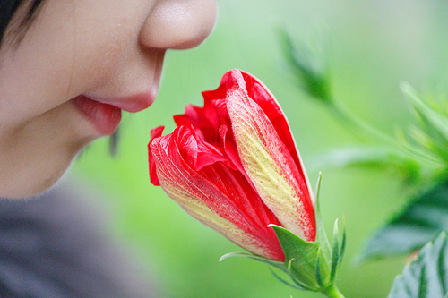
Bronchial tract and lungs
Essential oils are absorbed through the bronchial tract and lungs this causes the essential oils to pass into the body's circulatory system.

Slide 10
Safety First
When dealing with essential oils it is important to know and follow all guidelines.

Slide 11
Precautions
Do not take internally
Keep out of reach of children
Do not use near eyes or sensitive areas
Always follow manufactures directions
Use only 100% pure essentials oils
Always keep oils away from open flames
Store in a cool dark place
Never use directly on skin unless guided to
Never use on new born babies
Avoid during pregnancy
-basil -cedar wood -cypress
-clay sage -clove bud
-juniper -fennel -jasmine
-juniper -lemongrass
-marjoram -peppermint
-rosemary

Slide 12
Precautions continued
Avoid on skin that is easily sunburned
-bergamot -ginger -lemon -lime
-lemon verbena -mandarin -orange
Medical alert do not use if you have high blood pressure, epilepsy, kidney disease
-sage -thyme -cypress -rosemary -fennel
Do not use if driving far; causes drowsiness,
-clary sage -marjoram –ylang ylang

Slide 13
Aromatherapy family tree
RESINOUS
EARTHY
FLORAL
WOODY
CAMPHOR-
ACEOUS
CITRUS
HERBACEOUS
SPICEY

Slide 14
Aromatherapy oil Categories
Organic- grown without the use of synthetic fertilizers and pesticides, irrigation, genetic engineering, growth, hormones, or antibiotics.
Natural – oils without carrier oils adulterated oils with harmless additives.
*legislation is the separating factor of the two. The label of 100% pure doesn’t mean that all of the contents are natural or organic in fact it only 5% of the product to be “pure” to be labeled as pure.

Slide 15
Cleaning oils
 | Antiseptic | Antibacterial | Antimicrobial | Antifungal | Antiviral
Thyme | * | *
Lavender | * | * |  |  | *
Lemon | * | * | *
Pine | * | * | *
Eucalyptus | * | *
Lemongrass | * |  | * | *
Tea tree | * | * | * | *
orange | *
Geranium | *

Slide 16
Carrier Oils
Precautions
#1 Only buy organic carrier oils from the grocery store others are chemically processed
#2 Carrier oils should be cold pressed

Slide 17
Oil name | Color/texture | Benefits/description | Vitamins/minerals
Sweet almond oil | Fine, pale yellow | Slow to spoil or stale absorbs quickly good for oily/sensitive skin | Contains vitamin A & D
Grape seed oil | Very fine, clear satin smooth finish without a greasy touch | Excellent for baths excellent for shaving, shrinks varicose veins, aids in protection from the sun, and anti aging from antioxidants. | Linolic acids
Apricot oil | Pale yellow | Easily absorbed by skin nourishes and moisturizes, suites sensitive and inflamed dry skin. | Vitamins E & A
Sunflower oil | Pale yellow | heart health, energy when ingested, infant infection risk, antioxidant, prevent authorities, asthma, healthy nervous system, cell renewal, healthy immunity, excellent shelf life. | Proteins, minerals, vitamin F
Avocado oil | Rich, pale yellow | Nourishes skin like sebum, regenerates scared skin, dry, mature skin, nappy rash, and eczema. | Vitamins A ,C, E
Sesame oil | Dark yellow | Keeps well, good fro treating eczema, psoriasis, powerful antioxidant, | Vitamins A, E minerals protein, lecithin
Evening prime rose | Pale yellow, | eczema, rheumatoid arthritis, psoriasis, premenstrual syndrome, weight loss | Fatty acids that increase enzyme activity
Jojoba oil | Light oil , almost clear | Does not go rancid, skin care, acne, eczema, psoriasis, inflamed skin | Vitamins E,
Wheat germ oil | Fine oil, yellow orange | Anti stretch mark | Proteins, vitamin E

Slide 18
Basic applications
Blending – be sure that all oils used in your blend mix well together to avoid sour stomach or head ache
Storing- in cool dark colored bottle preferably glass with an air tight seal. Blends with lotions and creams last 2-6 months
*add wheat germ oil to any blend to act as a natural preservative and extend the shelf life.
keep bottle in a cool dark place including the refrigerator. Remove a hour before use to allow the oil to warm naturally. Pure essential oils last 2 years but with proper care 6 years are possible; mix as used to avoid waste.
Aromatic bathes
vaporization
Foot and hand baths
Aromatic shower
Sauna
Hot & cold compress
Massage
Steam inhalation
Direct
Gargles mouth washes

Slide 19
Activity read the following and select the oil or oils that can help with the ailment list the application and recipe.
Sara was in a car accident and now has bruises, a hair line fracture and muscle tension in her right lower calf.
Michelle has been feeling depressed lately she has major mid terms coming up and doesn’t know how she is going to focus with her full time work schedule.
Thomas has been experiencing asthma attacks accompanied by high blood pressure and insomnia.

