Slide 1
Fall 2019
BZS Zoning Training

Slide 2
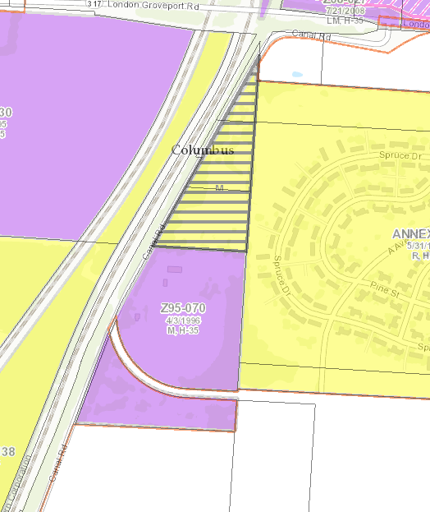
Relief from Zoning Code Requirements
Rezoning (Development Commission & City Council)
Changes the zoning district that is assigned to property
An example could be this recently annexed property near Rickenbacker. (From R to M)
Project may still need a BZA variance /Special Permit or concurrent CV.

Slide 3
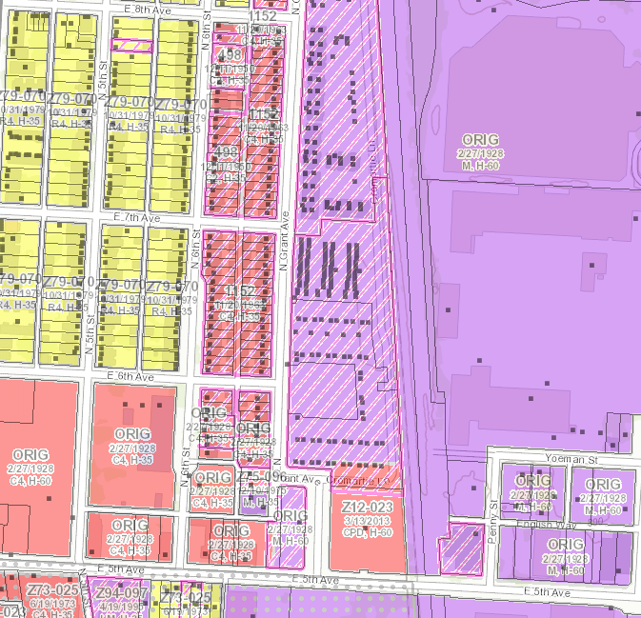
Relief from Zoning Code Requirements
City Council Variance (CV)
Permits a prohibited use not normally permitted by the zoning district
Permit a variation in the development standards of any district only in conjunction with a rezoning or a use variance
Example - Residential in an M and C4 district

Slide 4
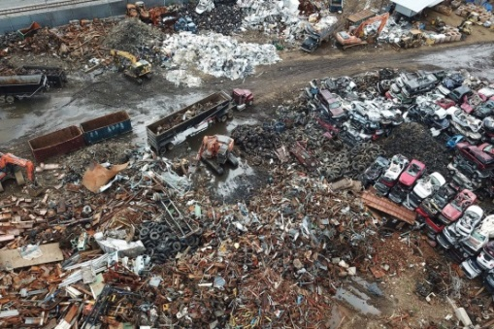
Relief from Zoning Code Requirements
Board of Zoning Adjustment (BZA)
Considers appeals to the code violations
Considers requests for variances to development standards
Considers requests for Special Permits for certain uses spelled out in zoning code. Examples:
Junk Yard
Crematory
Medical Marijuana Dispensary
Others

Slide 5
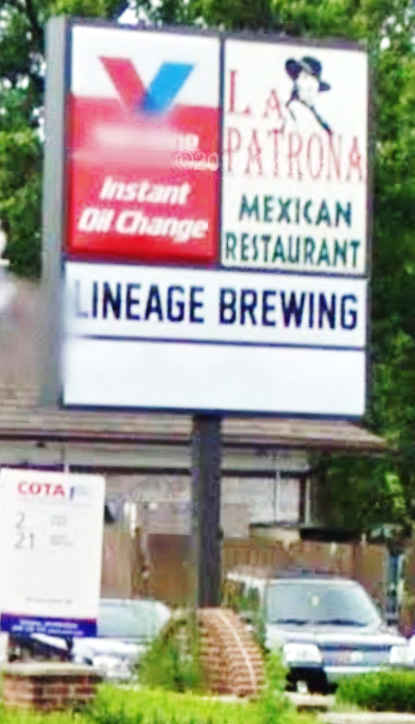
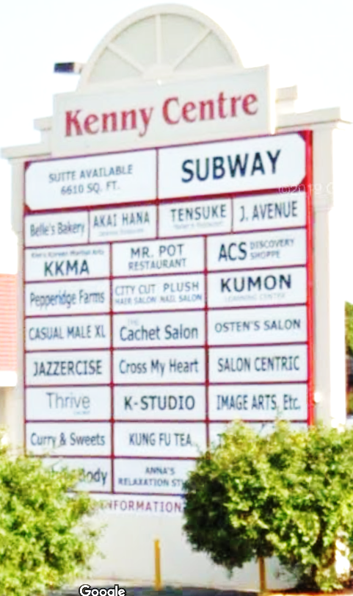
Relief from Zoning Code Requirements
Graphics Commission
Similar authority of the BZA, limited to the Graphics Code
Signs
Banners
Graphics on windows and walls
Others

Slide 6
Rezoning Process
Application submittal (two identical applications)
Applicant meets with staff to ensure application is complete and all variances are accounted for.
Identical application mailed to Area Commission
Staff site visit
Pictures of property and area for staff review
Staff review
Application is distributed to various City agencies for review and comment.
Who are they??
Concurrent with Staff Review Process:
Applicant reaches out to Area Commission
Area Commission Meeting(s) → Group issues recommendation in a reasonable time period on the variances requested.

Slide 7
Rezoning Process
City agencies that review all variance applications are:
Division of Planning
Traffic Management
Division of Power
Sewers and Drains
Recreation and Parks
Refuse
Fire
Police
Historic / Architectural Review
Others

Slide 8
Rezoning Process
Applicant will negotiate with the city agencies based upon initial comments on their requested variances.
Application generally will not move forward until all city review agencies are supportive of the requested variances.
Staff Report is written once city agencies are in agreement with variances and the Area Commission has made their recommendation.
Concurrent with the city review, applicant is meeting and talking with the Area Commission about the variances
City and Area Commission are viewing the application through different filters. On occasion recommendations may be different.

Slide 9
Rezoning Process
Development Commission Meeting – Public Meeting
Notices are sent to nearby property owners
Applicant provides testimony regarding the variances
Area Commission may also testify regarding the application and their recommendation
Development Commission considers the Staff recommendation (Staff Report) and the community group recommendation when deliberating
Results letter issued → Applicant response
Ordinance preparation, Ordinance submitted to City Council

Slide 10
Rezoning Process
City Council Meeting – Public Meeting
City Council decides when rezoning ordinances will be scheduled
Notices are sent to nearby property owners
Applicant provides testimony regarding the variances
Area Commission may also testify regarding the application and their recommendation
In some cases applicants need relief from the development standards. These companion CV’s will be scheduled with the accompanying rezoning applications.
Once the ordinance goes into effect it is reflected on the Zoning Map

Slide 11
Council Variance Process
Application submittal
Identical application mailed to Area Commission
Staff site visit
Staff review
Area Commission recommendation
Staff Report
(No Development Commission involvement)
City Council Meeting
Concurrent with Staff Review Process:
Applicant reaches out to Area Commission
Area Commission Meeting(s) → Group issues recommendation in a reasonable time period on the variances requested.

Slide 12
BZA/GC Variance Process
Application submittal
Identical application mailed to Area Commission
Staff site visit
Staff review
Area Commission recommendation
BZA or Graphics Commission agenda finalized
Staff Report written
No Development Commission involvement
No City Council involvement
BZA or Graphics Commission meeting
Decision is final for city but may be appealed to Common Pleas Court
Concurrent with Staff Review Process:
Applicant reaches out to Area Commission
Area Commission Meeting(s) → Group issues recommendation in a reasonable time period on the variances requested.

Slide 13
Area Commission
Review and Recommendation
Review application sent from BZS. Direct question to case manager listed on application.
Based upon your by-laws hold a zoning committee or all Area Commission hearing on the variance(s) requested in the application.
These are public meetings which should be open to the applicant and the public.
A record of votes and attendees should be kept
Area Commissions have the option to notify nearby property owners of the application. (Address labels are included in packet sent form BZS)

Slide 14
Area Commission Review and Recommendation
Once a recommendation is voted upon by the area commission, complete the Standardized Recommendation form. (Next Slide)
Complete all sections to ensure your recommendation is recorded and considered.
Return Standardized Recommendation form to the assigned planner or zoning office by e-mail as early as possible.
When a public hearing is held on the application, it is best to have a representative from the Area Commission in attendance to answer any questions and make any comments regarding the recommendation.

Slide 15
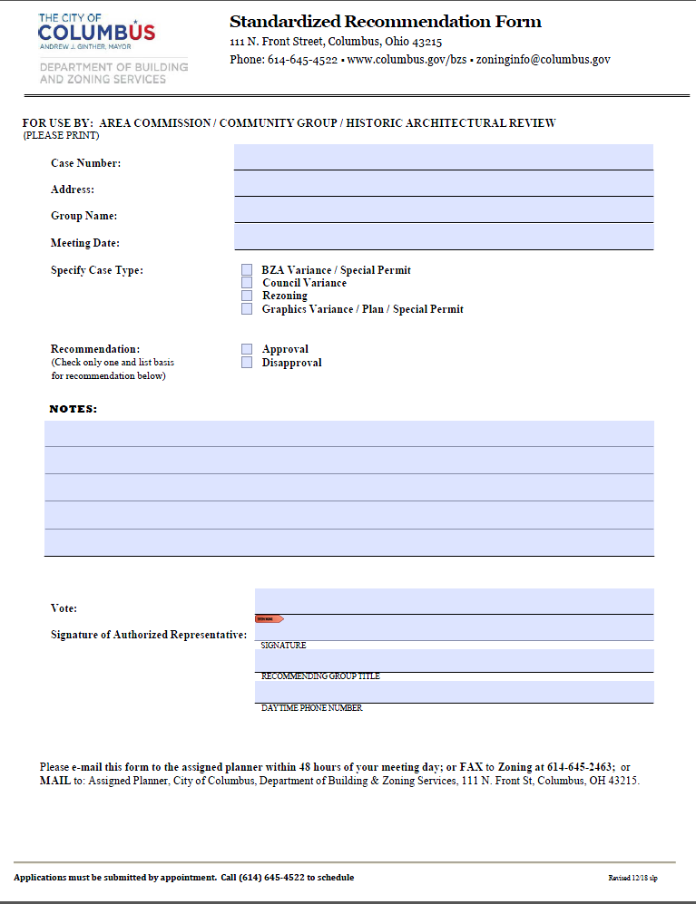

Slide 16
Contact Information
Building and Zoning Services
614-645-7433
Zoning:
Rezoning, Council Variances, Board of Zoning Adjustment, Graphics Commission
614-645-4522
zoninginfo@columbus.gov
Zoning and Building Records:
614-645-6082
recordscenter@columbus.gov
Planning Division:
Area Plan recommendations and design considerations
614-724-4437
planninginfo@columbus.gov
Division of Traffic Management:
Dan Blechschmidt; 614-645-1694
drblechschmidt@columbus.gov
Recreation and Parks Department:
Kathy Spatz; 614-645-0487
kaspatz@columbus.gov
Department of Neighborhoods:
Neighborhood Liaisons
David Hooie; 614-645-7343
dehooie@columbus.gov
Code Enforcement:
Code violations
311 or 614-645-3111
311@columbus.gov

Slide 17
Resources
Columbus City Code (Zoning Code - Title 33)
www.municode.com/library/oh/columbus
Columbus Zoning Map
gis.columbus.gov/zoning/
Columbus City Council agendas, legislation (including zoning ordinances)
columbus.legistar.com/Legislation.aspx
Building and Zoning Services
www.columbus.gov/bzs/
Citizen Access Portal (track application status / check permit history)
ca.columbus.gov/ca
Planning Division Columbus Site Information Resource (CSIR) Map
gis.columbus.gov/csir/
Planning Division Document Library
www.columbus.gov/planning/documentlibrary/

Slide 18
Questions?
Thank You!

Slide 19
Columbus Planning Division
Department of Development
Primary functions include:
Working with Columbus Communities to develop land use plans
Utilizing adopted plans to review development proposals
Plan policies are used to comment on rezoning and variance cases
Historic/design review boards and commissions
Columbus Planning Academy
Educational series for land use plan process
www.Columbus.gov/planning

Slide 20
Columbus Citywide Planning Policies (C2P2)
New planning framework adopted in 2018
C2P2 is the starting place for new land use plans
Guiding Principles, Design Guidelines, Land Use Policies
Area commissions may request City Council to adopt C2P2 Design Guidelines for their area – this is called “early adoption”
Early adoption - C2P2 Design Guidelines used with existing adopted area or land use plan

Slide 21
Rezoning and variance case review
Planning staff review cases for consistency with adopted plan policy
Columbus Citywide Planning Policies apply if adopted for an area
Comments are included in a report that is provided to the applicant.
Comments are based on policy, not code
Applicants often work with planning staff after receiving initial comments
Process that results in better project, but may not meet everyone’s goals
Development Review Video

Slide 22
6488 Hayden Run Road
New Veterinary Clinic
Existing Zoning – R, Rural
Requested Zoning – L-C-4, Limited Commercial District
Staff review request, site plan, elevations, and limitation text.
First Question: Is the applicant requesting to change the permitted use?
Yes, the applicant is requesting to change the existing zoning district, which regulates use
If yes, then we review request for consistency with land use policies.
If no, only design guidelines apply.

Slide 23
6488 Hayden Run Road
New Veterinary Clinic
Existing Zoning – R, Rural
Requested Zoning – L-C-4, Limited Commercial District
Second Question: What adopted plan policies apply to this case?
Go to http://gis.columbus.gov/csir/

Slide 24
6488 Hayden Run Road

Slide 25
6488 Hayden Run Road
Second Question: What adopted plan policies apply to this case?
Adopted Plan: Interim Hayden Run Corridor Plan
Plan land use recommendation: Neighborhood Center
Columbus Citywide Planning Policies: Early Adoption
Third Question: Is the new proposed use supportable?
Plan land use recommendation: Neighborhood Center
Look up land use recommendation policy in plan
Supports limited amount of nonresidential uses
Based on the plan recommendation, Planning supports the use

Slide 26
6488 Hayden Run Road
Adopted Plan: Interim Hayden Run Corridor Plan
Plan land use recommendation: Neighborhood Center
Columbus Citywide Planning Policies (C2P2): Early Adoption
Fourth Question: Is the new proposed site plan and design supportable?
Look up relevant design guidelines in plan and C2P2 (early adoption)
Commercial development
Building parallel to and facing street
Building design
Connected to sidewalk
Parking to rear or side of building
Landscaping and screening between right-of-way and street

Slide 27
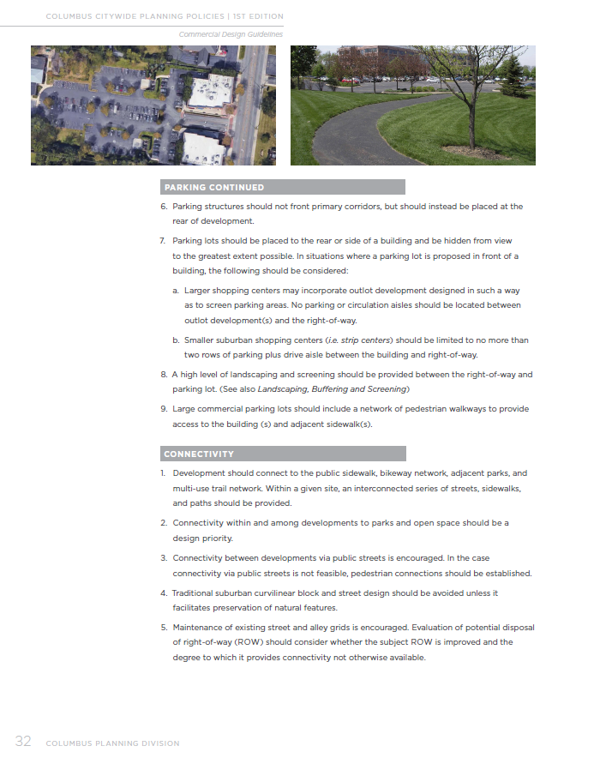
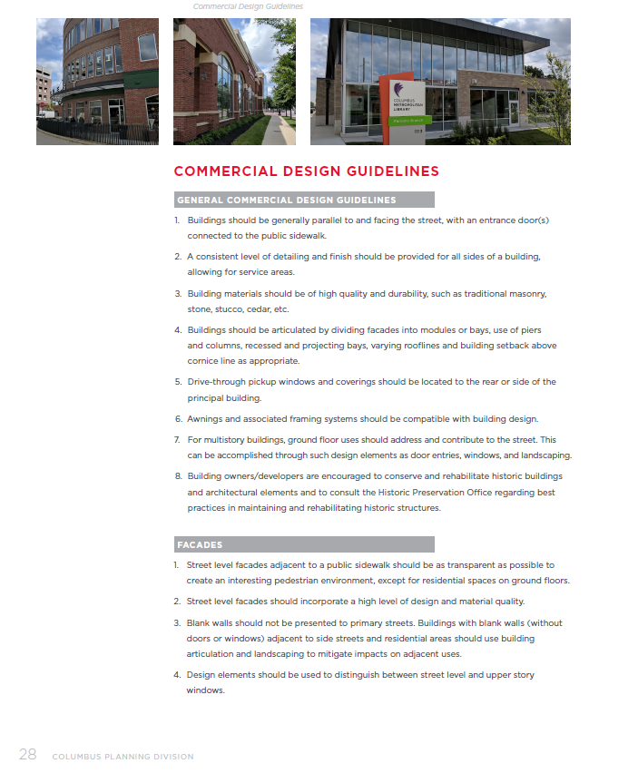
6488 Hayden Run Road
All plan documents available online
www.Columbus.gov/planning

Slide 28
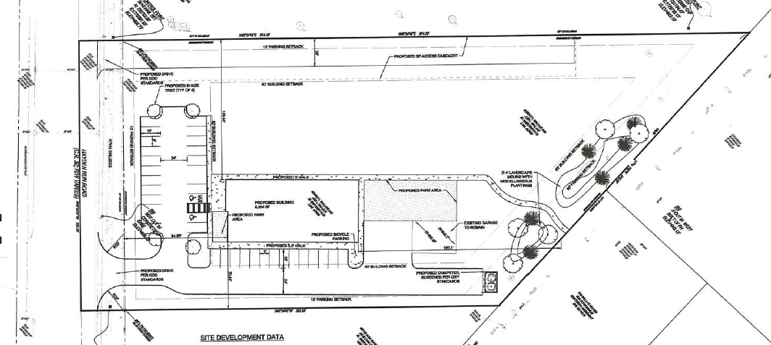
6488 Hayden Run Road
Is the new proposed site plan and design supportable?
Based on Plan and C2P2, Planning requested commitment to Community Commercial Overlay standards, as these code standards represent many plan recommendations
Also requested landscaping and street trees between parking and ROW
Hayden Run Road
BLDG

Slide 29
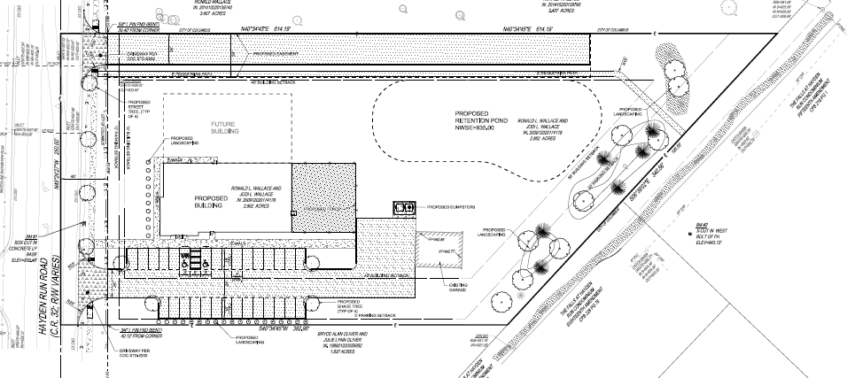
6488 Hayden Run Road
Is the new proposed site plan and design supportable?
After revisions, the site plan and design are consistent with plan recommendations
Hayden Run Road
BLDG

Slide 30
6488 Hayden Run Road
Three rounds of review based on application revisions:
#1 - Planning supports the use but requests revisions to the site plan and potential revisions to the proposed building elevations. Staff requests that the applicant commit to Community Commercial Overlay (CCO) standards, a high level of landscaping and screening, including street trees, be provided between the right-of-way and the parking lot.
#2 Planning is now in full support pending additional details about landscaping and street trees along the ROW. The revisions to the site plan with regards to parking placement and building location, as well as the applicant’s commitment to CCO standards for graphics are consistent with the recommendations found in the Interim Hayden Run Corridor Plan (2004) and Columbus Citywide Planning Policies (C2P2).
#3 Planning is now in full support with the addition of street trees and landscaping along the frontage.

Slide 31
Rezoning and variance case review
Staff encourages area commissioners to review their area’s adopted plan policies and design guidelines for each case
Provided comments should relate back to the request and plan policy
Review land use policies for Rezonings or variances related to use
Review applicable design guidelines for all cases

Slide 32
Questions?
Questions?
Thank You!

