Slide 1
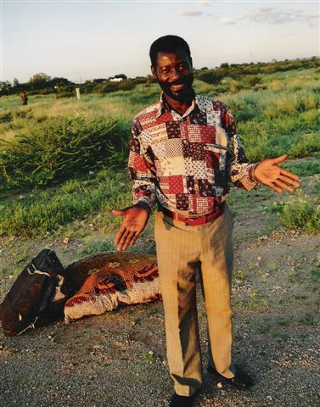
Update from“Titus…”

Slide 2
An Unknown God… Acts 17: 16… Now while Paul was waiting for them at Athens, his spirit was being provoked within him as he was observing the city full of idols. ¹⁷ So he was reasoning in the synagogue with the Jews and the God-fearing Gentiles, and in the market place every day with those who happened to be present. ¹⁸ And also some of the Epicurean and Stoic philosophers were ^{[n]}conversing with him. Some were saying, “What would this ^{[o]}idle babbler wish to say?” Others, “He seems to be a proclaimer of strange deities,”—because he was preaching Jesus and the resurrection. ¹⁹ And they took him and brought him ^{[p]}to the ^{[q]}Areopagus, saying, “May we know what this new teaching is ^{[r]}which you are proclaiming? ²⁰ For you are bringing some strange things to our ears; so we want to know what these things mean.” ²¹ (Now all the Athenians and the strangers visiting there used to spend their time in nothing other than telling or hearing something new.)

Slide 3
Sermon on Mars Hill ²² So Paul stood in the midst of the ^{[s]}Areopagus and said, “Men of Athens, I observe that you are very religious in all respects. ²³ For while I was passing through and examining the objects of your worship, I also found an altar with this inscription, ‘TO AN UNKNOWN GOD.’ Therefore what you worship in ignorance, this I proclaim to you. ²⁴ The God who made the world and all things in it, since He is Lord of heaven and earth, does not dwell in temples made with hands; ²⁵ nor is He served by human hands, as though He needed anything, since He Himself gives to all people life and breath and all things; ²⁶ and He made from one man every nation of mankind to live on all the face of the earth, having determined their appointed times and the boundaries of their habitation, ²⁷ that they would seek God, if perhaps they might grope for Him and find Him, though He is not far from each one of us; ²⁸ for in Him we live and move and ^{[t]}exist, as even some of your own poets have said, ‘For we also are His children.’ ²⁹ Being then the children of God, we ought not to think that the Divine Nature is like gold or silver or stone, an image formed by the art and thought of man. ³⁰ Therefore having overlooked the times of ignorance, God is now declaring to men that all people everywhere should repent, ³¹ because He has fixed a day in which He will judge ^{[u]}the world in righteousness ^{[v]}through a Man whom He has appointed, having furnished proof to all men ^{[w]}by raising Him from the dead.” ³² Now when they heard of the resurrection of the dead, some began to sneer, but others said, “We shall hear you ^{[x]}again concerning this.” ³³ So Paul went out of their midst. ³⁴ But some men joined him and believed, among whom also were Dionysius the Areopagite and a woman named Damaris and others with them.

Slide 4
Titus’ Biography…
He is 50 years old.
He has been doing missionary work for 25 years, of which 17 years have been spent in Omaheke (Gobabis District)
He and his family live in Gobabis (Central Eastern Namibia).
He serves around about 80,000 Namibians, of which 20,000 are Bushmen.
He has married around about 300 couples.
It is estimated he has baptized about 7000 people…part of his travel involves visiting and encouraging fellow Christians.
His favorite parts of the Bible are Abraham’s story and Paul’s missionary work
His favorite Bible verses are John 3:16, 1 Samuel 1:10 – 20, and Genesis 15: 3 – 6.
His father was an elder, and sometimes preacher. He is 1 of 7 children.
He attended school until 7th grade in Afrikaans.
His first language is Wambo. He also speaks Afrikaans, English and Herero (a native language).
At the age of 17, he began attending Bible School in Walvisbay, Namibia. He attended for 4 years.
He has a wife, two grown children, and a two year-old son.
He was tending sheep at the age of 12 and strongly felt the presence of God. From this day, he states he began praying and showing the fruit of the spirit: obedience, happiness, love, and faith.

Slide 5
A Little History…
Europeans (particularly Dutch) began settling in the 1700’s..
It became a German protectorate/colony in 1884…
Governmental control shifted from Germany to South Africa at the end of World War I.
Namibia became independent from South Africa in 1991…Democratic parliamentary government…
Namibia is home to many of the classic African animals: elephants, zebra, giraffes, antelope, and the big cats.

Slide 6
Facts about Namibia…
The world’s 34th largest country…319 square miles
One of the driest countries on Earth…Ranging from desert grassland to the tallest dunes in the world.
The second least populated…just over 2,000,000
The Capitol: Windhoek…about 250,000 people
85% Black African, 6.5 % Bi-racial, 6% White…racial tension is improving, but is still very common
About half the population depends on farming for its livelihood…other resources are mining and tourism

Slide 7
The Scene…
Farming is one of the main economic enterprises in Namibia…farms range from 10,000 acres to well over 40,000 acres.
Many farms have been passed from generation to generation.
Farm workers are key to the success of farms. Farm owners are required to provide housing and salary.
The types of homes provided vary from huts made out of sheets of plastic, to corrugated tin, to brick/cement. In many cases, there is no power to the houses.
In most cases, it is quite difficult for farm workers to go to town with any frequency due to long distances and limited transportation.

Slide 8
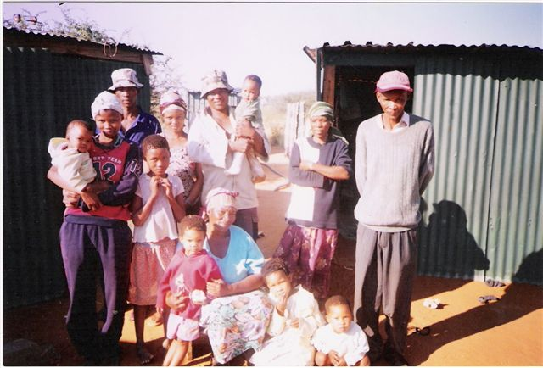
Titus’ Primary Mission: Preaching the Gospel to Namibia’s Farm workers…
He carries a small bag and a bedroll…
He stays with farm workers for a few days at a time…
He also spends time visiting the farm owners…
He does not have formal monetary sponsorship. He gets by on the generosity of the households where he preaches.

Slide 9
Getting to work…
Titus previously hitchhiked or walked to his
destinations...bicycles are very impractical due to distance
and the sandy soil
He now has a small Datsun car. He only has a learner’s
permit so his friend/mechanic travels with him.
The car was given to him so he has been using the money
donated to fix the car and pay for gas.
In the time we were there, he visited over 40 farms
teaching the Gospel.

Slide 10
The Culture…
There is very little in the way of systematic religious belief.
There is a common belief in “spirits.” Superstition is common.
In some cases, animals or objects might have some spiritual significance.
Witch-doctors have historically had a lot of influence.
There may be some sense of a “creator” for some, but very limited exposure to God or Jesus.
Some native groups have a concept of marriage. However, this is an unfamiliar concept for many. So, couples get together or part ways quite frequently. A stable father figure may not be present

Slide 11
Sometimes he uses church buildings…or teaches under a tree…or gets to use a large tent.

Slide 12
Titus’ Message…There is one God…Our Creator

Slide 13
Titus’ Message…
Romans 3: 23…for all ^{(F)}have sinned and fall short of the glory of God…
Romans 6: 23 …For the wages of ^{(A)}sin is death, but the free gift of God is ^{(B)}eternal life in Christ Jesus our Lord.
Isaiah 59: 1-2 “Behold, ^{﻿a﻿}the Lord’s hand is not so short That it cannot save; ^{b﻿}Nor is His ear so dull That it cannot hear. But your ^{﻿a﻿}iniquities have made a separation between you and your God, And your sins have hidden His ^{﻿1﻿}face from you so that He does ^{﻿b﻿}not hear…Separation from God=Death

Slide 14
Titus’ Message…
Philippians 2: 5-11 ⁵ ^{(I)}Have this attitude ^{[e]}in yourselves which was also in ^{(J)}Christ Jesus, ⁶ who, although He ^{(K)}existed in the ^{(L)}form of God, ^{(M)}did not regard equality with God a thing to be ^{[f]}grasped, ⁷ but ^{[g](N)}emptied Himself, taking the form of a ^{(O)}bond-servant, and ^{(P)}being made in the likeness of men. ⁸ Being found in appearance as a man, ^{(Q)}He humbled Himself by becoming ^{(R)}obedient to the point of death, even ^{(S)}death ^{[h]}on a cross. ⁹ ^{(T)}For this reason also, God ^{(U)}highly exalted Him, and bestowed on Him ^{(V)}the name which is above every name, ¹⁰ so that at the name of Jesus ^{(W)}EVERY KNEE WILL BOW, of ^{(X)}those who are in heaven and on earth and under the earth, ¹¹ and that every tongue will confess that Jesus Christ is ^{(Y)}Lord, to the glory of God the Father.
2 Corinthians 5: 21 He made Him who ^{(A)}knew no sin to be ^{(B)}sin on our behalf, so that we might become the ^{(C)}righteousness of God in Him.
I John 1: 5-10 This is the message we have heard from Him and announce to you, that ^{﻿b﻿}God is Light, and in Him there is no darkness at all. If we say that we have fellowship with Him and yet walk in the darkness, we ^{﻿b﻿}lie and ^{﻿c﻿}do not practice the truth; but if we ^{﻿a﻿}walk in the Light as ^{﻿b﻿}He Himself is in the Light, we have fellowship with one another, and ^{﻿c﻿}the blood of Jesus His Son cleanses us from all sin.
God’s son, Jesus, died on a cross for us…he takes away our sin and gives us forgiveness.
We must turn away from the bad things we do.
We must be baptized in Jesus’ name for forgiveness and to receive the Holy Spirit.
Titus then revisits as often as possible to teach Christian behavior.
He has been teaching the concept of marriage and stable family.

Slide 15
Titus’ Message…Repent & Be Baptized
Acts 2: 36-42
³⁶ Therefore let all the house of Israel know for certain that God has made Him both Lord and ^{[ai]}Christ—this Jesus whom you crucified.” ³⁷ Now when they heard this, they were ^{[aj]}pierced to the heart, and said to Peter and the rest of the apostles, “^{[ak]}Brethren, ^{[al]}what shall we do?” ³⁸ Peter said to them, “Repent, and each of you be baptized in the name of Jesus Christ for the forgiveness of your sins; and you will receive the gift of the Holy Spirit. ³⁹ For the promise is for you and your children and for all who are far off, as many as the Lord our God will call to Himself.” ⁴⁰ And with many other words he solemnly testified and kept on exhorting them, saying, “^{[am]}Be saved from this perverse generation!” ⁴¹ So then, those who had received his word were baptized; and that day there were added about three thousand ^{[an]}souls. ⁴² They were continually devoting themselves to the apostles’ teaching and to fellowship, to the breaking of bread and ^{[ao]}to prayer.

Slide 16
Titus’ Message…The Fruit of the Spirit
Galations 5: 16-24
But I say, walk by the Spirit, and you will not carry out the desire of the flesh. ¹⁷ For the flesh ^{[g]}sets its desire against the Spirit, and the Spirit against the flesh; for these are in opposition to one another, so that you may not do the things that you ^{[h]}please. ¹⁸ But if you are led by the Spirit, you are not under the Law. ¹⁹ Now the deeds of the flesh are evident, which are: ^{[i]}immorality, impurity, sensuality, ²⁰ idolatry, sorcery, enmities, strife, jealousy, outbursts of anger, disputes, dissensions, ^{[j]}factions, ²¹ envying, drunkenness, carousing, and things like these, of which I forewarn you, just as I have forewarned you, that those who practice such things will not inherit the kingdom of God. ²² But the fruit of the Spirit is love, joy, peace, patience, kindness, goodness, faithfulness, ²³ gentleness, self-control; against such things there is no law. ²⁴ Now those who ^{[k]}belong to Christ Jesus have crucified the flesh with its passions and desires.

Slide 17
Titus’ Message…Marriage
Matthew 19: 4-6
And He answered and said, “Have you not read that He who created them from the beginning MADE THEM MALE AND FEMALE, ⁵ and said, ‘FOR THIS REASON A MAN SHALL LEAVE HIS FATHER AND MOTHER AND BE JOINED TO HIS WIFE, AND THE TWO SHALL BECOME ONE FLESH’? ⁶ So they are no longer two, but one flesh. What therefore God has joined together, let no man separate.” ⁷

Slide 18
Results…
Through his kindness, Titus has earned the respect of both black and white communities…
He is welcomed by white churches…a very unusual accomplishment…
It is difficult to calculate how many he has baptized, but it is probably no less the 10,000 people.

Slide 19
Titus expresses his sincere thanks for your support!

