Slide 1
CHEMICAL AWARENESS

Slide 2
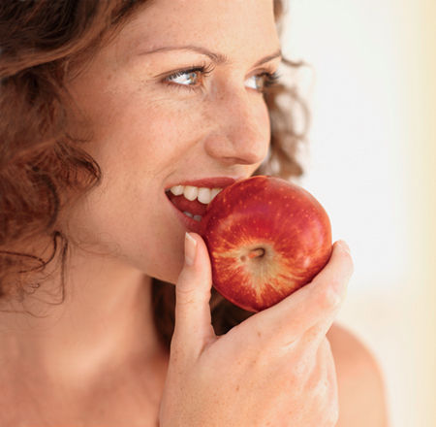
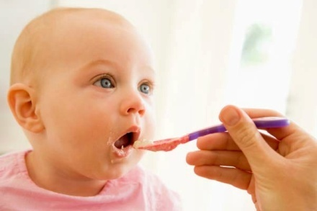

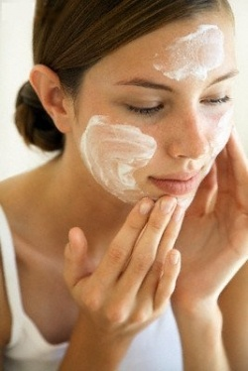
Though our bodies are seemingly protected by our skin there are three ways for toxins to enter our
Ingestion- by means of the digestive system
Inhalation- by means of respiratory tract
Absorption- by means of the skins pores and
follicles

Slide 3
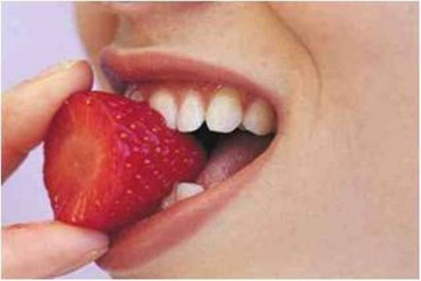
Ingestion
What is in what you eat?
when chemicals are ingested they leave behind what is called free radicals
which are molecules with no purpose that retard and decay healthy cells.
a free radical is a cellular killer that by damaging DNA, alters the biochemical compounds messing up cell membranes, and destroying cells.
In 1951 the united states of America gave the okay for sodium hydroxide (commonly used in chemical hair relaxer) to be used as a pesticide on our food.

Slide 4
The Process of ingestion
Define: Ingestion – The process of taking a material into mouth or body
The Mouth/throat – chew- swallow
Saliva is the watery and usually somewhat frothy substance produced in the mouths of some animals, including humans.
Produced in salivary glands, saliva is 98% water, but it contains many important substances, including electrolytes, mucus, antibacterial compounds and various enzymes.
The digestive functions of saliva include moistening food, and helping to create a food bolus, so it can be swallowed easily.
Saliva contains the enzyme amylase that breaks some starches down into maltose and dextrin.
Define: Digestion- the process of breaking down food by mechanical and enzymatic action in the alimentary canal into substances that can be used by the body.
The process of digestion
digestion of food occurs within the mouth, even before food reaches the stomach.

Slide 5
Stomach - Small Intestines - Large Intestines
The Stomach
acids and enzymes break down food
stomach's muscular lining squeezes and mixes the food
eventually, the food moves on to the intestine
Small intestine
breaking down of food for use by the body
special juices and enzymes finish breaking the food down into nutrients
vitamins and other nutrients are absorbed into the cells of the mucosa that lines the intestines
then are delivered to the cells of the organs.
Large intestine
waste to travels into the large intestine and out of the body
absorbs water from the remaining indigestible food matter
transmit the useless waste material from the body
You can see how important what we eat is to the healthy function of bodies.

Slide 6
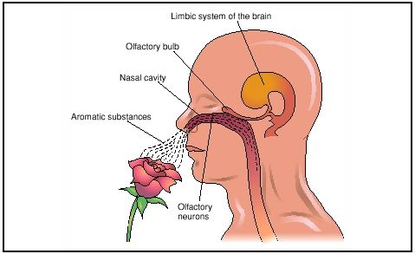
Inhalation
Our sense of smell is 10,000 times more sensitive than any other sense
Recognition of smell is immediate; the olfactory system response is
immediate, extending
directly to the brain.
This is the only place
where our central
nervous system is
directly exposed to the environment
Nero toxins would be an example of a substance that destroys the nervous system.
Inhalation can happen via fumes, gases, vapors and mist
Smells enter through the nose and or mouth it takes about 2-4 seconds to cause a physical reaction.

Slide 7
Fun facts
your scent cells are renewed every 28 days, so every four weeks you get a new “nose”.
smell is the sense most linked to our emotional recollection
75% of emotions are triggered by smell which is linked to pleasure, well-being, emotion and memory
A woman’s sense of smell is much stronger than a man’s.
It is heightened even more in the first half of the menstrual cycle and reaches its peak when she is most fertile.
You can smell things better in the spring and summer, due to the additional moisture in the air.
The sense of smell is stronger after exercise, because of the increases of moisture in the nasal passage.
No two people smell the same odor the same way
Your sense of smell is least acute in the morning; our ability to perceive odors increases as the day wears on.

Slide 8
Absorption
This brings us to the skin. To understand this we must first discuss the primary functions of the skin.
FUNTIONS OF THE SKIN (think: SHARPER)
Sensation- how you feel
Hydration- maintaining moisture
Absorption- taking in water
Respiration- Breathing
Protection- of bones, muscles, organs
Excretion- waste removal
Regulation- body temperature
Lets focus on four functions that we interfere with daily and look at how
FUNCTIONS
Hydration
Absorption
Respiration
Excretion

Slide 9


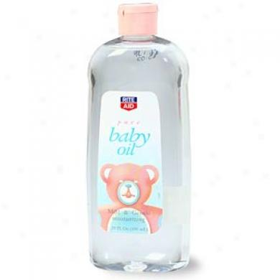
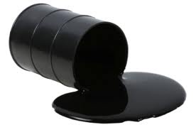
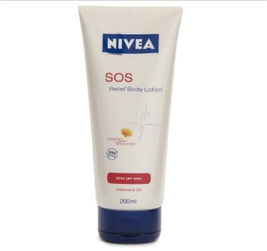
How…
products contain protective ingredients clog the pores and follicles of the skin
preventing it from performing the necessary function to maximize health and leaving behind free radicals.

Slide 10
THE SKIN
The skin is the largest functioning organ of the body. It is in fact the your bodies first line of defense and should be protected most fiercely and cared for with love and respect.
Define skin:
The skin protects us from microbes and the elements, helps regulate body temperature, and permits the sensations of touch, heat, and cold.
Skin has three layers
1. The epidermis, the outermost layer of skin, provides a waterproof barrier and creates our skin tone.
2. The dermis, beneath the epidermis, contains tough connective tissue, hair follicles, and sweat glands.
3. The deeper subcutaneous tissue (hypodermis) is made of
fat (adipose tissue) and connective tissue.
The skin’s color is created by special cells called melanocytes, which produce the pigment melanin.
Melanocytes are located in the epidermis
Everyone has them no matter how light their complexion is .

Slide 11
Nano technology
Nanotechnology is the study of nanoparticles
Definition
a nanoparticle is any material measuring less than 100 nanometers in at least one dimension.
To put that into perspective, a nanoparticle is at least 10,000 times smaller than the period in this sentence.
Many nano-sized materials have unique optical, thermal, electrical, and/or magnetic properties and have been included in everyday items, such as cosmetics and paints, for several years.
Status Update
No government in the world regulates nanoparticles
The European Union has at least begun to take action to better understand the risks posed by nanomaterials in cosmetics and personal care products

Slide 12
Over exposure
Over exposure happens when the chemicals are entering the body in abundance.
If we look at a chemical such as
Sodium hydroxide which is a chemical that is commonly used to relax over curly hair; you can find that same ingredient in products we use daily.

Slide 13
Sodium Hydroxide
Inhalation | Included in house hold cleaning products
Ingestion | In 1951 the FDA okayed sodium hydroxide to used as a pesticide on our food
Absorption | Found in many lotions and soaps including baby products

Slide 14
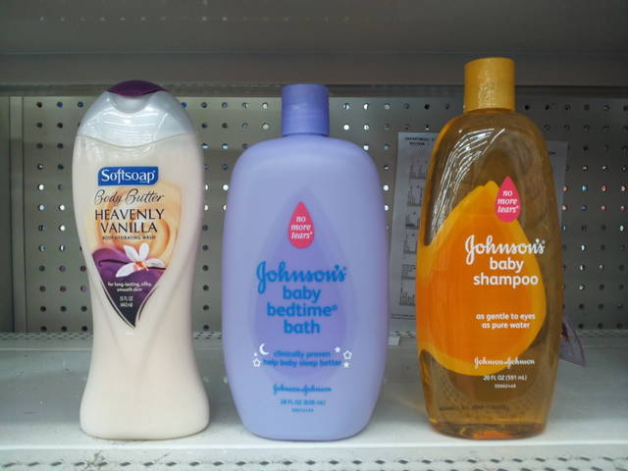
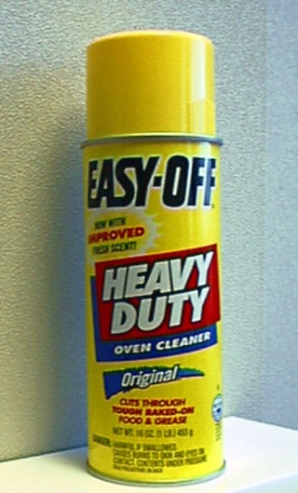
many packages have warning labels that say this product is fatal to humans and domestic animals but no one reads them and they certainly don’t say it on the commercial for you to hear.
Do you recognize these products or use something
Similar?

Slide 15
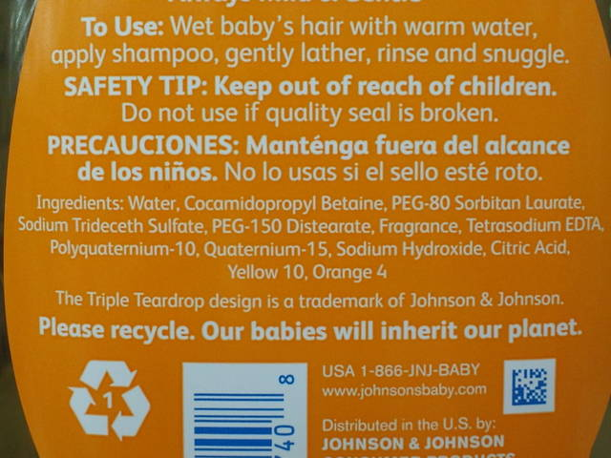

Slide 16
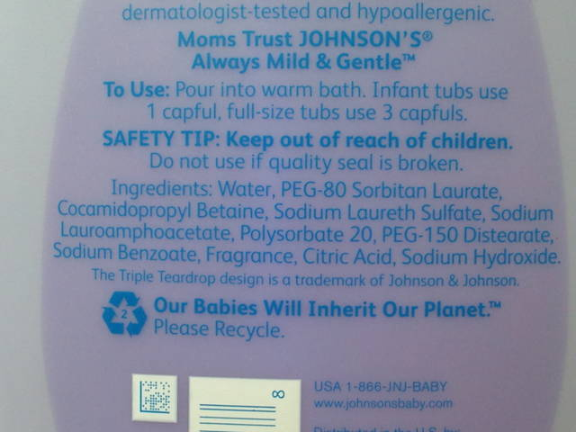

Slide 17
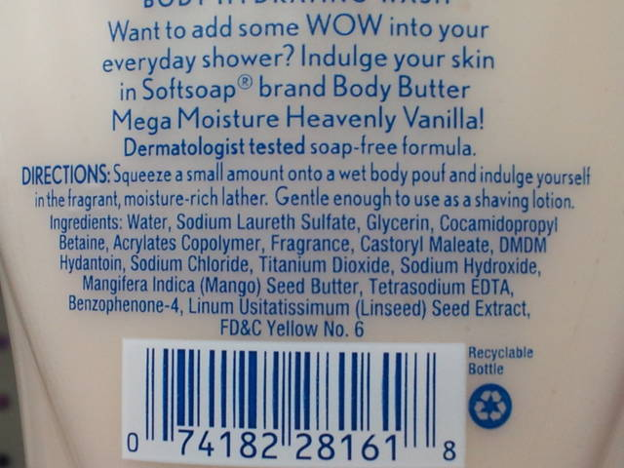

Slide 18
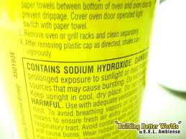

Slide 19
Prevention

Slide 20
Reading Labels
These toxins enter through our home care beauty care and food products. The easiest way to prevent exposure is by reading labels.

Slide 21
Let’s explore ingredients

Slide 22
VOCABULARY
Carcinogen-
A substance that causes or is believed to cause cancer. A carcinogenic substance is one that is known to cause cancer.
Dermal toxicity-
Toxicity of the skin which can range from mild irritation to corrosivity, hypersensitivity, and skin cancer.
Ecotoxicity-
The toxic effects on environmental organisms other than humans.
EPA-
Environmental Protection Agency. A federal agency responsible for regulation of most chemicals that can enter the environment. The EPA administers the following acts: Federal Insecticide, Fungicide, and Rodenticide Act (FIFRA), the Toxic Substances Control Act (TSCA), the Resource Conservation and Recovery Act (RCRA), the Safe Drinking Water Act (SDWA), Clean Air Act (CAA), and the Comprehensive Environmental Response, Compensation and Liabilities Act (CERCLA) ( Superfund Act).

Slide 23
Exposure-
Contact with a foreign substance, usually by inhalation, ingestion, or skin contact.
FDA-
Food And Drug Administration. A federal agency responsible for the safety evaluation of drugs, cosmetics, food additives, and medical devices.
Genetic toxicity-
Toxic effects that result from damage to DNA and altered genetic expression.
Genotoxic-
Toxic effects that result from damage to DNA and altered genetic expression.
Hazard-
The inherent adverse effect of a substance.

Slide 24
Neurotoxin-
A toxic agent or substance that inhibits, damages or destroys the tissues of the nervous system, especially neurons, the conducting cells of your body's central nervous system. Neurotoxic effects can include behavior changes, seizures, as well as wide range of effects, including death.
OSHA-
The U.S. Occupational Health and Safety Administration, OSHA, is a federal agency in the U.S. Department of Labor that regulates workers? exposures to hazardous substances and requires manufacturers of products containing chemicals to develop an MSDS for each brand.
Petroleum distillate-
Petroleum distillates, also called hydrocarbons or petrochemicals, refer to a broad range of compounds that are extracted by distillation during the refining of crude oil. Petroleum distillates pose a special health risk if ingested and vomited. When swallowed, the lighter, more volatile distillate products can be sucked into the lungs interfering with the lung's functions and chemical pneumonia may result. Aspiration of fluid into the lungs can occur both during swallowing and vomiting of the product. Upon skin contact, petroleum distillates can produce local skin irritation and sensitivity to light in some individuals.

Slide 25
Reproductive toxin-
Toxicity of the male or female reproductive system. Toxic effects may include damage to the reproductive organs or offspring.
Respiratory toxin-
Toxicity of the upper (nose, pharynx, larynx, and trachea) or lower (bronchi, bronchioles, and lung alveoli) respiratory system.
Systemic toxin-
A toxin that affects the entire body or many organs.
Toxicant-
An agent that produces adverse effects when absorbed into the body.
Toxin-
A specific protein produced by certain plants, animals and microorganisms that is highly toxic to other organisms (snake venom).

Slide 26
BEAUTY CHEMICALS
Chemical name: PARABEN
Used in: most beauty products
Purpose: preservative; fragrance
The Problem: is naturally found in very low amounts in some foods like barley, strawberries, ect.., and get metabolized making them non toxic; the synthetic form created from petro- chemicals for cosmetics bi passes the metabolic process leaving them toxic, proof of that is in the high levels found in human urine and breast cancer tissue.
Restrictions: no restrictions from the U.S.A
Chemical name: DEA, MEA, TEA, COCAMIDE DEA, LAURIMIDE DEA
Used in: creamy foaming beauty products
Purpose: makes products creamy and sudsy, also adjust pH
The Problem: Causes mild skin irritation, liver cancer, pre-cancerous changes in the skin and thyroid.
Restrictions: no restrictions from the U.S.A

Slide 27
Chemical name: DIBUTYL PHTHALATE OR DBP/ DEP
Used in: nail products, hairsprays, and plastic products
Purpose: used as fragrance(when use in recipe as fragrance they don't have to disclose the ingredient because its protected as trade secret)an din plastics to make them flexible.
The Problem: when absorbed through the skin it ENHANCES other chemicals to cause genetic mutations, reduces sperm count and causes developmental defects on unborn children, may cause health problems such as liver and kidney failure in young children when sucking or chewing on products made with DEP
Restrictions: no restrictions from the U.S.A
Chemical name: BHA, BUTYLATED, HYDROXYANISOLE & BHT BUTYLATED, HYDROXYTOLUENE
Used in: beauty care products, widely used in food
Purpose: preservative
The Problem: possible human carcinogen; interferes with hormone function; in other mammals causes liver. thyroid, kidney problems, disrupts lung function and blood circulation, and can promote tumor growth
Restrictions: no restrictions from the U.S.A

Slide 28
Chemical name: COAL TAR DYES PARAPHENYLENEDIAMINE FD&C OR D&C OR CI
Used in: hair dye, foods, candy, drugs,
Purpose: add pigment
The Problem: the mixture of many chemicals derived from petroleum is a known carcinogen, contains low levels of heavy metals with aluminum substrate
heavy metals + aluminum = brain toxin
linked to tumors by U.S National Cancer Institute, increase risk of Hodgkin's lymphoma.
Restrictions: no restrictions exist
Chemical name: FORMALDEHYDE DMDM HYDRATION, DIAZOLIDINYL UREA, IMIDAZOLINYL UREA, METHENAMINE, QUATERIUM
Used in: hair products, nail products,
Purpose: used as a preservative
The Problem: these types are a concern because the slowly and continuously release small amounts of formaldehyde.
Restrictions: no restrictions from the U.S.A

Slide 29
Chemical name: SYNTHETIC FRAGRANCE AND PARFUM DEP, PHTHALATES
Used infused inmost beauty and home care products
Purpose: to produce a pleasant scent
The Problem: some 3,000 chemicals are used as fragrance, most that have not been tested for toxicity alone or in combination, used even in unscented products, the chemical mixture can trigger allergies, asthma, and migraines in 3 out of 4 people, in laboratory some fragrance ingredients have been associated with cancer and neurotoxicity among other adverse health effects. Some ingredients don't add fragrance but enhances perfuming agents.
DEP- makes scents linger
PHTHALATES- cheap versatile reproductive toxin and may interfere with hormone function.
Restrictions: no restrictions from the U.S.A
Chemical name: PETROLATUM, MINERAL OIL, PETROLEUM,
Used in: hair products, make up, skin care, drugs
Purpose: to lock in moisture in a variety of moisturizers and in hair care products to make your hair shine.
The Problem: petroleum products can be contaminated with PAH'S, POLYCRYLIC AROMATIC HYDROCARBONS, that are cancer causing impurities.
Restrictions: no restriction from the U.S.A

Slide 30
Chemical name: MINERAL OILS
Used in: baby products, lotions, soaps, and make up
Purpose: preservative and assist in maintaining moisture
The Problem: can affect liver function and immune health, clogs pores and interferes with skins ability to remove toxins, and slows cells development causing ageing.
Restrictions: The U.S. Registry of toxic effects of chemical substances classifies mineral oil as both carcinogenic and tumorigenic.
Chemical name: SODIUM LAURYL SULFATES (SLS), SODIUM LAURETH SULFATE (SLES)
Used in: shampoo, cleansers, bubble bath, house cleaning products,
Purpose: to make bubbles and foam
The Problem: can be contaminated with the carcinogen 1,4-dioxane, SLS may cause liver damage, damage and severely irritates skin, eyes, respiratory tract, linked to depression, labored breathing, and diarrhea.
causes layers of skin to separate damaging the skins immune system, stays in your system up to 5 days and it may enter and ,maintain residual levels in the heart, liver, lungs, and brain, can contain carcinogen ethylene oxide, may interfere with human development, does not easily degrade so it remains in the environment long after its rinsed down the drain.
Restrictions: no restrictions exist

Slide 31
Chemical name: ALUMINUM
THE AVERAGE PERSON CONSUMES 3 POUNDS IN A LIFETIME EQUAL TO 229 SQUARE FEET OF ALUMINUM FOIL
Used in: deodorant, mostly antiperspirant, drinking water, and vaccinations, baking powders, feminine care products, cow's milk, soy milk, baby formula, antacids, aluminum foil, pots and pans.
Purpose: temporarily plugs the pores to prevent sweating
The Problem: forces toxins to flow back into the body, linked to Alzheimer's and brain disorders, possible breast cancer factor, and is a neurotoxin.
Restrictions: no restrictions exist
Chemical Name: TALC
Since 1980 several thousand infants died or became seriously ill after accidentally inhaling baby powder.
Used in: baby powder, face powder, deodorant, chalk, crayons, soap, body powder, paint, asphalt filler, food processing, antacids, garden pesticides.
Purpose: used for its anti moisture properties
The problem: Major known carcinogen major cause of ovarian cancer when use don the female genital area, can lodge in the lungs causing respiratory issues.
Restrictions: no restrictions exist

Slide 32
Chemical name: TOCOPHERYL ACETATE
Used in: beauty care products
Purpose: skin conditioning
The problem: enhances tumor formation
Restrictions: no restrictions from U.S.A
Chemical name: HEAVY METALS: LEAD, MERCURY, CADMIUM, ARSENIC, NICKEL, ECT...
Heavy metals can build up in the body over time and are known to cause varied health problems, which can include: cancer, reproductive and developmental disorders, neurological problems; memory loss; mood swings; nerve, joint and muscle disorders; cardiovascular, skeletal, blood, immune system, kidney and renal problems; headaches; vomiting, nausea, and diarrhea; lung damage; contact dermatitis; and brittle hair and hair loss. Many are suspected hormone disruptors and respiratory toxins, and for some like lead, there is no known safe blood level.
Used in: almost everything
TO LEARN MORE ABOUT HEAVY METALS AND OTHER CHEMICALS IN THE
SWEET & SIMPLE GUIDE TO CHEMICA AWRAENESS

Slide 33
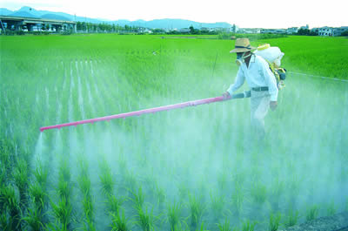
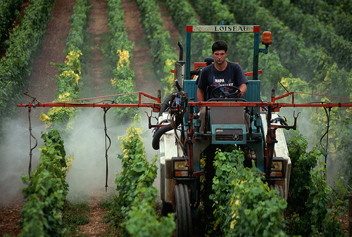
Our Food

Slide 34
Food Safety
What is in and on your food directly affects your health beauty and wellbeing

Slide 35
Food Chemicals
There is a great deal to be discussed when you are talking food chemicals from sow to plate. With this in mind we are going to hit on what we consider to be major areas of concern.
GENERAL RULE
As a general rule, the more processing a food undergoes, the more potential there is for nutrient loss

Slide 36
From Concentrate
From concentrate
a substance made by removing water or other diluting agent; a concentrated form of something, esp. food.
THE PROCESS
Juice from concentrate has most of its water removed through filtration, extraction and evaporation processes.
Evaporation involves heating the juice to high temperatures and extraction involves adding some chemicals to get a more condensed product, according to the “Dictionary of Food Science and Technology
Water is either added to it or it is frozen in smaller containers and must be added to water at home.
Even 100 percent fruit juice from concentrate can contain additives to enhance color, flavor and nutritional content, so read labels before you buy.
100 percent juice from concentrate with no added sugar is a healthy beverage that is comparable to fresh squeezed juice.
juice drinks and juice cocktails from concentrate have refined sugars and flavors added and are not healthy for your body in large quantities.
Check the labels on juice cartons for additives.

Slide 37
WHAT ARE THE DIRTY DOZEN?
According to the Environmental working group these foods are sprayed in very high amounts of pesticides. The dozen changes yearly.
Fruits such as oranges, lemons, and limes have been said to have skin thick enough to make them washable just please remember to wash your hands after you wash your fruit to avoid re polluting the fruit when peeled or simply touched.
The dirty dozen
nectarines
peaches
apples
strawberries
grapes
tomatoes
sweet bell pepper
spinach
potatoes
hot peppers
pears
cherries
hot peppers

Slide 38
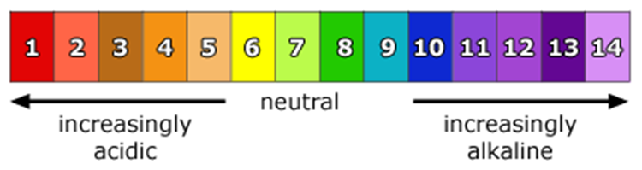
The facts
your bodies pH can determine its ability to fight off bacteria and viruses.
your body's pH should be between 6.0-7.0 when tested with a precision pH testing kit.
pH testing kits can be found at your local health food store.
to maintain health intake 60% alkaline 40% acid foods in your diet.
when sick its 80% alkaline 20% acid
Visit www.rense.com for more detailed information
VISIT BEEASWEETIE.COM FOR A LIST OF ALKALINE FOODS

Slide 39
The “Bitter Sweet” Truth about Sugar
Problem:
Sweeteners that have NO NUTRITIONAL VALUE which makes them empty calories
The chemicals used in the processing of these sweeteners causes your digestive system to retard by not producing the proper enzymes to absorb needed vitamins and minerals from nutritious foods.
It is very important that you know the source of your sweetener because all are not created equal.
Solution: Try Raw sugar its great and it’s a high alkaline food that helps the bodies pH
Lets briefly explore sweeteners and their origins
Sucrose- naturally in fruits, vegetables, grains
Dextrose a.k.a Glucose- naturally in pollen and corn
Maltodextrin- naturally in rice corn or potato
Lactose- found in dairy
Fructose- found in fruits
There is a major difference in the origin of...and the direct source.

Slide 40
Fructose does happen naturally
YES, apples naturally have fructose in them but guess what else apples have in them:
APPLES
potassium
calcium
phosphorus
magnesium
manganese
iron
sodium
copper
zinc
vitamin A
vitamin B1 (thiamine)
vitamin B2 (riboflavin)
vitamin B3 (niacin)
vitamin B9 ( folate acid
vitamin B5 (panthentic acid)
vitamin B6 (pyridoxine)
vitamin C
vitamin K

Slide 41

High fructose corn syrup
sweetener made from corn starch that has been processed by glucose isomerase to convert some of its glucose into fructose.
Is a liver toxin that cause a fatty liver which leads to high cholesterol.
It is metabolized like alcohol but has no affect on immediate brain activity so you don't feel the effects.
Also acts as insulin which can cause kidney damage and can lead to heart trouble.

Slide 42
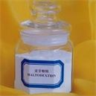
Maltodextrine
Has the ability to pass through the digestive system easily and into the blood because it has no nutrients to be collected by the natural enzymes that collect vitamins and minerals in the intestines.
The "passing" through process causes your body to literally forget how to process healthy foods.

Slide 43
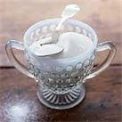
Granulated white sugar
The process:
Sulfur dioxide bubbles through the cane juice before it evaporates; affination ( attaching) occurs with mixing cane juice with heavy syrup and then centrifuged (separated by a spinning machine) washing away its outer coating.
The solution is again clarified by adding phosphoric acid and calcium hydroxide (also a used as chemical hair relaxer) which traps impurities that float to the surface and are skimmed off .
After remaining solids are filtered out, the clarified syrup is decolorized by filtration through a bed of activated carbon
The purified syrup is then concentrated to super saturation and repeatedly crystallized under vacuum, to produce white refined sugar.
To produce granulated sugar, in which the individual sugar grains do not clump together, sugar must be dried. Drying is accomplished first by drying the sugar in a hot rotary dryer, and then by conditioning the sugar by blowing cool air through it for several days.

Slide 44

Sucanant
Sucanat is a brand name for a variety of whole cane sugar
Unlike refined and processed white cane sugar and brown cane sugar, but similar to panela and muscovado, Sucanat retains its molasses content.
whole sugar cane has a sand like outer coating which is where the nutrients live.
when this coating is removed all nutrients gone.
has lowest amount of sucrose and contains : potassium, phosphorus, Vitamin A, calcium, iron, several B vitamins, and magnesium.

Slide 45
B.P.A bisopherol A
Cans and plastic bottles are usually treated with BPA
In cans and reusable water bottles to prevent the metal from poisoning you (however BPA does a great job at poisoning you by itself) and in plastics such as baby bottles and beverage bottles
Its used to help harden the plastics making them durable but toxic
Effects: ultimately decreasing fertility in women, sperm abnormalities in men, obesity, accelerated growth in children, fetal and infant brain development, heart disease, diabetes, breast cancer, testicular cancer, thyroid dysfunctions, miscarriage, and accelerated puberty.

Slide 46
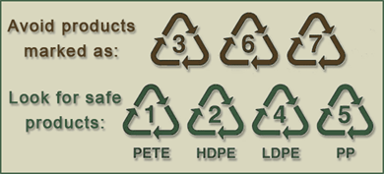
BPA Safety

Slide 47
BPA Facts
Putting hot food onto or into plastic eating ware allows BPA to leak into your food
Any food that is acidic or alkaline can cause BPA to leak into at room temperature
BPAs original use was as an estrogen drug
90% of all government studies found BPA to be harmful for pregnant women and infants
Canada and Chicago has banned its use in baby bottles
In January 2010 the FDA issued new warnings and concerns about BPA but DIDN’T list them on the MSDS(material safety data sheet).

Slide 48
Home care chemicals
The biggest issues
Inhalation
with the frequent use of aerosol cans, pump sprays, and home fragrance products leaving our respiratory tracts and nervous systems in real trouble
Chemical residue

Slide 49
Use products with care:
always open windows before you begin to create air flow
wear a mask when dealing with chemicals to prevent particle inhalation.
wear gloves to protect your skin
use mildly warm temperature water preventing steam and decreasing inhalation risk, every little bit counts
always pour water into the container first and follow with cleaning agent, to prevent chemical splashing
be sure that pets and children will not be the area during the cleaning process
after you are finished with the chemicals, clean your tools thoroughly with mildly warm water
now clean your surface with pure water in an attempt to remove as much residue as possible
its preferred that you wipe up moisture left behind but if not, allow the area to totally air dry before bringing children and animals into the area.

Slide 50
Green Washing
Green washing is when a product is presented as natural, organic or generally healthy for you and actually isn't.
What we suggest
We recommend that you take advantage of the budget friendly, family friendly, pet friendly, and eco- friendly, bull by the horns approach to home care.
Check out the Sweet & Simple Guide Aromatherapy for my family

Slide 51
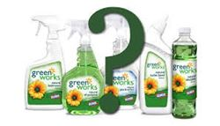
What is natural? legal definition: NONE
The FDA has considered the term “natural” to mean that nothing artificial or synthetic (including all color additives regardless of source) has been included in, or has been added to, a food that would not normally be expected to be in that food.
However, this policy was not intended to address
food production methods
use of pesticides,
food processing
manufacturing methods,
any nutritional or other health benefit
Lets look at this product that appears good for you but wait......it contains
sodium hydroxide
This mineral-based ingredient increases the pH levels in our products for improved cleaning performance. glass cleaner, laundry detergent*This is also found in beauty products and toothpaste.
This would be a somewhere in between its better than some others but no where near natural.

Slide 52
Legality of labeling
Nothing is for certain but there are organization that are supposed to ensure the legitimacy of the labels on our food

Slide 53


What is organic? legal definition:
Organic. A labeling term that refers to an agricultural product produced in accordance with the Act and the regulations in this part.
Organic matter. The remains, residues, or waste products of any organism.
Organic production. A production system that is managed in accordance with the Act and regulations in this part to respond to site-specific conditions by integrating cultural, biological, and mechanical practices that foster cycling of resources, promote ecological balance, and conserve biodiversity.
Organic system plan. A plan of management of an organic production or handling operation that has been agreed to by the producer or handler and the certifying agent and that includes written plans concerning all aspects of agricultural production or handling described in the Act and the regulations in subpart C of this part.
The Agricultural Marketing Service of the U.S. Department of Agriculture (USDA) oversees the National Organic Program (NOP). The NOP regulations include a definition of "organic" and provide for certification that agricultural ingredients have been produced under conditions that would meet the definition. They also include labeling standards based on the percentage of organic ingredients in food.
https://www.fda.gov/aboutfda/transparency/basics/ucm214871.htm

Slide 54
Do some more digging at…..
https://www.nal.usda.gov/afsic/organic-productionorganic-food-information-access-tools

Slide 55
The best option is to DO IT YOURSELF
Labeling is something that you will see to be an issue across the board. GMO foods have yet to be labeled and Nanotech beauty products also have yet to be labeled. This is pushing the average person into a D.I.Y. lifestyle slowly but surely. Lets look at some D.I.Y. ideas for beauty.
Sometime you have to become one of D.I.M girls
and say I’ll
DO IT MYSELF

Slide 56
DIY home care

Slide 57
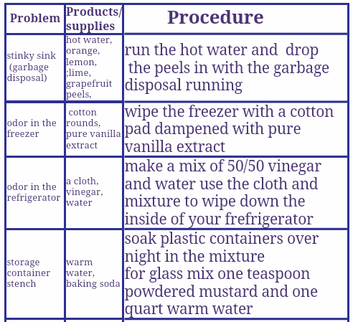

Slide 58
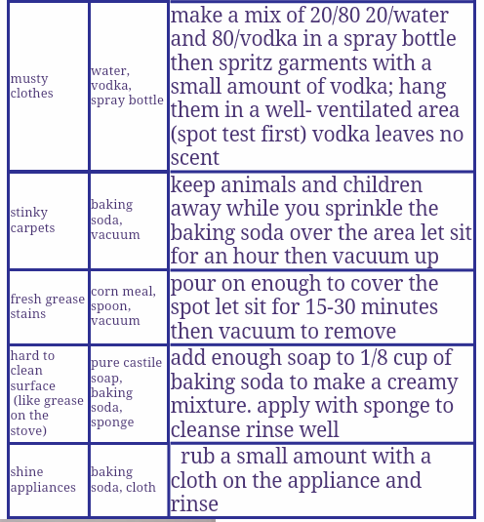

Slide 59
DIY beauty

Slide 60
HAIR Apply to clean hair let sit for 20 minutes and rinse with cool water | SKIN Apply to a clean face and sit for 10 minutes, rinse with warm water | NAILS Massage into nails daily
Smoothing Treatment: 1 tsp coconut oil- shine and moisture 1 oz. Vinegar- body 1 oz. Green tea- smooth 2 oz. Water | Dry: “go bananas face mask” half of a banana, 1 tsp. honey, mix together | Strengthening: 1 drop Lemon essential oil 1 tsp. coconut oil
Volumizing Treatment: 1 tsp. Cornstarch 1 tsp. Baking soda 1 oz. Vinegar 2 oz. water | Oily: “tea time mask” make a paste out of 1 tsp of baking soda, and tea from a green tea bag. Add just enough tea to create a paste | Growth: 1 drop Lime essential oil 1 tsp. coconut oil
Growth Treatment: 5 drops Lavender essential oil 5 drops Rosemary essential oil 2 oz. brewed coffee 2 oz. water | Normal: “ breakfast mask” mix together 1 tbsp. oatmeal, 1 tsp honey, and enough milk to form a paste | Dry cuticle: 1 drop Lavender essential oil 1 tsp olive oil

Slide 61
DIY food safety
BEST OPTION
Gardening
BETTER OPTION
Buying organic
GOOD OPTION
Cleansing what you got
MOST IMPOTANTLY DOTHE BEST YOU CAN FROM WHERE YOU ARE UNAPOLOGETICALLY

Slide 62
Gardening 101
Know your zone
Your zone will tell you what and when to grow
Decide if you will grow in ground or pots
Select the plants you want to grow
Learn needs of the plants, including soil, sun, water, and feeding
Purchase materials and supplies
Keep a notebook record of sowing, germination, care and harvesting

Slide 63

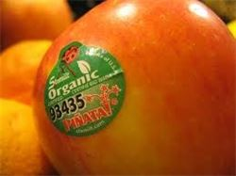
Buying Organic
Be sure to see the USDA seal
Remember that organic does not mean GMO or gluten free and the reverse
Remember organic does not mean free range or pasture raised
Remember to check produce sticker numbers
Consider the Dirty Dozen
9 ORGANIC | 3 or 4 CONVENTIONAL | 8 GMO

Slide 64
Cleansing and Considerations
Wash all your fruits and vegetables. According to the CSE, washing them with 2% of salt water will remove most of the contact pesticide residues that normally appear on the surface of the vegetables and fruits
CSE ( Center for Science and Environment) claims that if done diligently, washing with cold water should be able to remove 70% to 80% of all pesticides
Fill a large bowl with 4 parts water to 1 part plain white vinegar, then soak the fruit or vegetables in the mixture for 20 minutes, after rinse the fruit or vegetables well with water. Save.
Remember that fresh or frozen is always better than canned.
Avoid processed and concentrated foods

Slide 65


