Slide 2
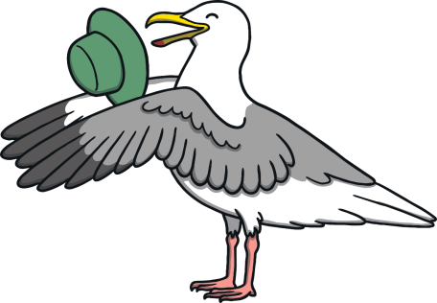
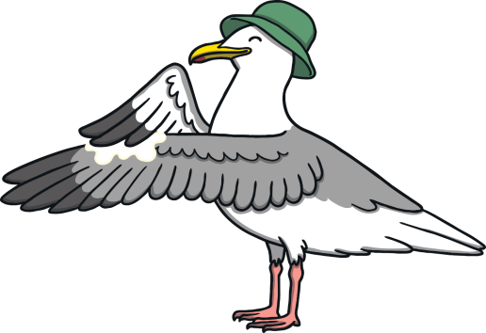
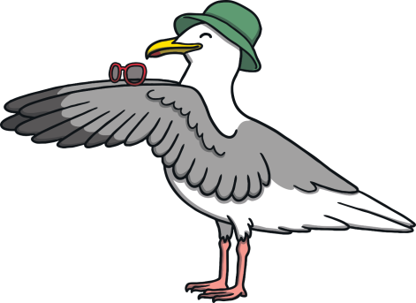
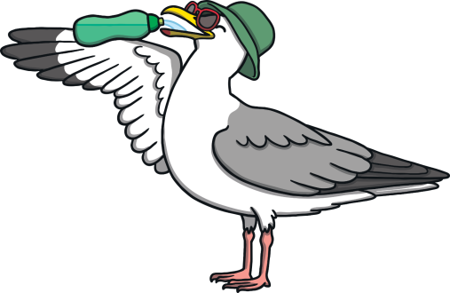
In the summer, it’s lots of fun,
To play outside, in the sun.
Just remember – put on a hat,
And rub in sun cream, just like that!
Then put on sunglasses, it’s really cool,
Drink lots of water, that’s the rule!

Slide 3
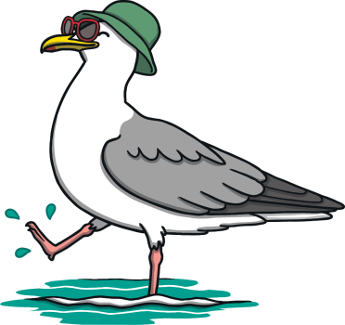
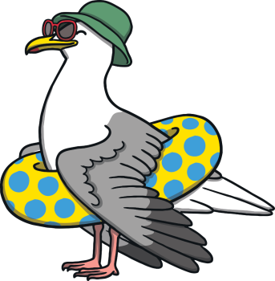
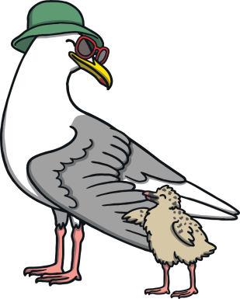
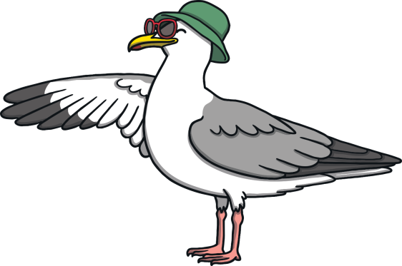
To keep safe when you’re by the sea,
Only go in the water, carefully!
Wear a rubber ring or arm bands,
Stay near your grown-up and hold their hand.
Hold on tight - waves can be strong,
Stay by the shore and you won’t go wrong.

