Slide 1
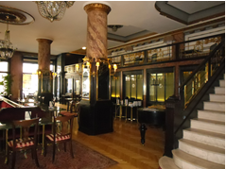
Hungary – both traditional and modern

Slide 2
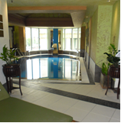
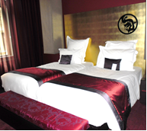
Budapest hotels
Kempinski is a typical spa hotel
Buddha-Bar is very hi-tec

Slide 3
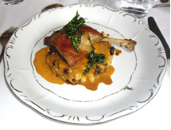
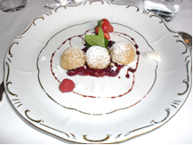
Superb food at The Gundel
Duck Leg
Cottage Cheese Dumplings

