Slide 1
When Jesus Comes Riding Into Town
John 12:12-16

Slide 2
The Chronology of Events
Zacchaeus’ salvation
Healing of the ten lepers
Bartimaeus is healed of blindness
Blessing of the little children

Slide 3
Why the Crowds Were Cheering for Jesus
They had witnessed his miracles
They were ready for a revolution

Slide 4
They understood the prophesies
They believed the traditions

Slide 5
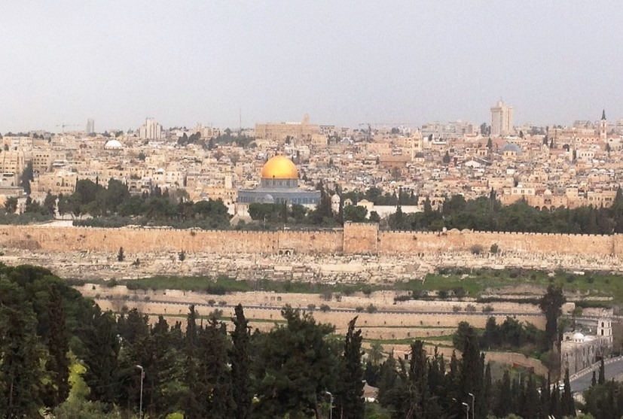

Slide 6
Jesus’ First Triumphal Entry Into Jerusalem
Their motives were shallow
John 12:17-18
They misunderstood His purpose John 12:23-33

Slide 7
They did not comprehend judgment John 12:37-40

Slide 8
Jesus’ Next Triumphal Entry Into Jerusalem
He will come with purpose Revelation 19:11
He will come with power Revelation 19:15

Slide 9
He will come in judgment Revelation 19:19-21

