Slide 1
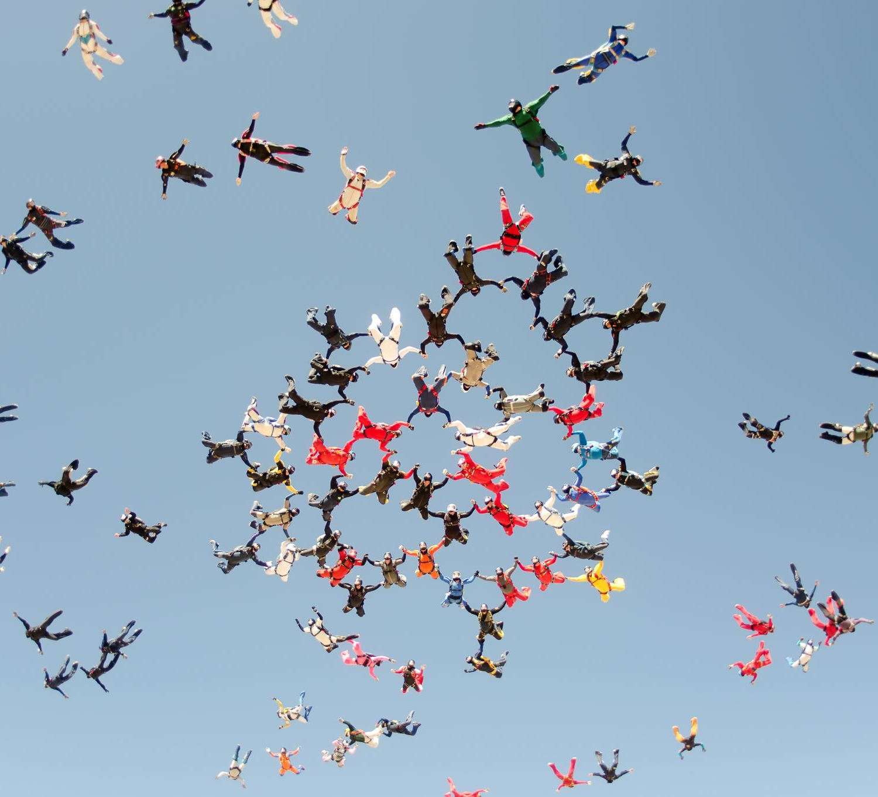
Group Development: Beginning
Angela Waggoner, MA, LPC-S, LCDC-I, NCC
Ph.D. Student at Liberty University
Notes:
Just as Gladding likens group development to Twyla Tharp’s forming a dance assembly, group development can also be liken to these sky divers forming their art as they free fall. In order for the dance assembly to function, these sky divers to get into formation, or your groups to achieve the outcome it was set out to achieve, then understanding how to begin and nurture will help any group reach it’s desired goals.

Slide 3
Gladding’s Four Stage Process
Formation/Orientation
Transition
Storming
Norming
Performing/Working
Mourning/Closing
Notes:
Many researchers agree there is a four to five stage process in groups. Gladding states four stages.

Slide 4
Forming Stage
Stage 1
Develop a Rationale for the Group
Stage 2
Deciding on a Theoretical Format
Stage 3
Weighing Practical Considerations
Stage 4
Publicizing the Group
Notes:
Each step in this stage is important, while it can be completed together or individually, each must be completed in order for the groups to function successfully.
Stage 1: With a clear rationale, the group will have positives outcomes and responses. Without a clear rationale, the group process can be harmful.
Stage 2: Even no theoretical format is a theoretical format. Some leaders come from an eclectic stance. Overall the theoretical stance should match the needs of the group members.
Stage 3: Focusing on meeting time, place and frequency. Also if the topic of the group is a sensitive topic and depending on the setting, parental notification may be necessary. The setting will have a great deal of influence on meeting time, place, frequenting, and notification guidelines.
Stage 4: Word of mouth can sometimes be the most effective means, but also use personal contact and written announcements. Can anyone list some advantages and disadvantages to different types of publication means? In your book, on pg 85 (Figure 4.1) Gladding provides a checklist that can prove helpful to forming a group.

Slide 5
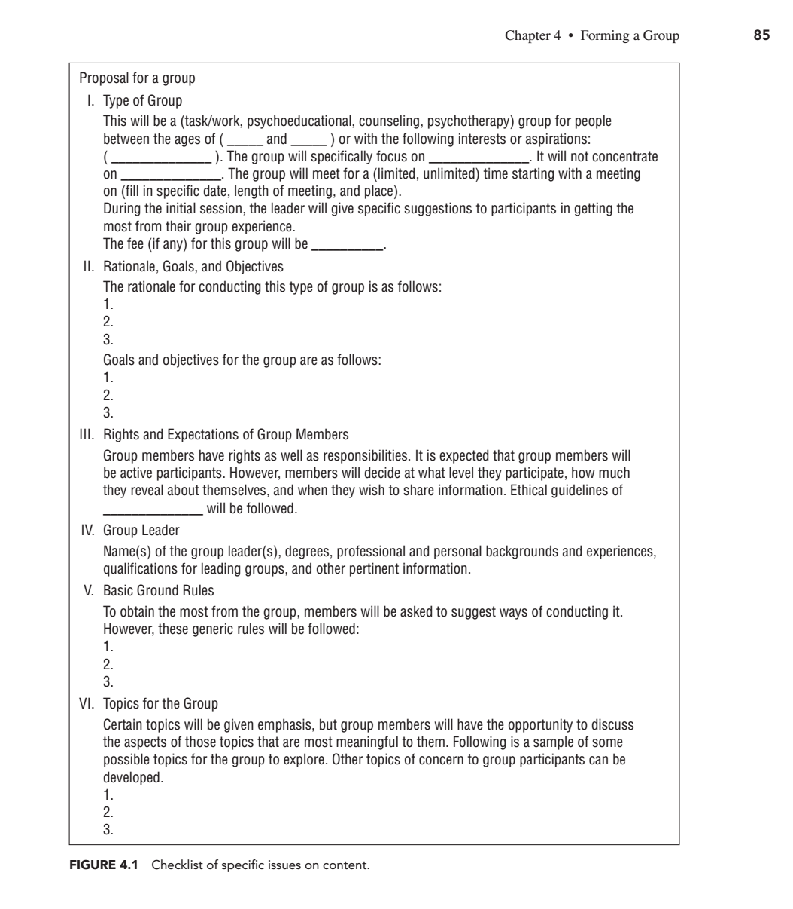
Notes:
Get into 4 groups of 5 and remember these groups because you will be working with these groups off and on throughout the lectures with me. Within your groups, work through this checklist.

Slide 6
Group Activity
Get into groups and develop your own group.
01
Develop a Poster for your group.
02
Present your group to the class in 5 minutes or less.
03

Slide 7
Forming Stage
Stage 5
Screening and Pretraining
Identify needs, expectations and commitment
Challenge myths and misconceptions
Convey information
Stage 6
Selecting Group Members
Stage 7
Selecting a Group Leader
Notes:
Stage 5: Two types of Pre -group screenings: individually or group-conducted
What happens in the pre-group screening? Intake interviews, determining level of interpersonal behavior or comfort with others that may impact group interaction, determining if premature termination will occur
Which is considered most important: needs, expectations or commitment? Commitment
Gladding finds it crucial for potential group members accurate information and not misinformation about groups, why do you feel there is misinformation out there and we need to correct it prior to the member joining the group?
What type of information, according to Gladding, is important to convey? Nature and limits of confidentiality, group stages, roles, importance of balancing content and process, length of group, what might occur, member attention to nonverbal and verbal interactions
Stage 6: Two-way process in most groups except in some psycho-educational groups. Those who are invited should be those who are likely to benefit and have specific goals in mind. What are examples of group members who are not ready to be in a group? Who are ready to be in a group?
Stage 7: Based on your readings, what qualifications makes a good group leader?
The leader’s professional and personal disclosure to the member will help the member to decide if they feel this person can lead effectively or not.

Slide 8
Tasks of Beginning a Group
Dealing with Apprehension
Reviewing Members’ goals and contracts
Specifying more clearly or reiterating group rules
Setting limits
Promoting a Positive Interchange Among Members
being enthusiastic
draw out members
hold focus on interesting topics
shift focus when topics are irrelevant or only interesting to a few members
shutting down hostile/negative interactions
Notes:
Apprehension = anxiety = normal;
Goals = specifics objectives the group wants to accomplish (should have already been developed prior to the first meeting)
Contract = An agreement each member makes with themselves and an accountability with the leader to meet the group goal
Rules = Guidelines by which the groups are run. Rules should be set in a positive manner. A rule to set but difficult to enforce with groups is confidentiality, some members violate unintentially or intentially. It is crucial to deal with confidential breaches immediately and effectively when they occur. What do you feel like are the best ways to deal with those breaches?
As leaders to maintain confidentiality, destroy records in a manner that will verify confidentiality will be upheld and/or store the records in a place that is secure.
Limits = boundaries of the group that will dictate what behaviors are allowed within the group. Can be explicit and implicit.
Positive Interchange – begins with the leader. Can incorporate interactive journal writing

Slide 9
Potential Problems
People Problems
Manipulators
Resisters
Monopolizes
Silent Members
Users of Sarcasm
Diagnostic Analyzers
Focusers on Others
Subgroups
Group Procedural Problems

Slide 10
Opening the Group
Some options for beginning are to begin with an opening statement about the group and then,
Conduct an Introduction Exercise
Get right into the Content of the Group
Then have the members form dyads
Have members complete a short-sentence form
Begin with an unusual opening
Structure
Involvement
Group Cohesion
Hope and Risk Taking
Closing of the Session

Slide 11
Useful Procedures for The beginning stages of a group
Joining
Use of Icebreakers
Linking
Cutting Off
Drawing Out
Clarifying the Purpose

Slide 12
Closing Thoughts/Questions
What do you think are important tasks to complete before the initial group meeting or on that first group meeting?
Gladding only mentions a four-stage process, where other theorists mention a five-stage process. What are your thoughts?
Do you feel that being a group leader it is better to be prepared as Gladding emphasizes or do you believe it is ok to “wing it” sometimes?

Slide 13
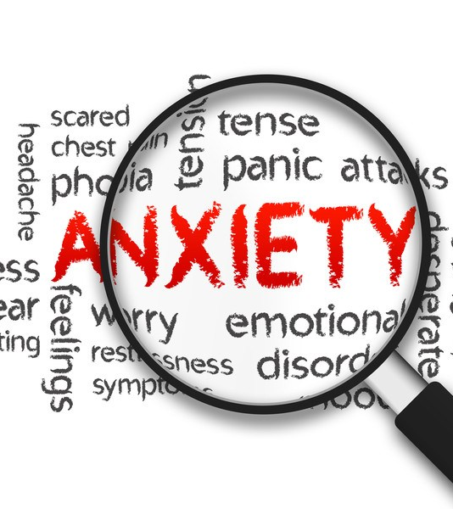
Transition Period: Storming and Norming
Angela Waggoner, MA, LPC-S, LCDC-I, NCC
Ph.D. Student at Liberty University
This Photo by Unknown Author is licensed under CC BY
Notes:
﻿In the midst of struggles, stagnation, and stress we gather as pilgrims on a journey to explore the territories of our minds and the spaces that separate us from others. The air is tense with anxiety as we venture into the unknown. Like the settlers of yesterday’s time we strive to take in all we encounter. Enlivened by a new awareness we are moved to consider change.*
Gladding, Samuel T.. Groups (p. 103). Pearson Education. Kindle Edition.

Slide 14
Remember the Titans: An Example of Group Development

Slide 15
Group Activity
Find
Find your group by practice location (i.e. school, private, managed care, undecided)
Discuss
Discuss amongst yourselves your theoretical orientation (i.e. CBT, DBT, Solution-focused, eclectic, Gestalt, etc)
Notes:
After group activity come together as a group and discuss the transition, storming and norming process. Did they feel the transition of everyone trying to find their place in the group? Did they feel the storming of some attempting to compete with others? Did they feel the groups norming?
Which part seemed more normal, beginning with practice groups or beginning with theoretical orientation groups?

Slide 16
Storming
Primary Tension – awkwardness about being in a strange situation
Secondary Tension – intragroup conflict
Quiet Storming – Avoidance
Conflict Resolution – Primary focus is on ending the conflict (conflict is seen as negative)
Conflict Management – Directing conflict toward constructive dialogue (conflict is seen as positive)

Slide 17
Storming: Peer Relationships
There is a “battle” for power during this process
Informational – what you know or how much you know
Influential – manipulation
Authoritative – pulling rank
Some may be Resistant during this time or pull away

Slide 18
Other Storming Characteristics
Intellectualization
Questioning
Advice Giving
Band-Aiding
Dependency
Monopolizing
Attack on the Group Leader

Slide 19
How to Work through storming
Use a process observer to provide unbiased feedback
Leveling – draw out those who are not participating as much and limiting those who are participating too much
For Group Members and Leaders to openly discuss issues happening within the group as they occur
Obtain feedback from group members
Informal
Formal
Logs
Journals
Motivational Interviewing

Slide 20
Successfully working through storming
The group members take on a deeper level and allow for others to express, the members are now accommodating.
Members may choose to revise goals
Members may also choose to change their interpersonal relationship styles.

Slide 21
Norms and Norming
Norms are expectations about the groups and the group members that should or should not take place.
Group Norming – cohesiveness of the group
There is a sense of belonging
A feeling of identification occurs within the group

Slide 22
Here and Now Experiences in the Norming process
Feeling the sense of belonging each and every session may not occur due to existential variables, such as conflict, withdrawal, support, change, etc
Address these issues as they arise
Hope energizes the group member and the group as a whole
Cooperation helps bring the group together to build hope and community, especially during the storming stage
Collaboration helps members share with the other group members
Cohesion allows the group to feel that connectedness

Slide 23
Task Process during Norms
Reach an agreement of norms, rules and standards
A commitment to the group, its rules, and individual goals

Slide 24
Promoting norming
Actions by the group leader and members can promote norming
Supporting
Empathizing
Facilitating
Self-disclosure

Slide 25
The Working Stage
Angela Waggoner, MA, LPC-S, LCDC-I, NCC
Ph.D. Student at Liberty University

Slide 26
Johari Window

Slide 27
Activity
Complete the Johari Window

Slide 28
Task Processes During the Working Stage
Group members are working on improving themselves
Allow group members to discuss their issues, by making rounds, equal talk time
Role play
Homework
Incorporation – realizing how the group has helped the individual both in the group and outside of the group

Slide 29
Case Study
﻿Nanette is an overweight, unkempt, and lethargic sixth grader. She is teased a lot in school. The counseling group she is in is working with her on controlling her temper. She is asked to play the role of being nonchalant when others poke fun at her. She pretends the words are like raindrops bouncing off a finely waxed car. She is in the driver’s seat and can remain cool instead of revving up. Nanette finds her ﻿role refreshing and she is surprised that she can control her temper.
How do you think the car metaphor helps Nanette?
What other roles might Nanette play that would help her? How might she transfer what she does in a role-play to real life?
Gladding, Samuel T.. Groups (p. 125). Pearson Education. Kindle Edition.

Slide 30
Team Building At the Working Stage
Remember the Titans
Two ways of selecting members
Team Player Inventory
Group Emotional Intelligence Individual Regulation
After selecting team members, promote teamwork and build up your team through teambuilding exercises.
Ice-breaking exercises can be effective at this point

Slide 31
Problems in the development of Teams
Leadership Styles
Member maturity and motivation
Group task or purpose characteristics
Membership stability and group size
Time availability
Organizational, institutional, cultural, and societal expectations

Slide 32
Team Building Activities
Return to your groups
Share your biggest accomplishment before you were 25
Share your biggest regret before you were 25

Slide 33
Problems in the Working Stage
Racial and Gender Issues
Culturally encapsulated – rigid and stereotypical regarding racial and gender issues
Group Collusion – knowingly or unknowingly reinforcing norms, prevailing attitudes and/or behaviors
Group think – a phenomenon that prevents open dialogue and causes closed mindedness
Devil’s Advocate Procedure can be used to bring group collusion and group think to an end

Slide 34
How to Assist a group not working well
Modeling
Exercise
Groups observing Groups (Fishbowl)
Brainstorming
Nominal Group Technique
Synectics (excursions)
Written Projections (Therapeuitic Fairytale)
Group Processing – prevents memory decay
Teaching Skills

Slide 35
Working Stage Outcomes
How do you know if your working stage was successful?
Should you seek feedback at the end?
Is humor effective?

Slide 36
Closing a Group
Angela Waggoner, MA, LPC-S, LCDC-I, NCC
Ph.D. Student at Liberty University

Slide 37
Finding your Sound

Slide 38
When a Group closes, how does it effect the members or the leader(s)?
﻿I travel back to the land of my genesis as a different man in a changing world, like Joseph, after his stay in Egypt. At the end of night, I will begin, by exploring the light and hope of dawn, recalling the length of just past days, and feeling the warmth of lasting friendships. Amid the abundance of still fresh memories I will journey on a path of transition into the unknown and ever evolving as I experience the fullness of time that leads to closure and permanent growth.*
Gladding, Samuel T.. Groups (p. 140). Pearson Education. Kindle Edition.

Slide 39
Closing activities for Group members
Reflect on past experiences
Process memories
Evaluate what was learned
Acknowledge ambivalent feelings
Engage in cognitive decision making
Closing provides an end of one experience so that another experience can begin for the members

Slide 40
Potential issues
Emotional ambivalence
Feelings of loss, sadness, pain and/or separation
Feelings of hope, joy, accomplishment, and/or anticipation
Unfinished business
Transference
Countertransference

Slide 41
Closing group Preparations
Leaders should have this set from the beginning stage – before the group meets for the first time
Set boundaries
Physical
Psychological
Closing occurs on two levels
End of each group
End of the set amount of sessions

Slide 42
Closing using a family therapy session model
Orientation
Summarization
Discussion of Goals
Follow-Up

Slide 43
Closing a group
During orientation closing is discussed
During the process closing is discussed
The leader reminds the group 5-30 minutes before closing the group will be ending
When closing the group the last few group sessions should be focused on closing the group and processing those emotions and/or concerns for the members

Slide 44
Effects on Group Members when Closing a group
Some group members may need further assistance, referrals to:
Individual counseling
Another group or organization
Recycling – returning to the group or a similar group experience again to learn lessons missed the first time or at a deeper level.

Slide 45
Group Activity
Return to your group preparation groups and discuss what you feel like are some reasons for “recycling” a group member. Be prepared to have one of your group members share with the class.

Slide 46
Premature closing of a group
This occurs due to the individual members not attending suddenly or the actions of the leader.
Premature termination negatively affects the group participants that were attending regularly.
If the leader is having to close the group due to moving, illness, or another issues; It is recommended and highly encouraged for members’ wellbeing to have at least one session to provide an “ending session.” This provides closure.

Slide 47
Premature closure by group members
External factors
Group deviancy
Problem of intimacy
Fear of emotional contagion
Inability to share the doctor
Complications of concurrent individual and group therapy
Early provocateurs
Inadequate orientation to therapy
Complications arising from subgrouping

Slide 48
Group Activity
Work in your groups and decide how your group will plan to prevent your group from closing prematurely by its group members. Be prepared to share your ideas with the class.

Slide 49
Preventing Premature Closing Groups
Groups should start and end on time
Members should commit to attend a set number of sessions
Members should be treated personally and professionally
Group issues should be discussed with clarity and conciseness
Send reminders of meetings to group members
Send a “missing you” note to those group members who have not been in group for at least two meetings

Slide 50
Closing Group sessions
Member summarization – discuss what they have gained personally
Leader summarization – personal reaction to what they perceived has occurred in the group
Rounds – similar to member summarization except for every member to comment in 1-2 sentences
Dyads
Scaling Activities – Using a Likert Scale (1-10)
Written Reactions
Rating Sheets
Homework

Slide 51
Group Activity
In your groups decide how your group will close. Be prepared to share with the class your closing style and why you chose that style.

Slide 52
Final closings of a Group
The members should already be aware this is coming as they were told at the beginning there were a set number of sessions. (Setting a time limit for the group)
Capping – easing from the emotional to the cognitive
Use reflective questioning

Slide 53
Capping Skills
Allow the group members to summarize their reflections from the group experience
Evaluate the group members’ growth and change from when the beginning to the close
Pay attention to unfinished business and evaluate next steps
Help group members ”rehearse” their plans for the after group life (or everyday life)
Allow group members to share homework with other group members
Allow group member feedback for your growth as well as their own
Possibly the most important, allowing the opportunity to say “good-bye” and express
Develop a specific plan for continued growth

Slide 54
Potential Pitfalls in Closing a group
Denial
Transference
Countertransference
The leader not closing the group correctly

Slide 55
Group activity
Discuss how you would handling in your groups if the following situations occurred:
One of the members toward the end attack you or your co-lead and claims his/her experience has been worthless.
The majority of the members request to extend the group sessions for at least 6 more sessions.
At the close of the group, a member lingers and decides to discuss with you a situation she chose not to disclose to the entire group.

Slide 56
Group Activity
Each group will come to the front and role-play a group session where one member gets up and leaves the group. The member leaving will decide when he/she will leave but no one else will be aware.
The group will then discuss how they felt when this occurred as members and as leaders.
Those observing will discuss what they may do if they were in that situation.

Slide 58
Group Jeopardy
Characteristics of the Groups Stages | Peers and Groups | Tasks in the Groups | Useful Procedures | Anything Groups
$200 | $200 | $200 | $200 | $200
$400 | $400 | $400 | $400 | $400
$600 | $600 | $600 | $600 | $600
$800 | $800 | $800 | $800 | $800

Slide 59
It is often characterized by the initial caution associated by any new experience; attempt to avoid being rejected by others
Answer

Slide 60
What is Forming?

Slide 61
It is often characterized by a focus on the achievement of individual and group goals and the movement of the group into a more unified and productive system
Answer

Slide 62
What is Performing and Working Stage?

Slide 63
It is characterized by a time of conflict and anxiety; group moves from primary to secondary tension; attempt to balance between too much and too little tension
Answer

Slide 64
What is Storming?

Slide 65
Is Characterized by a feeling of “we-ness” that comes when individuals feel that they belong to the group; often enthusiasm and cooperation at this time
Answer

Slide 66
What is Norming?

Slide 67
Feelings of empathy, compassion, and care abound; participants relate to one another on a deep and sometimes emotional level; feelings of warmth and sorrow occur simultaneously
Answer

Slide 68
What is Mourning/Termination?

Slide 69
Identification with others in the group; hope, cooperation, collaboration, cohesion
Answer

Slide 70
What is Norming?

Slide 71
Group members are superficial and center conversation around historical or future events that do not have a direct impact on the group
Answer

Slide 72
What is forming?

Slide 73
Genuine concern on a deep, personal level by members for one another; greater willingness to self-disclose on the part of members; increased awareness in the group about individual participants and the world of each person.
Answer

Slide 74
What is Performing/Working?

Slide 75
It is characterized by participants coming to know themselves on a deeper level; primary activities – reflect on past experiences, process memories, evaluate what was learned, acknowledge ambivalent feelings, engage in cognitive decision making
Answer

Slide 76
What is Mourning/Termination?

Slide 77
Group members tend to be more anxious in their interactions with one another; concern for power is prevalent
Answer

Slide 78
What is storming?

Slide 79
Concentration on direct objectives diminishes; a healthy “pause” takes place; scapegoating might take place
Answer

Slide 80
What is Storming?

Slide 81
Major emphasis on productivity whether the results are tangibly visible or not; maintenance of interpersonal relationships must be attended to and balanced with productivity
Answer

Slide 82
What is Performing/Working?

Slide 83
Dealing with apprehension; reviewing members; goals and contracts; specifying more clearly or reiterating group rules; setting limits; promoting positive interchange among members so they will want to continue
Answer

Slide 84
What is forming?

Slide 85
Major emphasis on promoting relationships in the group; consolidation of gains, finding of meaning in group, making decisions for new ways of behaving; prepare for a new beginning
Answer

Slide 86
What is mourning/termination?

Slide 87
Members must agree on the establishment of rules from which to operate the group; groups accept both prescriptive and proscriptive rules; important of commitment is stressed during this time;
Answer

Slide 88
What is norming?

Slide 89
Joining, linking, cutting off, drawing out and clarifying purpose
Answer

Slide 90
What is Forming?

Slide 91
Supporting, empathizing, facilitating, self-disclosure
Answer

Slide 92
What is Norming?

Slide 93
Leveling feedback, Informal and formal Feedback
Answer

Slide 94
What is Storming?

Slide 95
Summarization, rounds, dyads, written reactions, rating sheets, homework, time limits, capping skills, and modeling
Answer

Slide 96
What is mourning/termination?

Slide 97
Modeling, exercises, group observing group, brainstorming, nominal-group technique, Synectic, written projections, group processing, teaching skills
Answer

Slide 98
What is Performing/Working?

Slide 99
Welcome to Final Jeopardy
Please write down the points you Would like to wager and place them to the side.

Slide 100
There are stages each group goes through. How many stages are there according to Gladding and what are they?
Answer

Slide 101
4 Stages Forming Transition Performing/Working Mourning/Termination

