Slide 1
Restaurants for REVOLUTIONARY SCHOOLING
“If you’re dreams don’t scare you, they’re not big enough.”
~ Pauline Rolfe
David Booth, PhD
(OISE-University of Toronto);
Barbara Smith, PhD (ZPD School & Curriculum Design)
May 18, 2017
Collingwood
Community Centre

Slide 2
Why do we need a revolution?
ZPD Talks

Slide 3
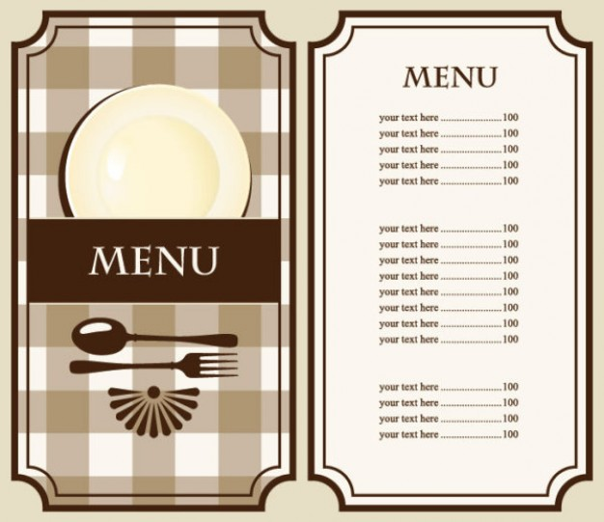
Planning Menus for revolutionary education
ZPD Talks
Starters (your ideas)
Main Courses
(Examine cases with
’special sauces’)
Desserts
(toppings to add to your
dream school)

Slide 4
POT LUCK STARTERS What would you want in a DREAM SCHOOL?
ZPD Talks
What would you bring?
Draw and label an outline of your dream school? (on poster paper)
Put your non-negotiables inside the walls.
Place the optional ideas in clouds around the outside the school.

Slide 5
Appetizers…
ZPD Talks
Fun
Memory-making
Meaningful
Interaction
Images
What keeps you engaged?

Slide 6
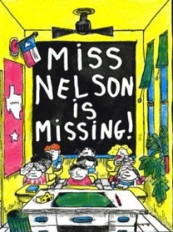
Ask Students what they like
ZPD Talks

Slide 7
Sample Menu Items
ZPD Talks
Telling oral storytelling
Dramatizing a story
Clapping rhythms in Math
Making quilts to see fraction patterns
Designing & building dwellings (i.e. bee boxes, bat houses)
Coding
Playing games (bridge, chess, board, card, on-line…)
Making robots, rockets, things that surprise
E-pals (writing to someone who responds)
Peer teaching
Being active, physical education, outdoor education
Model United Nations simulations

Slide 8
Familiar Main Courses
ZPD Talks
Montessori Schools
Reggio Emilia Education
International Baccalaureate
(primary years program, middle years program,
IB – grade 11/12)
Waldorf Education
Single-gender education
21st Century Learning schools
Growth Mindset Schools

Slide 9
Fresh Catches of the Day…
ZPD Talks
High Tech High (STEAM school)
Institute of Child Study Laboratory School (Knowledge building school)
Blue School (creativity school)
Kindness School (character education/service learning school)
The Green School in Bali (environmental education)
Coast Mountain Academy in BC (outdoor education)
Red-Tailed Hawk Forest School (outdoor education)
Bolles School in Florida (sports school)
Duke Ellington School in DC (performing arts schools)
Scouting
Community Recreation Programs

Slide 10
ZPD Talks
Recipe for Specialty Dishes…
Hard Work
Learning from mistakes
Student, parent and teacher responses
Current peer-reviewed research
Action research (responsible piloting of new approaches)
Have Integrity – being true to brand (doing what you say you do – WELL)
Embrace change (cannot improve without change and risk)
Employ a critical mass of exceptional teachers
Build schools crawling with student, teacher & parent leaders
Contribute to model schools and advancing the field of education

Slide 11
Hours of Operation & Occupancy
ZPD Talks
Consider:
Time for targeted staff development
Time to develop customized curriculum
Time to assess staff (and students)
Too many patrons (<than 301 students ideal)
Too many staff members (better quality control with fewer staff)
Too many non-instructional staff (jobs should not require ‘assistants’
Too many chefs (administrators)
Too many board members (difficult to come to agreement)
Sharing space/facilities

Slide 12
Dessert – Add more toppings ☺
ZPD Talks
Using a different colored-marker…
Go back to your DREAM SCHOOL poster and edit it.
Add more images and labels with ideas that you would like to see happen in the future.
Share your poster in a small group.
Create a shopping list of questions that we can talk about as a large group– or respond to electronically.

Slide 13
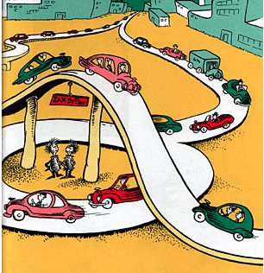
Restaurant Reviews….
ZPD Talks
Do not assume change is not worth the risk. Schooling is not about one way or direction (as Dr. Seuss north-going Zak or South-going Zak infer)
“Building a REVOLUTIONARY SCHOOL RESTAURANT is about finding ways to make engaging ideas be a part of a constant path towards improvement. We can’t stand still…”

