Slide 1
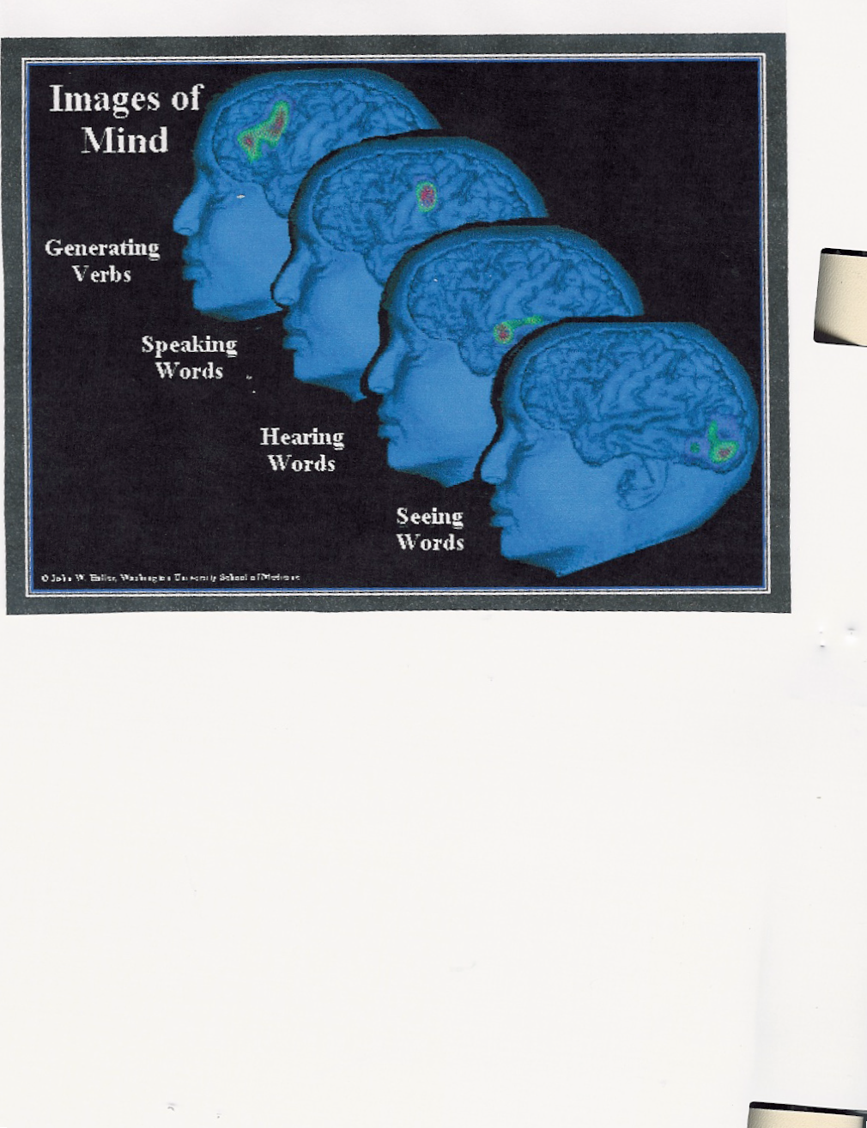
THE BRAIN
Prepared by Dr. Mary Custureri from material included in Instructional Strategies: Helping All Students Succeed. Custureri, Mary, Maureen Goldstein and Ann Frearson. Washington, D.C.: NCEA, 2004.) and PEP Parents: Powerfully Effective Parents. Custureri, Mary
How do we enhance its power to work for us?
Notes:
Our brain is a marvelous machine.
In some respects, it’s like a computer.
However, while the computer can store in the millions, the brain can store billions of facts.

Slide 2
What does brain research reveal?
“All mental activity has a physical basis, with electrical and chemical reactions occurring constantly in the billions of nerve cells of the brain.” (Wartik, 47)
Notes:
The brain uses the neural system, an intricate transmitting system which uses the chemical and electrical impulses to receive, process and send out messages.

Slide 3
The brain and neurons (nerve cells)
Center of brain is like a large transmitter
Transmitter has branches to connection points connecting to thousands of other points
There are billions of interacting neurons or nerve cells inside the brain
A trillion “glial” cells support neurons through important functions.
Stimulation from sights and sounds is processed, collated and conveyed through neuron cells at very fast speeds

Slide 4
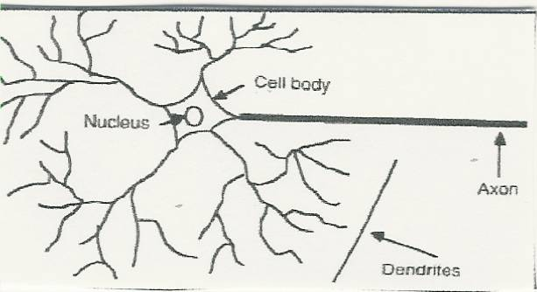
Networks of the brain
Components of a neuron
Notes:
The brain looks and feels like a walnut, with all its wrinkles; however, it is soft. It weighs approximately three pounds. Inside this brain are hundreds of billions of neurons, which can later stretch “over two million miles long,” (Restak 13); Each of these neurons can receive up to two hundred thousand signals from the neurotransmitters at the end of the axion terminal dendrites

Slide 5
Neurotransmitters
Thousands of chemical molecules act as neutransmitters from the 100 billion neurons (like a computer)
Information stored in the dendrites is used to process up to millions of pieces of information each second
These form new dendrite branches
Information goes to other cells with electrical impulses (axions, axle or axis) to a synapse (connecting gap)
Another action adds on to another, etc..

Slide 6
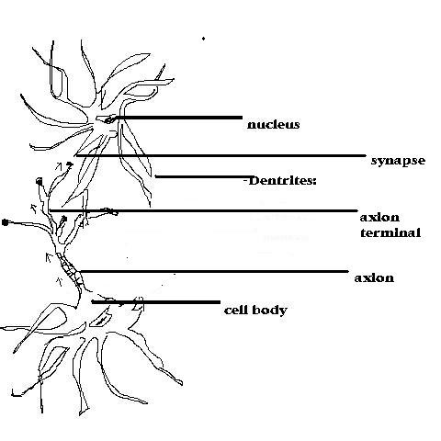
Neurotransmitters Activity
Notes:
Neurotrnsmitters, synapse, etc.
Thousands of chemical molecules act as neutransmitters from the 100 billion neurons (like a computer)
Information stored in the dendrites is used to process up to millions of pieces of information each second
These form new dendrite branches
Information goes to other cells with electrical impulses (axions, axle or axis) to a synapse (connecting gap)
Another action adds on to another, etc..

Slide 7
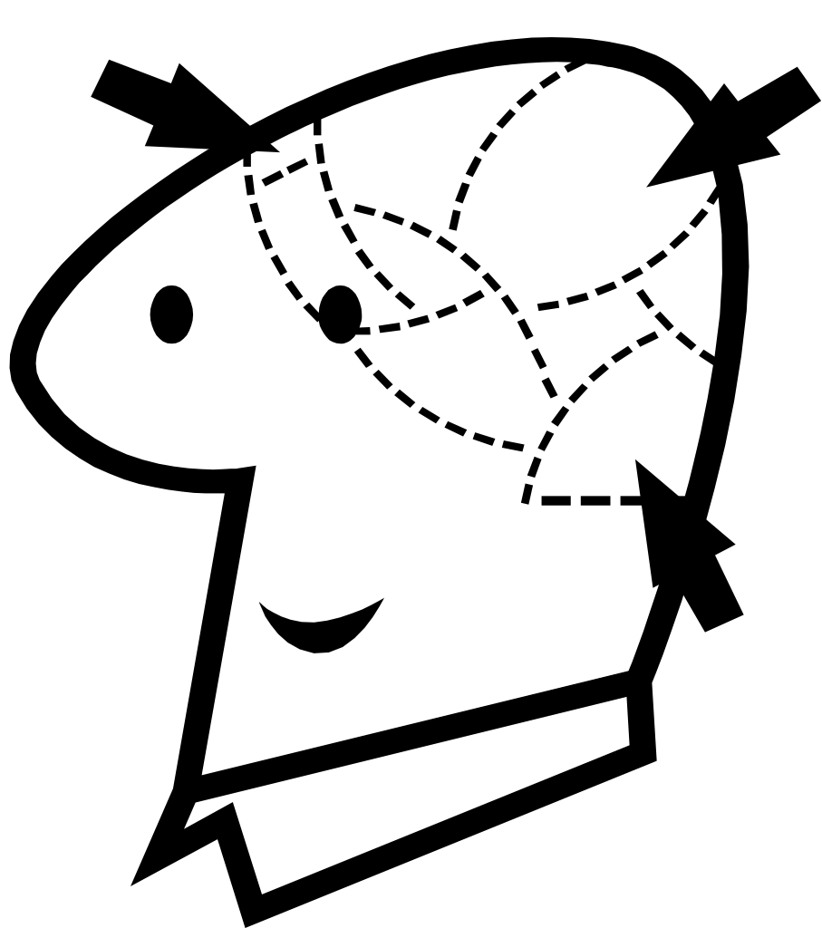
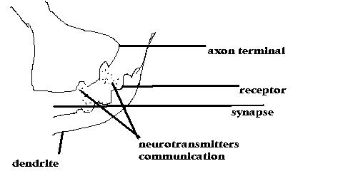
Neurotransmitters and Communication
Notes:
The more information one has stored in the brain, the more receptors it has
The more receptors, the faster the brain processes and stores new information
It’s like putting money in the bank
The more one has stored, the greater the capacity to use the brain
People need to LEARN HOW TO LEARN

Slide 8
Strengthening the Brain
Learn to perform tasks in a semi-automatic fashion (The brain requires less glucose)
When you play an instrument or participate in a sport, practice helps you to become more skillful
Familiar tasks require less thought and preparation
Practice (through homework, essays, grammar, reading, math) strengthens the brain and accelerates new learning
Notes:
First of all, you should know that the neurons which hold and send out all messages to the countless other neurons, rebuild themselves in approximately three months. The blood brings nutrition to the cells to maintain it and to help strengthen the communication. The neurons need good nutrition to regenerate themselves and maintain top function.
In order to think faster and to learn faster, we must store knowledge in the brain so that we have more receptors to accept and transmit information. Practice (through homework, essays, grammar, reading, math) strengthens the brain and accelerates new learning
The brain needs to be exercised. Again, think of the brain as a computer. If good, useful “software” (knowledge) has been stored, then the person can retrieve this information when he needs to demonstrate knowledge in a specific area; when he adds new software, (new information), he can perform more sophisticated functions
Every experience a person has is important. The more dendrite branches are filled with knowledge, the faster and better the knowledge can be transmitted.

Slide 9
Learning and the brain
Tired students cannot learn well
Many students are sleep-deprived
Caffeine, over-scheduling activities, too much TV, video games, snacks deprive the brain
Physical disorders, emotional difficulties, medications, anxiety, EVEN SNORING cause harm.
The circadian or biological clock goes out of whack with sleep deprivation
Notes:
In order to help the brain maintain top function, not only does the body need good nutrition, and exercise, it also needs REST.
Tired students cannot learn as well as alert students
The mind works best when it is in non-stressed alertness
Many students are sleep-deprived. Some of the main causes are use of caffeine to stay awake; over-scheduling of activities; and too much TV, video games, or heavy snacking before going to bed.
Other culprits may be physical disorders, emotional difficulties, medications, or anxiety. EVEN SNORING may be a problem. The person may have sleep apnea, which causes him to stop breathing a number of times whiles sleeping. This causes fatigue.
With these difficulties, the circadian or biological clock goes out of whack with sleep deprivation.
Notice the figure which shows what happens when the brain is not functioning at its top potential in the classroom.

Slide 10
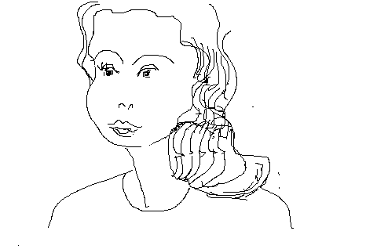
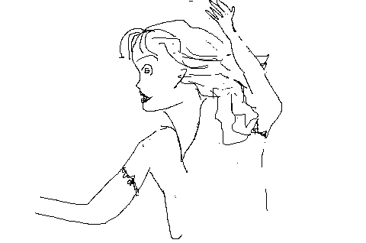
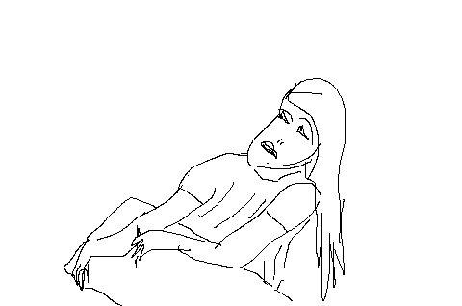
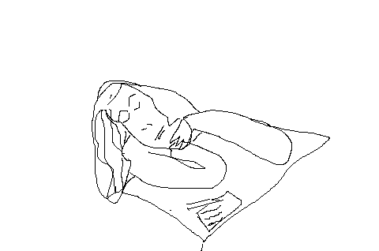
BRAIN ACTIVITY
Alpha brain activity | An alert, relaxed person Functions well | 8-12 cycles per second
Beta-wave act. | A wide awake focused person thinks, clearly, speaks and thinks logically | 13-25 cycles per second * The best
Theta wave activity | A less alert, tired person has poor concentration | 4-7 cycles per second
Delta wave activity | A tired, sleepy or sleeping person absorbs very little | .05 – 3 cycles per second
Notes:
Note the brain activity when a student is at rest and when he is not.
The first student is alert and relaxed. That is good, but her brain is going at 8-12 cycles per second. She is in the alpha brain activity.
The next student is at an optimum learning mode. Her brain it as beta-wave activity and is going 13-25 cycles per second. She is wide awake, thinks and speaks logically, and is able to concentrate very well. She can take good notes, participate well and learn.
The third student is at theta wave activity. She feels tired. Her brain is going at 4-7 cycles per second. Her concentration is not strong. How much will she remember, especially if she does not take good notes?
The fourth student is at only delta-wave activity level. Her brain is at .05 to only 3 cycles per second. She is sleepy or may even fall asleep in the classroom.

Slide 11
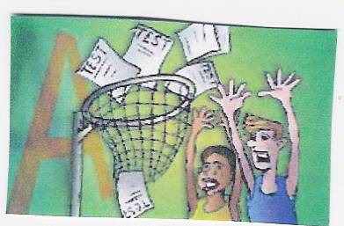
Stress interferes with learning

Slide 12
WHAT A PERSON NEEDS TO FUNCTION BEST
Health check-up
Diet improvement (neurotransmitters in brain affected by diet)
Physical activity
Sleep
De-stressing activities
Notes:
If you feel that you’re doing everything right and you still don’t feel at top strength, you are advised to get a checkup. You might have a physical problem or learning problem which is making you perform at less that top potential. Let the experts worry!
Remember your diet, especially when you are stressed out with “brain work”. You need omega fats found in fish and fish oil, you need to eat your daily fruits and vegetables, and you need protein.
You need physical activity. Join a sport or find a sport you can do with others as well as an activity you can do by yourself. Your body needs this for oxygen and for your muscles.
Remember that you need enough sleep. Eight hours is about right for your age group. If you cannot always maintain this routine, try resting during the day occasionally.
Don’t become a “workaholic.” You need to de-stress once in a while. Join something, so that you have enjoyable activities with your peers, work on a hobby or sport so that you get exercise.

Slide 13
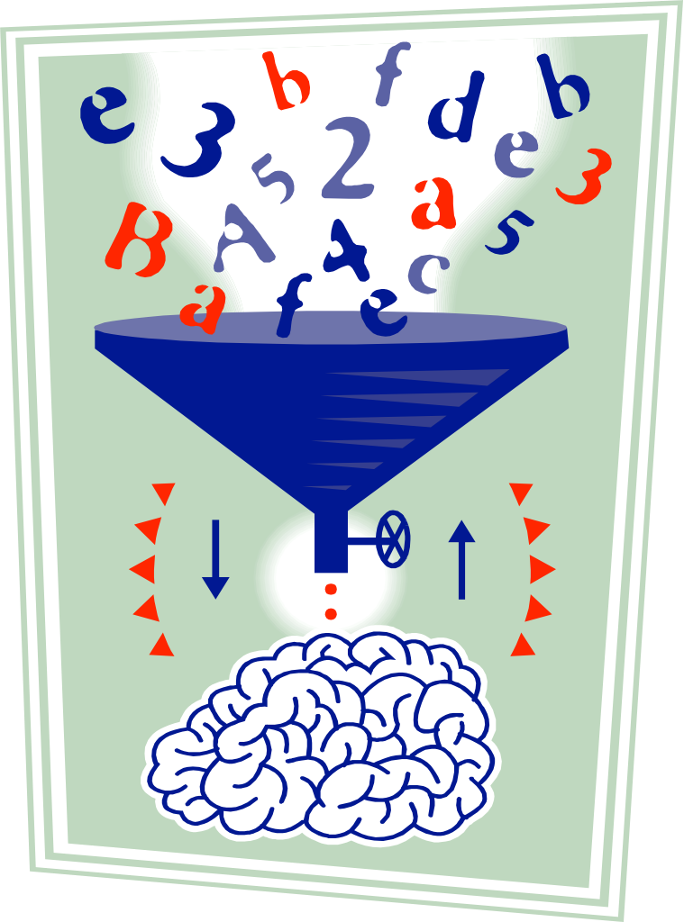
STRESS … … … …
STRESS
Too much overload
Not enough preparation
Over-anxiety
Too much leads to failure
NEED: Counseling, help, change in habits, organization
Notes:
What can cause stress besides not enough rest and not enough nutrition?
Over-sheduling: an overload of work or play
Not enough preparation, especially in the early part of the semester. This can lead to ANXIETY.
OVERANXIETY: Some students are more anxious than they need to be. Maybe talking to a counselor or with peers may help. They’ve been through this battles for learning before, and they are better equipped to handle the problems than you are. This is your first time!
You may need counseling, help from teachers or other students, a change in habits, or a way to organize your work.
OVER-ANXIETY may lead to failure. An over-anxious person becomes frustrated, loses confidence, and sometimes causes his/her own mental block in learning, exam preparation or even during an exam.
DISCUSS THIS

Slide 14
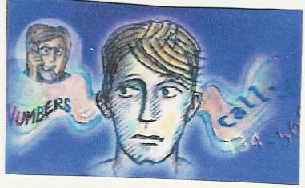
How we remember Why we forget
Notes:
Students sometimes worry that they are not good “test-takers” or that they cannot remember what they learned.
Yet, they forget that they remember words to songs, moves in a sport, and many other things that others may not remember.
There are strategies that different students use to utilize their own strengths.
Subsequent presentations will cover the problems in not remembering and ways to overcome them.

Slide 15
Rate of forgetfulness
Ebbinhaus: He researched. After 24 hours we forget 75% of what we hear or see
Second time we study something: Forget about 50%
Third time, forget about 25% and will retain 75% always.
Memory jogs help
Strategies to jog memory help
Utilizing learning strengths to memorize helps
Notes:
In the 1920’s Ebbinhaus wrote that after 24 hours most people forget 75% of what they have heard or seen and will remember only 25%.
The second time they see or hear the same material, they will forget only about 50%
The third time they will forget ONLY 25%. That means they will always remember 75%! (especially if they have something to job their memory…
There are strategies to “jog” one’s memory. Using learning strategies made for your learning style will help.

Slide 16
HOW PEOPLE LEARN
Acquiring knowledge | Storing knowledge | Demonstrating knowledge
Prior experiences Reading vocabulary | Visualizing Note-taking tech. mnemonics | Test-taking skills for various tests Pre-planning strat.
Paraphrasing, Analyzing, listening Note-taking | Jingles Sentences w/key letters | Essay writing basics Analytical thinking
Math skills Research skills | Strategies to fit a person’s learning style | Understanding lit. and writing purposes
Notes:
There are three things you must know about how you learn. First is how the brain acquires or gets the knowledge. You get it through prior experience (what you knew before you see or hear something new) because prior experience (or the information stored in your dendrites) helps you to grasp something new better. Some of this knowledge is in the form of paraphrasing, analyzing, listening, note-taking, math skills and research skills.
Storing knowledge is the second factor in learning. You store what you see and hear through visualizing, note-taking techniques, use of mnemonics to help you remember, as well as jingles (I before e except after C or when sounded as A as in …or weigh), letters in sequence, and any strategy to fit a person’s learning style.
Demonstration of knowledge is another important factor in learning, because you might have much knowledge but not be able to demonstrate what you know. You can be very bright but still fail because you do not know the ways to show your teacher or others that you know the material. For example, you need pre-planning strategies for demonstrating test-taking skills for different kinds of tests (multiple-choice, true-false, essay…). You need knowledge for essay writing – structures of different types of essays, brainstorming, organizing, analytical thinking…
You need reading strategies to understand different types of literature and demonstrate that you can spot important details and think critically by analyzing the material you read.

