Slide 1
Poka Yoke
By Dr. Tammy Sagastizado

Slide 2
ポカヨケ [poka yo-ke]
Poka Yoke is a Japanese term that means "fail-safe-ing" or "mistake-proofing".
A poka-yoke is any mechanism in a lean manufacturing process that helps an equipment operator avoid (yokeru) mistakes (poka).
Its purpose is to eliminate product defects by preventing, correcting, or drawing attention to human errors as they occur.

Slide 3
Shigeo Shingo 新郷 重夫
[Shingō Shigeo] 1909 - 1990
The concept was formalized, and the term adopted, by Shigeo Shingo as part of the Toyota Production System.
Born in Saga City, Japan: a Japanese industrial engineer who distinguished himself as one of the world’s leading experts on manufacturing practices and the Toyota Production System.

Slide 4
Poka Yoke
It was originally described as baka-yoke, but as this means "fool-proofing" (or "idiot-proofing") the name was changed to the milder poka-yoke, i.e., "error avoidance."
More broadly, the term can refer to any behavior-shaping constraint designed into a process to prevent incorrect operation by the user.
Similarly, a constraint that is part of the product (or service) design is considered DFM or DFX.

Slide 5
DFM and DFX
DFM
DFX
Design for manufacturability (also sometimes known as design for manufacturing)- (DFM) is the general engineering art of designing products in such a way that they are easy to manufacture.
Design for X, is when a design guideline addresses a particular issue that is caused by, or affects the characteristics of a product.
The design guidelines may help to generate and apply technical knowledge in order to control, improve, or even to invent particular characteristics of a product.

Slide 6
What Does A Poka Yoke Look Like?
Poka Yoke looks different in each situation. I'll try to present a few different scenarios for poka yoke use.
Let's take a transactional situation and analyse a few parts of it. Say, for instance, we're at the signing of a bank loan by a lucky couple closing the mortgage on their first home.

Slide 7
Example 1:
The lucky couple picks up the pen to sign, but when they depress the top of the pen to extend the writing part it malfunctions because the spring is missing.
A poka yoke could have prevented this situation.
If all pieces of the pen were presented to the assembler in a dish, a simple poka yoke would be for the assembler to visually inspect the dish for any remaining parts once the pen was assembled.

Slide 8
Example 2:
The lucky couple bypasses the signature part of the process because their bank is really high-technology focused. In fact, they signed a writing pad and their signature was recorded electronically. The bank also needed to collect 4 additional pieces of information before the entire package of information is sent to the processing department.
A simple poka yoke to add to this process is to require all fields to be filled in (including the loanee signature) before allowing the form to be sent to processing.
This prevents the processing department from reviewing an incomplete document, sending back to the loan department, delaying the processing of paperwork...you get the idea.

Slide 9
Example 3:
Once the complete paperwork is submitted to the processing department and it is printed, it then needs to be filed with the city and state. In order for this to occur, papers need to be filled out (the city and state are not high-technology enabled) and attached to the form.
A poka yoke used by the city is a simple check-sheet at the top of the form.
This allows the person submitting the form to ensure that all additional information and payments are attached. As in example 2 above, this prevents the city/state from reviewing an incomplete document, sending back the document to the sender, delaying the processing of paperwork...again, you get the idea.

Slide 10
Some examples of POKA-YOKE devices
Attached gas cap
Gas pump nozzle
Polarized electrical plug and socket
Disc brake pad warning noise
Notes:
Ask others to give more examples from their experience

Slide 11
Who Develops Poka Yokes?
Here's the beauty of the methods...anyone, from manager to line supervisor to line employee can develop a poka yoke.
All it takes is the empowerment of employees, as well as a little instruction about what makes a good poka yoke.

Slide 12
Why is “Zero Defects” an Important Concept?
Maintain Customer Satisfaction & Loyalty
  Happy Customers mean more sales!

Slide 13
Why is “Zero Defects” an Important Concept?
COST
There is always a cost associated with manufacturing defects!

Slide 14
Costs of Defects ?
Does it cost more to make processes better ? NO
Making processes better leads to reduced
Rework
Scrap
Warranty costs
Inspection costs
Notes:
Eliminating process wastes,such as defects, through implementation of Poka-yoke efforts, will result in more repeatable and reproducible processes.
Thus, processes will be more efficient and be more cost effective.

Slide 15
1-10-100 Rule
The 1-10-100 rule states that as a product or service moves through the production system, the cost of correcting An error multiplies by 10.
Activity Cost
Order entered correctly $ 1
Error detected in billing $ 10
Error detected by customer $ 100
Dissatisfied customer shares the experience with others the costs is
$1000
Notes:
This rule shows the importance and the possible escalation of the costs associated with defects.
The idea is, that as the defective item is processed, the costs increased by a factor of 10 at each successive step.
Theses increases in costs are due to the accumulation of wastes of each successive step as well as the increase in the consumption of resources associated with each additional step in the process.

Slide 16
Mistake-Proof or Poka Yoke the process!
Recognize that it is natural for people to make mistakes.

Slide 17
Mistake-Proof or Poka Yoke the Process
Not noticing that an error is made or a machine is not functioning does not make a person stupid or foolish.

Slide 18

Relationship between processes and quality defects.
Almost any business activity can be considered a process.
Production processes involve the flow of material. Machining, assembly, and packaging are typical production processes.
Business processes involve the flow of information. Financial planning, purchasing & order entry are typical business processes.
All processes have the potential for defects. Hence, all processes offer a opportunity for the elimination of defects and the resultant quality improvement.
Notes:
Work is a series of interrelated processes.
All processes have variation associated with them.
Variation results in defects.
Defects in one process can lead to defects in another process.
When defects escalate costs escalate.

Slide 19
In order to reduce quality
defects and stop
throwing away money, we must:
Understand the process an its relationship to other business processes.
Identify the inputs and outputs of the process.
Know who are the suppliers to and customers of the process.
=
Reduce the
variation of the process
And

Slide 20
What Causes Defects?
Common Cause Variation
1. Poor procedures or standards.
2. Machines.
3. Non-conforming material.
Worn tooling.
Poor processes, etc.
5. Human Mistakes.
Except for human mistakes these conditions can be predicted and corrective action can be implemented to eliminate the cause of defects. (or Root Cause of variation).

Slide 21
All Measurements Show Variation
Common cause variation versus uncommon
DAILY COMMUTE
Variation from unusual or “special cause“: a bad accident, an ice storm, and so forth.
Most of the time, however, the variation results from “common cause” that are built into the process: the number of people on the road, the way traffic lights are timed, what time you leave, etc.

Slide 22
Ten Types of Human Mistakes
Forgetfulness
Misunderstanding
Wrong identification
Lack of experience
Willful (ignoring rules or procedure)
Inadvertent or sloppiness
Being Slow
Lack of standardization
Surprise (unexpected machine operation, etc.)
Intentional (sabotage)
Notes:
Mistakes can be assigned to any of ten categories depending on the basis of their origin.

Slide 23
Poka-yoke
A fully implemented quality system requires Poka-yoke usage at or before the inspection points during the process.
Poka-yoke will catch or prevent the errors before a defective part is manufactured most of the time.

Slide 24
The selected Poka Yoke (mistake proofing) technique should qualify the following criteria:
Inexpensive
Based upon common sense, preferably of the operator or the 1st line employee
It MUST eliminate Occurrence / Detection of the problem at the source itself

Slide 25
Occurrence oriented Poka Yoke should follow the procedure as below:
Required action is NOT performed or is performed incorrectly.
Undesired action is exercised.
Information essential for performing the action is mis-interpreted.
Mistake occurs due to complexity.

Slide 26
Detection oriented Poka Yoke should use one of the following techniques for ensuring 100% detection of the mistake:
It should be autonomous inspection occurring without intervention.
It should determine 'before the fact' whether the conditions for 100% quality exist or not.
It should make the error visible to the operator.
Consider supply of exactly made kits of components to the assembler, so that any balance part will signal error in assembly.
Consider use of electronic sensors to activate warning lights or buzzers.
Use color coded parts or graphics.
Make use of contact devices e.g. Fixtures, Limit switches, probes or Non-contact devices e.g. LEDs, Pressure transducers etc.

Slide 27
Poka-yoke Systems Govern the Process
Two Poka-Yoke System approaches are utilized in manufacturing which lead to successful quality:
1. Control Approach
Shuts down the process when an error occurs.
Keeps the “suspect” part in place when an operation is incomplete.
2. Warning Approach
Signals the operator to stop the process and correct the problem.

Slide 28
Control System
Takes human element out of the equation; does not depend on an operator or assembler.
Has a high capability of achieving zero defects.
Machine stops when an irregularity is detected.
“There must have been an error detected; the machine shut down by itself!”

Slide 29
Warning System
Sometimes an automatic shut off system is not an option.
A warning or alarm system can be used to get an operators attention.
Below left is an example of an alarm system using dials, lights and sounds to bring attention to the problem.
Color coding is also an effective non automatic option.
“I’m glad the alarm went off, now I’m not making defects!”
BEEP!
BEEP!
BEEP!

Slide 30
Methods for Using Poka-yoke
Poka-yoke systems consist of three primary methods:
1. Contact
2. Counting
3. Motion-Sequence
Each method can be used in a control system or a warning system.
Each method uses a different process prevention approach for dealing with irregularities.

Slide 31
Contact Method
A contact method functions by detecting whether a sensing device makes contact with a part or object within the process.
Cylinder present
Missing cylinder; piston fully extended alarm sounds
An example of a physical contact method is limit switches that are pressed when cylinders are driven into a piston. The switches are connected to pistons that hold the part in place. In this example, a cylinder is missing and the part is not released to the next process.
Cannot proceed to next step.
Contact Method using limit switches identifies missing cylinder.

Slide 32

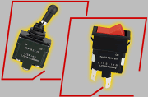
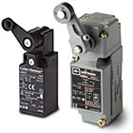

Physical Contact Devices
Toggle Switches
Limit Switches

Slide 33
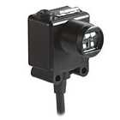
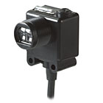
Energy Contact Devices
Photoelectric switches can be used with objects that are translucent or transparent depending upon the need.
Transmission method: two units, one to transmit light, the other to receive.
Reflecting method: PE sensor responds to light reflected from object to detect presence.
Light
Transmitter
Receiver
Object
If object breaks the transmission, the machine is signaled to shut down.

Slide 34
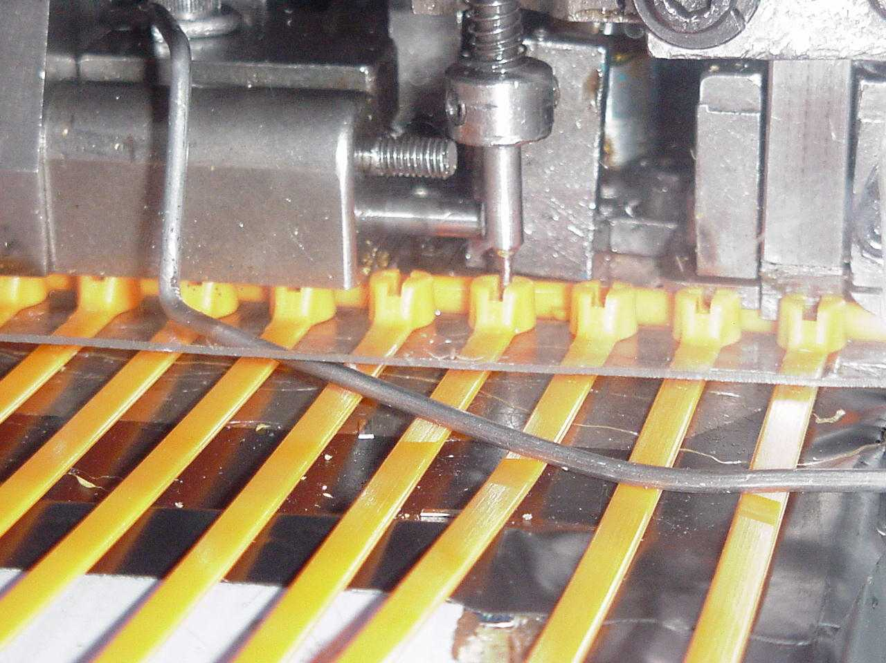
Contact Device
An example of a contact device using a limit switch. In this case the switch makes contact with a metal barb sensing it’s presence. If no contact is made the process will shut down.

Slide 35
Contact Methods
Do not have to be high tech!
Passive devices are sometimes the best method. These can be as simple as guide pins or blocks that do not allow parts to be seated in the wrong position prior to processing
Take advantage of parts designed with an uneven shape!
A work piece with a hole a bump or an uneven end is a perfect candidate for a passive jig. This method signals to the operator right away that the part is not in proper position.

Slide 36
Counting Method
Used when a fixed number of operations are required within a process, or when a product has a fixed number of parts that are attached to it.
A sensor counts the number of times a part is used or a process is completed and releases the part only when the right count is reached.
In the example to the right a limit switch is used to detect and count when the required amount of holes are drilled. The buzzer sounds alerting the operator that the appropriate amount of steps have been taken in the process.

Slide 37
Counting Method
Another approach is to count the number of parts or components required to complete an operation in advance. If operators finds parts leftover using this method, they will know that something has been omitted from the process.
“I have an extra part. I must have omitted a step!”

Slide 38
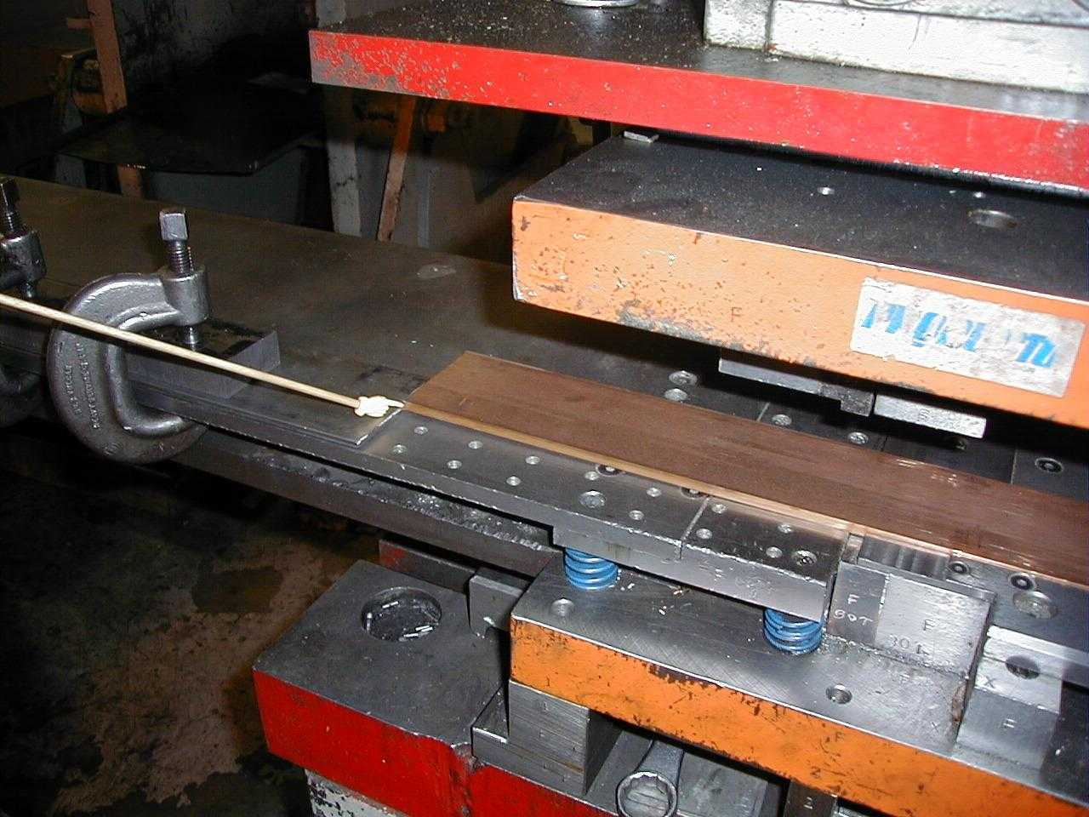
Motion-Sequence Method
The third poka-yoke method uses sensors to determine if a motion or a step in a process has occurred. If the step has not occurred or has occurred out of sequence, the sensor signals a timer or other device to stop the machine and signal the operator.
This method uses sensors and photo-electric devices connected to a timer. If movement does not occur when required, the switch signals to stop the process or warn the operator.

Slide 39
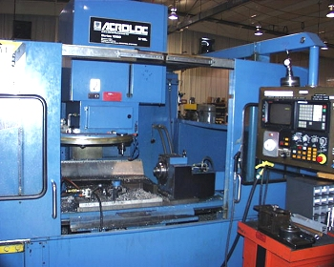
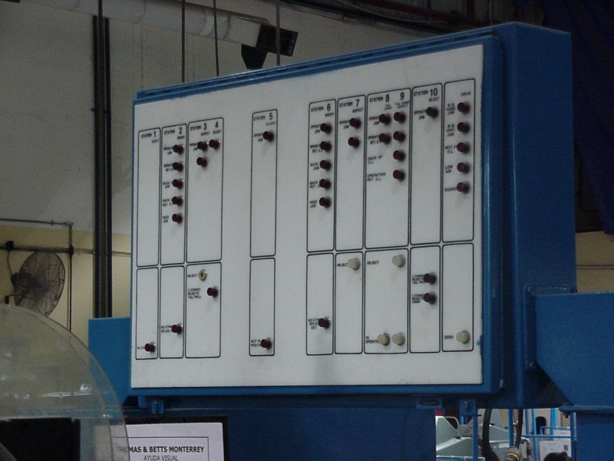
Motion-Sequence Method
In order to help operators select the right parts for the right step in a process the “sequencing” aspect of the motion-step method is used. This is especially helpful when using multiple parts that are similar in size and shape.
In this example, each step of the machine cycle is wired to an indicator board and a timer. If each cycle of the machine is not performed within the required “time” and “sequence”, the indicator light for that step will be turned on and the machine will stop.
Machine
Indicator Board

Slide 40
Types of Sensing Devices
Sensing devices that are traditionally used in poka-yoke systems can be divided into three categories:
1. Physical contact devices
2. Energy sensing devices
3. Warning Sensors
Each category of sensors includes a broad range of devices that can be used depending on the process.
Notes:
Sensing devices are the actual mechanism used to make contact, count, or identify the motion sequence of a work piece. They are the third tier of a poka-yoke system ( tires: approaches-methods-sensing devices).

Slide 41
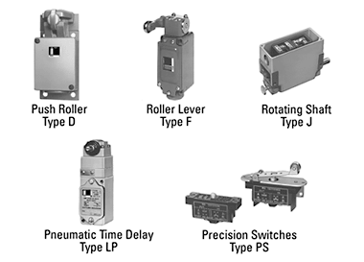
Physical Contact Sensors
These devices work by physically touching something. This can be a machine part or an actual piece being manufactured.
In most cases these devices send an electronic signal when they are touched. Depending on the process, this signal can shut down the operation or give an operator a warning signal.
Notes:
Various examples

Slide 42

Touch Switch
Used to physically detect the presence or absence of an object or item-prevents missing parts.
Used to physically detect the height of a part or dimension.

Slide 43
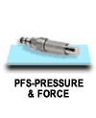
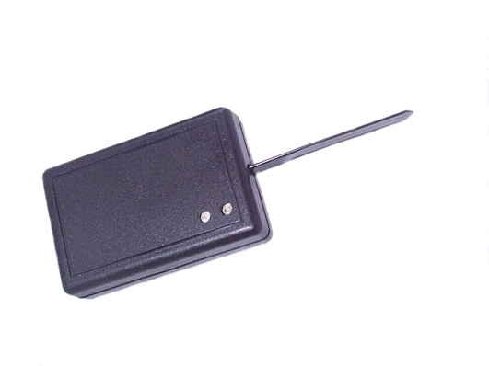
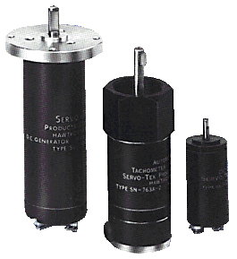
Energy Sensors
These devices work by using energy to detect whether or not an defect has occurred.
Fiber optic
Vibration
Photoelectric

Slide 44
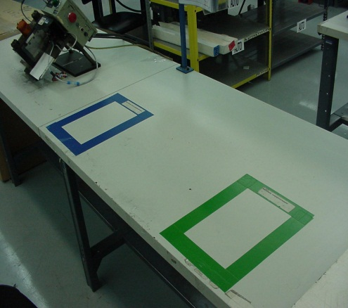
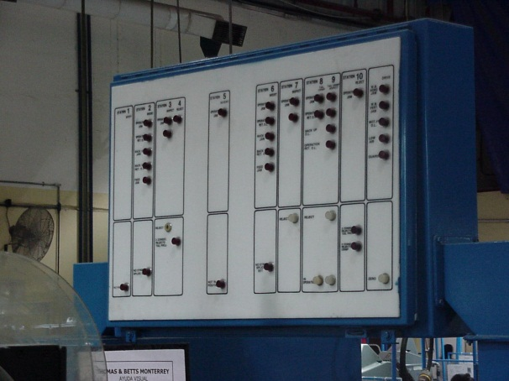
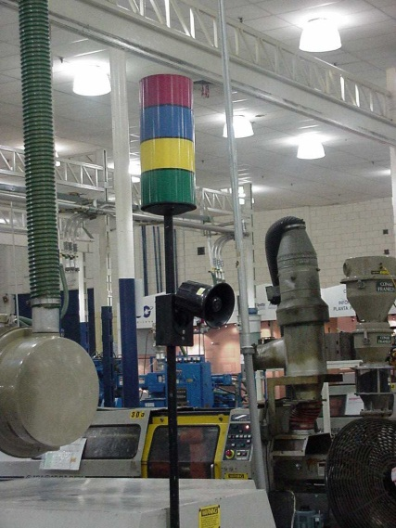
Warning Sensors
Color Code
Warning sensors signal the operator that there is a problem. These sensors use colors, alarms, lights to get the workers attention !
These sensors may be used in conjunction with a contact or energy sensor to get the operators attention.
Lights connected to Micro switches & timers
Lights

Slide 45
To prevent mistakes, develop error proofing devices
POKA-YOKE to avoid (yokeru) inadvertent errors (poka)
Checklists
Dowel and locating pins
Error & alarm detectors
Limit or touch switches
Detectors, readers, meters, counters
Notes:
To prevent mistakes from becoming defects, Poka-Yoke, or error proofing devices build quality into a process.
To avoid (yokeru) inadvertent errors (poka)
Often worker originated

Slide 46
Two types of error proofing devices
POKA-YOKE
Control - eliminates the possibility of a mistake to occur (automatic machine shutdown)
Warning - signals that a mistake can occur (blinking light, alarm, etc.)
Notes:
Control examples : polarized electrical plug, gas pump nozzle, car transmission must be in park in order to start engine.
Warning examples : disc brake pad noise when pad becomes thin, alarm for car lights left on after engine is turned off.

Slide 47
Who Develops Poka Yokes?
Here's the beauty of the methods...anyone, from manager to line supervisor to line employee can develop a poka yoke.
All it takes is the empowerment of employees, as well as a little instruction about what makes a good poka yoke.

Slide 48
3 Rules of POKA-YOKE
Don’t wait for the perfect POKA-YOKE. Do it now!
If your POKA-YOKE idea has better than 50% chance to succeed…Do it!
Do it now….improve quality!
Notes:
Adopt a bias for action, avoid paralysis by analysis

