Slide 1
Eco Science toys Constructed by: Taryn Kelly

Slide 2
Background Information
Kit included materials to make seven toys
Called “Eco” Science Toys because many of the materials used were recycled objects collected around the house
Construction time: 3-5 minutes per project

Slide 3
Methods
Gathered all materials before starting construction on each project
Followed step by step directions
Final step: testing the project

Slide 4
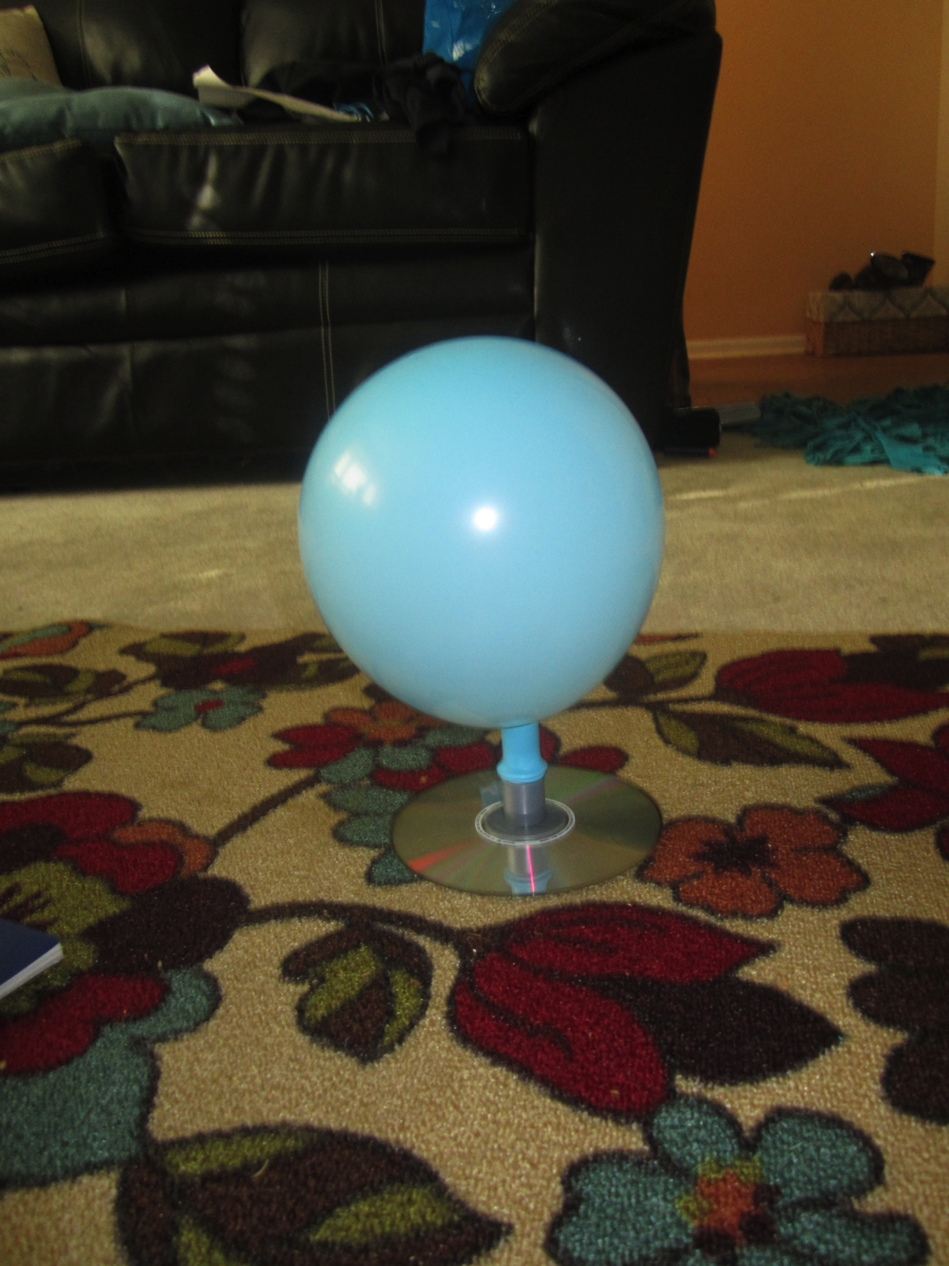
Instructions and Demonstration
Hover disc
1. attach double sided tape to recycled disc and attach connector
2. push neck of balloon onto mouth piece
3. blow up balloon via mouth piece, twist neck of balloon, attach mouth piece to connector
4. give it a tap!

Slide 5
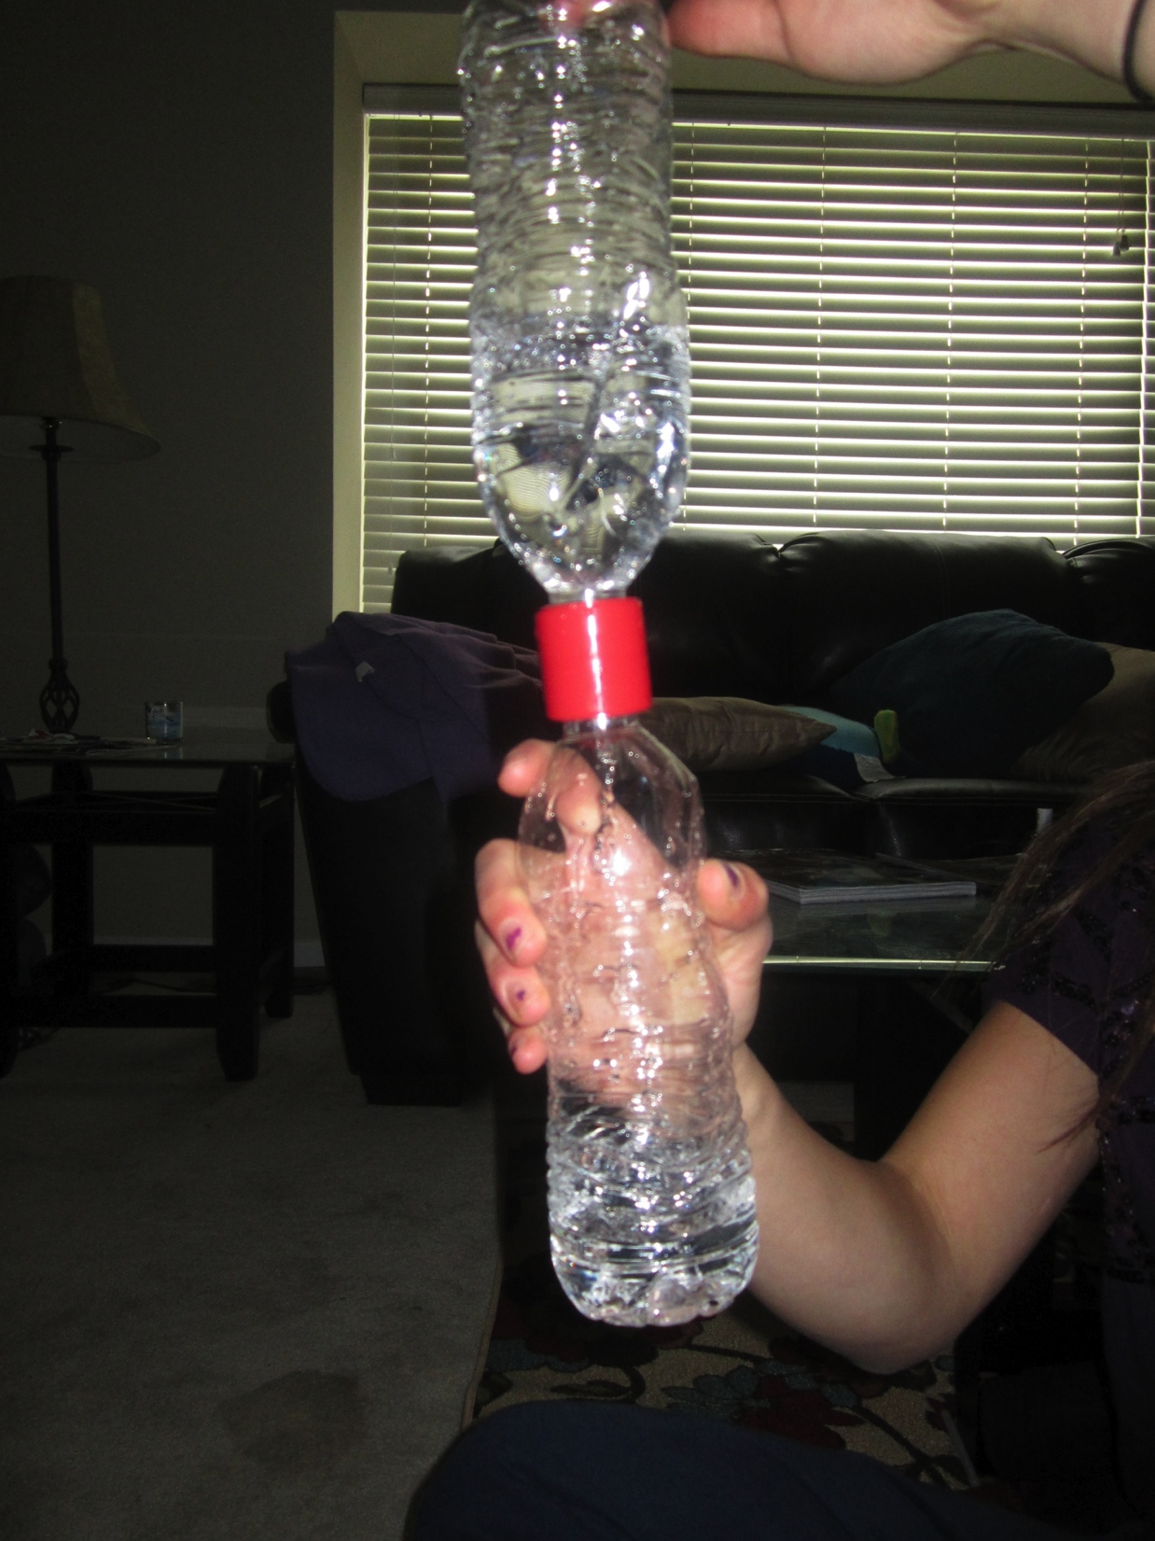
Tornado Tube-
1. screw a cap onto each bottle (one half way filled, one empty)
2. put connector onto cap attached to the bottle with water in it
3. tip tube so that the water is on top
4. move tube in a circular motion

Slide 6
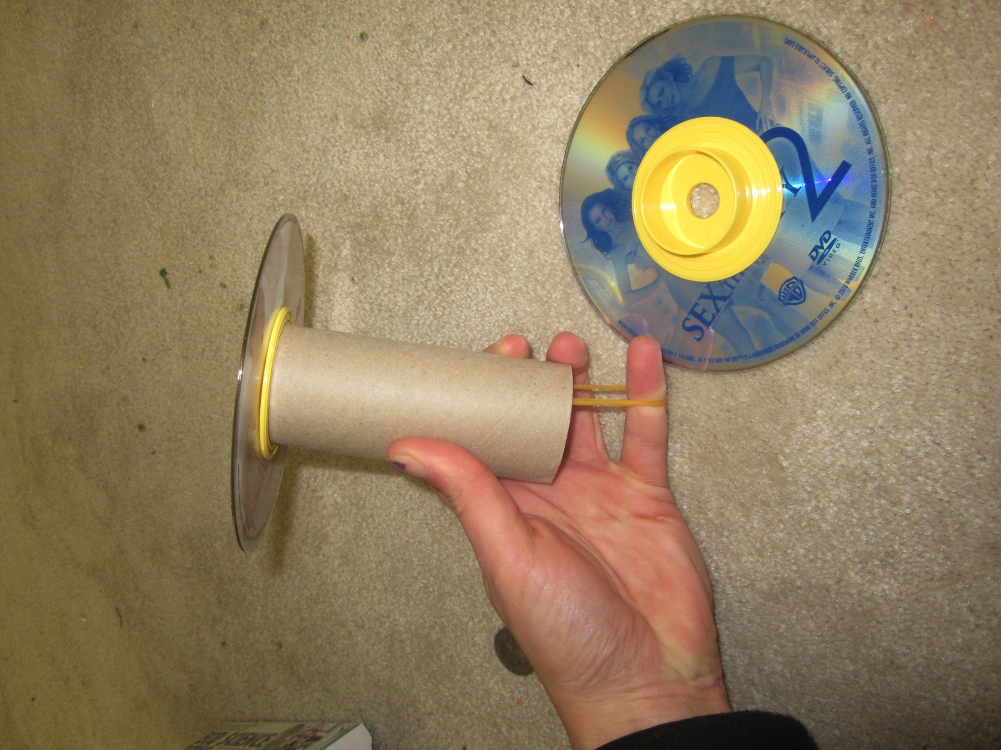
CD Racer-
Attach double sided tape to each disc
Attach yellow tube to one end of cd, and one yellow tube with hook to the other cd
Attach rubber band through cardboard tube and attach to yellow tube to hook
Place pencil through the loop of the rubber band
Pencil should be longer than CD

Slide 7
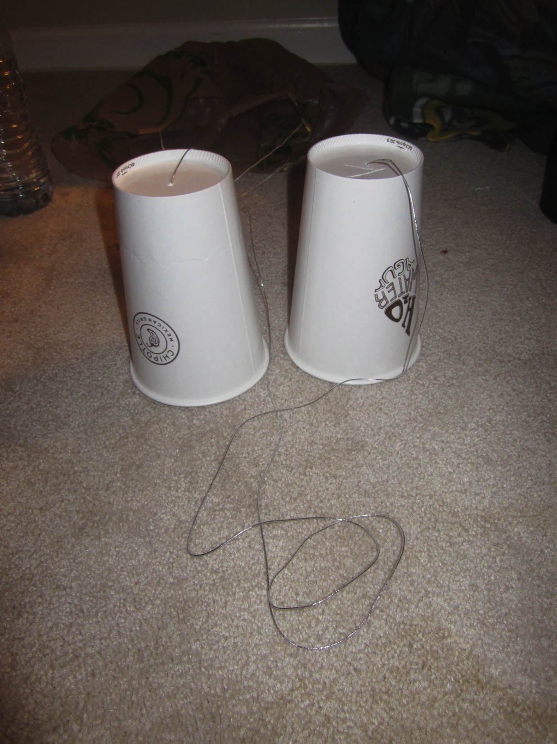
Walkie-Talkie
Using a sharp pencil, pierce a small hole in the base of each paper cup
Feed ends of elastic string through pierced holes and tie a knot at each end

Slide 8
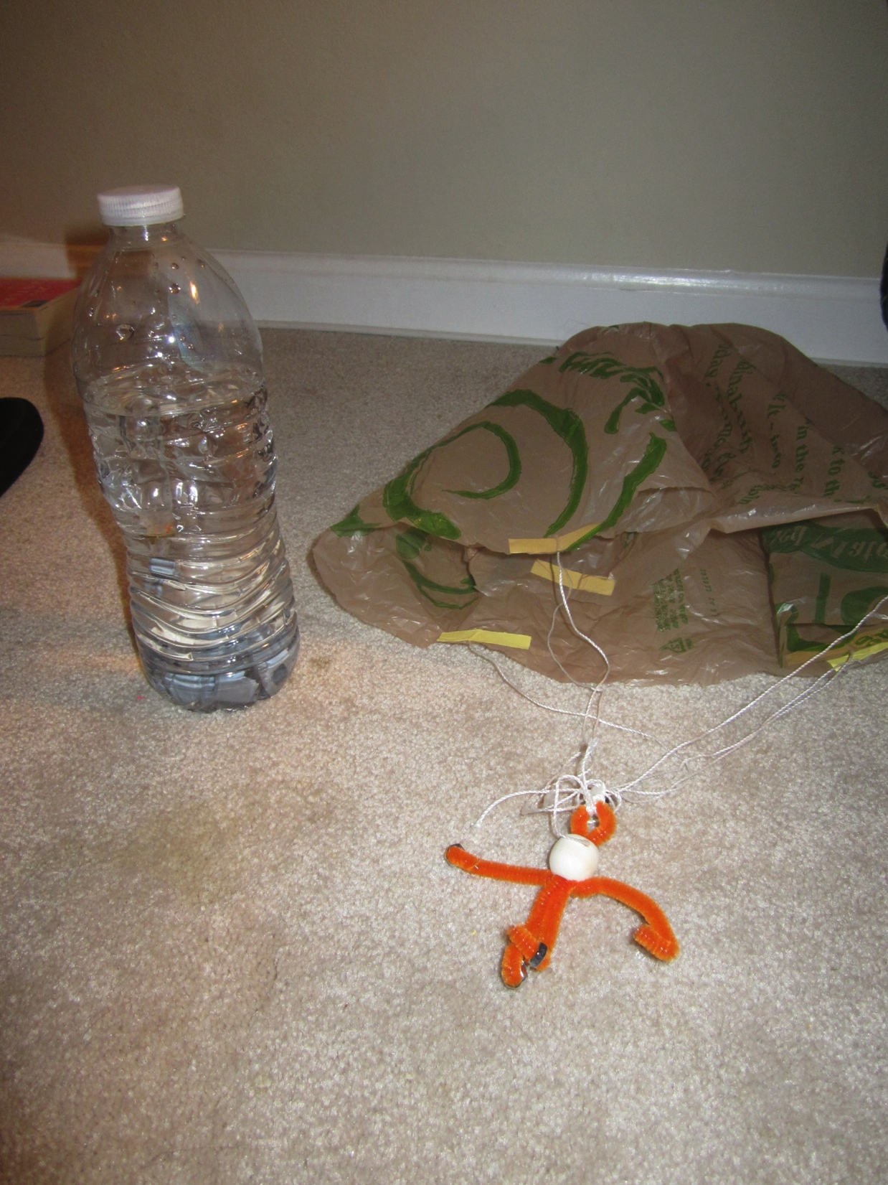
Shopping Bag Parachute
Cut plastic bag
Adhere 6 strings to opening of bag with tape
Create space man
Gather all ends of strings and attach to loop at head of space man

Slide 9
Cartesian Diver:
Stick score labels on the different weights
Push three copper washers onto the neck of the dropper
Attach hook to neck of the dropper
Fill dropper two-thirds full

Slide 10
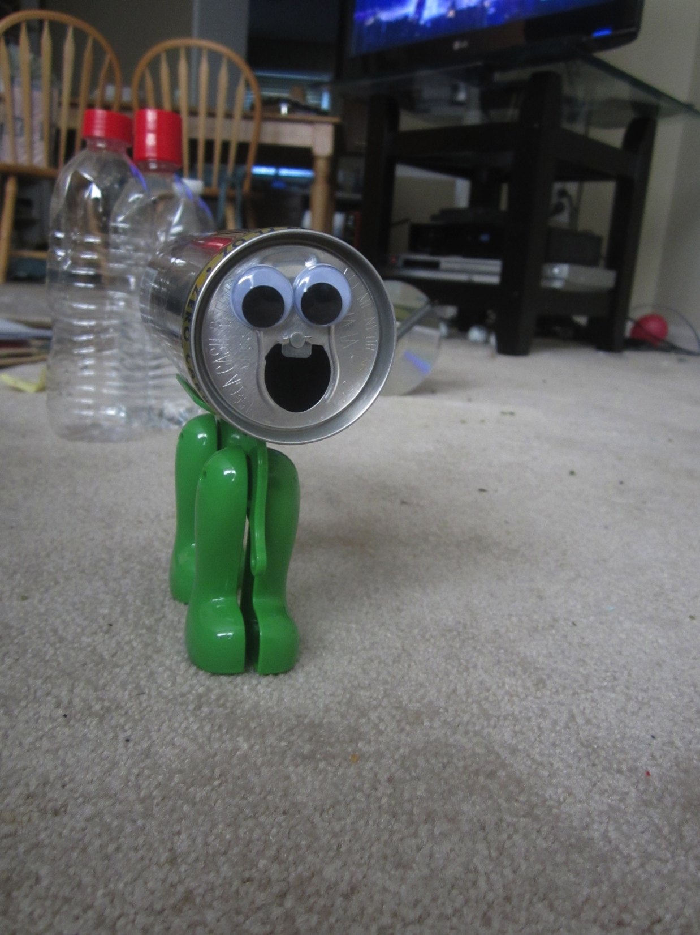
Gravity robot:
Attach drinking can to top of feet with tape
Tie a string to the hanging hole on walking structure
At the other end of the string, tie 15 screw nuts
Secure nuts in place with a few knots at end of the string

Slide 11
Larger Scale
Teaches children at young age to recycle
Examples of mechanims used on a larger scale:
Hovercraft lawn mowers
Parachutes used to slow down fighter jets

Slide 12
Applicable to Environmental Health?
Many materials used were recycled
Reduce, re-use and, recycle

