Slide 1


Working Together
Althea Stewart-Pyne RN, MHSc Beth McCracken, RPN,
Program Manager, International Affairs Director, Professional Practice Recruitment & Retention Best Practices

Slide 2

Overview
Background of workplace violence in healthcare
What constitutes workplace violence
What constitutes bullying/intimidation
How intra-professional teams can work together
Resources to address conflict/violence
      E-Learning
      Collaborative BPG
      Preventing and Managing Violence BPG

Slide 3
Acknowledging Violence in Health Care
Global
Health Issue
Organization
Health Care
Provider
Notes:
Violence is a topic that is well acknowledge in healthcare.
Global Health Care Violence is acknowledged by the World Health Organization as a major global public health issue (2003)
While certain occupations (police and military) are acknowledged by society to have dangerous facet, the health care environment is generally not considered a violent setting and nurses are not viewed as recipients of violence (Kowalenko, Walters, Khare, & Compton, 2005).
Organizations Multiple risk factors have been cited for the increase in WPV in hospital settings, including interacting factors related to patient and family, nurse, and the environmental setting. Additionally the attitudes of patients, nurses, and administrators can impact on WPV.
Health Care Provider The APNA (2008) cites exposure and desensitization to violence in society as a whole as contributing to WPV in health care. (Howerton Child, R.J., Mentes, J.C., 2010)
Stats Canada identified that in 2007, almost one in five violent incidents in Canada occurs at work
The International Labour Organization specified that women are at higher risk of workplace violence
And in 2009 the Ontario MOL identified health care as an area associated with a higher risk of violence

Slide 4
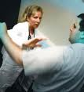
What is Workplace Violence?
Workplace Violence*
Incidents where staff are abused, threatened, or assaulted in circumstances related to their work, including commuting to and from work, involving an explicit or implicit challenge to their safety, well-being, or health.
*ICN adapted this from the European Commission
Notes:
The International Council of Nurses defines Workplace Violence as….

Slide 5

What is Horizontal Violence?
Horizontal Violence
Overt and covert non-physical hostility, which can include bullying, criticism, undermining, infighting, scapegoating and bickering
Source: Duffy (1995)
Notes:
While horizontal violence can impact any work environment, numerous research project have been focused on horizontal violence in nursing. While workplace violence research for students has focused on clinical experiences and the academic setting between professor and students, the area of horizontal violence among nursing student has not been studied but this does not mean that it does not occur.

Slide 6
Workplace Violence
Who are the perpetrators of violence in the health sector workplace?
Patients
Families
Colleagues
Supervisors
Notes:
Commonly patients and their families tend to be the perpetrators , in long term care, emergency and mental health areas these incidents are often physical
While colleagues and supervisors are most often responsible for the unacceptably high rate of psychological violence.
Stats Canada identified that in 2007, almost one in five violent incidents in Canada occurs at work
The International Labour Organization specified that women are at higher risk of workplace violence
And in 2009 the Ontario MOL identified health care as an area associated with a higher risk of violence

Slide 7
Consequences of Violence
In Ontario, health/community care sector have highest rate (34%) of lost time injuries due to violence in the workplace compared with any other sector
Negative individual health effects: burnout diminished self-esteem), increased sickness physical injury including death
Organizational costs: increased absenteeism, lower productivity, high turnover decreased capacity to offer effective nursing care increased costs for recruitment and retention
Notes:
Ref: (OSACH, Dec. 2007) (Einarsen, 2000), (Glendinning, 2001; Randle, 2003; , (Kivimaki et al., 2003; Vahtera et al., 2000), (Bernardi, 2001) (Urbanski, 2002) Henderson, 2003) Sofield & Salmond, 2003; Stevens, 2002)
Healthcare workers face 16 times the risk of
violence from patients/clients than other
service workers
(Elliot, P. 1997. Nursing Management, 28, 12, 38-41)

Slide 8
Prevalence in Health Care
10 x
Assault rates more than 10 times those in non-health sectors
70%
70% of nurses in a US nursing survey reported being bullied at work
45%
45% of those bullied report stress affected their health
Source: Public Services Health & Safety Association (2009)
Source: Vessey, Demarco, Gaffney, & Budin (2009)
Source: Workplace Bullying Institute (2007)
Notes:
CNO statistics also show that 10% of nurses do not renew registration at first renewal, while there is no specific data related to reasons for not renewing, it would be interesting to know how many of these nurses are not continuing in nursing due to experiences with workplace violence

Slide 9

Clouded Vision
• Perception that assaults/injuries are part of the job in healthcare
• Worker beliefs that reporting incidents will reflect poorly on them
Lack of reporting policies & access
Incident reports may not represent the overall issue
Notes:
9

Slide 10

Reporting of Workplace Violence
40%
of those bullied never report
the incident
Source: Workplace Bullying Institute (2007)
Notes:
The International Centre for Human Resources in Nursing (ICHRN) has identified that the prevalence of workplace bullying is likely to be much higher than stated in literature due to the unrecognized or unreported incidents.
Nurses do not report WPV because they feel that they will be viewed as incompetent, as having provoked the incident, or as trouble makers because of lack of physical injury (Ferns, 2005; Pawlin, 2008; Phillips, 2007; Ray, 2007).
The Workplace Bullying Institute 2010 stats show that 35% of workers have experienced workplace violence, down from 37% in 2007 but an increase in women bully other women from 71% in 2007 to 80% in 2010.

Slide 11
Contributors to Violence
Patients/Client
Peers
Environment

Slide 12

Contributors of Violence
Patients/clients
  vulnerability,
  feeling powerlessness,
  frustration
  History of violent behaviour
  Side effect of medications
  Alcohol abuse

Slide 13
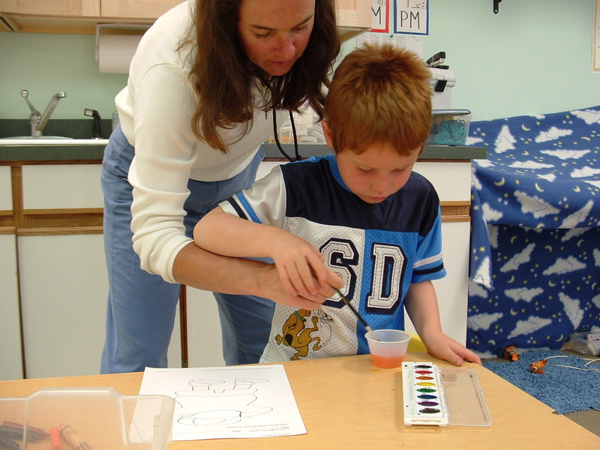
Peers
Span of Influence
Stress
Heavy workload
Fatigue and/or Burnout
Emotional
Exhaustion
Abuse of power

Slide 14
Environment
Lack of support from organization
Lack of organizational policies to address violence
Culture
Lighting
Presence of alcohol, drugs
Presence of distraught family members, and/or visitors
Time of day
Visibility of security personnel
Insufficient or lack of training around managing hostile behaviour

Slide 15
Moving towards a healthy environment

Slide 16
Collaboration
Nurses develop knowledge about the values and behaviours that support team work
Nurses contribute to a culture that supports effective team work
Working well intraprofessionally contributes to your role as an interprofessional
Notes:
This is done by understanding your own role and responsibilities as well as seeking information and understanding about other roles

Slide 17

Accountability
Responsibility for one’s conduct or the willingness to be answerable for one’s actions.
Concise Oxford Dictionary, 1982; Bergman, 1981

Slide 18
External/System: Governments
Review and enact legislation (Bill 168)
Resources – financial and human
Role modeling respectful behaviour
Monitoring key indicators
Responding to recommendations from coroners’ inquests
Funding from multi-sectoral strategies that address root causes of violence
Notes:
These are recommendations from the BPG Preventing and Managing Violence to support your understanding and moving forward to develop a plan

Slide 19
Workplace Violence Legislation in Ontario
In Ontario Bill 168:
Made changes to Ontario’s Occupational Health and Safety Act (OHSA) effective June 15, 2010 to strengthen protections for workers from workplace violence and address workplace harassment
Provides a definition of workplace violence and harassment and redefines employer duties in all workplaces covered by the OHSA
Notes:
In 2010 the US census bureau reported that workplace violence was the third leading cause of all occupational deaths and the second leading cause of occupational deaths in women. Workplace homicides declined 7 percent in 2010 to the lowest total ever recorded by the fatality census, however workplace homicides involving women increased by 13 percent. This specific information is not available from statistics Canada.
In Canada, legislation was impacted by workplace homicide related to the death of a nurse Lori Dupont. As you know she was employed at Hotel Dieu.

Slide 20
External/System
Accreditation
Standards that support violence free workplaces
Education
Education for all healthcare professionals that includes skills, communication strategies, reporting methods, policies and procedures
Recognition of intended and unintended forms of incivility, violence and aggression can reproduce and escalate violent behaviours

Slide 21
The Need for Education
Quality care is dependent on the safety and health of our care providers
Source: Boucher, Sikorski, & Nichol (2009)
A general lack of adequate training and administrative supports are factors contributing to workplace violence
Sources: Lanza & Kane (1995); Lipscomb & Love (1992/1996)
Notes:
The most effective way to tackle stress and violence is through prevention and results in greater cost savings of absenteeism.
Studies demonstrate that quality care is dependent on safety and health of our care providers (Boucher, Sikorski, & Nichol, 2009)
A general lack of adequate training and administrative supports are factors contributing to workplace violence (Lanza & Kane 1995; Lipscomb & Love, 1992; Poster 1996)

Slide 22
External/System: Professional/Regulatory
Role model
Outreach programs
Policies, standards, guidelines and educational materials
Notes:
By being here today, this an example of an outreach program

Slide 23
Educational Systems Recommendations
7.0 Nursing education institutions should strive to be leaders in the integration of health, safety and well-being into their own workplace culture.
8.0 Nursing education institutions should build health, well-being and safety into the core curriculum of nursing education programs.

Slide 24
Organization Practice Recommendations
1.0 Organizations / nursing employers foster a climate and culture encompassing supportive practices, which ensure the promotion of health, well-being, and safety of nurses.
1.1 Organizations / nursing employers create and design environments and systems that promote safe and healthy workplaces including strategies such as:
  • Creating a culture, climate and practices that support and promote staff health, well-being and safety.
  • Organization’s annual budget includes adequate resources (human and fiscal) to implement health and safety initiatives.
  • Organizational practices that foster mutual responsibility and accountability by individual nurses and organizational leaders to ensure a safe work environment.

Slide 25
Organizational
Promote and support a workplace free of violence
Prevention program with monitoring in place
Ensure all staff have knowledge and competencies
Develop and implement a process to evaluate programs
Clear strategies for responses to violence

Slide 26
Individual
Knowledge to identify, prevent and respond
Self-reflection
Knowledge and implementation of organizational strategies and processes
Support team members
Collaborate with team members in a manner that fosters respect, trust and prevents violence
Notes:
Discuss examples : verbal disagreements and face to face (invasion of personal space)

Slide 27

Spectrum of Workplace Violence
Notes:
Add updated note i.e. emotional intelligence
27

Slide 28
Typical Responses to Violence
PASSIVE
Accept
Avoid
(International Council of Nurses)
ACTIVE
Defend verbally
Negotiate
Defend physically
Notes:
This is a continuum that starts passively and may escalate to active response.

Slide 29
Developing a Program
Evidence supporting education strategies:
Teamed RN mentors with academic participants Source: Latham, Hogan & Ringl (2008)
Bullying management interventions*
Source: Griffin (2004)
*Self reflection of own behaviour is vital
Instruction on assertiveness and aggression Source: Oostrom & Mierlo (2008)
Aggression and violence minimization modules Source: Grenyer, et al (2004)
Notes:
Evidence demonstrates that these are key strategies required to develop an effective WVP program
As nurses self reflection is pat of our practice and an important aspect of reflecting on bullying is to evaluate our participation in a situation, have we been part of the problem??

Slide 30
Workplace Violence Program
Program Development
Collaboration
Dissemination to Broader RPN Audience
Supporting Ontario’s Health Care Organizations
Evaluation
Supporting Others
Notes:
The Workplace Violence Prevention Toolkit was developed following a proposed project presented to the Ontario Ministry of Heath and Long Term Care Health Sector Labour Market Policy Branch in 2009
Initial funding supported a pilot project at the Niagara Health System where RPNAO collaborated with Niagara Health System to implement the program
RPNAO developed a workbook and presented the strategies in workshops that were developed by Niagara Health System to introduce program
Outcomes resulted in a greater awareness of workplace violence and the strategies to address it and this recognition was important to RPNAO as this outcome and the fact that the 2005 National survey identified that RPNs perceived a greater lack of respect program demonstrated the need for this program to support a wider RPN audience in Ontario
This resulted in the development of the electronic toolkit in 2010 supported by the Nursing Retention and Recruitment funding and was launched in 2011
In the fall of 2011, RPNAO was fortunate to partner with Southlake Regional Health Centre, a progressive, patient centred organization that is focused on staff development.

Slide 31
RESOURCES

Slide 32

Access to Resources
Notes:
Ontario is large province (more than a million square kilometres)
Internet is the best medium to provide nurses across the province with access to resources and nurses work in urban, rural and remote areas across Ontario
A free internet portal with easy access would allow more students and nurses to have necessary resources
BPG’s E-learn Toolkit

Slide 33

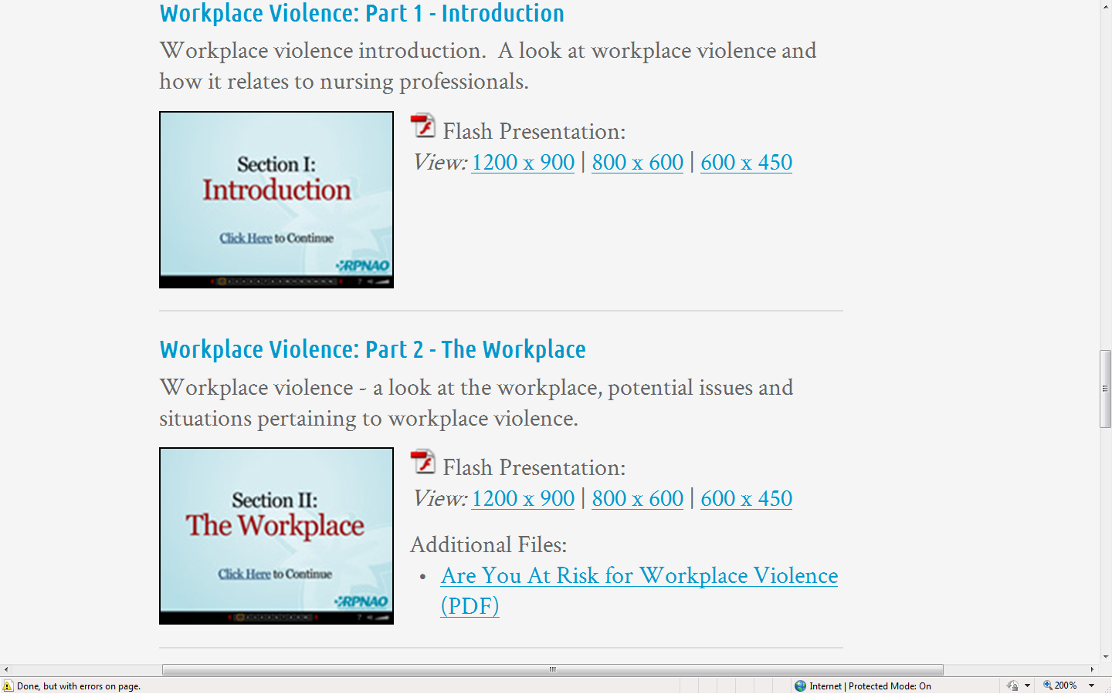
Notes:
The toolkit was designed to support self directed learning
Narrated modules
Easy access with option to stop and restart at users convenience
Specific topics easily accessed
Self assessment tools

Slide 34
Workplace Violence Prevention Toolkit
Table of Contents
Section I Introduction
Section II The Workplace (Are you at risk for Workplace Violence?)
Section III Responding to Harassment & Bullying
Section IV Actions for dealing with Harassment & Bullying
Section V Assertiveness (Assertion Self-Assessment)
Section VI Teamwork
Section VII Leadership (Assessing Leadership Skills)
Notes:
Section 1 Introduction A look at workplace violence and how it relates to nursing professionals.
Section 2 - The Workplace A look at the workplace, potential issues and situations pertaining to workplace violence.
Section 3 - Responding to Harassment, Bullying and Workplace Violence Examines what to and what not to do when faced with harassment.
Section 4 Actions for Dealing with workplace Harassment or Bullying Provides an overview of best actions for dealing with forms of workplace violence
Section 5 Assertiveness An examination of assertive in the workplace to support successful prevention strategies
Section 6 Teamwork Provides an overview of teamwork, examines barriers to teamwork and the RPN's contribution to the team.
Section 7 Leadership Provides an overview of leadership and the importance of leading a change to workplace violence and includes discussion about the professional portfolio.

Slide 35

How to Access the Workplace Violence Toolkit
www.rpnao.org
Notes:
Some colleges have incorporated this program into their leadership courses and students indicated that the education program supported self-awareness and created changes to practice
Most significant change was awareness that being a bystander promoted bullying in the workplace
Acknowledgement of completion of the program will be added in the new year with the additional modules
De-escalation
Conflict theory
Emotional Intelligence

Slide 36
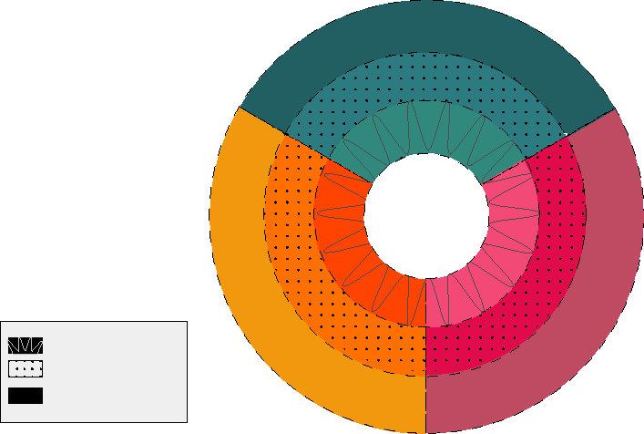
Organizing Framework for Healthy Work
Environments Best Practice Guideline Project
Physical / Structural
Policy Components
External Policy
Factors
Organizational Physical
Factors
Physical
Work Demand Factors
Nurse
Patient
Organizational
Societal
Outcomes
Individual Cognitive/Psycho / Social Work Demand Factors
Professional/
Occupational
Components
Cognitive Psycho/Socio/
Cultural
Components
Individual
Nurse Factors
Organizational
Social
Factors
Organizational
Professional/
Occupational
Factors
Individual Work Context
Micro Level
Organizational Context
Meso Level
External
Socio-Cultural
Factors
External
Professional/
Occupational
Factors
External Context
Macro Level
Notes:
There are several factors that will impact situational violence.

Slide 37
Target Group
Nurses in all roles and settings:
  Interdisciplinary team members
  Students
  Administrators/leaders at all levels of the organization and system
  Policy makers, regulatory bodies and governments
  Professional organizations, employers and labour groups
  Educators
  Researchers
  Other stakeholders including to patients/clients, family advisory groups, law enforcement/security personnel and the public
Notes:
37

Slide 38

“A safe work environment free from danger is a basic element for providing quality health care.”
Notes:
This BPG provides recommendations for actions that can be undertaken in the workplace by staff at all levels

Slide 39
Educational Systems Recommendations
7.0 Nursing education institutions should strive to be leaders in the integration of health, safety and well-being into their own workplace culture.
8.0 Nursing education institutions should build health, well-being and safety into the core curriculum of nursing education programs.

Slide 40
Organization Practice Recommendations
1.0 Organizations / nursing employers foster a climate and culture encompassing supportive practices, which ensure the promotion of health, well-being, and safety of nurses.
1.1 Organizations / nursing employers create and design environments and systems that promote safe and healthy workplaces including strategies such as:
  • Creating a culture, climate and practices that support and promote staff health, well-being and safety.
  • Organization’s annual budget includes adequate resources (human and fiscal) to implement health and safety initiatives.
  • Organizational practices that foster mutual responsibility and accountability by individual nurses and organizational leaders to ensure a safe work environment.

Slide 41
Applying the Guideline to Your Context
Study the model
The conceptual model was created to allow users to understand the relationships between and among the key factors involved in the healthcare work environments.
Understanding the model, is critical to using the guideline effectively.
Notes:
2. Identify an area of focus. Once you have studied the model, we suggest that you identify an area of focus
for yourself, your situation, or your organization, that you believe requires attention to enhance the
health, safety and well-being of the nurse.
3. Read the recommendations and the summary of research for your area of focus. For each major
element of the model, a number of evidence-based recommendations are offered. The
recommendations are statements of what organizations/researchers/educators/governing bodies
should do to promote healthy work environments. The literature supporting these recommendations is
briefly summarized; readers may find this instructive to gaining understanding of the rationale and
methodology of the recommendations.
Focus on the recommendations or desired behaviours that seem most applicable to you and your
current situation. The recommendations contained in this document are not meant to be applied as
rules, but rather as tools to assist individuals or organizations in making decisions that improve the
health, safety and well-being of nurses in their workplaces, recognizing everyone’s unique culture,
climate and situational challenges. In some cases there is great deal of information to consider. Readers
may want to explore further and identify those behaviours that need to be analyzed and/or strengthened
in specific workplace situations.
5. Make a plan. Having selected a small number of recommendations, behaviours for attention and
strategies to successfully implement them, consider the suggestions offered. Make a tentative plan for
what you might actually do to begin to address your area of focus. If you require more information, you
may wish to refer to some of the references cited, the evaluation instruments identified in Appendix D
or the helpful websites listed in Appendix E.
6. Discuss the plan with others. Take the time to solicit input into your plan from people whom it might
affect, those whose engagement will be critical to its success, and from trusted advisors, who will all
provide feedback on the appropriateness of your ideas. For the intervention to be most effective, support
is required from multiple levels within the organization/program unit.
7. Revise your plan and get started: It is important to begin, and then make adjustments as you go. The
development of effective new health and safety practices is a life-long quest.

Slide 42
Applying the Guideline to Your Context
Identify an area of focus:
for yourself, your situation, or your organization, that you believe requires attention to enhance the health, safety and well-being of the healthcare worker.
Notes:
2. 3. Read the recommendations and the summary of research for your area of focus. For each major
element of the model, a number of evidence-based recommendations are offered. The
recommendations are statements of what organizations/researchers/educators/governing bodies
should do to promote healthy work environments. The literature supporting these recommendations is
briefly summarized; readers may find this instructive to gaining understanding of the rationale and
methodology of the recommendations.
Focus on the recommendations or desired behaviours that seem most applicable to you and your
current situation. The recommendations contained in this document are not meant to be applied as
rules, but rather as tools to assist individuals or organizations in making decisions that improve the
health, safety and well-being of nurses in their workplaces, recognizing everyone’s unique culture,
climate and situational challenges. In some cases there is great deal of information to consider. Readers
may want to explore further and identify those behaviours that need to be analyzed and/or strengthened
in specific workplace situations.
5. Make a plan. Having selected a small number of recommendations, behaviours for attention and
strategies to successfully implement them, consider the suggestions offered. Make a tentative plan for
what you might actually do to begin to address your area of focus. If you require more information, you
may wish to refer to some of the references cited, the evaluation instruments identified in Appendix D
or the helpful websites listed in Appendix E.
6. Discuss the plan with others. Take the time to solicit input into your plan from people whom it might
affect, those whose engagement will be critical to its success, and from trusted advisors, who will all
provide feedback on the appropriateness of your ideas. For the intervention to be most effective, support
is required from multiple levels within the organization/program unit.
7. Revise your plan and get started: It is important to begin, and then make adjustments as you go. The
development of effective new health and safety practices is a life-long quest.

Slide 43
Applying the Guideline to Your Context
Read the recommendations and the summary of research for your area of focus.
For each major element of the model, a number of evidence-based recommendations are offered.
The recommendations are statements of what organizations/researchers/educators/governing bodies should do to promote healthy work environments.
Notes:
2. 3..
Focus on the recommendations or desired behaviours that seem most applicable to you and your
current situation. The recommendations contained in this document are not meant to be applied as
rules, but rather as tools to assist individuals or organizations in making decisions that improve the
health, safety and well-being of nurses in their workplaces, recognizing everyone’s unique culture,
climate and situational challenges. In some cases there is great deal of information to consider. Readers
may want to explore further and identify those behaviours that need to be analyzed and/or strengthened
in specific workplace situations.
5. Make a plan. Having selected a small number of recommendations, behaviours for attention and
strategies to successfully implement them, consider the suggestions offered. Make a tentative plan for
what you might actually do to begin to address your area of focus. If you require more information, you
may wish to refer to some of the references cited, the evaluation instruments identified in Appendix D
or the helpful websites listed in Appendix E.
6. Discuss the plan with others. Take the time to solicit input into your plan from people whom it might
affect, those whose engagement will be critical to its success, and from trusted advisors, who will all
provide feedback on the appropriateness of your ideas. For the intervention to be most effective, support
is required from multiple levels within the organization/program unit.
7. Revise your plan and get started: It is important to begin, and then make adjustments as you go. The
development of effective new health and safety practices is a life-long quest.

Slide 44
Applying the Guideline to Your Context
Focus on the recommendations or desired behaviours that seem most applicable to you and your current situation. The recommendations contained in this document are not meant to be applied as rules, but rather as tools to assist in specific workplace situations.
Notes:
5. Make a plan. Having selected a small number of recommendations, behaviours for attention and
strategies to successfully implement them, consider the suggestions offered. Make a tentative plan for
what you might actually do to begin to address your area of focus. If you require more information, you
may wish to refer to some of the references cited, the evaluation instruments identified in Appendix D
or the helpful websites listed in Appendix E.
6. Discuss the plan with others. Take the time to solicit input into your plan from people whom it might
affect, those whose engagement will be critical to its success, and from trusted advisors, who will all
provide feedback on the appropriateness of your ideas. For the intervention to be most effective, support
is required from multiple levels within the organization/program unit.
7. Revise your plan and get started: It is important to begin, and then make adjustments as you go. The
development of effective new health and safety practices is a life-long quest.

Slide 45
Applying the Guideline to Your Context
Make a plan for your environment
Make a tentative plan for what you might actually do to begin to address your area of focus.
If you require more information, you may wish to refer to some of the references cited, the evaluation instruments or the helpful websites
Notes:
6. Discuss the plan with others. Take the time to solicit input into your plan from people whom it might
affect, those whose engagement will be critical to its success, and from trusted advisors, who will all
provide feedback on the appropriateness of your ideas. For the intervention to be most effective, support
is required from multiple levels within the organization/program unit.
7. Revise your plan and get started: It is important to begin, and then make adjustments as you go. The
development of effective new health and safety practices is a life-long quest.

Slide 46
Applying the Guideline to Your Context
Discuss the plan with others. Take the time to solicit input into your plan from people whom it might affect,
those whose engagement will be critical to its success, and from trusted advisors
For the intervention to be most effective, support is required from multiple levels within the organization/program unit.
Notes:
7. Revise your plan and get started: It is important to begin, and then make adjustments as you go. The
development of effective new health and safety practices is a life-long quest.

Slide 47
Applying the Guideline to Your Context
Revise your plan and get started: It is important to begin, and then make adjustments as you go.
Notes:
7.

Slide 48
Case Scenario: Effects of unaddressed conflict
Background: During free lab time for two streams of nursing students at a community college the following activities occurred: nursing students were observed throwing balled up paper at their peers, books were sliding aggressively across the lab, and nasty remarks were uttered.
The tension continued to escalate between the two streams of students to the point where there was personal invasion of space and physical pushing. At that time one of the students reported the incident, as she felt that she was now studying in an unhealthy and hostile environment.
The student could not identify when the conflict /violence began but did recognize that an on-going deterioration of the relationship had resulted and that a series of small events contributed to the problems. Communication between the two streams deteriorated to point where individuals were no longer speaking directly to each other unless absolutely necessary.

Slide 49
What are some of the Impacts that may occur as a result of the Conflict ?
absenteeism
related stress
gossiping
divisive behaviour i.e. choosing sides
injury: physical or emotional

Slide 50
Web Resources
RNAO: www.rnao.ca
RPNAO www.rpnao.org
Ontario Ministry of Labour: www.labour.gov.on.ca/english/hs/sawo/pubs/fs_workplaceviolence.php
Canadian Nurses Association: www.cna-nurses.ca
International Council of Nursing
Position Statement “Abuse and Violence Against Nursing Personnel”
www.icn.ch/psviolence00.htm

Slide 51
Registered Practical Nurses Association of Ontario
Annette Weeres, RN, MN
Project Leader, Retention, Recruitment, and Professional Practice RPNAO
_________________________________________________________
RPNAO website:
www.rpnao.org
Workplace Violence Prevention Toolkit: http://www.rpnao.org/practice-education/e-learning/workplace-violence

Slide 52




Slide 53
Case Scenario: Effects of Unaddressed Conflict
Background: During free lab time for two streams of nursing students at a community college the following activities occurred: nursing students were observed throwing balled up paper at their peers, books were sliding aggressively across the lab, and nasty remarks were uttered.
The tension continued to escalate between the two streams of students to the point where there was personal invasion of space and physical pushing. At that time one of the students reported the incident, as she felt that she was now studying in an unhealthy and hostile environment.
The student could not identify when the conflict /violence began but did recognize that an on-going deterioration of the relationship had resulted and that a series of small events contributed to the problems. Communication between the two streams deteriorated to point where individuals were no longer speaking directly to each other unless absolutely necessary.

Slide 54


Case Scenario: Effects of Unaddressed Conflict
What are some of the impacts that may occur as a result of the conflict ?
ADDRESSING CONFLICT
What are some steps required to address the conflict? Assessment Process
GROUP ACTIVITY
Develop recommendations for all three levels: Academic, Environmental, Individual

Slide 55
Organizing Framework for Healthy Work
Environments Best Practice Guideline Project
Physical / Structural
Policy Components
External Policy
Factors
Organizational Physical
Factors
Physical
Work Demand Factors
Nurse
Patient
Organizational
Societal
Outcomes
Individual Cognitive/Psycho / Social Work Demand Factors
Professional/
Occupational
Components
Cognitive Psycho/Socio/
Cultural
Components
Individual
Nurse Factors
Organizational
Social
Factors
Organizational
Professional/
Occupational
Factors
Individual Work Context
Micro Level
Organizational Context
Meso Level
External
Socio-Cultural
Factors
External
Professional/
Occupational
Factors
External Context
Macro Level
Notes:
There are several factors that will impact situational violence.

